Slide 1


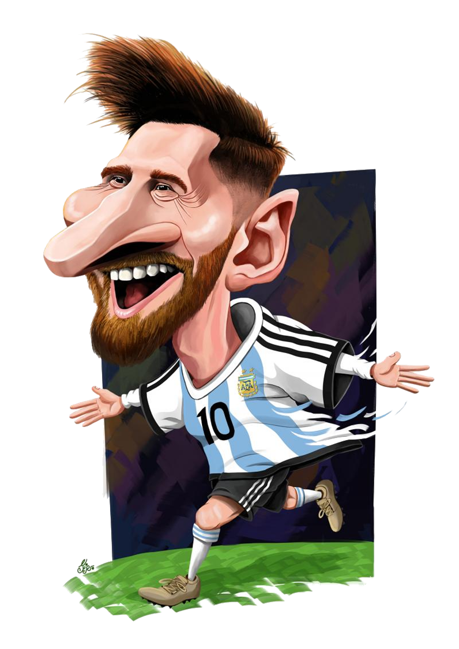

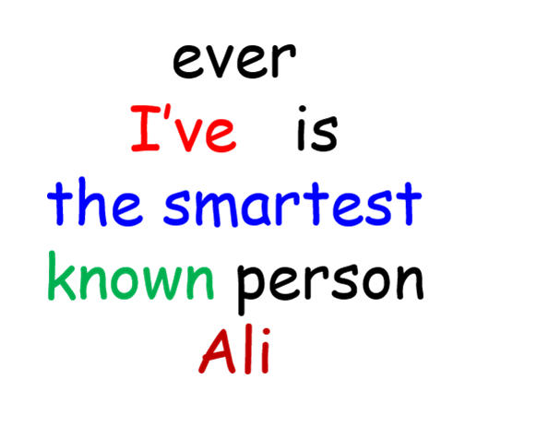
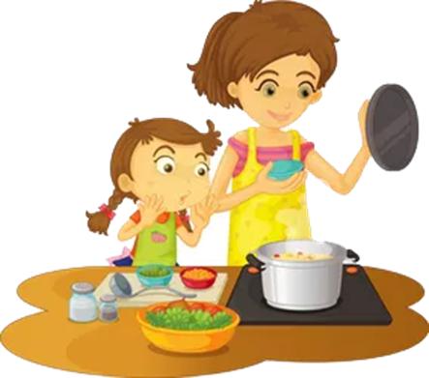


Past Lesson Review
Spin & Make a sentence
Gerund / Gerund Phrase
Superlative + Present perfect

