Slide 1
Unit 3
There is No Place Like Home
Form , Meaning & Function
Done by: Entisar Al-Obaidallah

Slide 2
Lesson Objectives
01
03
02
04
Practice
Express
asking for and giving direction
Requests,Offer,Promise , Warnings and Spontaneous decision
Ask
Practice
Someone to repeat something
the future with dependant time clause

Slide 3
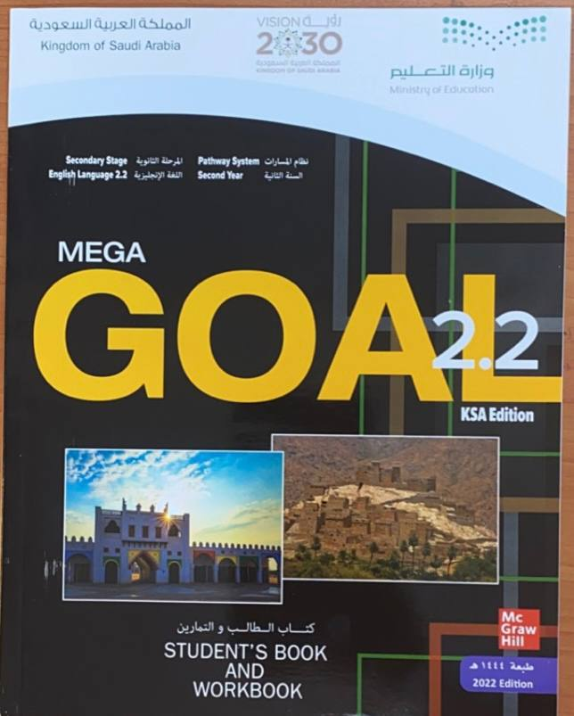
Book Open
Page( 40)

Slide 4
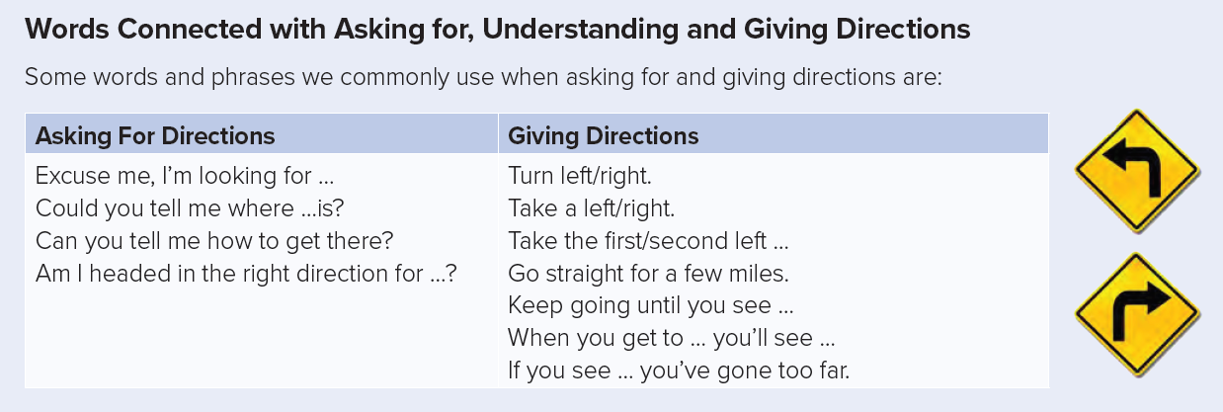

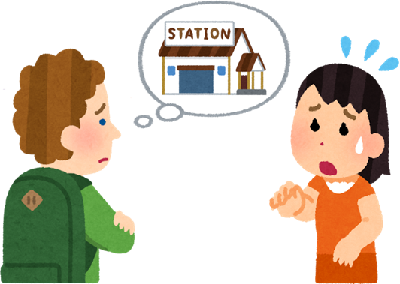
Excuse me, ……………

Slide 5

Of course, ………

Slide 6
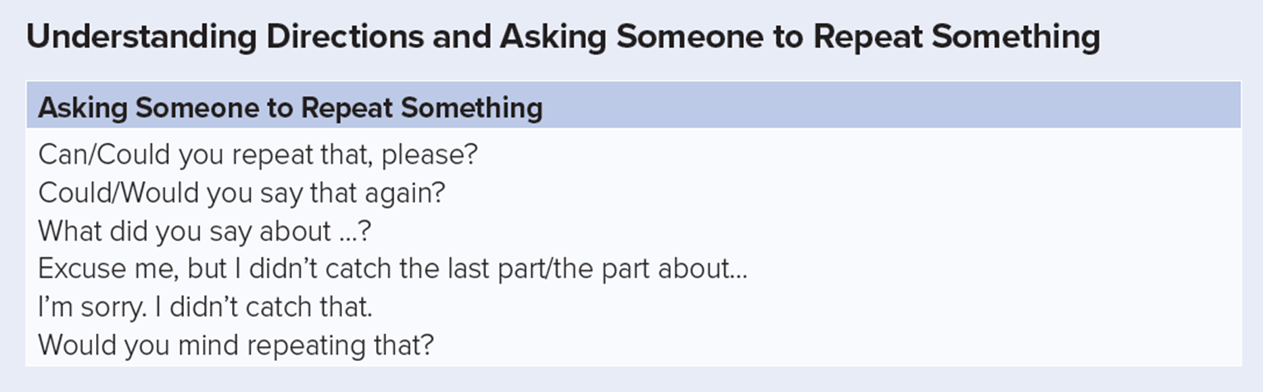


Slide 7
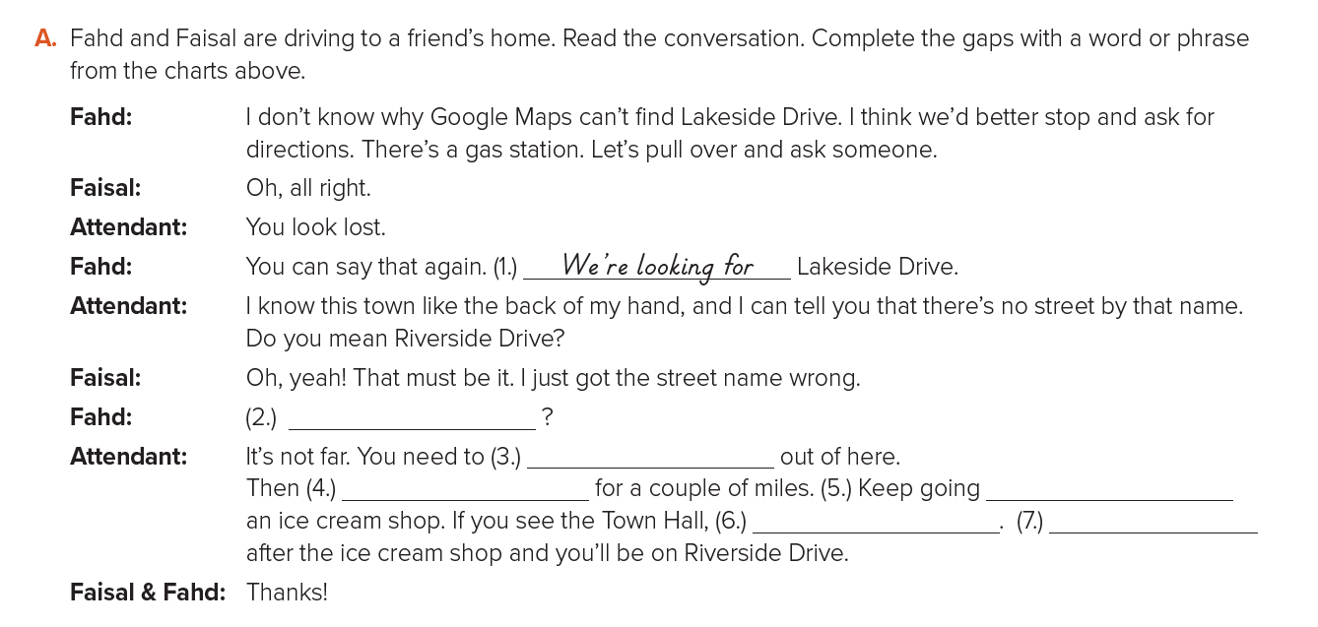
Can you tell us how to get there?
turn right
Go straight
until you see
you’ve gone too far
take the 1st left

Slide 8
Book Open
Page ( 41)

Slide 9
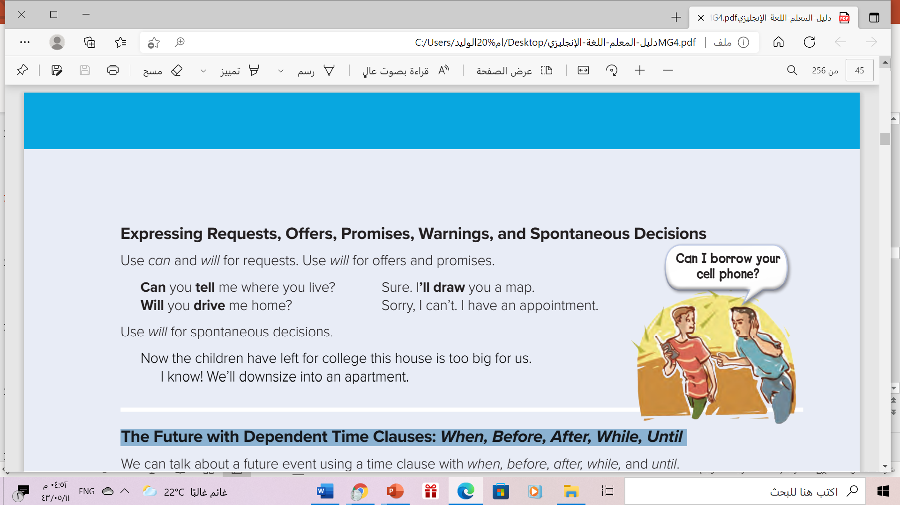

Slide 10

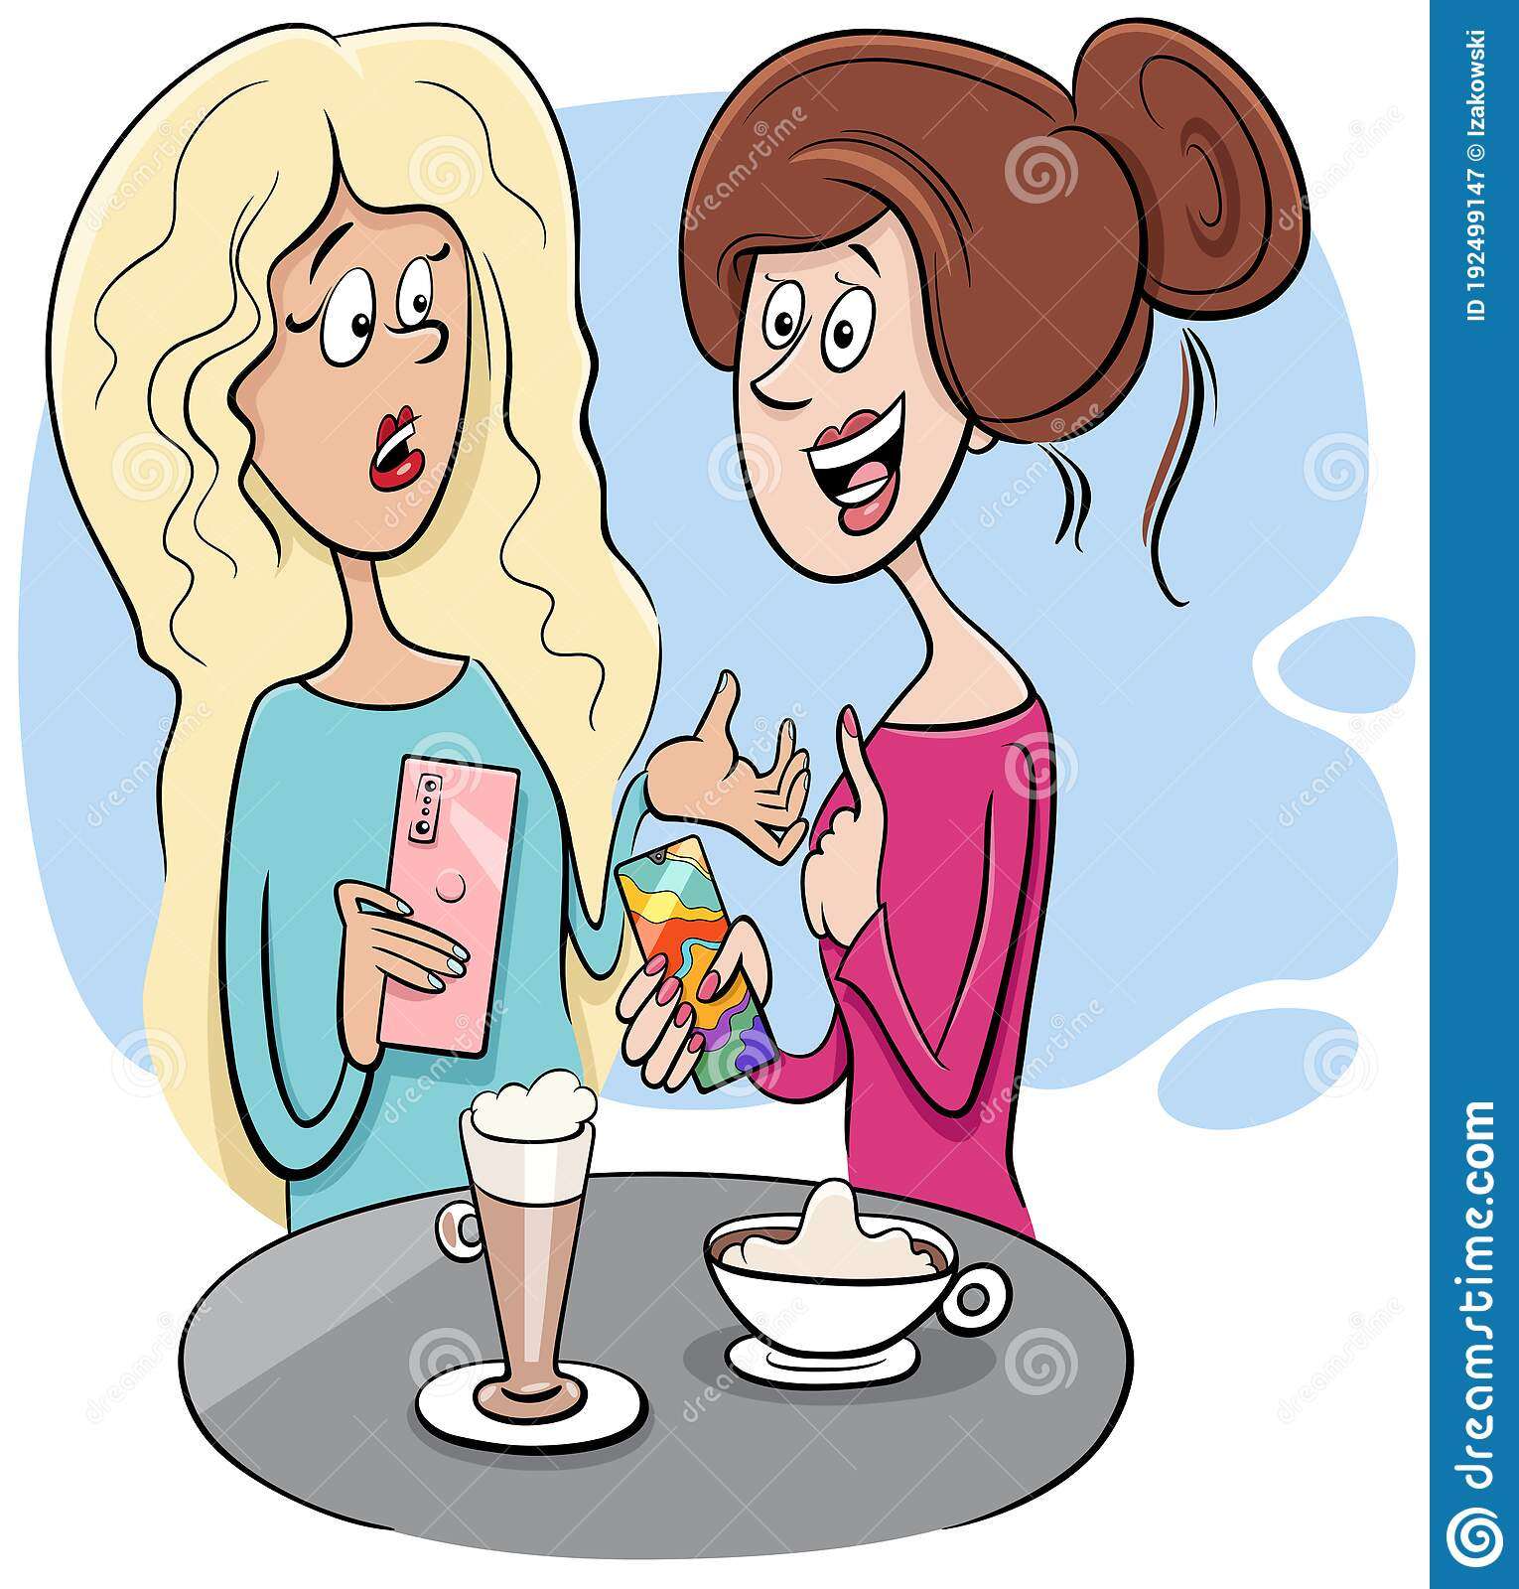
Use Will and Can for Request
Will you drive me school ?
Can you bring me another cup of coffee?

Slide 11

Use will for offer.
Don’t worry! I will help you with your homework.
It is difficult homework!

Slide 12

Use will for promise
We will be friends forever.

Slide 13

Use will for warning.
Stop or I will shoot .

Slide 14
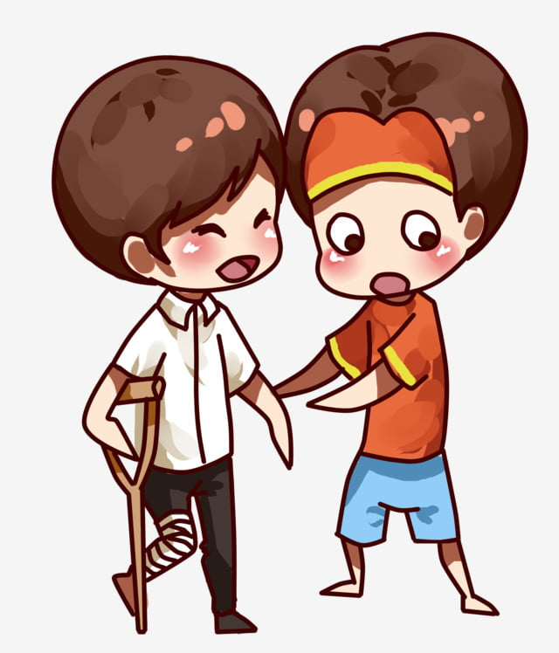
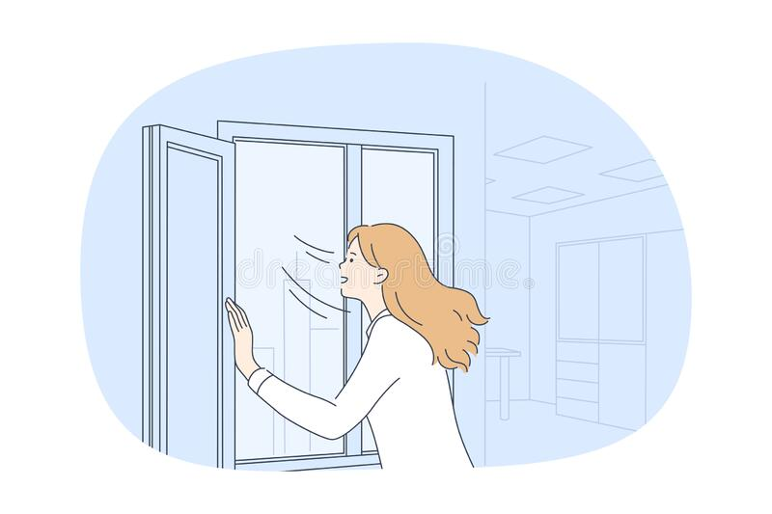
Use will for spontaneous decisions.
Wait !! I will help you .
I will close the window right now. It is very windy.

Slide 15
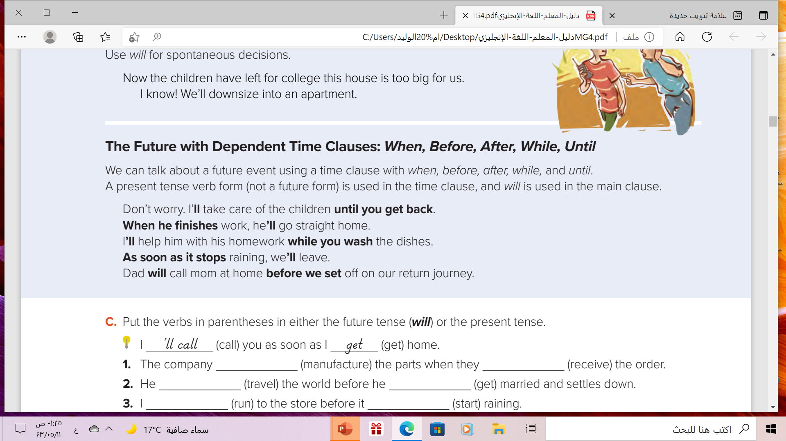
What do you notice about the verbs in these sentences?

Slide 16


What is a time clause?
A time clause tells when something will happen.
A time clause is always a dependent clause that must be joined to independent (main) clauses.
Future time clause may begin with :
after, as soon as, once, or when.
present
future
Example :
When I finish my homework , I will go to bed.
Time clause
Main clause

Slide 17

We can put the time clause at the beginning or end of the sentence.
If Time clause at the beginning, use a comma to make your sentence easier
to read.
Example :
After I finish my homework , I will go to bed.
Time clause at the beginning
Add comma in the middle
But :( If Time clause at the end, you don’t need a comma.)
I will go to bed after I finish my homework.

Slide 18



In Short
The Form of Time Clause
Present Simple
She, he ,it (v + s)
I, you, we , they(infinitive V)
After
As soon as
Before
Until
When
Will+ infinitive
Time clause
comma
Main clause

Slide 19


Slide 20
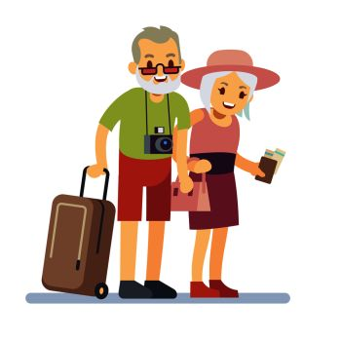
Complete
After we ……………… ( retire) ,
we ………………………(travel)
retire
will travel

Slide 21
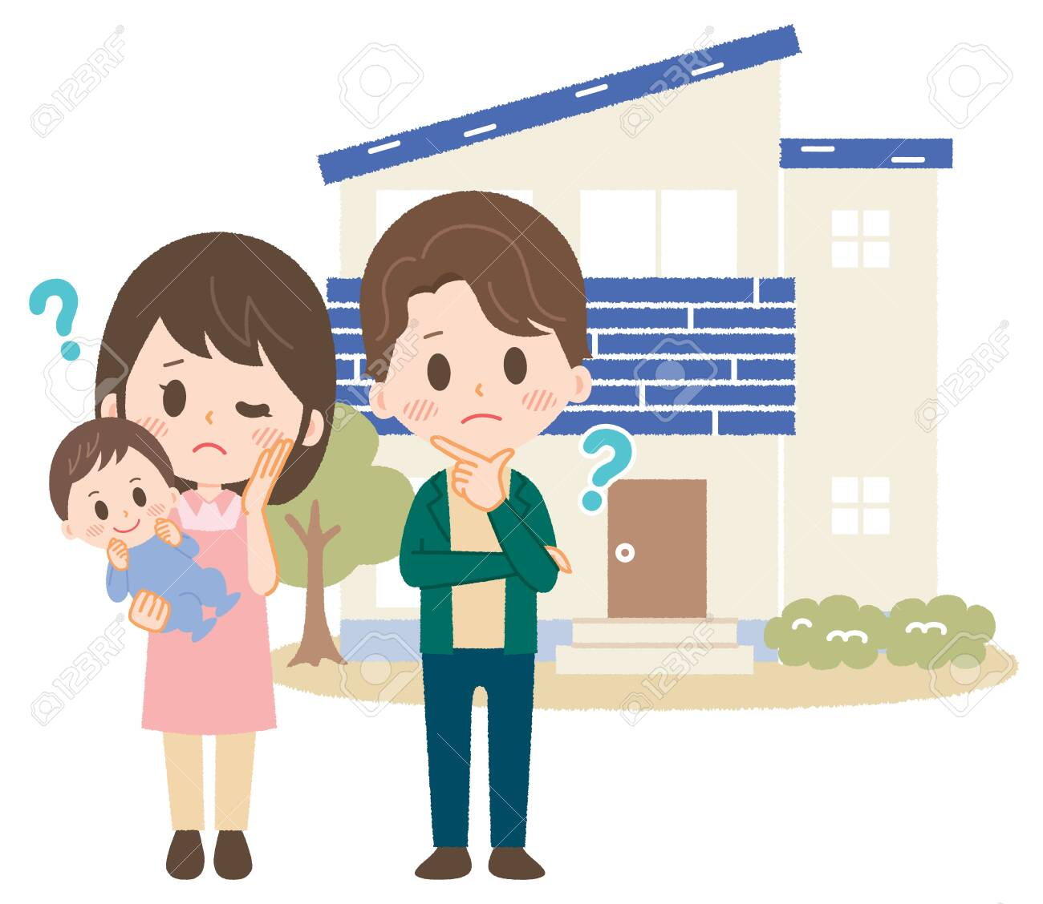
Complete
Before we have a new baby,
we ……………………(buy)
a bigger house
will buy

Slide 22

Complete
As soon as he………….… ( take),
medicine , he ………….….…(feel)
better
takes
will feel

Slide 23

Complete
When he …………( have) time,
he ……………………(paint)
the house
has
will paint

Slide 24
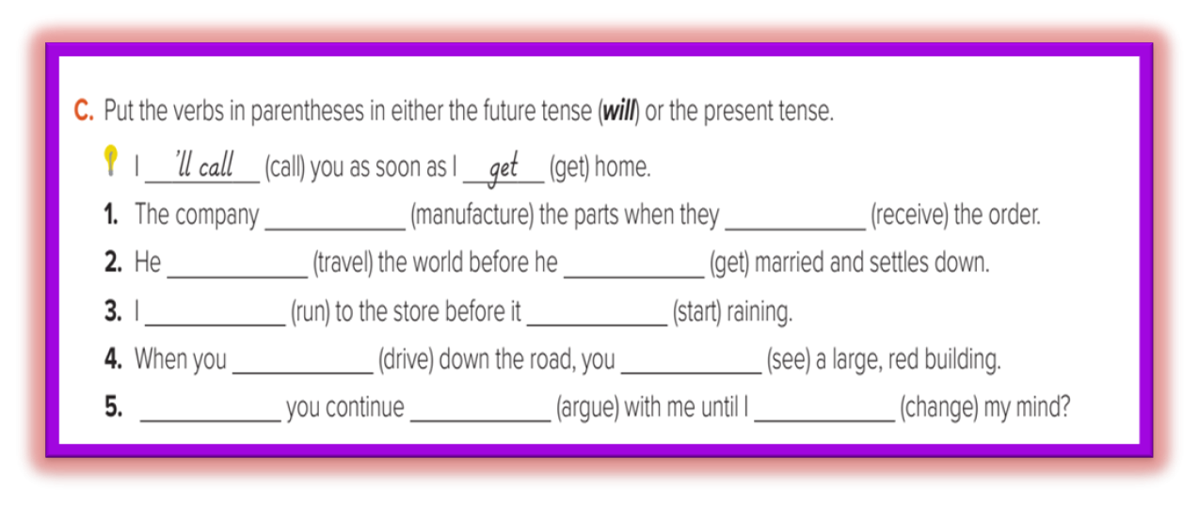
OUR EVOLUTION
02
receive
will manufacture
will travel
gets
You can enter a subtitle here if you need it
will run
starts
drives
will see
Will
to argue
change

Slide 25


Slide 26
Homework
Page ( 106) , Exercise ( P)

Slide 27






THANKS!

