Slide 1
Unit 1 Did You Hurt Yourself ? Form, Meaning & Function
Mega Goal 1.2
Done by: Entisar Al-Obaidallah

Slide 2
Lesson Objectives
01
02
03
04
Distinguish
Use
Between the Modal Auxiliaries (must & should)
adverbs of manner correctly.
Use
Use
imperative for giving directions correctly
prepositions of place to describe directions

Slide 3

Open
Student’s book , p. ( 14 )

Slide 4
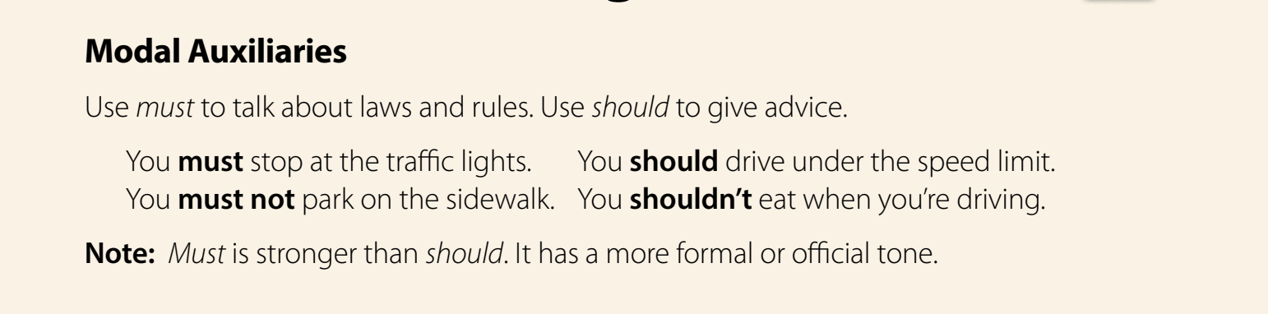

Slide 5


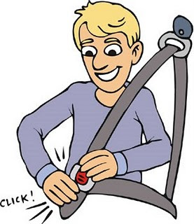


Modal Auxiliaries
Must
To talk about laws and rules .
To express obligation or something that is necessary to do.
Followed by the base form of the verb .
Examples:
Drivers must wear a seat belt.
We must keep silent in hospital
You must respect your parents.

Slide 6
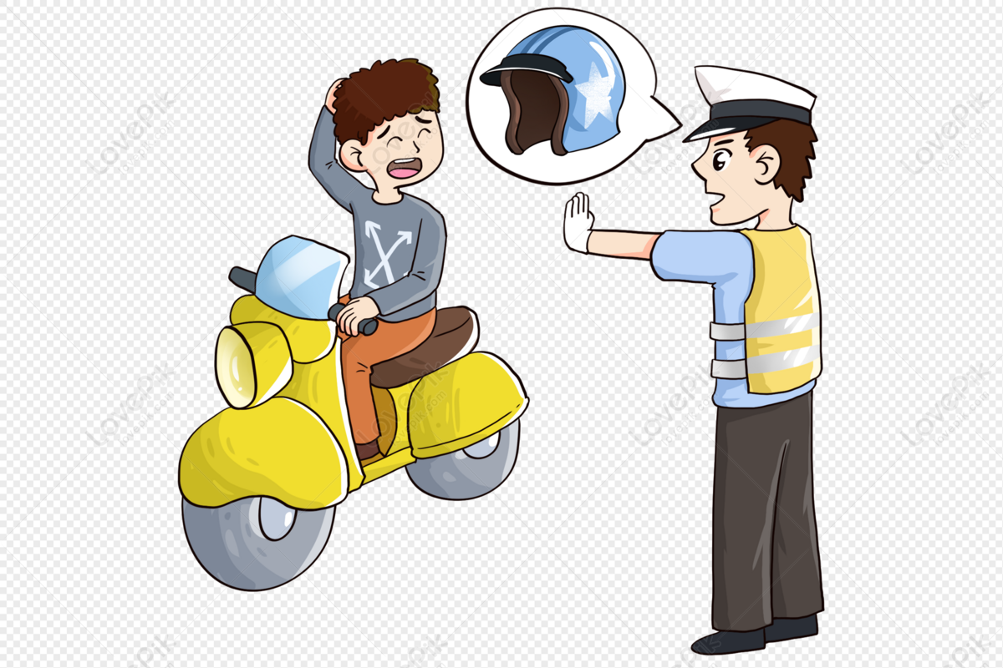
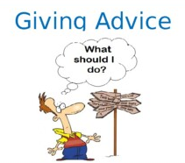
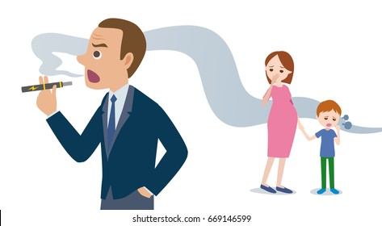
Modal Auxiliaries
Should
Use to give advice
Use to make a suggestion that might be important.
Followed by the base form of the verb .
Examples:
You should wear a helmet.
He should stop smoking .

Slide 7
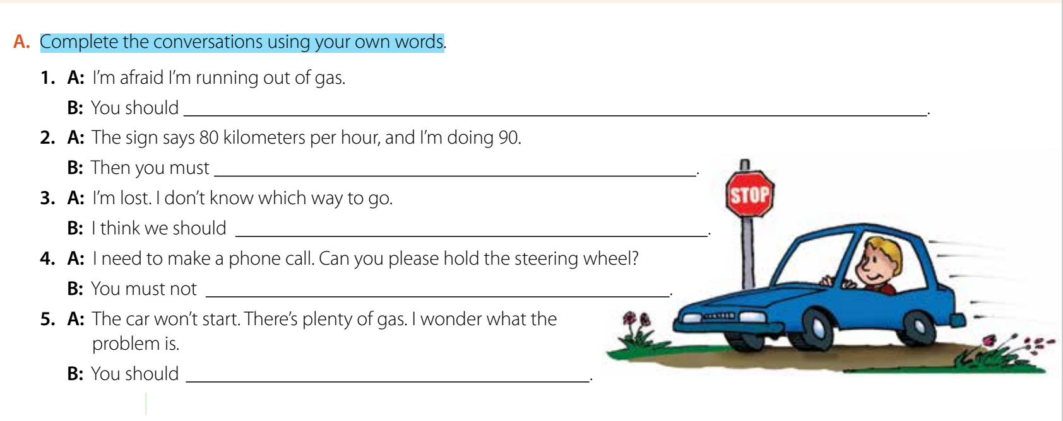
Student’s book p.(14)
stop at a gas station
slow down
ask someone
speak on the phone when driving
take it to a car mechanic

Slide 8


Slide 9
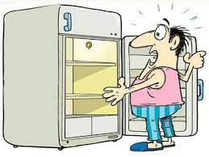
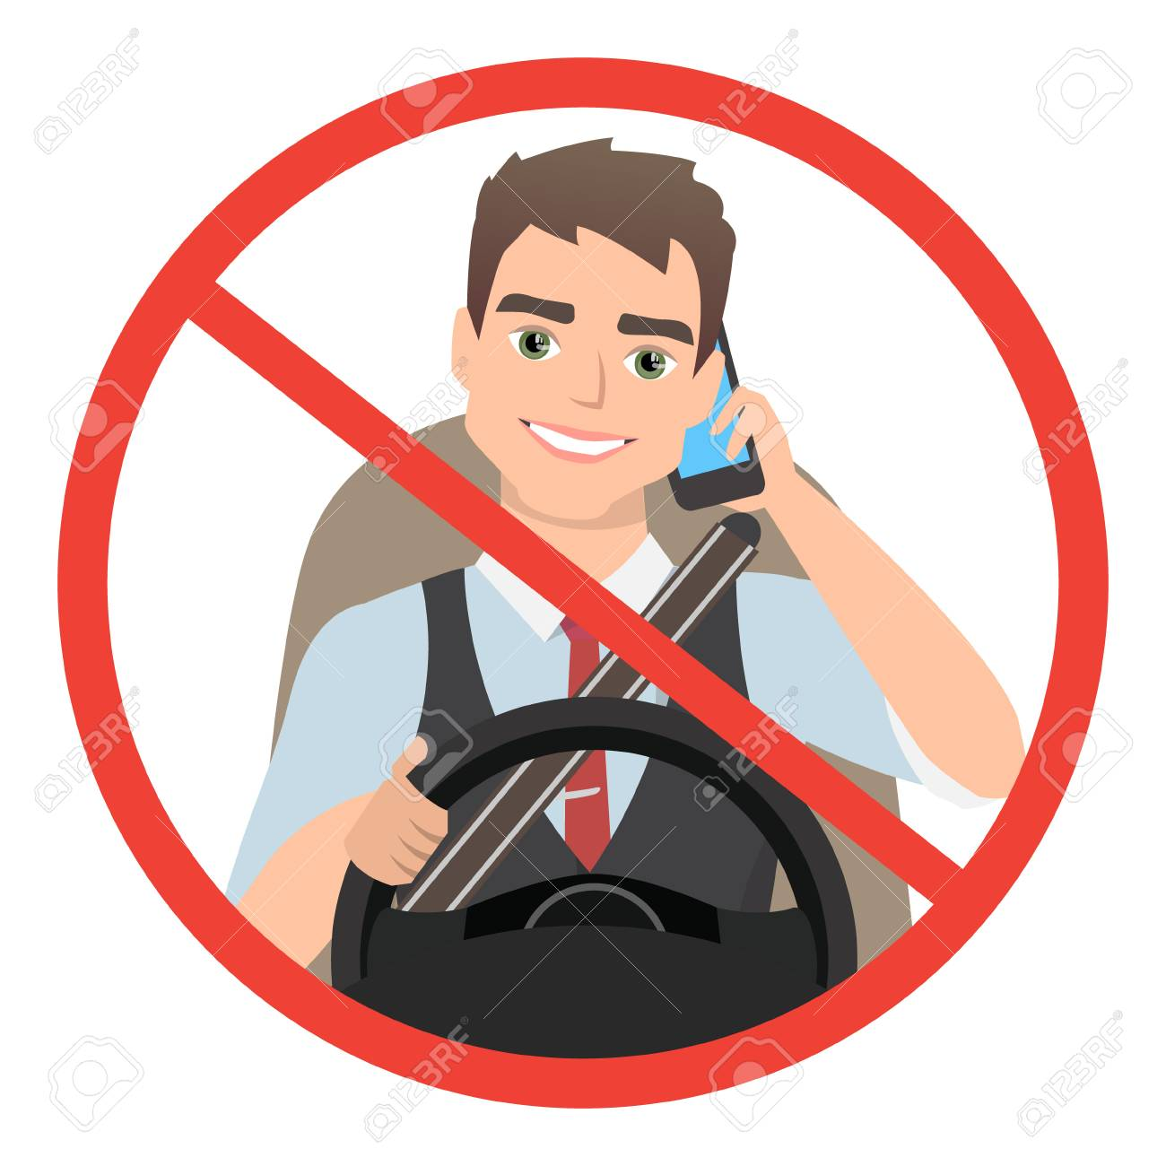
Must or mustn’t
He ……………………………….. go shopping .His fridge is empty
must
He……………………………….. use his mobile
phone while driving.
mustn’t

Slide 10
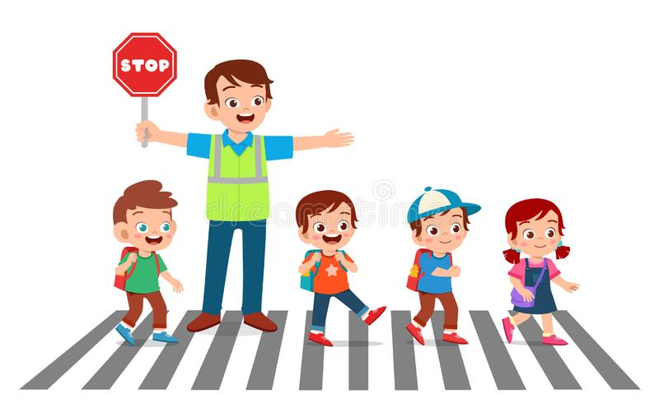

must or mustn’t
must
Drivers ……………………………….. stop because
the kids are crossing.
You ……………………………….. Swim here .
mustn’t

Slide 11
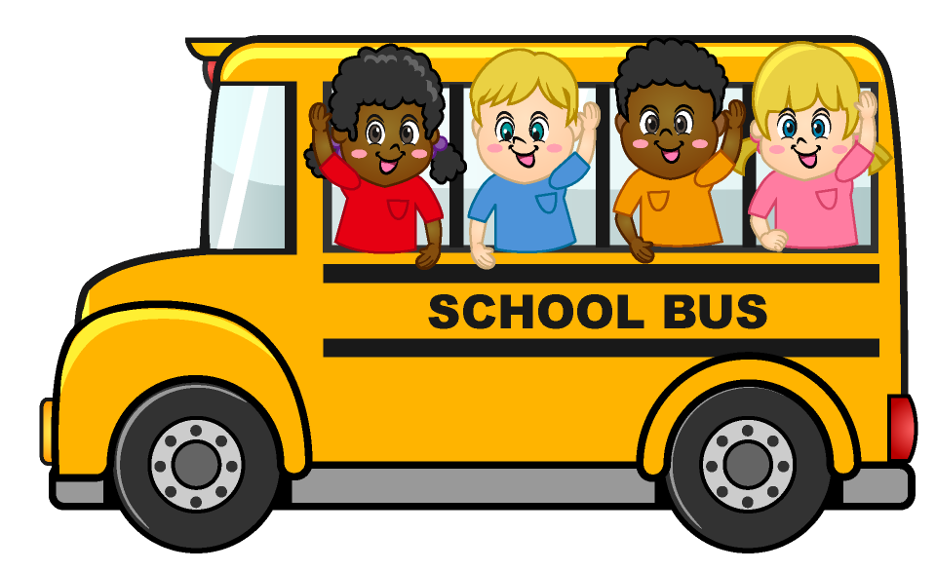
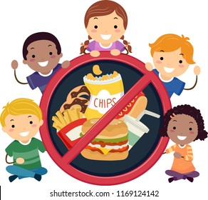
Should or Shouldn’t
02
should
This is dangerous . They ………………………………..
Sit down .
Kids……………………………….. eat junk food. It is not
good for their health .
shouldn't

Slide 12

Extra Activity
https://www.liveworksheets.com/vc989787px

Slide 13
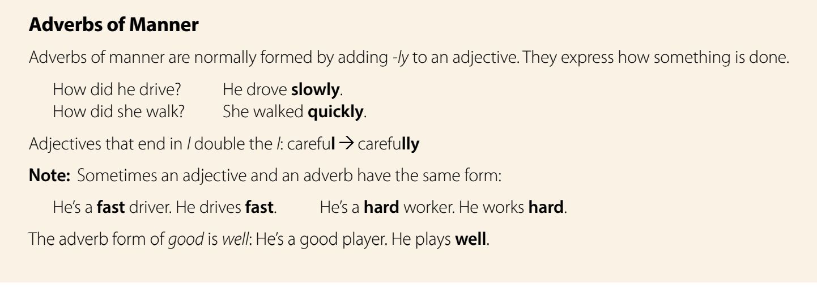

Slide 14
➔ tell how something is done or happens.
For examples:
How did he drive? He drove slowly.
How did she walk? She walked quickly
Adverb of Manner
➔ formed by adding –ly to an adjective.
quick – quickly
careful – carefully
gentle – gently
➔When an adjective ends in -y we change
the -y to -i then add -ly. For example:
happy – happily
easy – easily
➔There are also some irregular adverbs:
good – well late – late
straight – straight hard – hard
High – high fast – fast
Exceptions

Slide 15
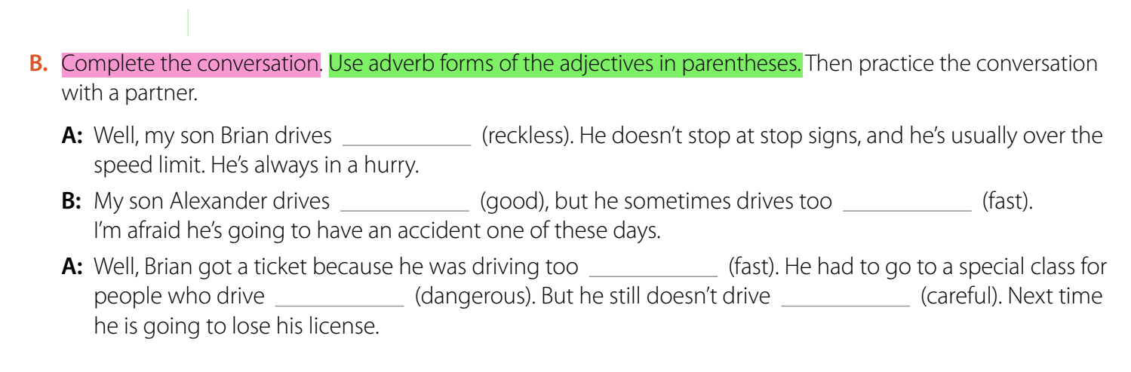

Student’s book p.(14)
recklessly
well
fast
fast
dangerously
carefully

Slide 17
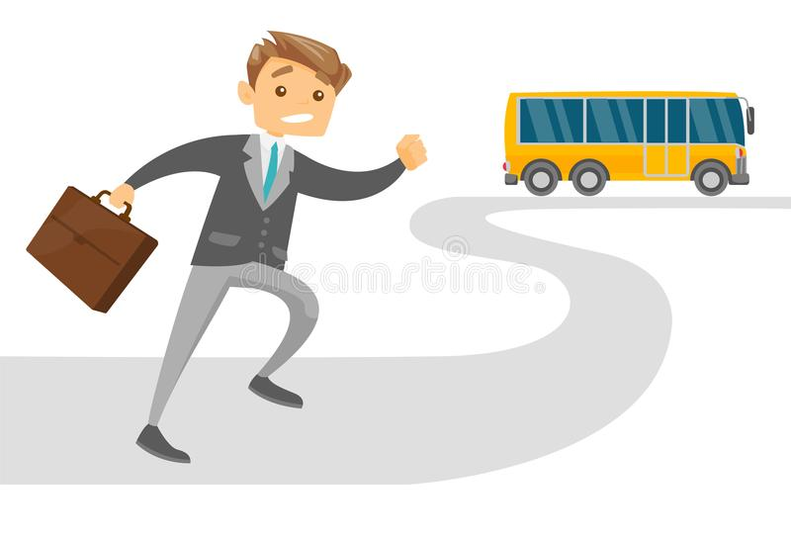
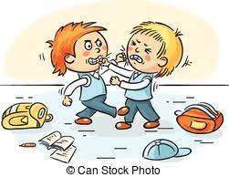
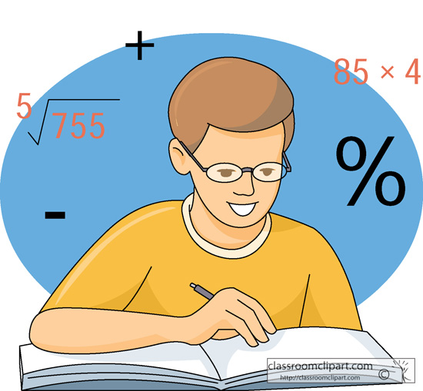
Complete with adverbs
quickly
He ran _____________________(quick)
in order to catch the bus.
badly
These two boys behave ___________________(bad) .
easily
The student could solve the problem___________________(easy) .

Slide 18


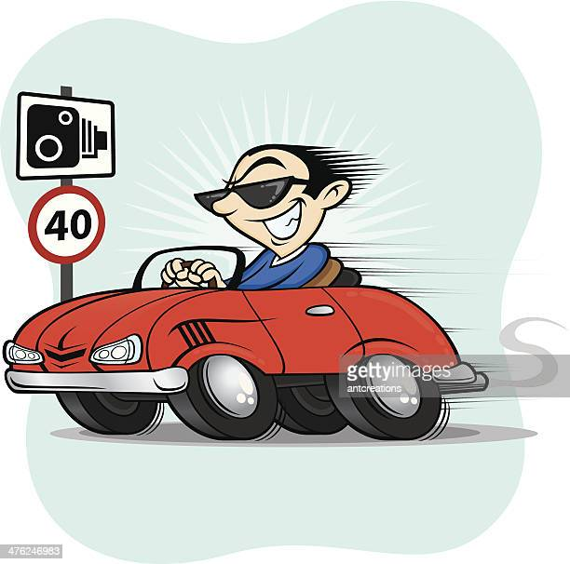
Complete with adverbs
hard
He must study _________________(hard) to pass the exam.
well
He speaks a lot of languages very ______________( good)
fast
He drives very ______________( fast)

Slide 19
Extra Activity
https://www.liveworksheets.com/iu10735vt

Slide 20
Open
Student’s book , p. ( 15 )

Slide 21
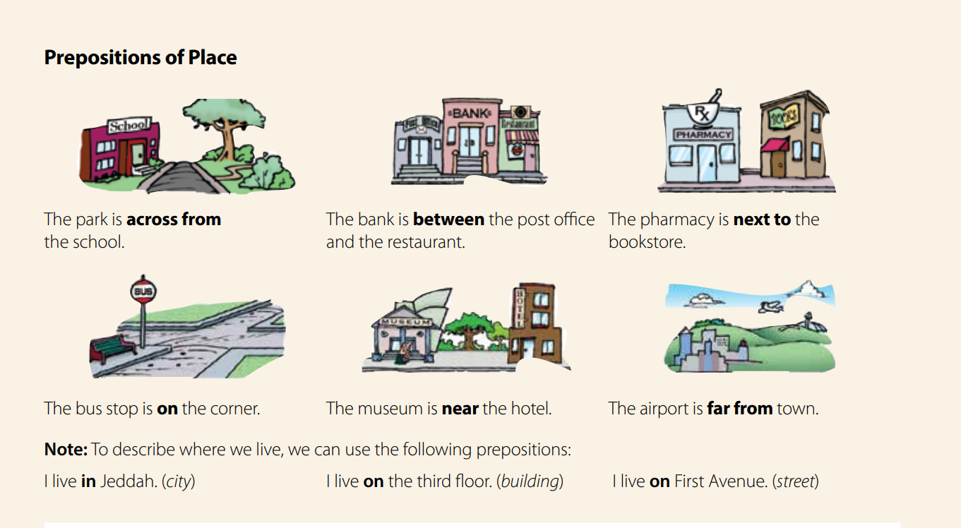

Slide 22
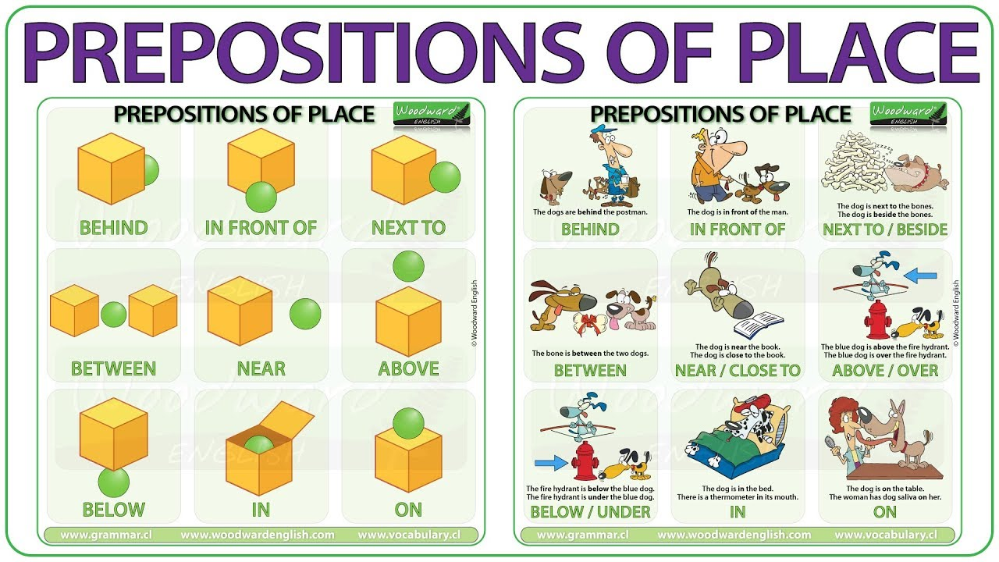

Slide 24
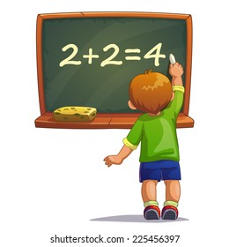
Use Preposition of place
He is writing………………………the board.
on

Slide 25

Use Preposition of place
He is standing…………………………………bookcase.
in front of

Slide 26
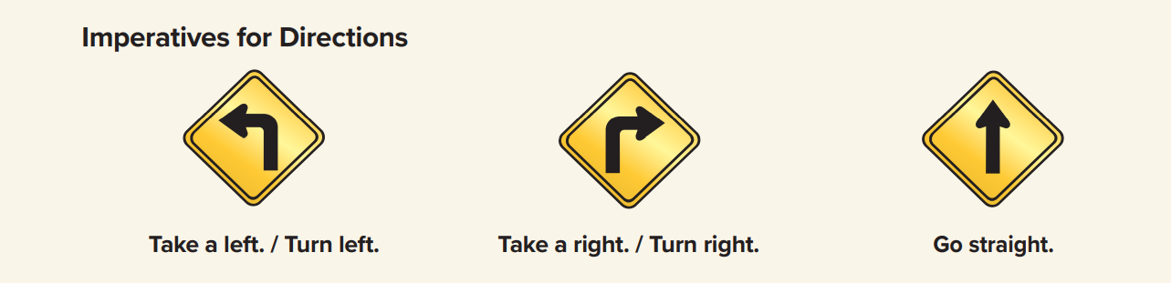

➔The imperative is the form of the verb we use to give directions
➔We simply use the base form of the verb
Example:
Ali: Can you tell me where the airport is?
Saad: Go straight and turn right after the petrol station.
Take this road. Go past the car park and you’ll find the airport.

Slide 27
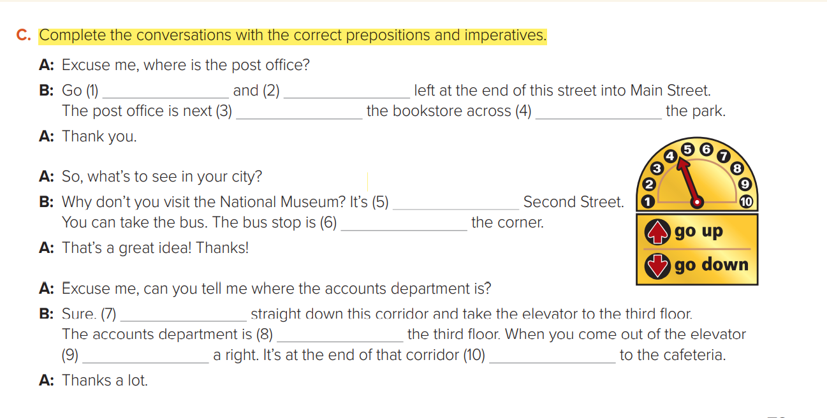
straight
turn
to
from
on
on
go
on
take
next

Slide 28
More Activities
https://wordwall.net/ar/resource/10346362
https://wordwall.net/ar/resource/10525535

Slide 29
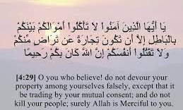
Remember !

Slide 30
Homework
Workbook p.( 85 ) , exercise ( O )

Slide 31

Thanks!

