Slide 1
Revision Unit 4
Answer the questions
Start

Slide 2


Wrong answer
Retry

Slide 3
Wrong answer
VOCABULARY

Slide 4
emperor
prominent
philanthropist
excelled
a person who helps the poor, especially by giving them money

Slide 5

Next question

Slide 6
Have a good time
Have a bad time
Have a terrible time
disappoint
Have a ball

Slide 7
Correct answer
Next question

Slide 8
sums
rich
prey
bankruptcy
legal status of having no money, broke

Slide 9
Correct answer
Next question

Slide 10
inherit
ventures
fines
business
receive property from someone who has died

Slide 11
Correct answer
Next question

Slide 12
Scientists
Sanity
Psychiatrist
Advisory team
group that gives advice

Slide 13
Correct answer
Next question

Slide 14
crazy
insanity
sanity
insane
ability to think in a normal way

Slide 15
Correct answer
Next question

Slide 16
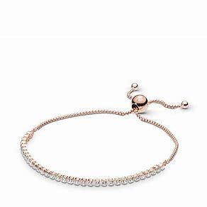
ring
bracelet
earring
necklace

Slide 17
Correct answer
Next question

Slide 18

coin
Game show
prize
cash

Slide 19
Correct answer
Next question

Slide 20
Wrong answer
Grammar

Slide 21
have
had
having
has
If I_____ more experience, I’d apply for the job.

Slide 22
Correct answer
Next question

Slide 23
was
were
will
would
If I could choose any destination, I ______ travel to New Zealand.

Slide 24
Correct answer
Next question

Slide 25
don’t
didn’t
doesn’t
done
I wish my friend ______ eat too much junk food.

Slide 26
Correct answer
Next question

Slide 27
am
had
I wish I _______ enough money to buy a present.
were
have

Slide 28
Correct answer
Next question

Slide 29
a
an
some
any
There is ______ big supermarket near my house.

Slide 30
Correct answer
Next question

Slide 31
some
any
no
an
In my city, there are _____ good schools, but they are very old.

Slide 32
Correct answer
Next question

Slide 33
some
any
no
an
There isn’t _____crime.

Slide 34
Correct answer
Next question

Slide 35
some
any
no
an
There are _____ recycling facilities and there isn’t anywhere to play sport either.

Slide 36
Correct answer
Next question

Slide 37
some
any
no
an
Is there______ pollution?

Slide 38
Correct answer
Next question

Slide 39
much
many
would
can
Excuse me, How _____ is this? It’s $20, sir.

Slide 40
Correct answer
Next question

Slide 41
much
many
would
can
How _____ you like to pay? I’d rather pay in cash.

Slide 42
Correct answer

Slide 43



