Slide 1
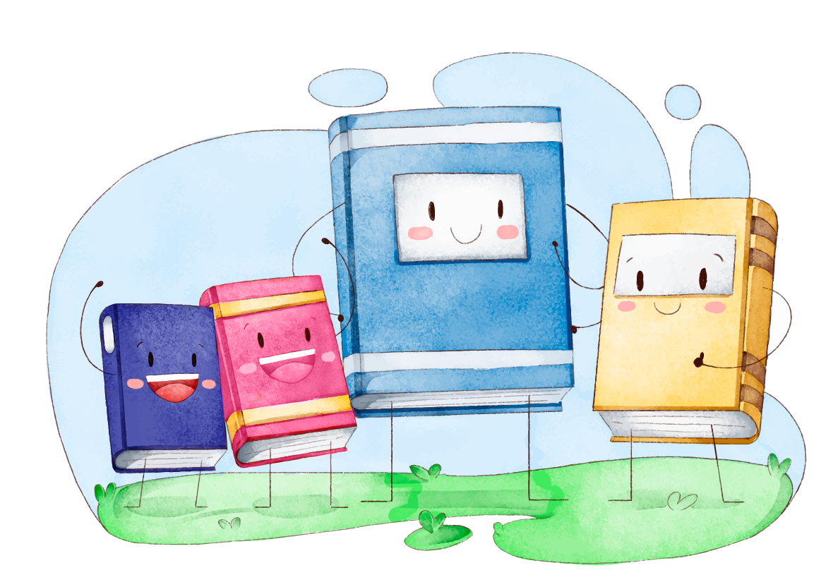
Unit 4
Wishful Thinking
Form, Meaning & Function
Mega Goal 1.2
Done by: Entisar Al-Obaidallah

Slide 2

Lesson Objectives
01
Differentiate
02
Use
Practice
03
Apply
04
between countable and uncountable nouns
Expressions of quantity: some, any, no
Using words Connected with Money, Shopping Habits and Prices
the grammatical rules to do the exercises

Slide 3

Open your student’s
Book p. 30

Slide 4
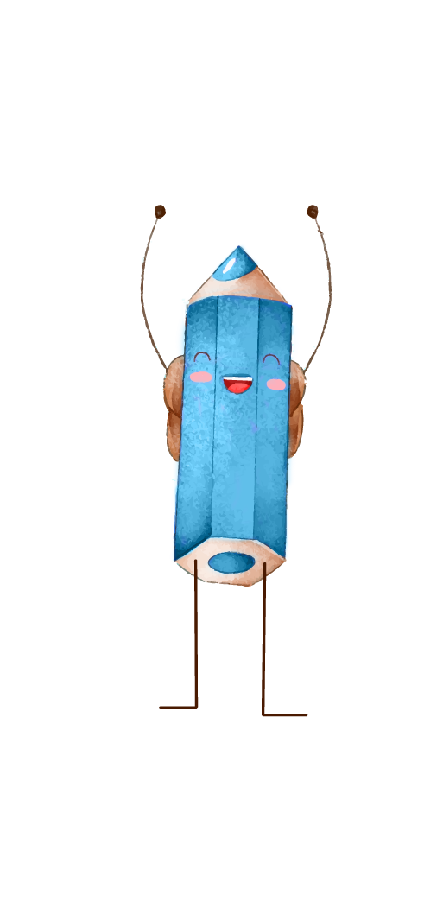
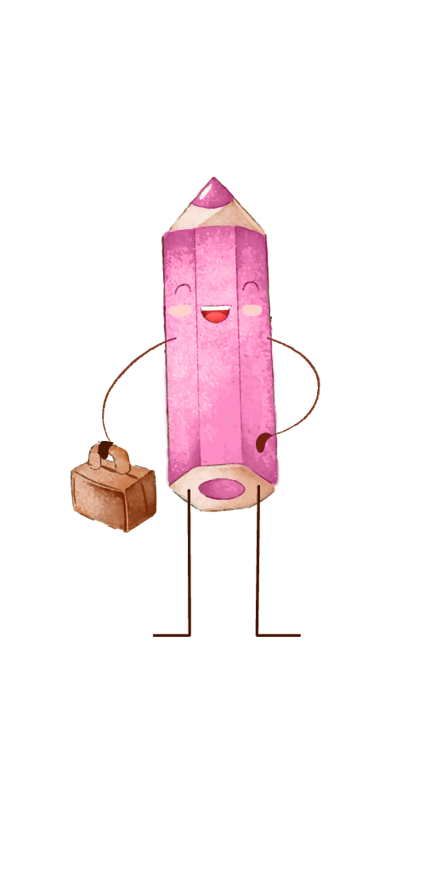
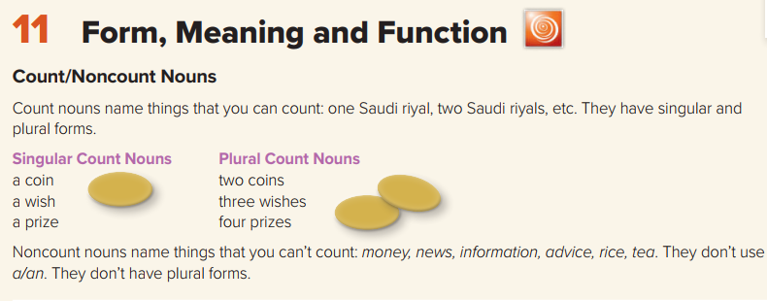
01
Count –Noncount Nouns!

Slide 5

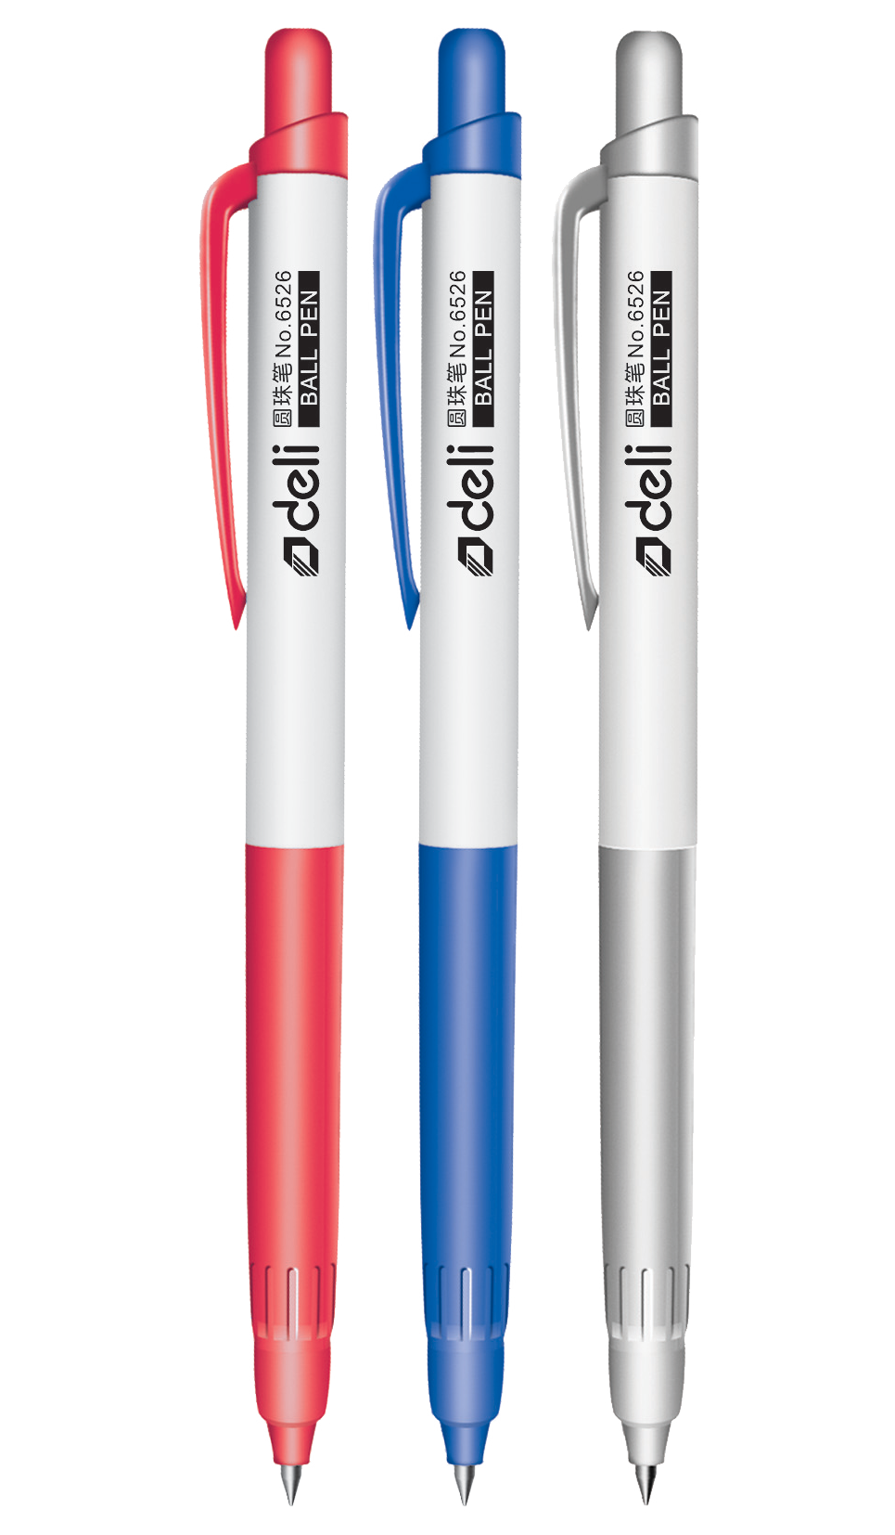
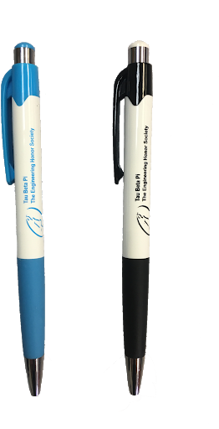

Examples
One pen
2 pens
3 pens
Count & Noncount Nouns
What is the difference between them ?
Nouns that we count are countable

Slide 6
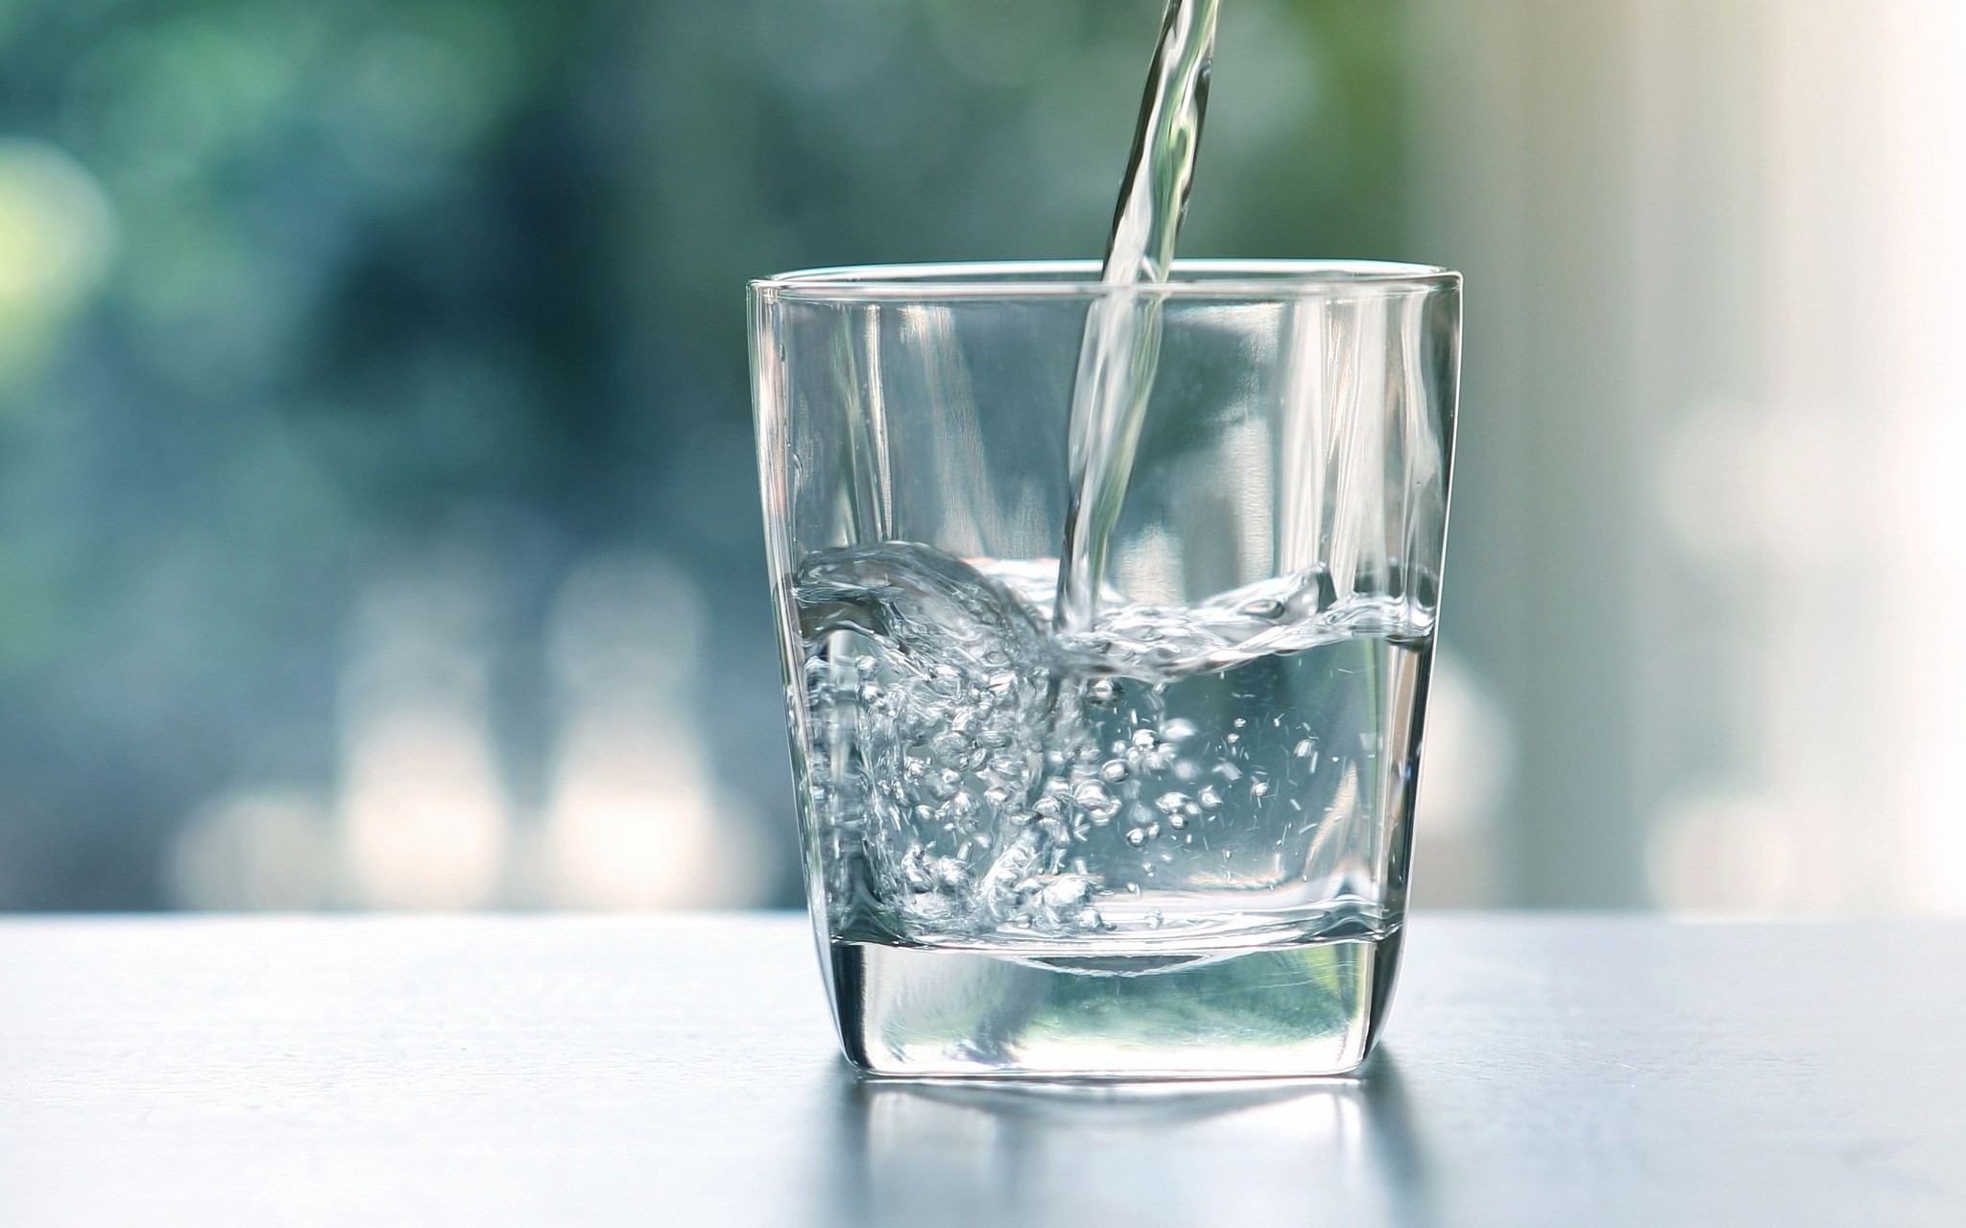
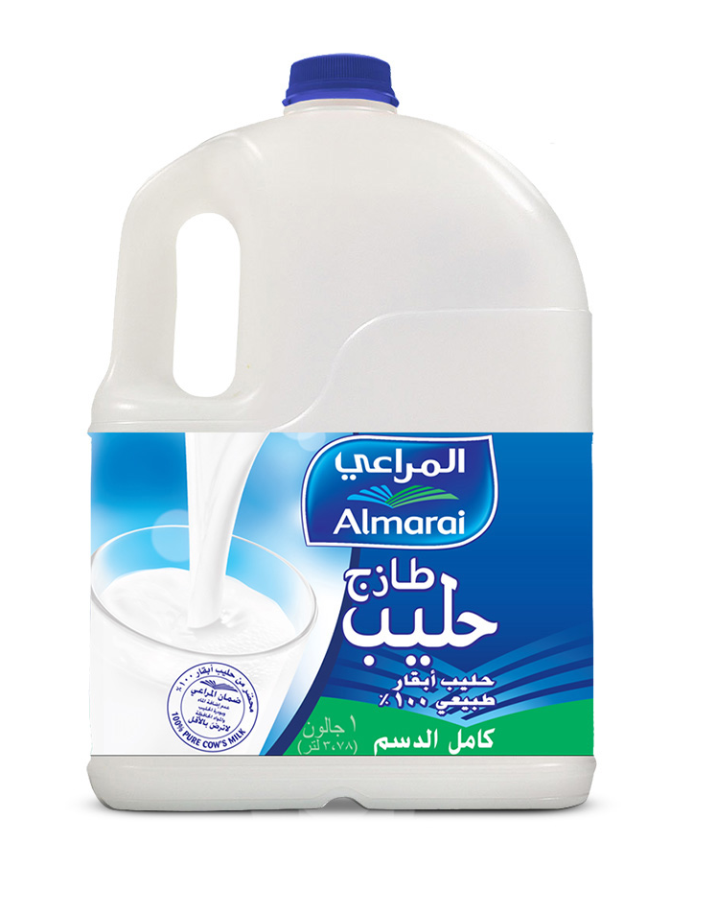
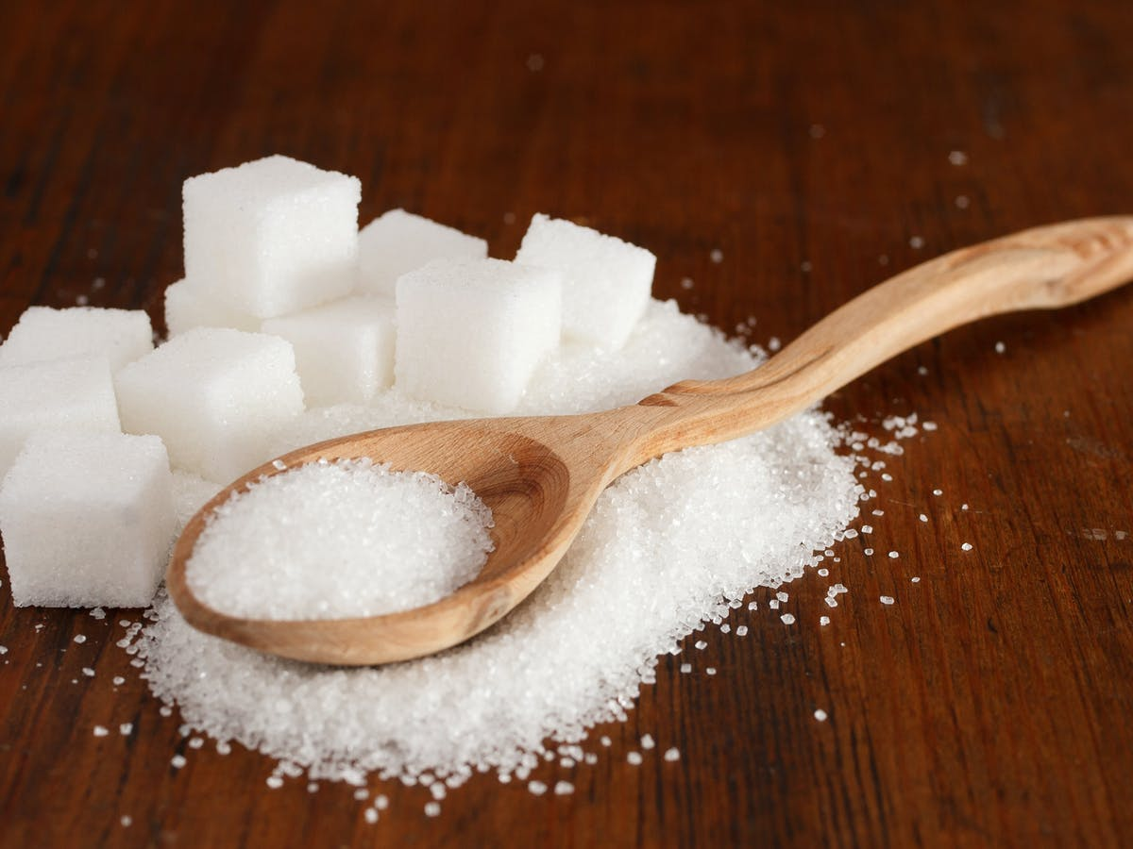
Examples
Count & Noncount Nouns
Nouns that can Not count are uncountable
sugar
water
milk

Slide 7
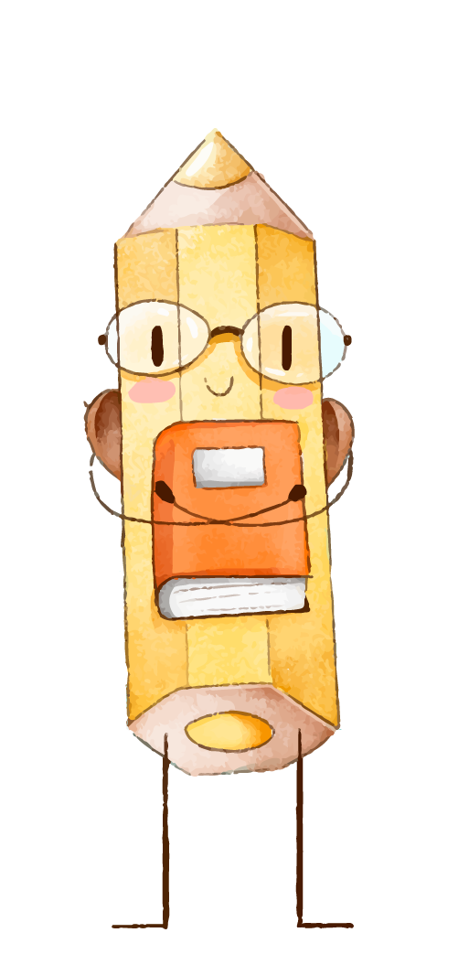
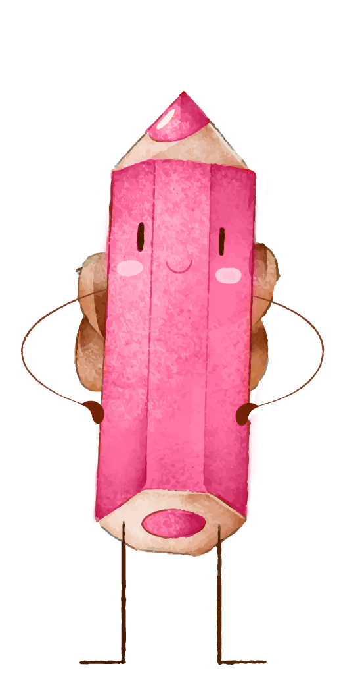
Classify the following nouns into countable and uncountable??
Egg ,cheese , girl , pencil ,butter , jacket , salt , juice , meat , cat ,oil,
Countable
Uncountable
eggs
cats
cheese
meat
salt
pencils
girls
jackets
butter
oil
juice

Slide 8
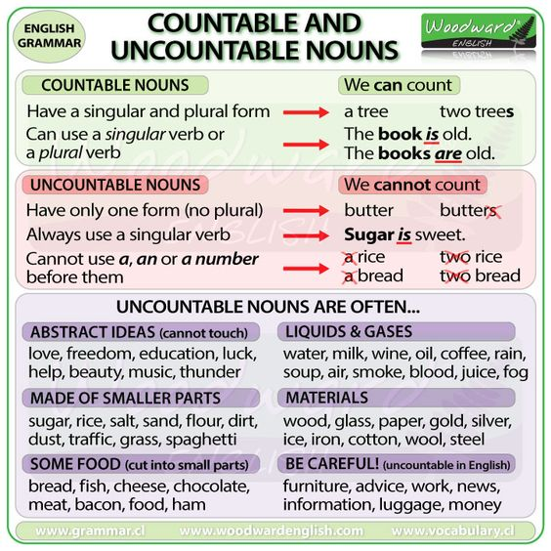

Slide 9
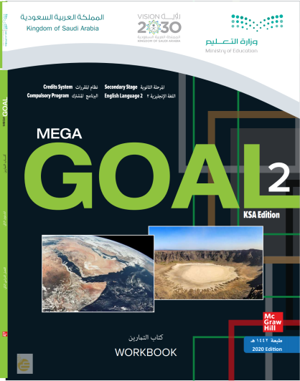
Open your work
Book p. 19

Slide 10
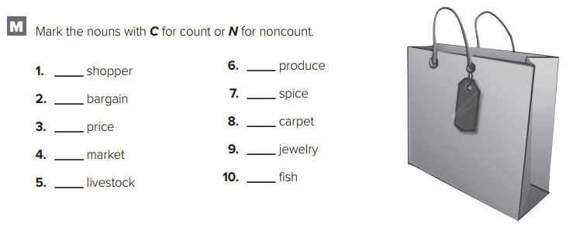
C
N
C
C
C
C
C
N
N
N

Slide 11
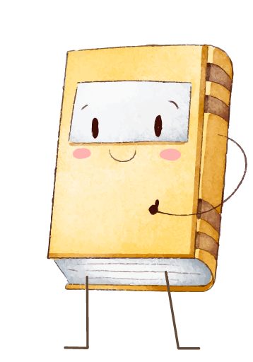
02
Expressions of Quantity
Some – Any - No

Slide 12
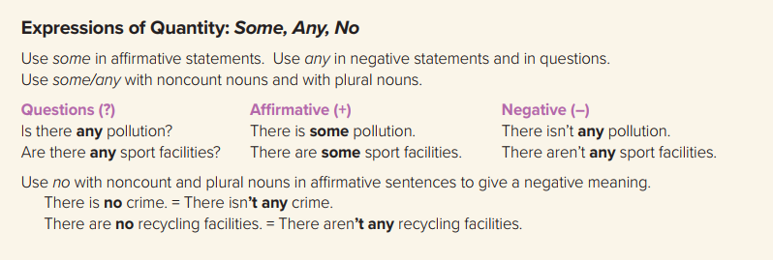

Slide 13
Quantifiers
Some
No
Any
affirmative
Affirmative with negative meaning
Negative
&
Question

Slide 14
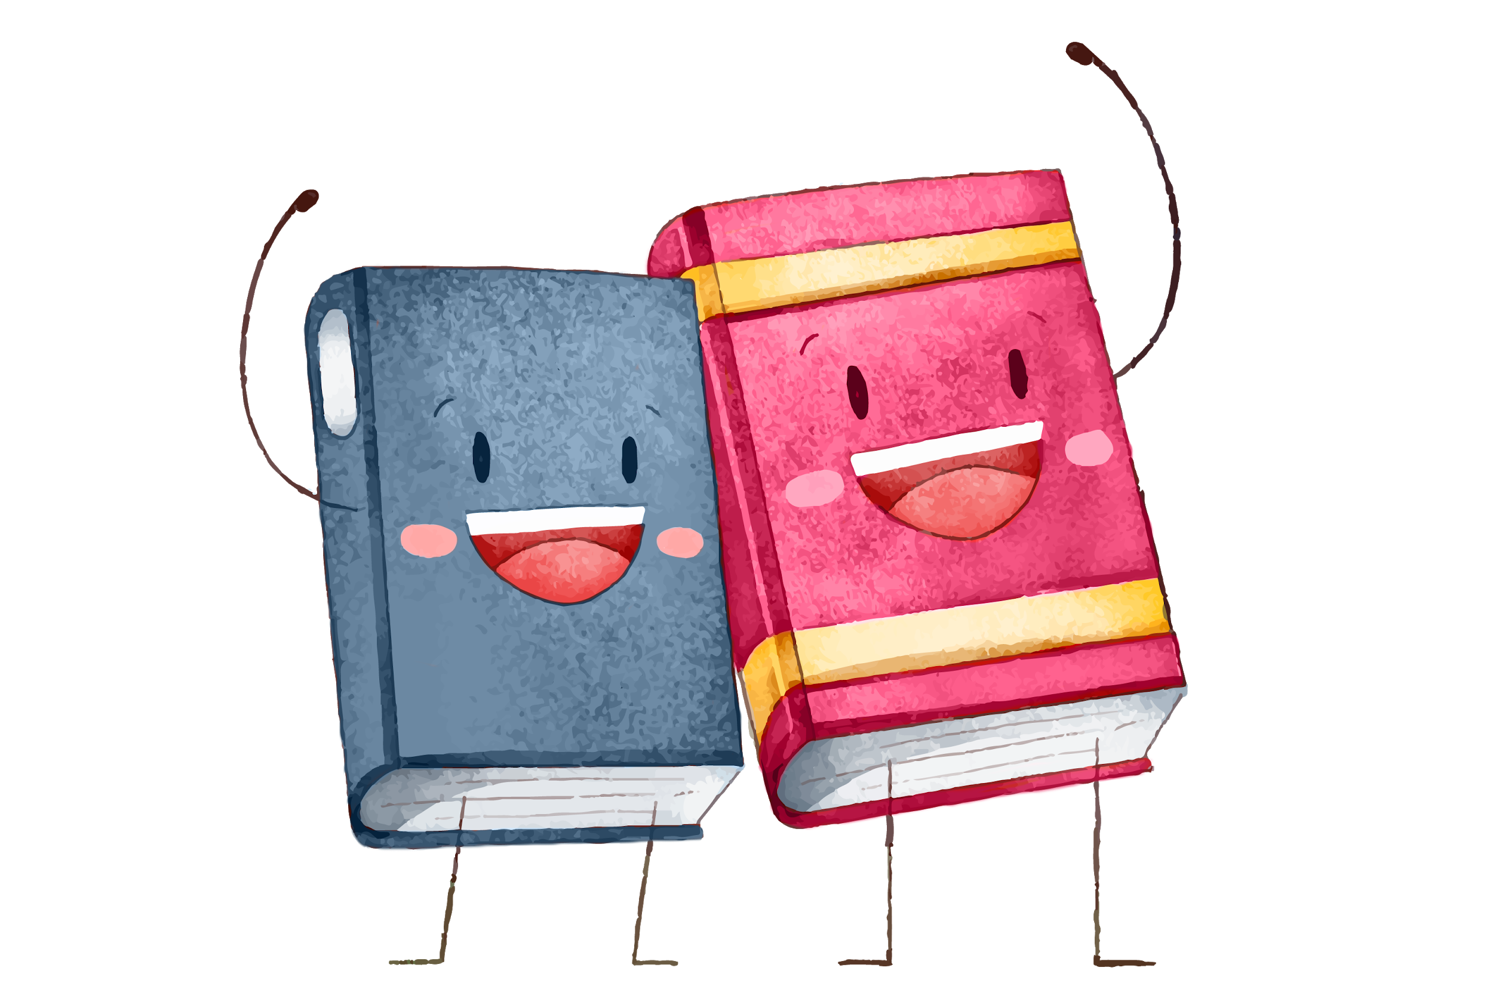
Some & Any
When are they used ?
Some
is used in positive sentences .
Example :
There are some apples on the table .
( countable )
There is some water in the glass.
(uncountable )

Slide 15
Some & Any
When are they used ?
Some
is used when we offer or ask for something politely.
Example :
Would you like some water?
offer
Can I have some milk, please?
ask for something

Slide 16
Some & Any
When is it used ?
Any
is used in negative sentences and question .
Example :
Are there any students in the school ?
( countable )
Is there any milk in the fridge?
(uncountable )
question

Slide 17
No
When is it used ?
No
is used in in affirmative sentences to give a negative meaning (= not any).
Example :
I have no friends .
( countable )
There is no milk.
(uncountable )
positive
Note : (There’s no milk in the glass = There isn't any milk in the glass).

Slide 18
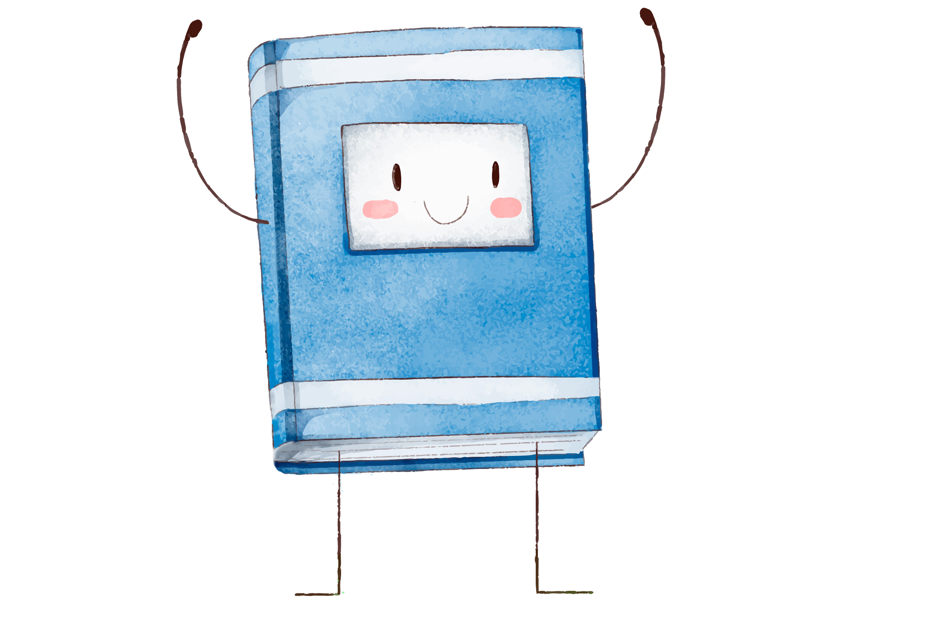
Open your work
Book p. 19

Slide 19
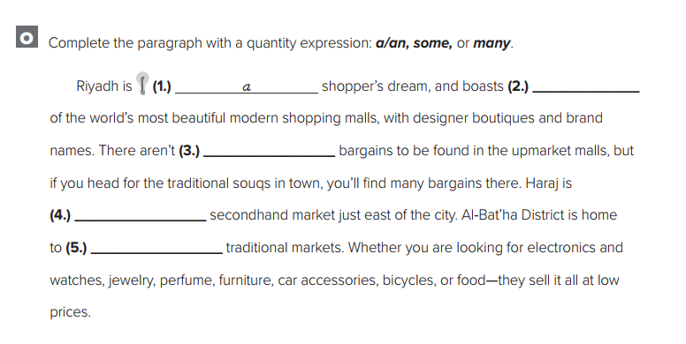
some
any
a
some

Slide 20
Words Connected With
Money, Shopping Habits and Prices
03

Slide 21
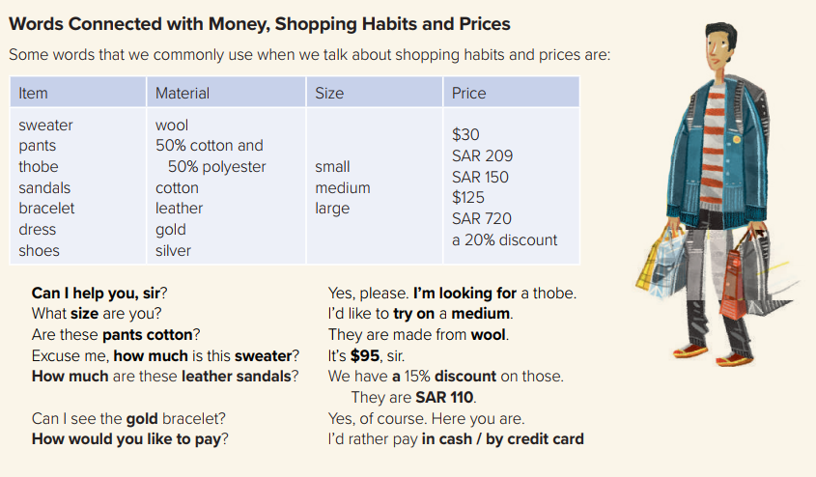

Slide 22
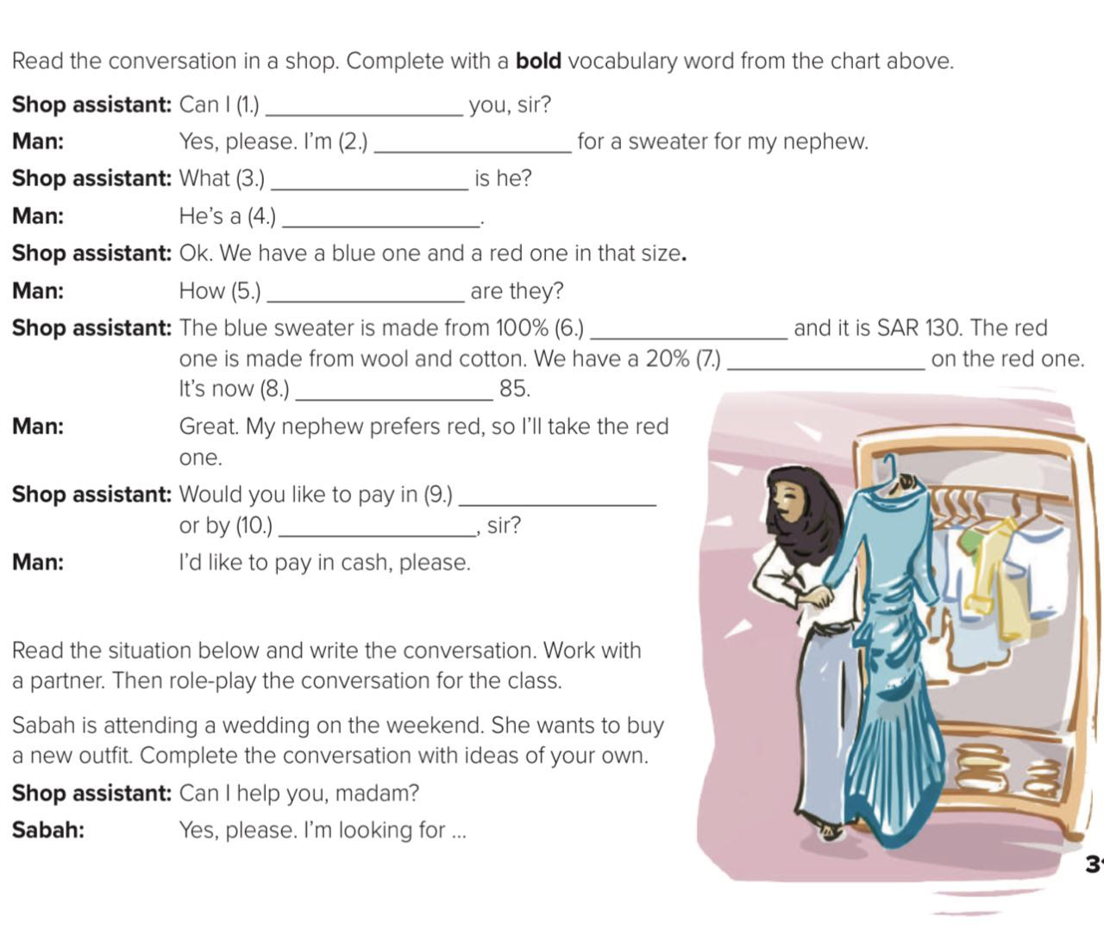
help
looking
size
small
much
wool
discount
SAR
cash
Credit card

Slide 23
Homework
p. (20) , Exercise (p)

Slide 24

Thanks

