Slide 1



Mega: 1.2
Meaning and Function
Count/noncount Nouns
Grammar
Wishful thinking
Done by :
Deema Aldossari

Slide 2

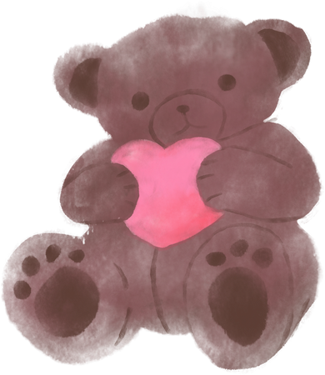

Today's objectives
- Differentiate between count nouns and noncount nouns
- Using the quantifiers (some, any, no) in the sentence
- Completing the sentence using words connected with money, shopping habits, and prices.

Slide 3


What do we mean by count nouns?
Count nouns are used to name things that we can count:
1- Singular count nouns
2- Plural count nouns

Slide 4
Nouns types:
1- count nouns
Books, tables, fingers, friends, trees
2- noncount nouns (mass)
Water, money, homework, sand, information, oil, salt

Slide 5



Examples of count nouns:
We can add a / an in front of them
Vowel sounds take an
a coin three coins
a wish a lot of wishes
a prize five prizes
a chair four chairs

Slide 6

What do we mean by noncount nouns?
we cannot count them in number.
Ex, money, news, information, advice, rice, tea,
milk, homework, assignment.
  They don't use a/ an
  They don't have plural forms s/es
  Ex, happiness- sadness- stress

Slide 7
Noncount nouns are categorized
Furniture I have furniture / pieces of furniture
Clothes I have clothes/ types of clothes counted
Money I have a lot of money or no money We count coins
Juice I will have two glasses of juice.

Slide 8
Expressions of quantity:
some, any, and no
1- Some (used with countable and non countable)
is used in affirmative statements (+)
ex,
there are some chairs.
there is some furniture.
there is some coffee spilled.

Slide 9
2- Any
is used in negative statements (-)
Ex,
There is not any pollution.
There are not any sport facilities.
2- Any
is used in questions (?)
is there any pollution?
Are there any sport facilities?

Slide 10
3- No
with noncount and plural nouns in affirmative sentences to give a negative meaning.
There is no crime--- There is not any crime.
There are no recycling facilities--- There are not any recycling facilities.

Slide 11
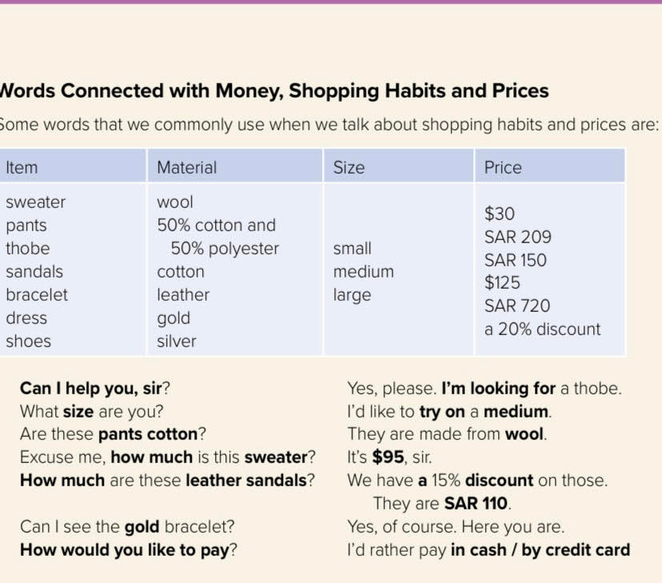
some words that we commonly use when we talk about shopping habits and prices:
Guess how to say them in English

Slide 12
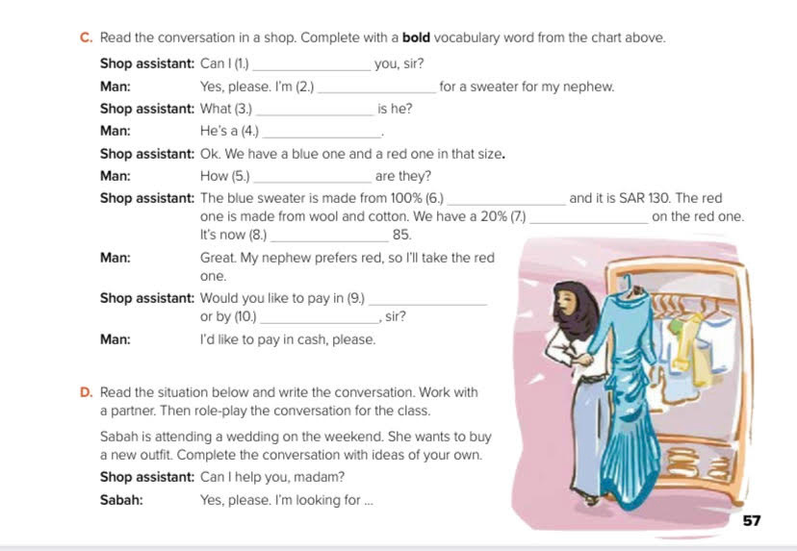

Slide 13
help
looking
size
medium
much
wool
discount
SAR
cash
Credit card

Slide 14




