Slide 1
Unit4 Wishful Thinkings Reading
Done by : Entisar Al-Obaidallah

Slide 2
01
02
03
04
Discuss
Read
Underline
Answer
The topic of money : a blessing or a problem
For specific information
Words and expressions that refer to money
Some questions about the passage

Slide 3

Warm up
Is it important to have MONEY? Why ?

Slide 4

Open student’s book p. 52

Slide 5
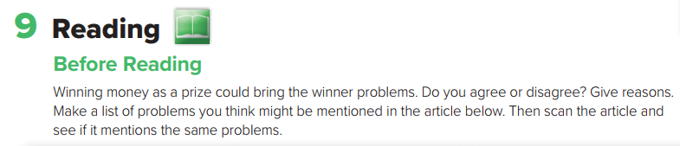

Slide 6
Before Reading
Scan the text to find the answers of the following questions
1.what is the topic about ?
About money
2. Do you think money is A blessing or Problem?
It could be a blessing or problem.

Slide 7
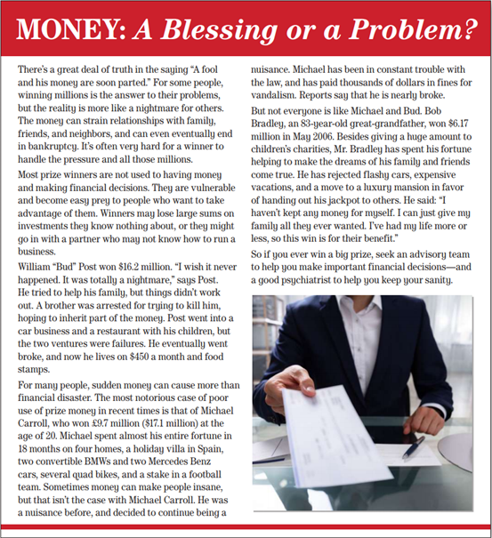
Before Reading
1- What’s the title of the passage ?
Money: A Blessing or a problem ?
2. How many paragraphs are there ?
Six paragraphs
3. What can you see on the photo?
A man holding a a cheque

Slide 8

Read and Listen

Slide 9
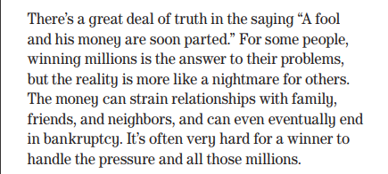

1- What does this saying mean ( A fool and his money are soon parted ) ?
Used to say that a foolish person spends money too quickly on unimportant things.

Slide 10
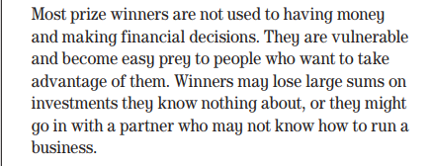
1- Are most prize winners used to having money and making financial decision?
No , they aren’t

Slide 11
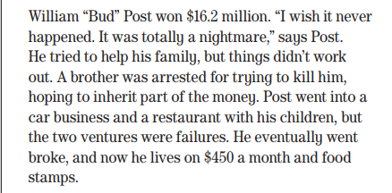
1- Who won $16.2 million ?
William Bud

Slide 12
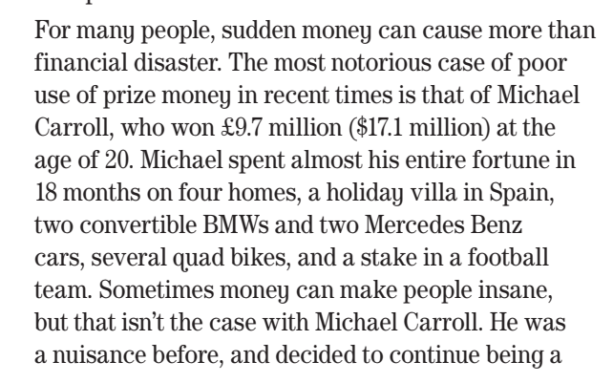
How much did Michael Carroll win ?
17.1 million dollars
How did Michael spend his fortune ?
on four homes, a holiday villa in Spain,two convertible BMWs and two Mercedes Benzcars, several quad bikes, and a stake in a football teams

Slide 13
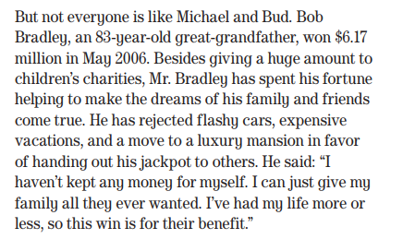
1- How old is Bob Bradley ?
83- years
2- How much did Bob win ? When ?
$6.17million in May 2006.

Slide 14
New Vocabulary
bankruptcy
legal status of having no money
vulnerable
easily harmed
sums
amounts
sanity
ability to think in a normal way
advisory team
group that gives advice

Slide 15
Open your student’s book p.27

Slide 16
winning million
bankruptcy
financial decisions
investments
went broke
spent his fortune
fine

Slide 17
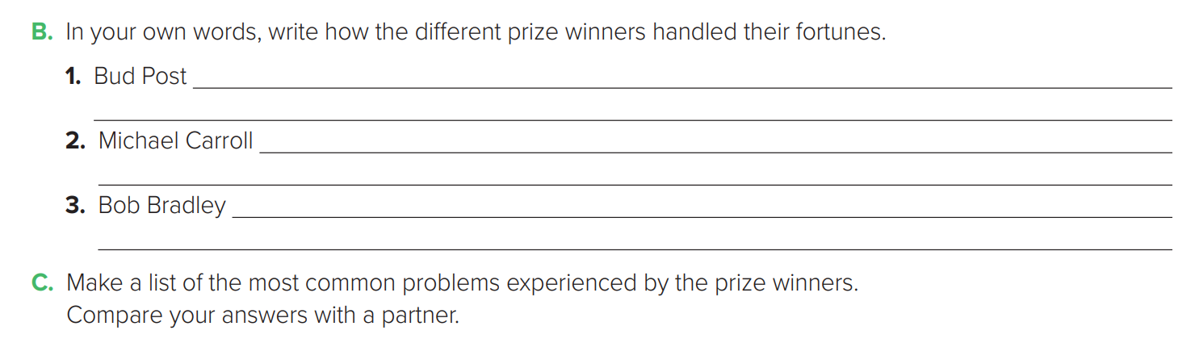
After Reading
Post tried to help his family, but his brother tried to kill him. He invested money in businesses, but they failed .
Carroll spent his fortune in 18 months. He bought things like a Mercedes and a villa in Spain. He was in trouble with the law and paid fines .
Bradley gave huge amounts of money to charity. He didn’t buy things for himself. He gives money to make the dreams of his family and friends come true.

Slide 18
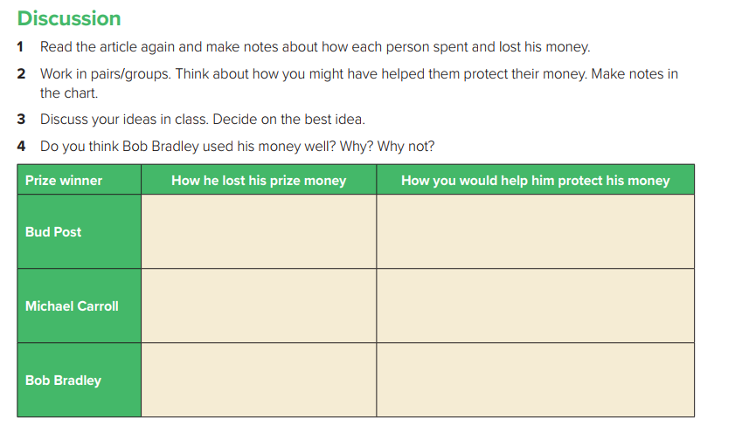
He tried to help his family but things didn’t workout . He invested money in different business but he failed .
Be partner with his brother .
Ask for financial advice .
Carroll spent his fortune in 18 months . He bought things like a Mercedes and a villa in Spain. He was in trouble with the law .
Save some money –spend his money wisely
Ask for financial advice .
He gave money to charity. He didn’t buy things for himself. He made the dreams of his family and friends come true .
-Actually He did very well. I would do the same thing if I were him.
-Not to forget himself .

Slide 19

Home work Exercise (J) P.(101)

Slide 20

Thanks

