Slide 1


Slide 2
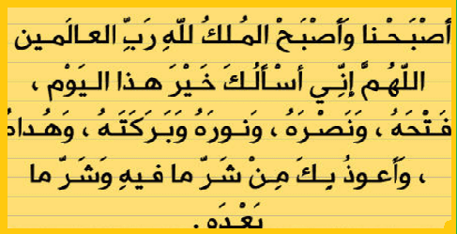

Slide 3
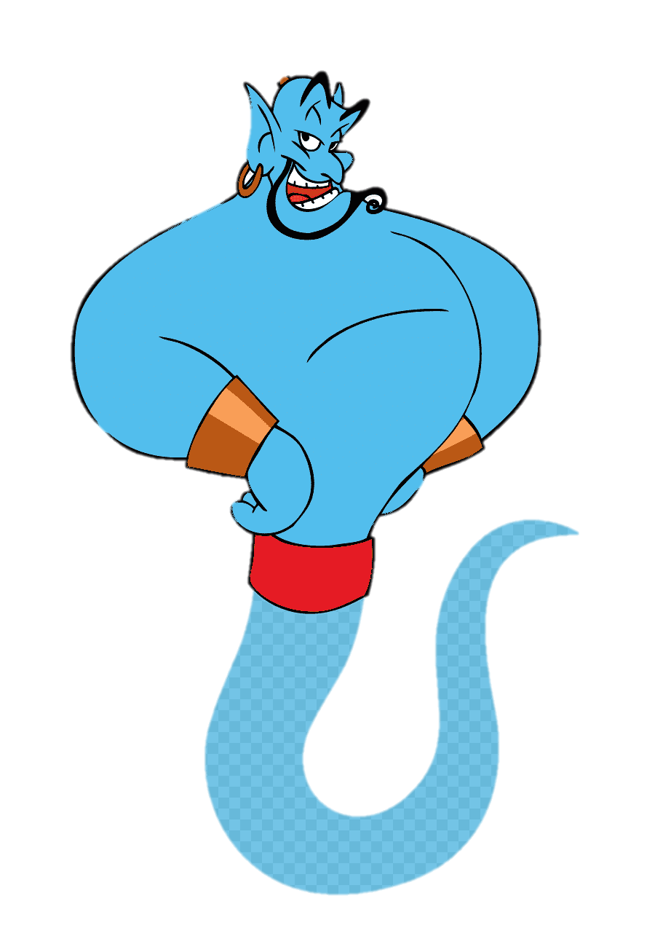
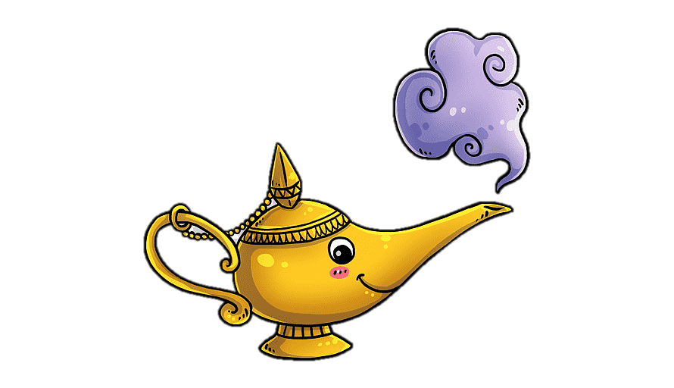
Unit-4
Wishful Thinking

Slide 4
3-Grammar

Slide 5

Conditional Sentences with If-Clause: Imaginary Situations
Conditional Sentences with Might and Could
Verb: Wish
What are there answers?

Slide 6
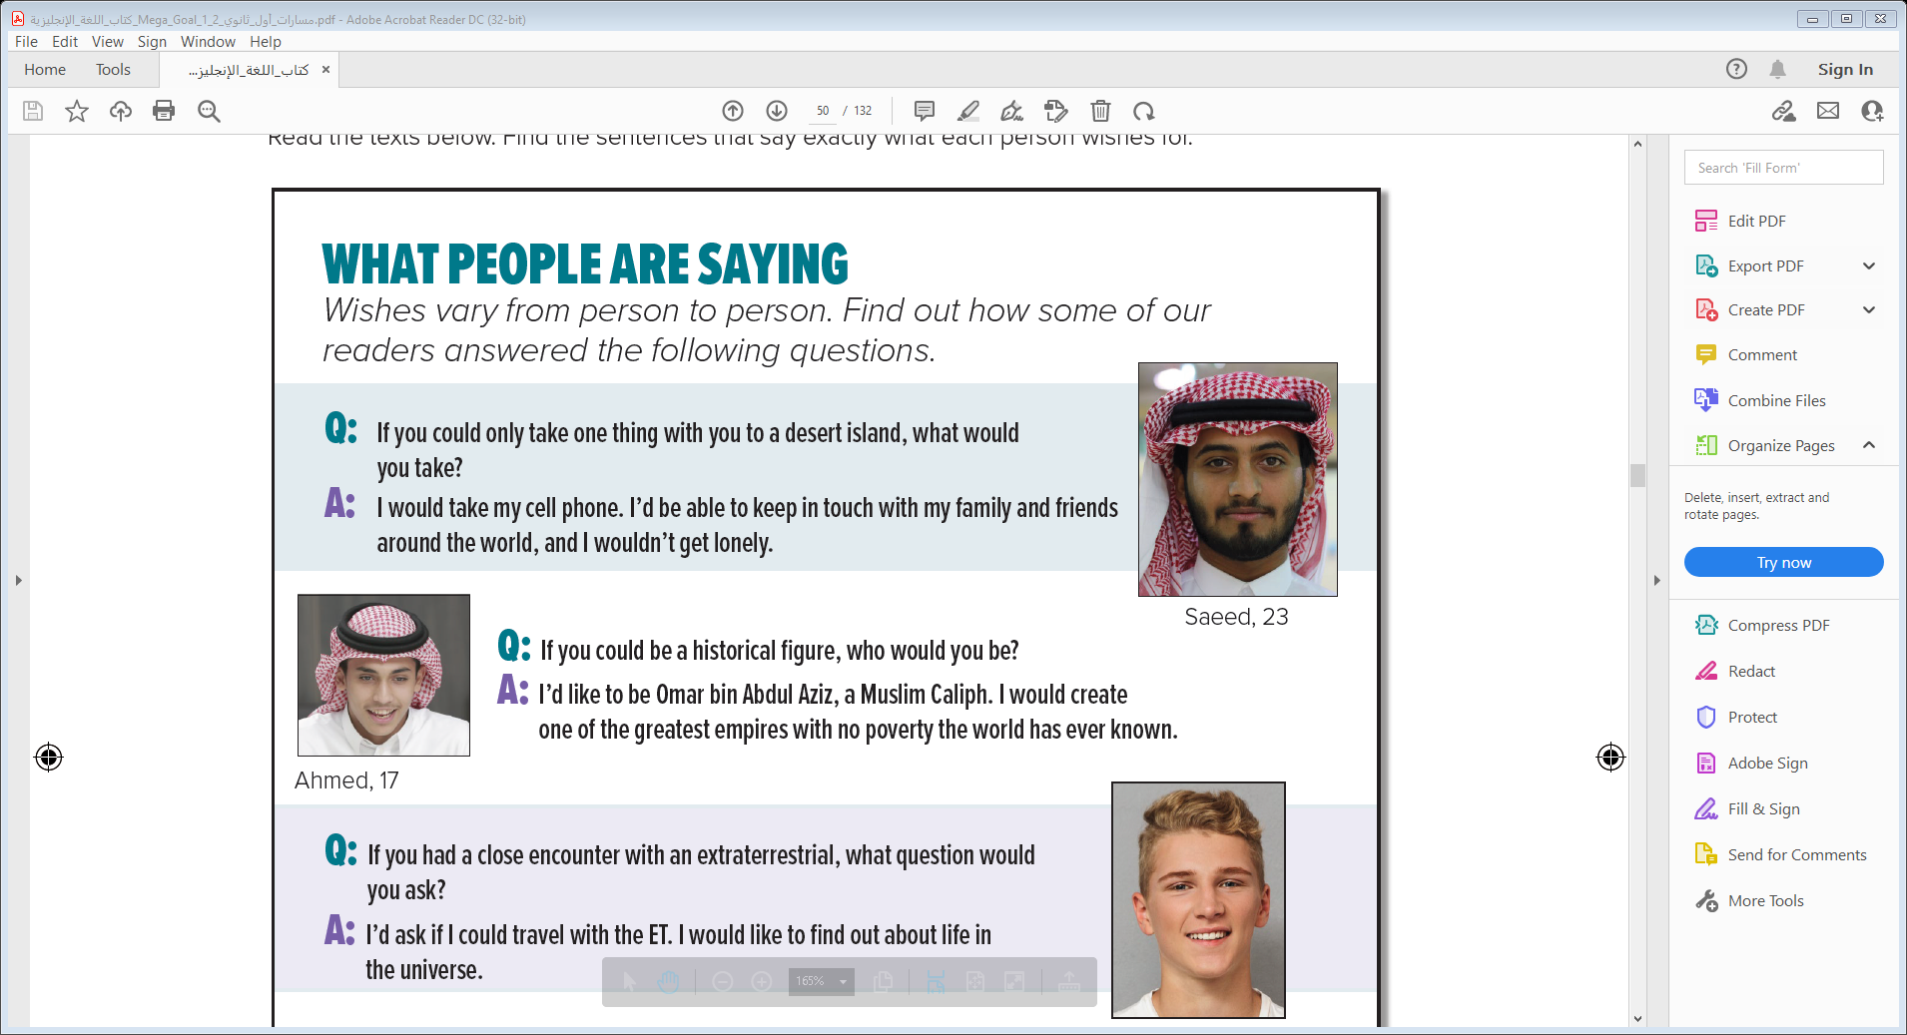
Revision
What are their answers?

Slide 7

Objectives
The students will be able to :
1 – use conditional sentence (if-clause ) to express imaginary situations .
2 – express possibility with (might) in a conditional sentence .
3 – use (could) in if-clause .
4 – use "could" in the main clause of a conditional sentence .
5 – use the verb (wish) with the present tense .
6 – use the verb (wish) with the future tense .
Conditional Sentences with If-Clause
: Imaginary Situations

Slide 8
Conditional Sentences with If-Clause
: Imaginary Situations

Slide 9

If clause,simple past
Main clause
If he were taller , he would be accepted into the team

Slide 10
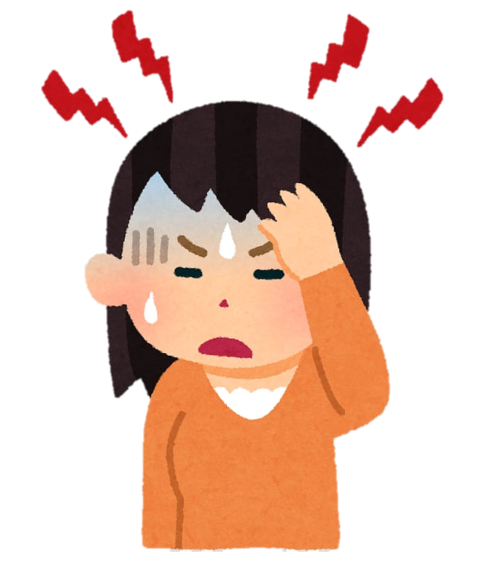
If clause ,simple past
Main clause
If I didn’t have a headache, I would go to the party .
If he were taller , he would be accepted into the team

Slide 11

If clause ,simple past
Main clause
If we bought a new car, we wouldn’t be late again .
If I didn’t have a headache, I would go to the party .
If he were taller , he would be accepted into the team

Slide 12
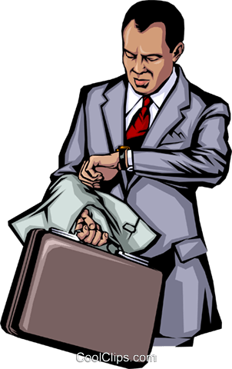
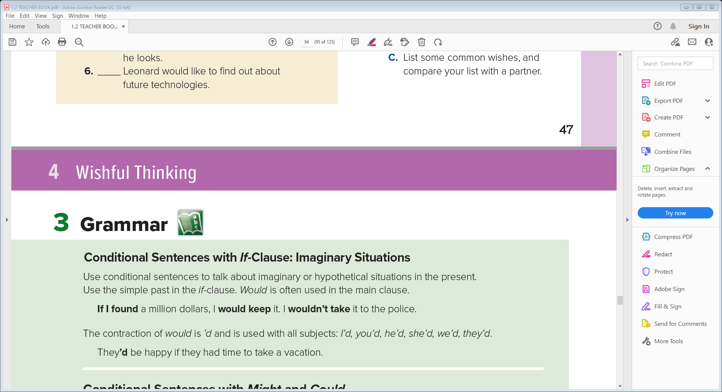
Main clause
If clause ,simple past
He would go to the party if he had a time .
If we bought a new car, we wouldn’t be late again
If I didn’t have a headache, I would go to the party .
If he were taller , he would be accepted into the team

Slide 13
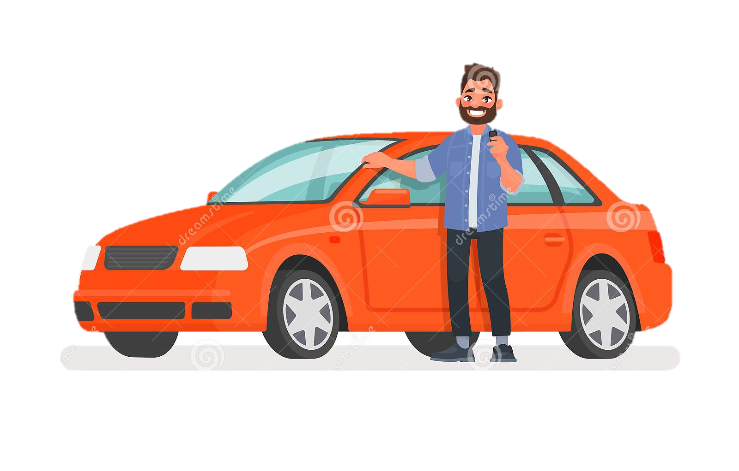
He would go to the party if he had a time .
If we bought a new car, we wouldn’t be late again
If I didn’t have a headache, I would go to the party .
If he were taller , he would be accepted into the team

Slide 14

He would go to the party if he had a time .
If we bought a new car, we wouldn’t be late again
If he were taller , he would be accepted into the team
If I didn’t have a headache, I would go to the party .
If conditional
Imaginary situations
,
If
Past simple
would
infinitive
would
infinitive
If
Past simple

Slide 15
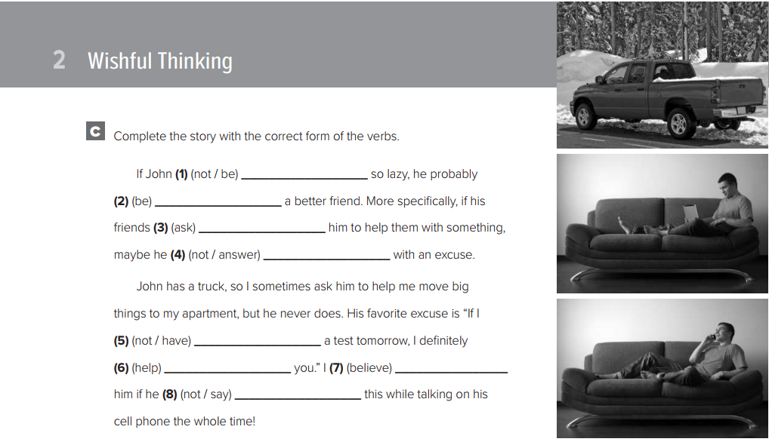
Work Book P.108
weren’t be
would be
Conditional Sentences with Might and Could
asked
wouldn’t answer
didn’t have
would help
would believe
didn’t say

Slide 16
Conditional Sentences with Might and Could

Slide 17
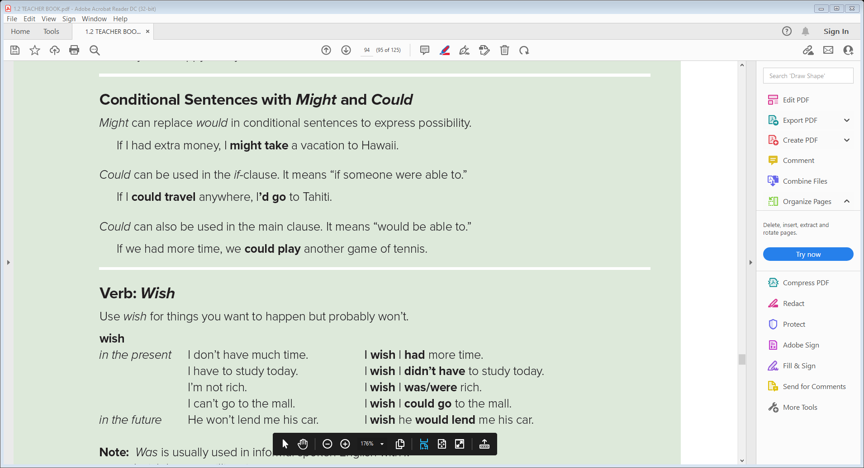


If clause ,
Main clause
If I had extra money , I might visit Paris .
Main clause
If clause ,
He might go to the party if he had a time .

Slide 18
If I had extra money , I might visit Paris .
He might go to the party if he had a time .

Slide 19
If conditional
Possibility
,
If
Past simple
might
infinitive
Or
might
infinitive
If
Past simple
If I had extra money , I might visit Paris .
He might go to the party if he had a time .

Slide 20

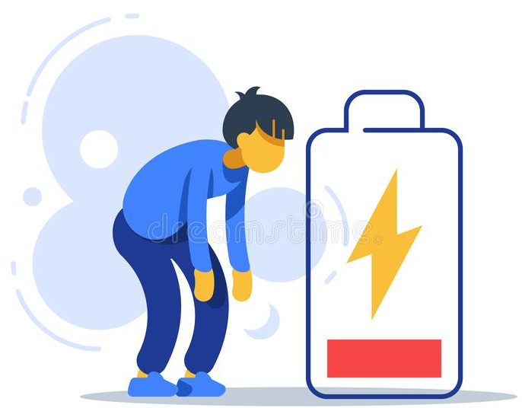
If clause ,
Main clause
If I could visit any city , I would go to London .
If clause ,
Main clause
If I had more energy , I could run farther .

Slide 21
If I could visit any city , I would go to London .
If I had more energy , I could run farther .

Slide 22
If conditional
ability
,
If
could
would
infinitive
Or
would
infinitive
If
could
If I could visit any city , I would go to London .
If I had more energy , I could run farther .

Slide 23



Quick Check
Verb: Wish

Slide 24
Verb: Wish

Slide 25
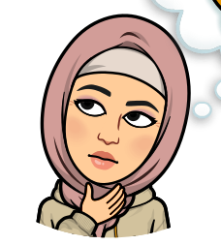

I’m not good at math
I wish I was/were better at math.
My friend won’t lend me any money
I wish my friend would lend me some money.

Slide 26
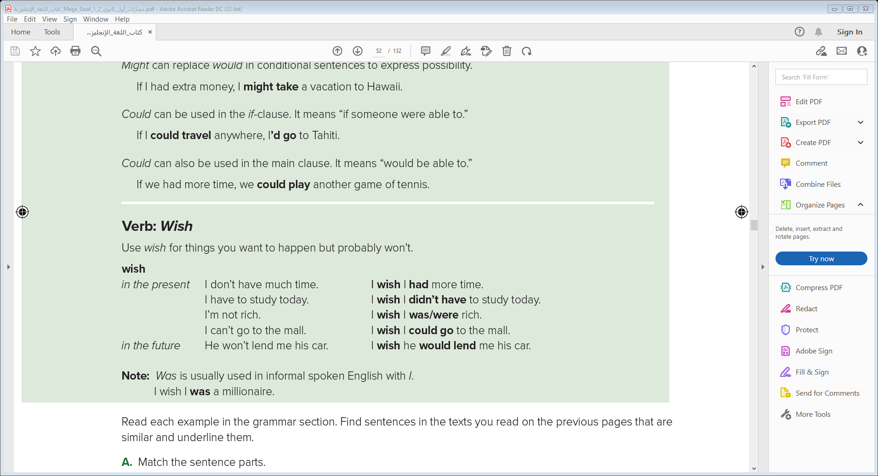
subject
wish
subject
Past simple
I wish I was/were better at math.
I wish my friend would lend me some money.

Slide 27
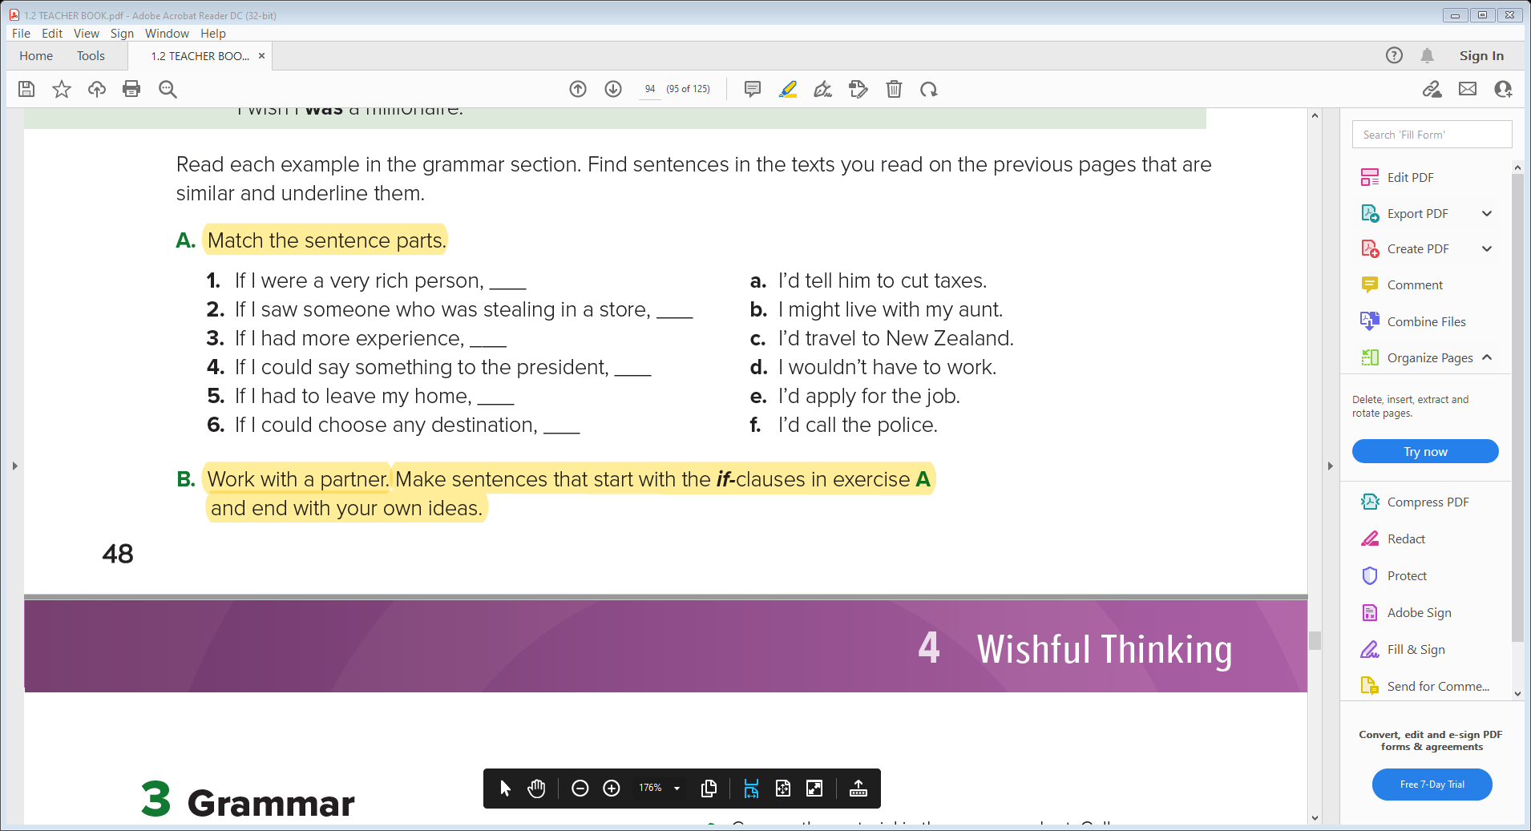

Student Book P.48
d
f
e
a
b
c

Slide 28

Quick Check

Slide 29


