Slide 1


Unit 3 You’ve Got Mail
Mega Goal 1.2
Listen & Discuss
Done by : Entisar AL-Obaidallah

Slide 2

Lesson Objectives
01
02
03
Listen
Discuss
Answer
04
05
06
Make
Wish
for specific information
Email & letter format and etiquette
True – False questions
and accept opology
Someone success

Slide 3












What do you use emails for?
Can you guess the topic of the unit?
warm up
How do people communicate with each other?

Slide 4
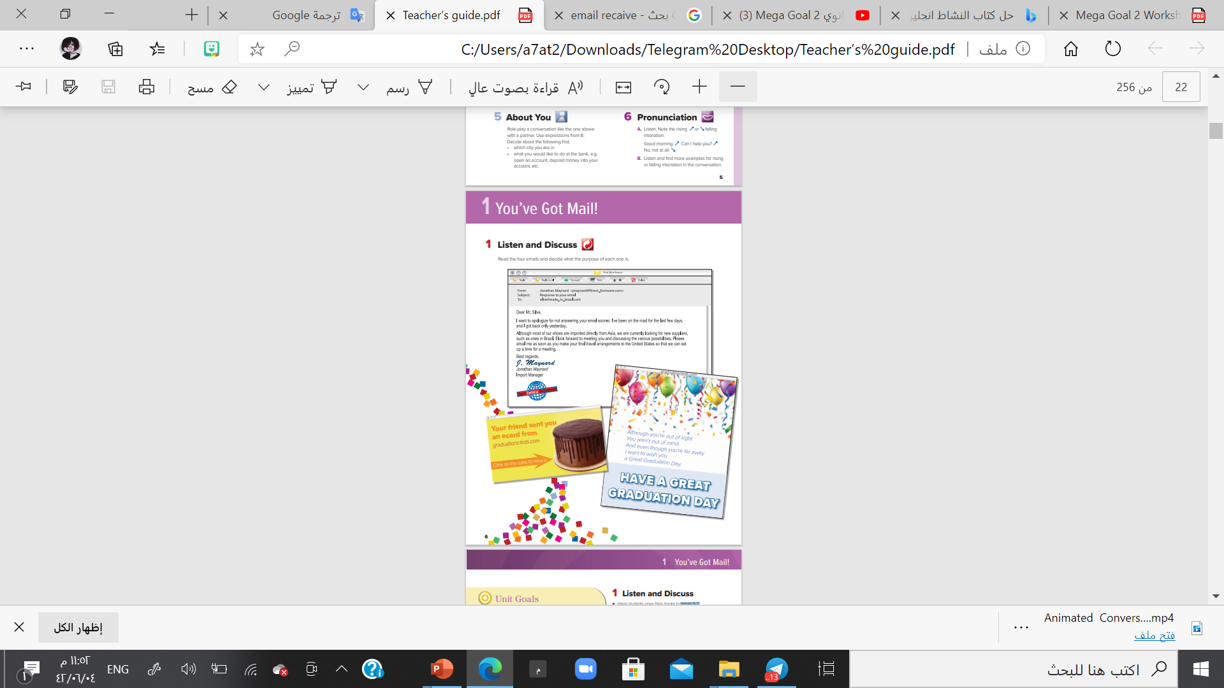
Listen & Discuss p.6-7
Open
Student’s book page ( 33) ,

Slide 5
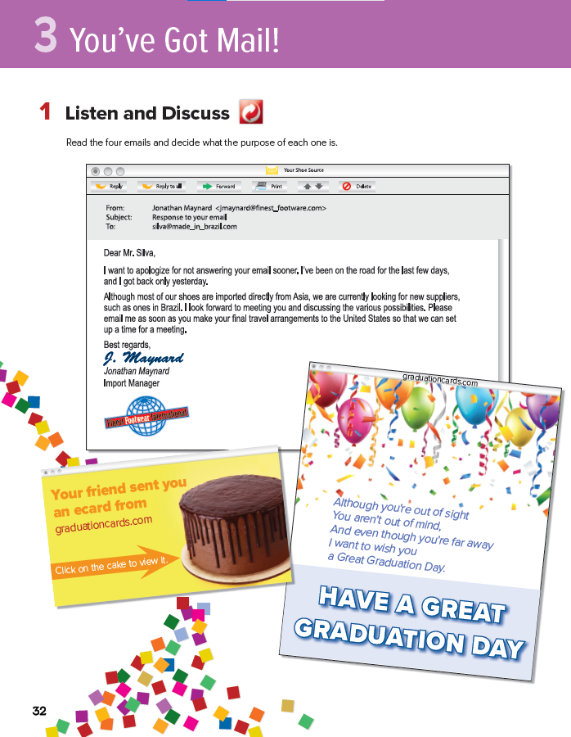
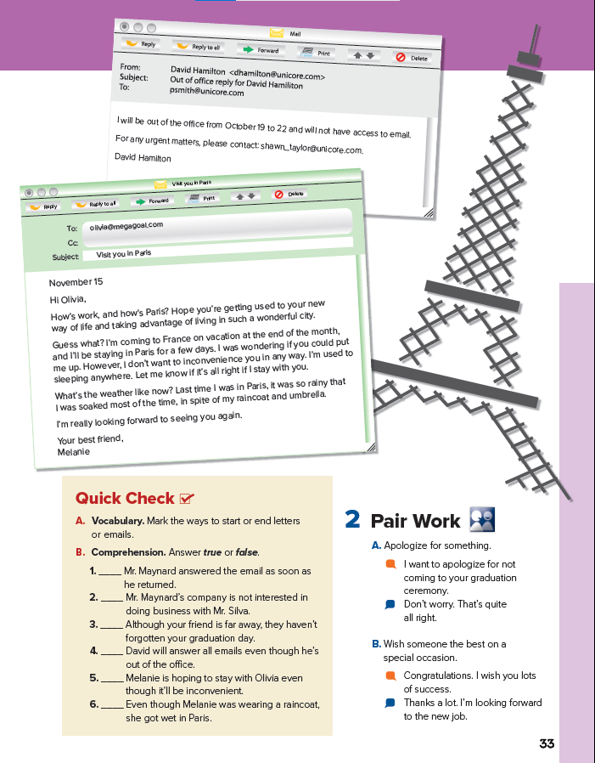
3
Pair Work p.7
1
4
Read the four emails and decide what the purpose of each one is.
2

Slide 6

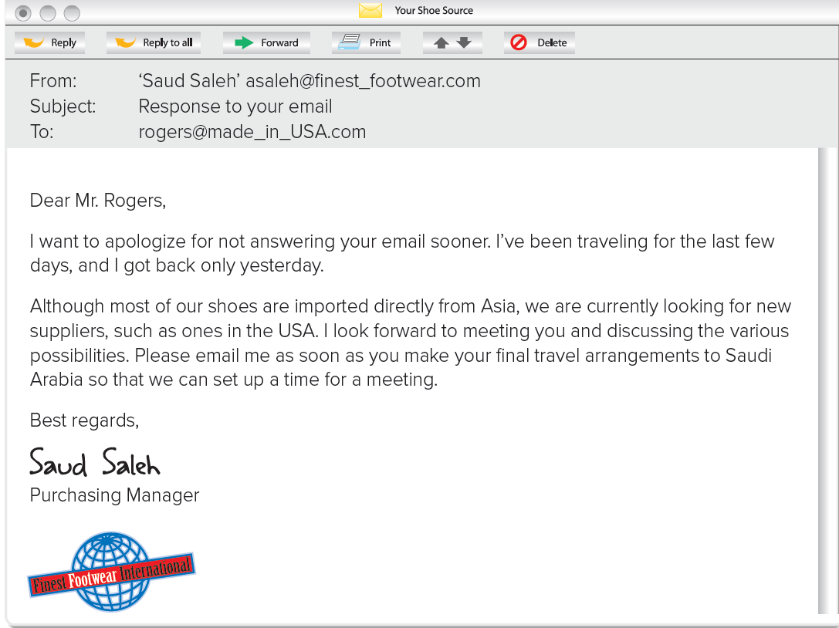

suppliers = a person who provides something
Who’s the sender?
Who’s the receiver?
Requesting a pardon
What’s the subject of the email?
Requesting an action
How did he start the email?
How did he end the email?
apologize = to say sorry
What’s the purpose of this email?

Slide 7
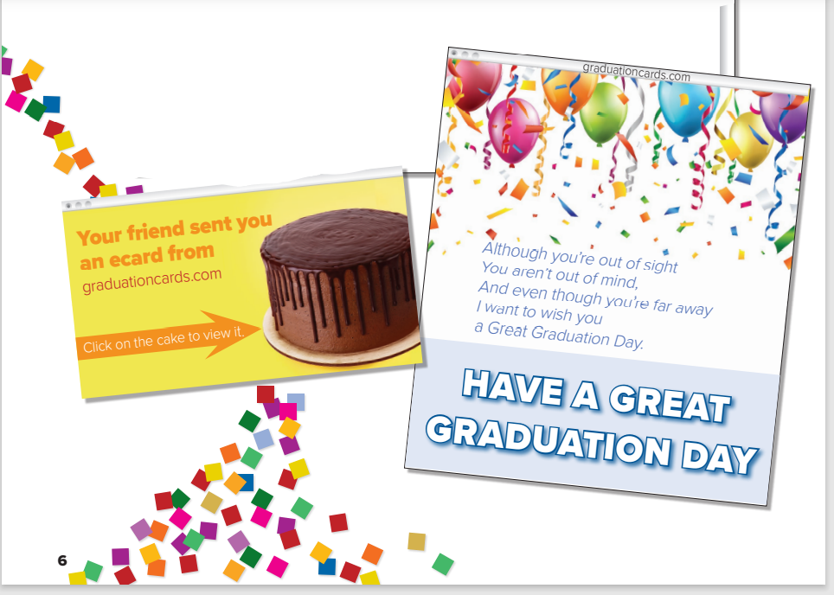

graduation e-card
What’s this?
Listen & Discuss
What kind of e-card is this?
Expressing a wish
What’s the purpose of this email?

Slide 8
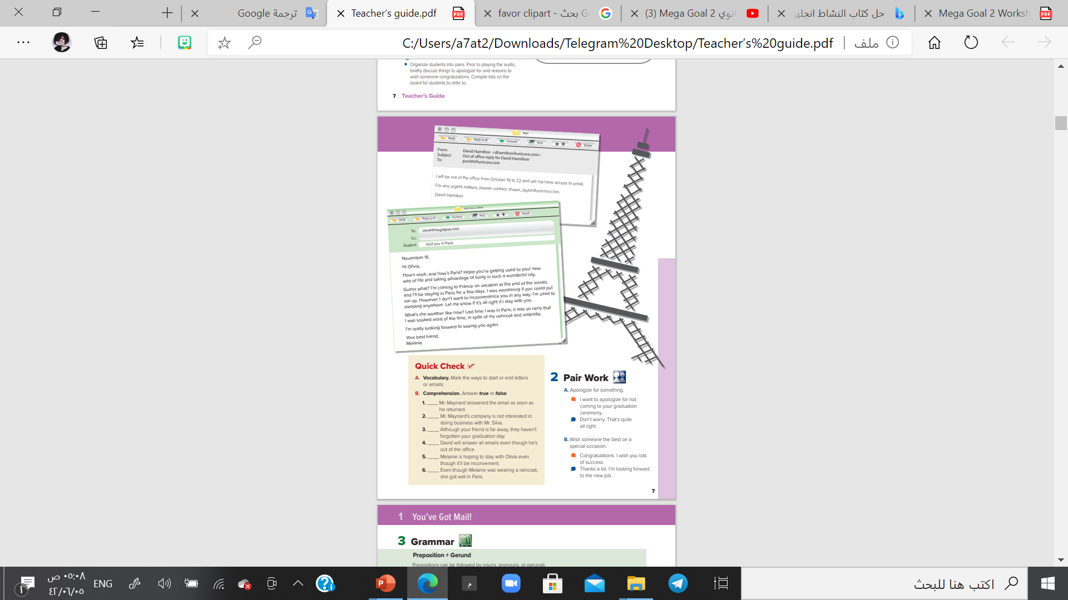
Listen & Discuss p.6-7
Open
Student’s book page ( 34) ,

Slide 9

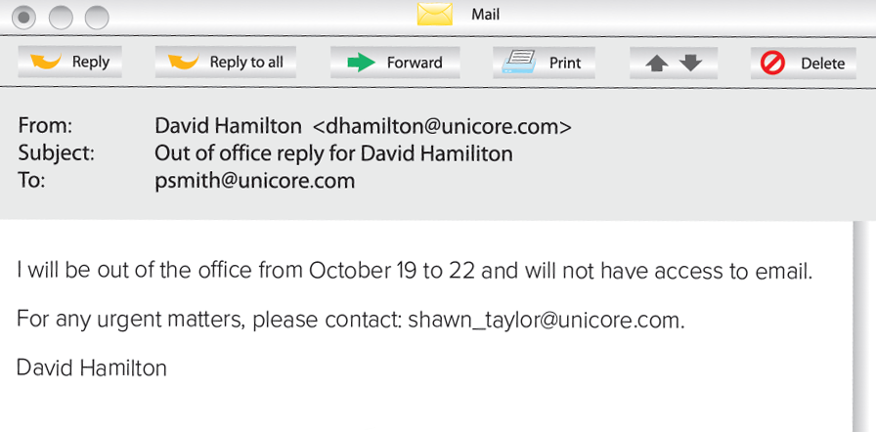

urgent = instant, necessary
Who’s the sender?
Who’s the receiver?
Requesting an action
What’s the subject of the email?
How did he end the email?
What’s the purpose of this email?

Slide 10
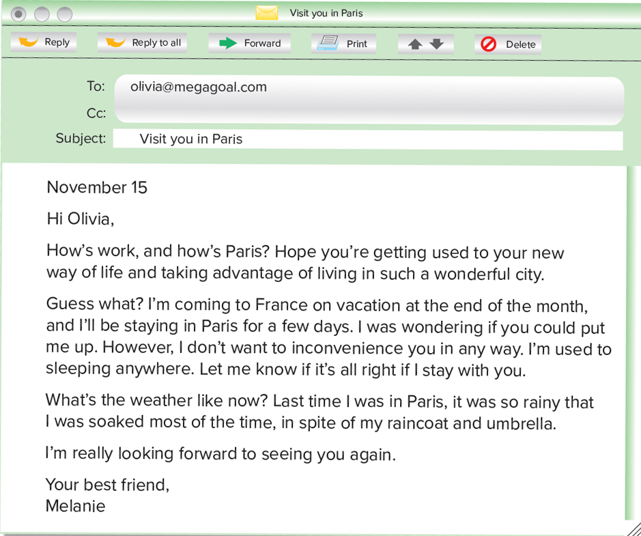
Who’s the sender?
Put me up = Let me stay in your home
Who’s the receiver?
Requesting a favor
How did she start the email?
How did she end the email?
What’s the purpose of this email?
soaked =Extremely wet
inconvenience =Cause a problem

Slide 11
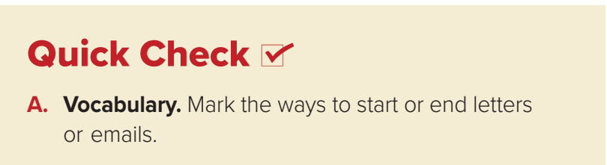
To End :
To Start :
Dear Mr ……,
Hi ,
Hello ,
Best regards , ……
Love …………,
Sincerely …………,

Slide 12
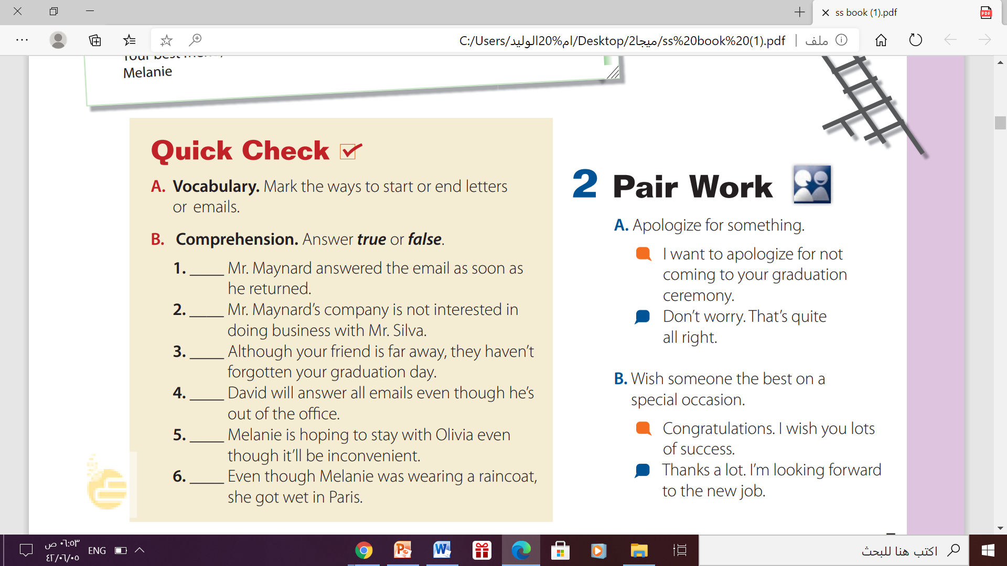
True
False
True
False
False
True
Quick Chick

Slide 13

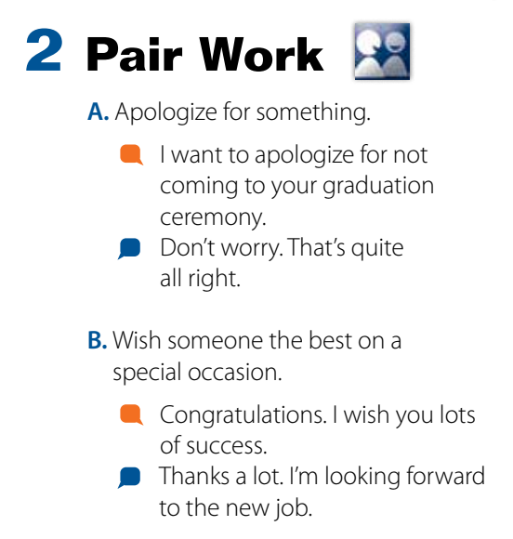
Pair Work p.34

Slide 14


Slide 15
supplier
person who provides something
apologize
To say sorry
urgent
Instant , necessary
Extremely wet
inconvenience
cause problem or worry
Put me up
soaked
Let me stay in your home
Extremely wet
Done by T. Talal Alhazmi

Slide 16

Thanks!

