Slide 1


Slide 2


Slide 3


Unit -3-
You’ve Got Mail!
3- Grammar

Slide 4

Although, Even Though, In Spite Of
As Soon As, When
Preposition + Gerund
So … (That)
3- Grammar

Slide 5

Objectives
The students will be able to :
1 – Identify the correct verb form after the preposition .
2 – Select the correct preposition for the verb.
3 – Build a correct sentence with ( although and even though ).
4 – Write the correct word form after ( in spite of ).
5- Use the correct verb tense with ( as soon as , while ) .
6- Form a sentence with ( so ) .

Slide 6




Preposition + Gerund
Lets Check What you Know
I apologize for arriving late.
I decided against wearing a uniform.
I look forward to meeting you personally.
I insist on paying for our lunch.
I’m thinking of moving to a new house soon.
I succeeded in getting into college.
I’m dreaming of going on vacation.
I asked about applying for a job.
to-import-apologize-inconvenience-travelling-for-on
Spam-supplier-meeting-about-junk mail-wondering
Classify
Gerund | Preposition | Noun | Verb
import
Spam
to
travelling
inconvenience
supplier
for
meeting
apologize
Junk mail
on
wondering
about

Slide 7
Preposition + Gerund
I apologize for arriving late.
I decided against wearing a uniform.
I look forward to meeting you personally.
I insist on paying for our lunch.
I’m thinking of moving to a new house soon.
I succeeded in getting into college.
I’m dreaming of going on vacation.
I asked about applying for a job.

Slide 8
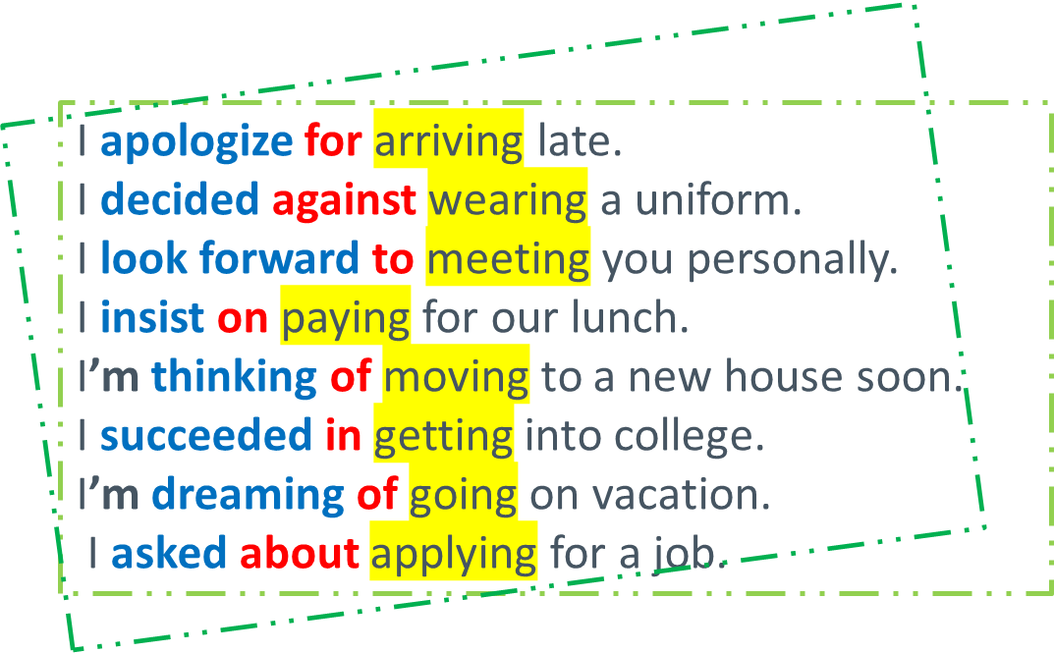
Preposition + Gerund
l apologized to Allison. (noun)
I apologized for forgetting her graduation day . (gerund)
I apologized to her. (pronoun)
V + Preposition + Gerund

Slide 9
Preposition + Gerund
l apologized to Allison. (noun)
I apologized for forgetting her graduation day . (gerund)
I apologized to her. (pronoun)
Some adjectives are followed by certain prepositions.
I’m tired of waiting for an answer.
I’m used to having coffee at breakfast.

Slide 10


Practice Time

Slide 11


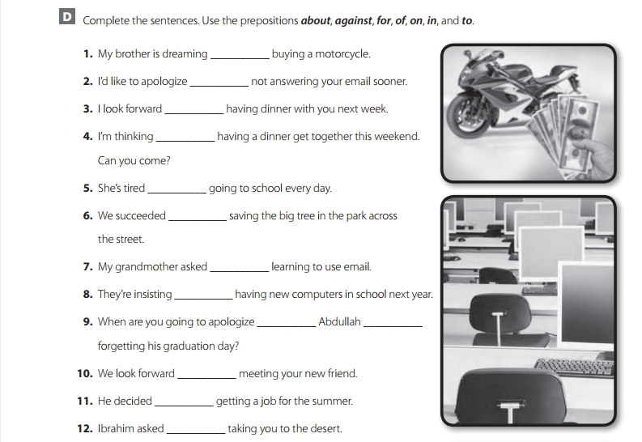
Work Book
p98
of/about
for
to
of
of
in
about
on
to
for
to
against
about

Slide 12
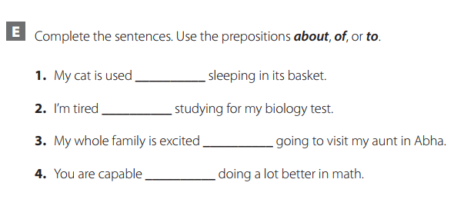
Although, Even Though, In Spite Of
Although it rained, we enjoyed the vacation.
In spite of the traffic, I arrived on time.
Even though I was tired, I couldn’t sleep.
He went to school in spite of being sick.
to
of
about
of

Slide 13
Practice Time
Although, Even Though, In Spite Of
a clause that has a subject and a verb
Although it rained, we enjoyed the vacation.
Even though I was tired, I couldn’t sleep.
He went to school in spite of being sick.
In spite of the traffic, I arrived on time.
gerund
noun

Slide 14
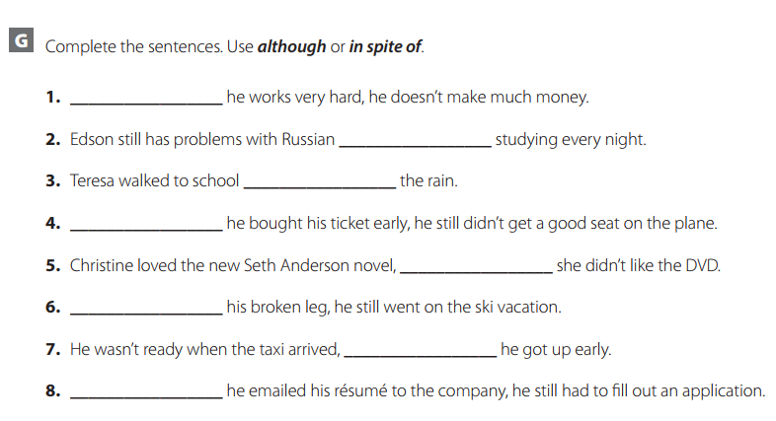
Work Book
p99
Practice Time
Although
in spite of
in spite of
Although
although
in spite of
although
Although

Slide 15
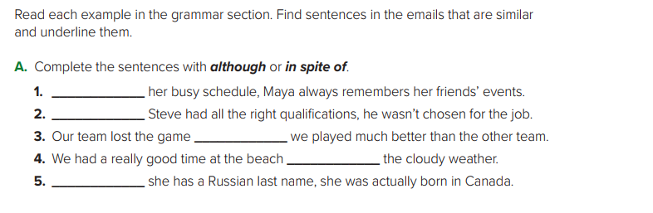
As Soon As, When
Student Book
p34
I’ll tell you as soon as I know.
I’ll call you when I arrive.
In spite of
Although
although
in spite of
Although

Slide 16
As Soon As, When
I’ll tell you as soon as I know.
I’ll call you when I arrive.
Present
The noise was so loud (that) we could hardly hear ourselves talk.
There were so many cars (that) we couldn’t find a place to park.

Slide 17
Practice Time

Slide 18
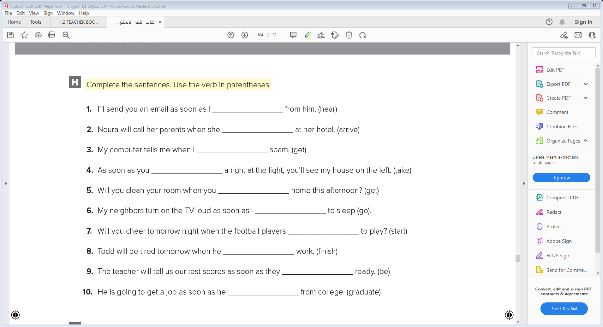
Work Book
p100
hear
arrives
get
take
get
go
start
finishes
are
graduates

Slide 19
So … (That)
The noise was so loud (that) we could hardly hear ourselves talk.
There were so many cars (that) we couldn’t find a place to park.
Express result
Express degree
Use so with an adjective or with many, much, few, or little to express result or degree

Slide 20
Practice Time

Slide 21
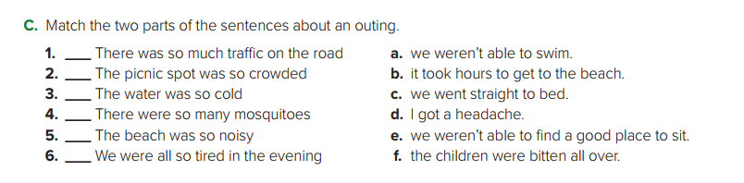
Student Book
p35
b
e
a
f
d
c

Slide 22


