Slide 1


Slide 2


Slide 3


Unit -3-
You’ve Got Mail!
8-Conversation

Slide 4

Revision
9-Reading

Slide 5


Revision
Fill in the blanks with correct words:
No way!
Dear Mr.
Best regard
arriving
1 – is a way to end emails .
Best regard
2 – I apologize for late .
arriving
3 – is used to say you won’t allow something .
No way!
4 – is a way to start emails .
Dear Mr.

Slide 6


Warm Up
Objectives
Recognize sentences about means of communication.
List means of communication.
Illustrate how drummer simulate speech .
Explain the reasons Tomlinson want to develop email.
Demonstrate the meaning of ( @ ).
Find the meaning of new words in the text .

Slide 7

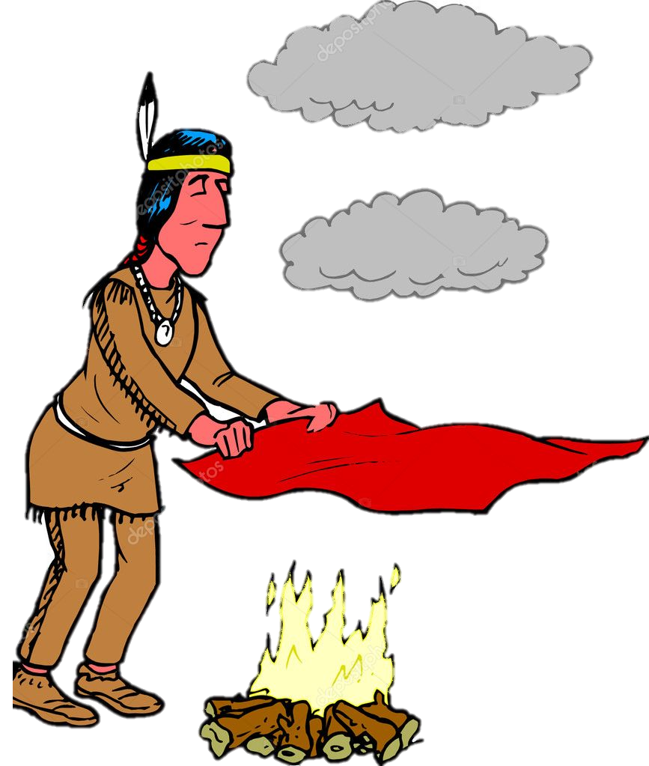

Warm Up
What does this man do ?
Students Book
P38-39
Why does he do that ?

Slide 8

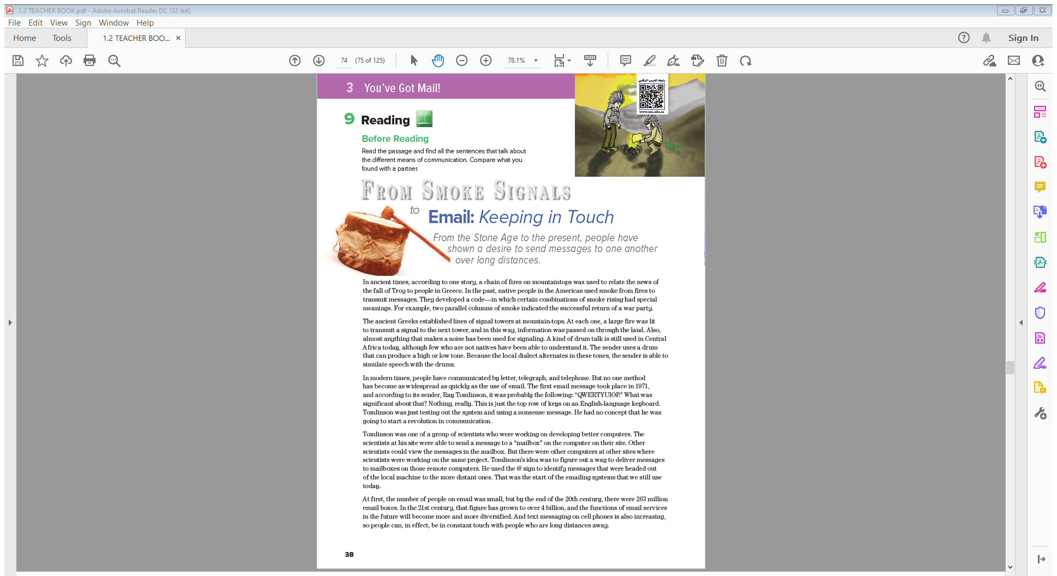
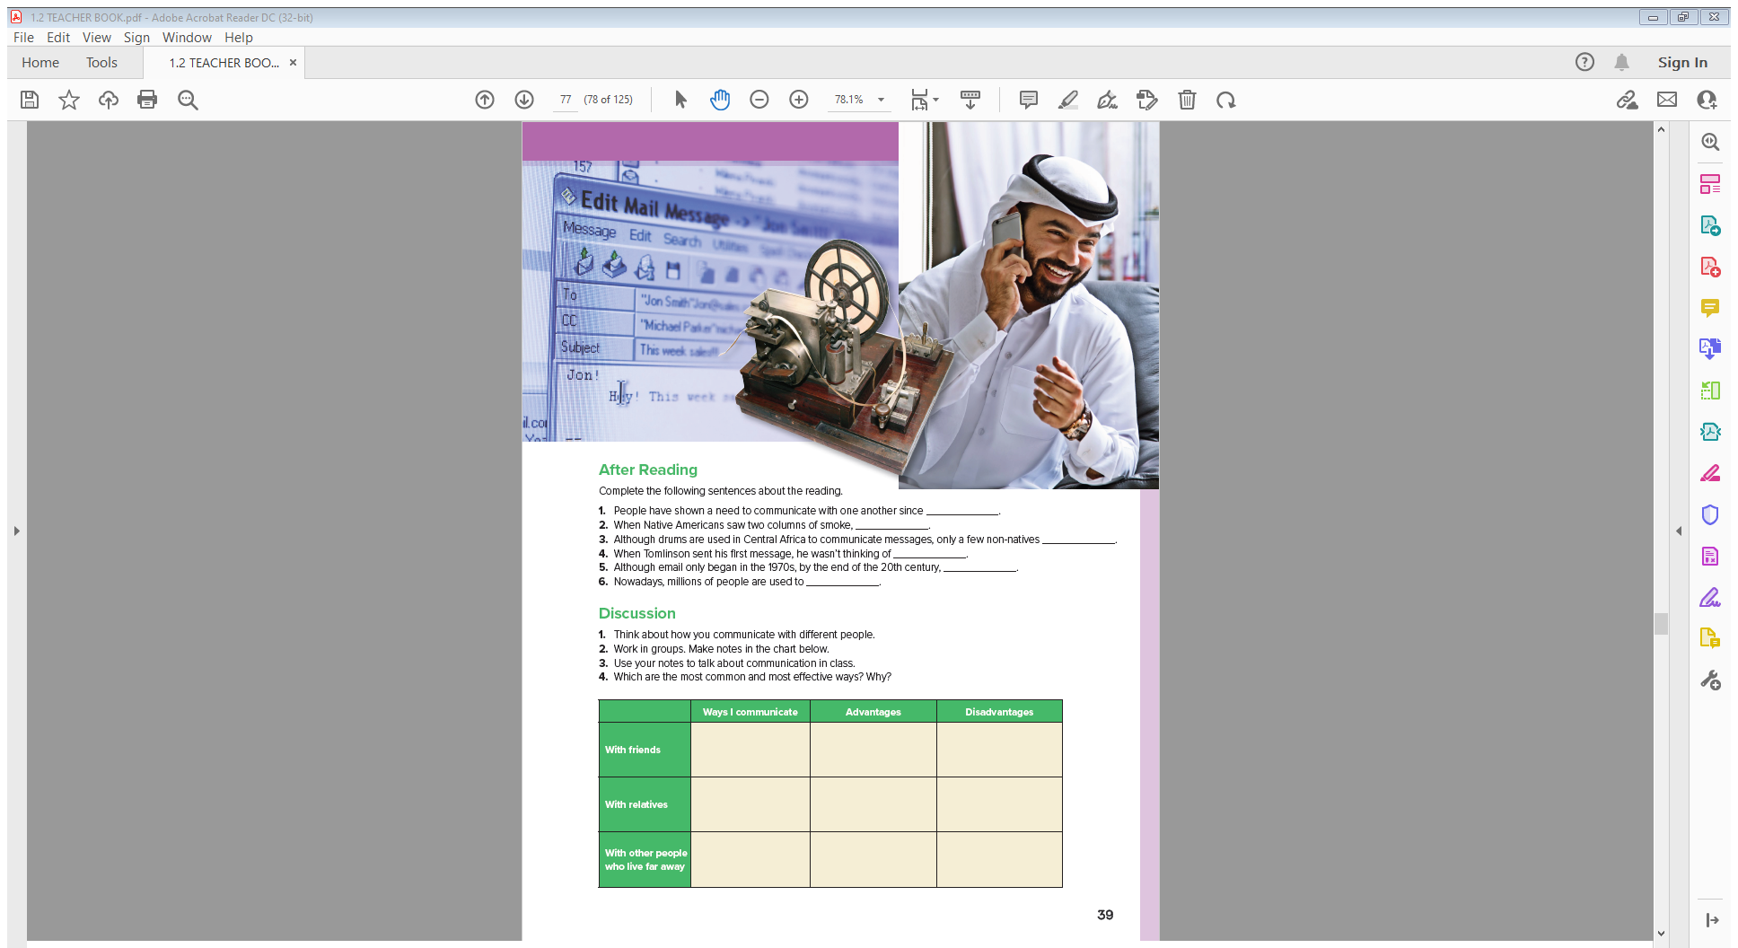
Students Book
P38-39

Slide 9


Skimming
,,,,,title?
,,,,,Paragraphs?
,,,,,photos

Slide 10

listen
Notes:
Language Builder
Explain that to transmit messages means to send them
from one place to another. Write on the board: trans- =
across, through. Give examples of words with this prefix.
For example:
transport = to carry across
transatlantic = across the Atlantic Ocean
transcend = to climb across
Have students use their dictionaries to find more words
with the prefix trans-.

Slide 11
Scan
,,,,,forms of Communications?
Unfamiliar words?
parallel =
dialect
simulate =
widespread =
revolution =
nonsense =
sites =
Notes:
parallel = extending in the same direction
dialect = variety of a language spoken by people in a
geographical area
simulate = assume the likeness of
widespread = over a large area
revolution = big change
nonsense = without meaning
sites = locations

Slide 12
Read & listen
What does the reading say about fire and signaling?
How does the drummer simulate speech?
(Why did Tomlinson want to develop email?
(Why did Tomlinson use @?
Does the author of the article think email will
become even more popular?
Notes:
What does the reading say about fire and signaling?
(fire was used in ancient Greece to pass information
through the land)
How does the drummer simulate speech?
(by changing the tone)
Why did Tomlinson want to develop email?
(to communicate with other scientists working
with him)
Why did Tomlinson use @? (to signal that messages
were for the distant computers)
Does the author of the article think email will
become even more popular? (yes)

Slide 13

Quick Check

Slide 14
After Reading
Complete the following sentences about the reading.
1. People have shown a need to communicate with one another since ____________.
2. When Native Americans saw two columns of smoke, ____________.
3. Although drums are used in Central Africa to communicate messages, only a few non-natives ____________.
4. When Tomlinson sent his first message, he wasn’t thinking of ____________.
5. Although email only began in the 1970s, by the end of the 20th century, ____________.
6. Nowadays, millions of people are used to ____________.
the stone Age
the knew that a war party was returning and that it was successful
can understand the drum language
starting a revolution in communication
there were 263 million email boxes
being in constant touch with people who are long distances away
Notes:
يضض

Slide 16


