Slide 1


Slide 2


Slide 3


Unit -3-
You’ve Got Mail!
8-Conversation

Slide 4
8-Conversation

Slide 5

Objectives
Listen to the audio.
Skim the text
Scan the text
Use real talk phrases in a conversation .
Ask and answer questions about conversation details.
Share positively in pair work.

Slide 6


Underline the words that have short e, a, and i..
Revision
Ahmed: Abdullah, thanks for inviting me to your graduation
event. I was really looking forward to next Thursday
night, …
Abdullah: I’ve been planning this event for ages! You’re
coming, aren’t you?
Ahmed: Well, Abdullah, I’m calling you up to explain.
Unfortunately I’m not going to be able to make it.
Abdullah: No way! I refuse to accept that. I insist on your coming.
Ahmed: I’m sorry, I really am. You see, it’s my uncle’s wedding,
and they’re having the whole family over for dinner.
They expect me to be there, and I can’t let
them down.
Abdullah: So, sneak out as soon as the dinner’s over.
Ahmed: I can’t just walk out like that.
Abdullah: Of course you can.

Slide 7




Skimming
Where is he?
Ahmed: Abdullah, thanks for inviting me to your graduation
event. I was really looking forward to next Thursday
night, …
Abdullah: I’ve been planning this event for ages! You’re
coming, aren’t you?
Ahmed: Well, Abdullah, I’m calling you up to explain.
Unfortunately I’m not going to be able to make it.
Abdullah: No way! I refuse to accept that. I insist on your coming.
Ahmed: I’m sorry, I really am. You see, it’s my uncle’s wedding,
and they’re having the whole family over for dinner.
They expect me to be there, and I can’t let
them down.
Abdullah: So, sneak out as soon as the dinner’s over.
Ahmed: I can’t just walk out like that.
Abdullah: Of course you can.
Who is he talking to?
How does he feel?
What is he saying?

Slide 8


Listen
Ahmed: Abdullah, thanks for inviting me to your graduation
event. I was really looking forward to next Thursday
night, …
Abdullah: I’ve been planning this event for ages! You’re
coming, aren’t you?
Ahmed: Well, Abdullah, I’m calling you up to explain.
Unfortunately I’m not going to be able to make it.
Abdullah: No way! I refuse to accept that. I insist on your coming.
Ahmed: I’m sorry, I really am. You see, it’s my uncle’s wedding,
and they’re having the whole family over for dinner.
They expect me to be there, and I can’t let
them down.
Abdullah: So, sneak out as soon as the dinner’s over.
Ahmed: I can’t just walk out like that.
Abdullah: Of course you can.

Slide 9

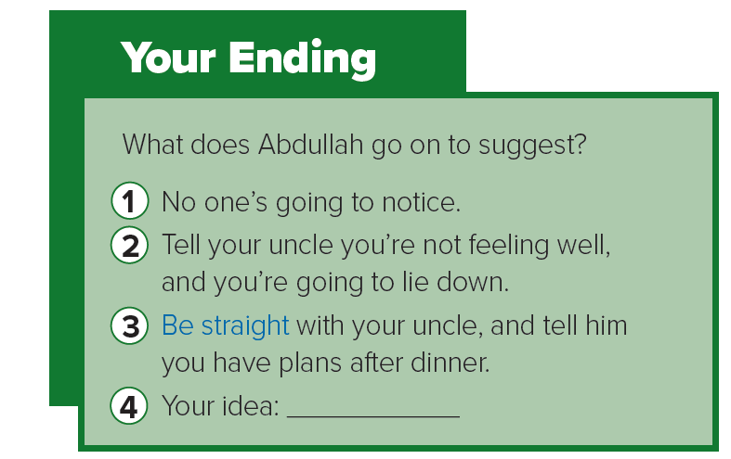
Scan
….for two- and three word
Verbs.
Ahmed: Abdullah, thanks for inviting me to your graduation
event. I was really looking forward to next Thursday
night, …
Abdullah: I’ve been planning this event for ages! You’re
coming, aren’t you?
Ahmed: Well, Abdullah, I’m calling you up to explain.
Unfortunately I’m not going to be able to make it.
Abdullah: No way! I refuse to accept that. I insist on your coming.
Ahmed: I’m sorry, I really am. You see, it’s my uncle’s wedding,
and they’re having the whole family over for dinner.
They expect me to be there, and I can’t let
them down.
Abdullah: So, sneak out as soon as the dinner’s over.
Ahmed: I can’t just walk out like that.
Abdullah: Of course you can.
Ahmed: Abdullah, thanks for inviting me to your graduation
event. I was really looking forward to next Thursday
night, …
Abdullah: I’ve been planning this event for ages! You’re
coming, aren’t you?
Ahmed: Well, Abdullah, I’m calling you up to explain.
Unfortunately I’m not going to be able to make it.
Abdullah: No way! I refuse to accept that. I insist on your coming.
Ahmed: I’m sorry, I really am. You see, it’s my uncle’s wedding,
and they’re having the whole family over for dinner.
They expect me to be there, and I can’t let
them down.
Abdullah: So, sneak out as soon as the dinner’s over.
Ahmed: I can’t just walk out like that.
Abdullah: Of course you can.
excited about
achieve a specific goal
demand
disappoint

Slide 10

Ahmed: Abdullah, thanks for inviting me to your graduation
event. I was really looking forward to next Thursday
night, …
Abdullah: I’ve been planning this event for ages! You’re
coming, aren’t you?
Ahmed: Well, Abdullah, I’m calling you up to explain.
Unfortunately I’m not going to be able to make it.
Abdullah: No way! I refuse to accept that. I insist on your coming.
Ahmed: I’m sorry, I really am. You see, it’s my uncle’s wedding,
and they’re having the whole family over for dinner.
They expect me to be there, and I can’t let
them down.
Abdullah: So, sneak out as soon as the dinner’s over.
Ahmed: I can’t just walk out like that.
Abdullah: Of course you can.

Slide 11


Real Talk
No way! =
let someone down =
Of course =
Be straight =
No way! = used to say you won’t allow something
let someone down = disappoint
Of course = used to give someone permission or encouragement
Be straight = be honest and frank
Quick Check

Slide 12
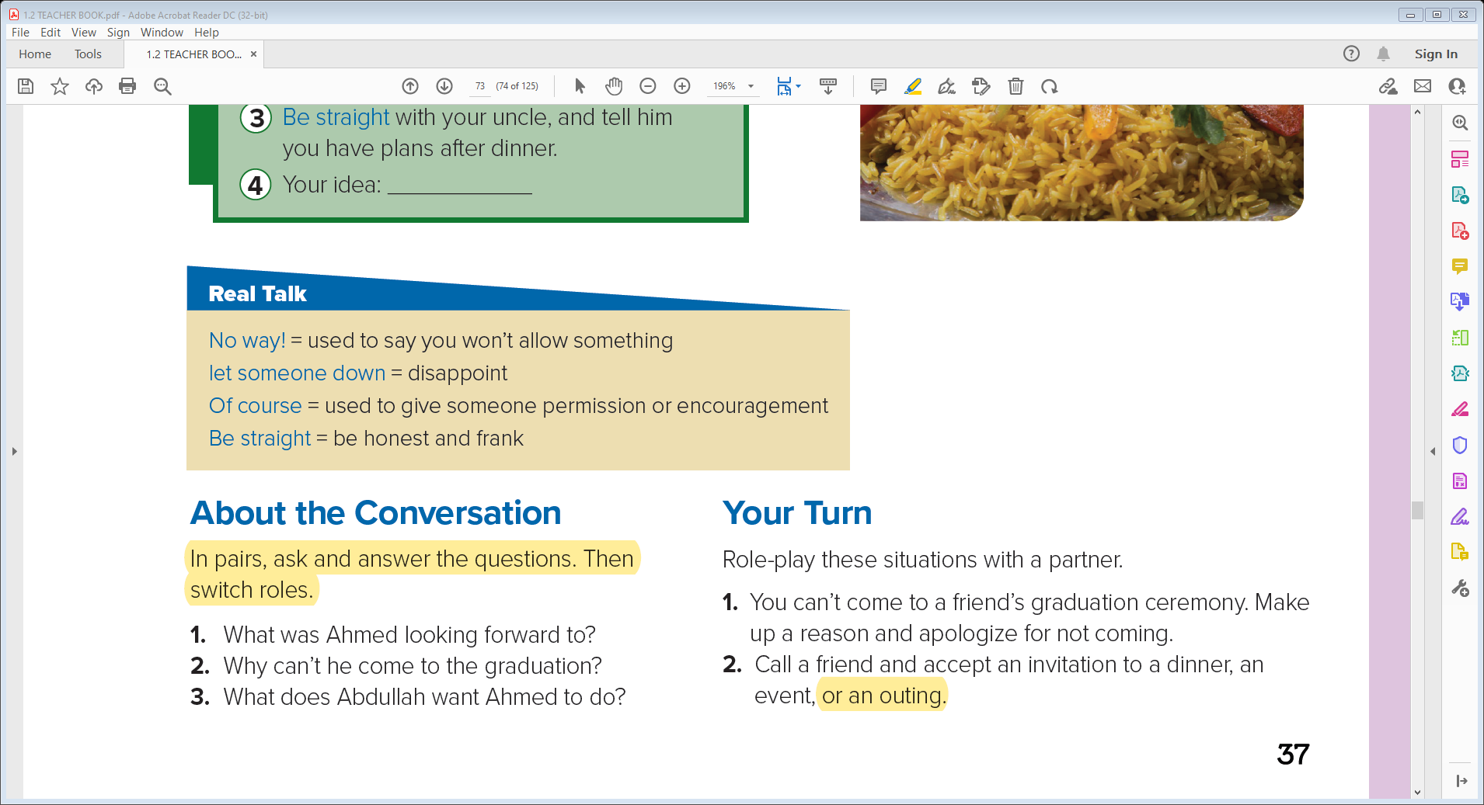
About the Conversation
1- Ahmed was looking forward to going to Abdullah’s graduation event.
2- Ahmed has to go to a family dinner for his parents’ wedding anniversary .
3- He wants Ahmed to leave the dinner early .

Slide 13
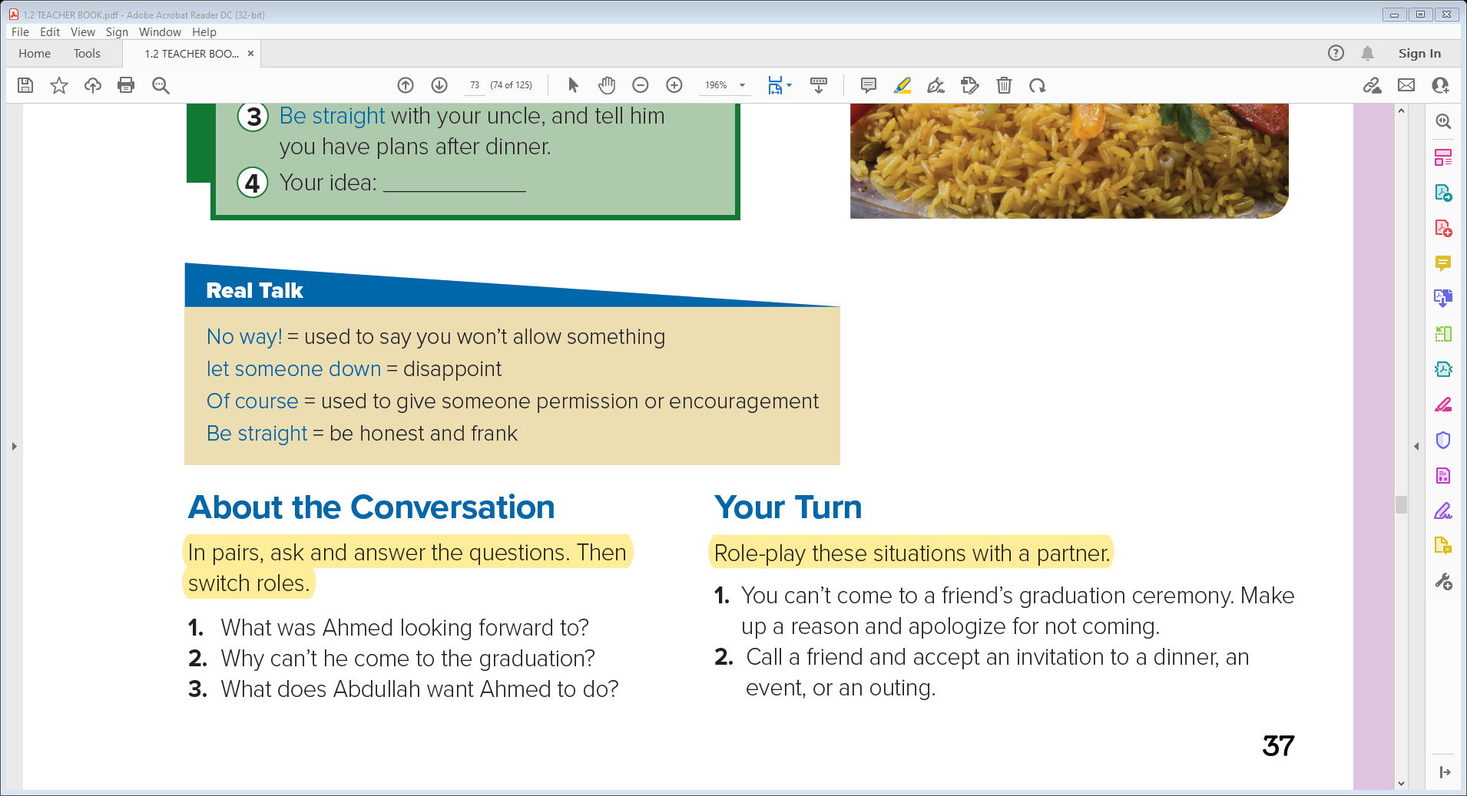
Your Turn

Slide 14
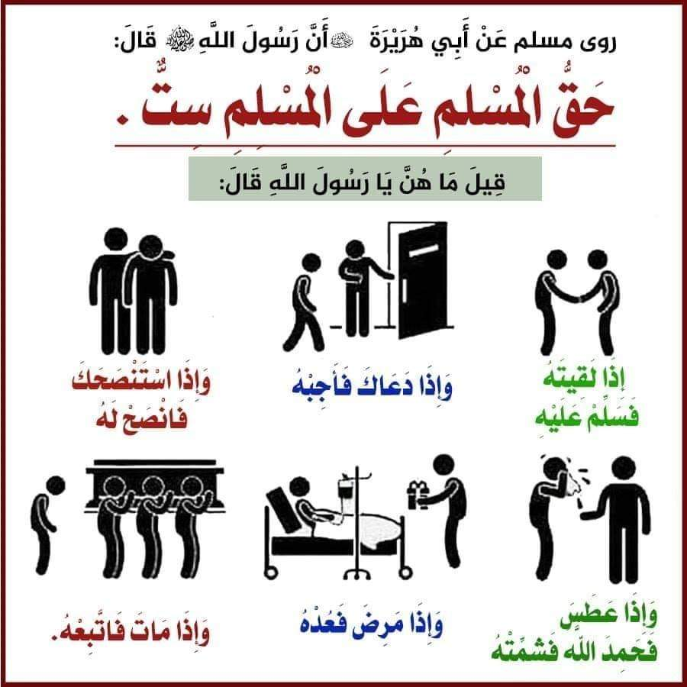

Slide 15


