Slide 1



Slide 2




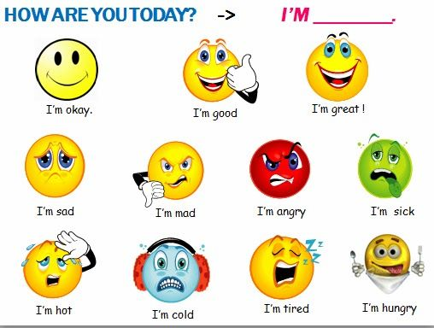
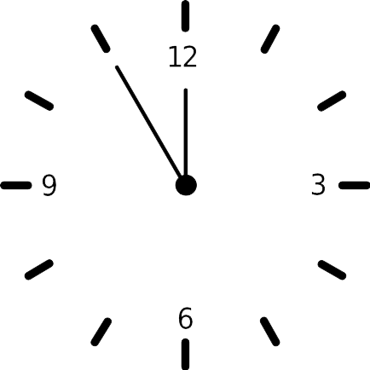
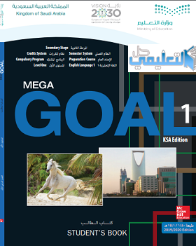

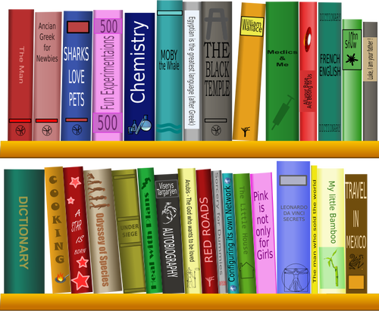

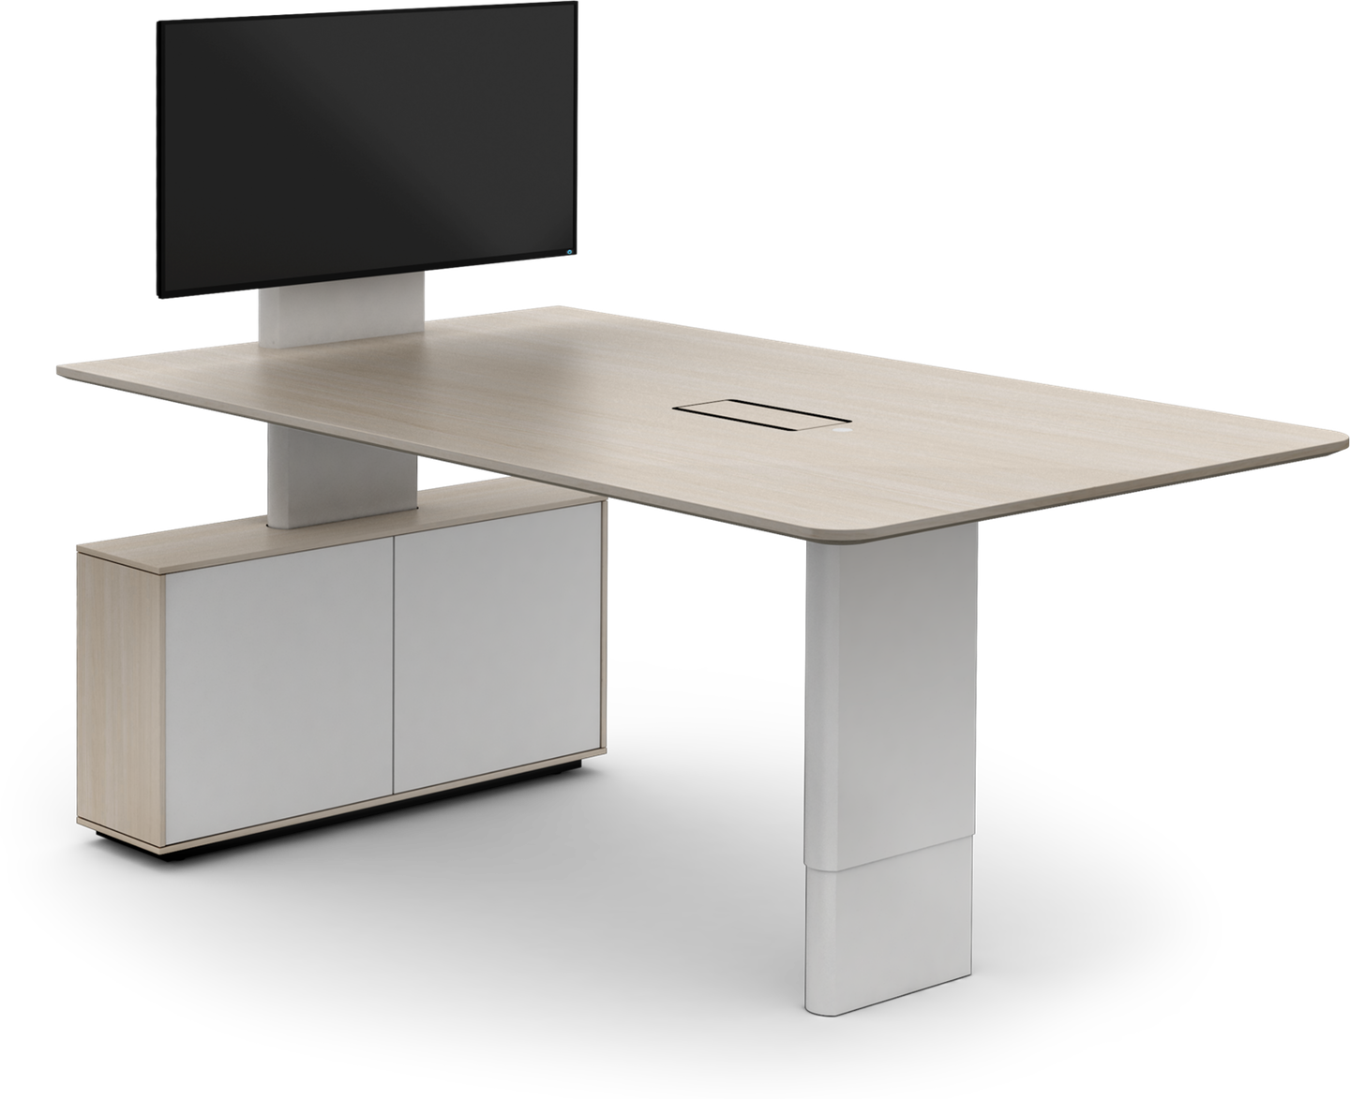
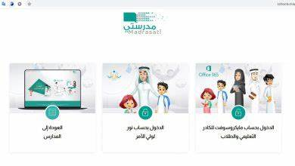


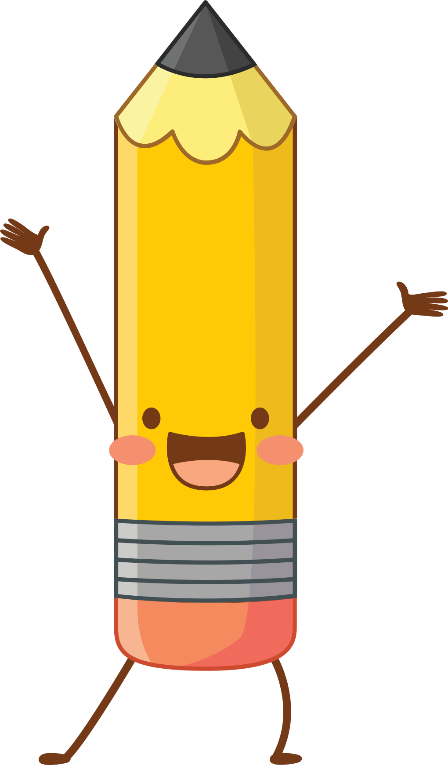



I love English

Slide 3

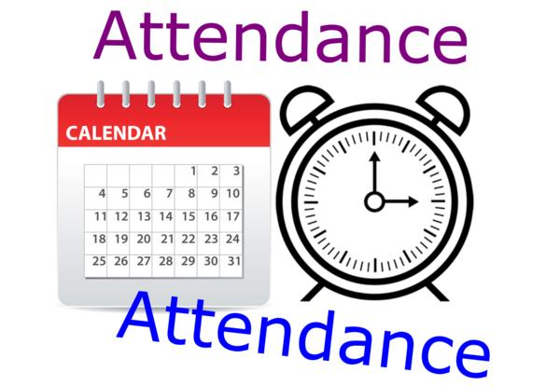
I love English

Slide 4
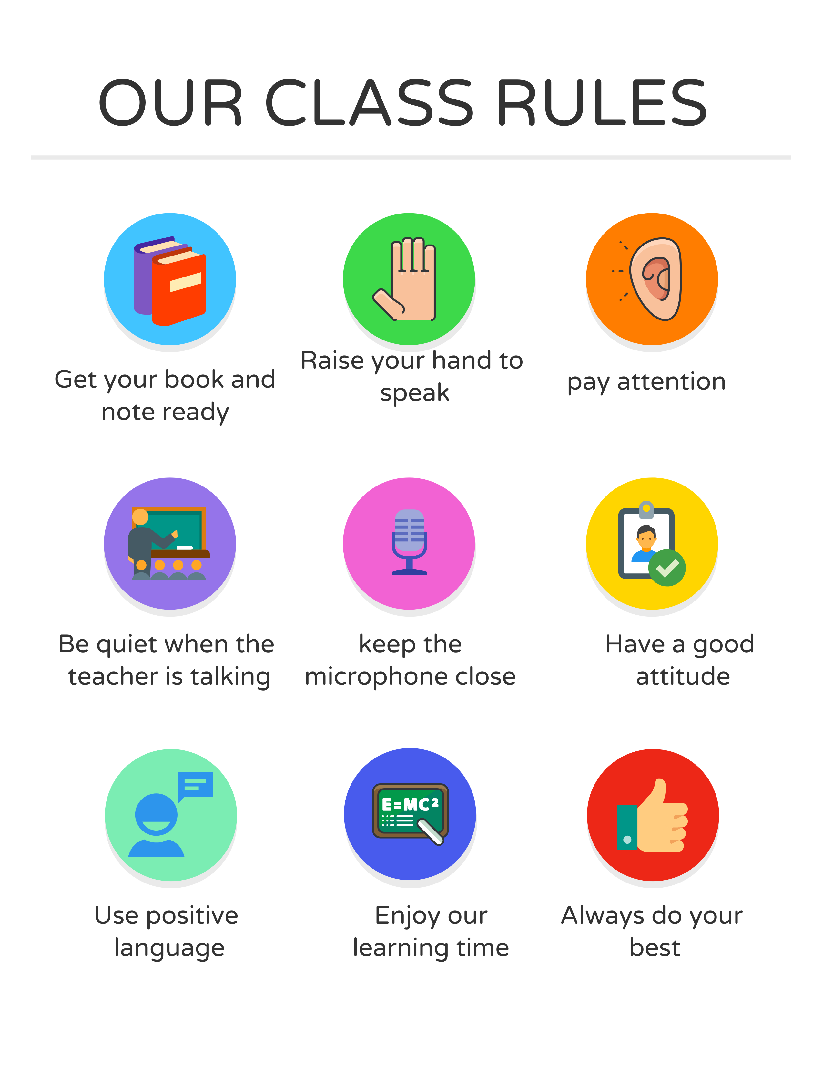

I love English

Slide 5
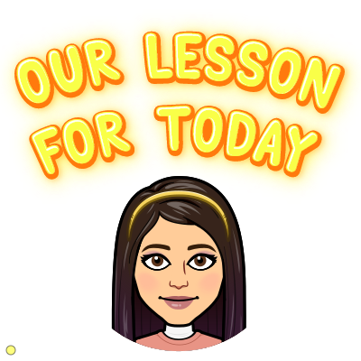

I love English
Mega Goal 1
Unit 6
Project
Sunday
21/4/1442

Slide 6


I love English
Revising the previous lesson
Choose the correct answer:
1- How_____ sugar would you like?
a. many
b. much
2- He has ____ photos on Instagram.
a. few
b. little

Slide 7

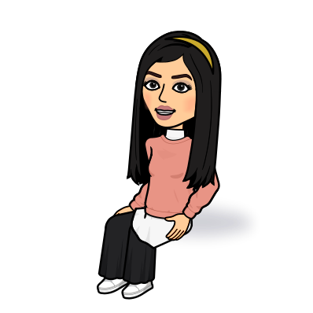
I love English
Lesson Goals
Students will be able to:
Research and find Saudi organizations in their community that provide services.
Write about community resources in their country.
Prepare a poster presentation on the organization

Slide 8

I love English

Slide 9
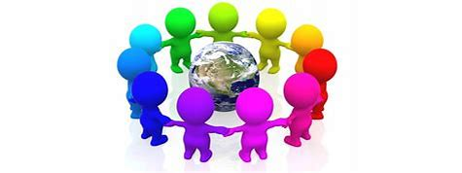
I love English
Warm Up
What does organization mean?
a social unit of people that is structured and managed to meet a need or pursue collective goals.

Slide 10
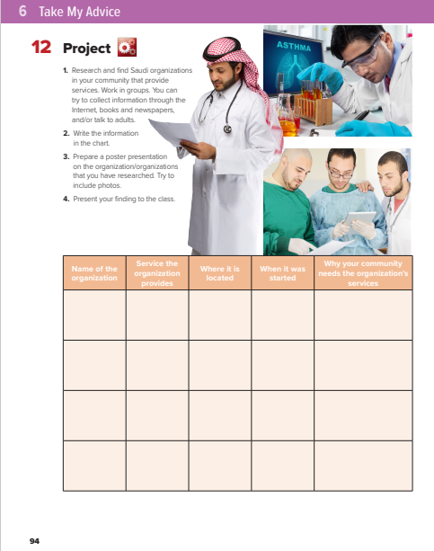

I love English
Open your Student’s book page:94

Slide 11
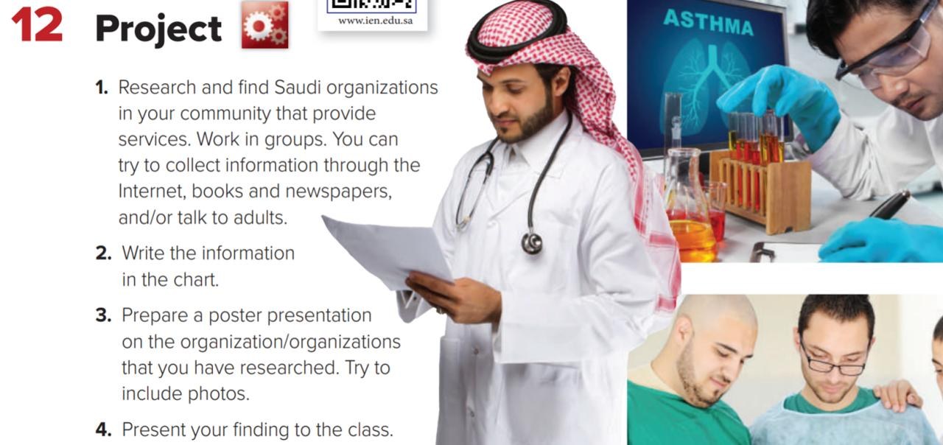
I love English

Slide 12

I love English

Slide 13
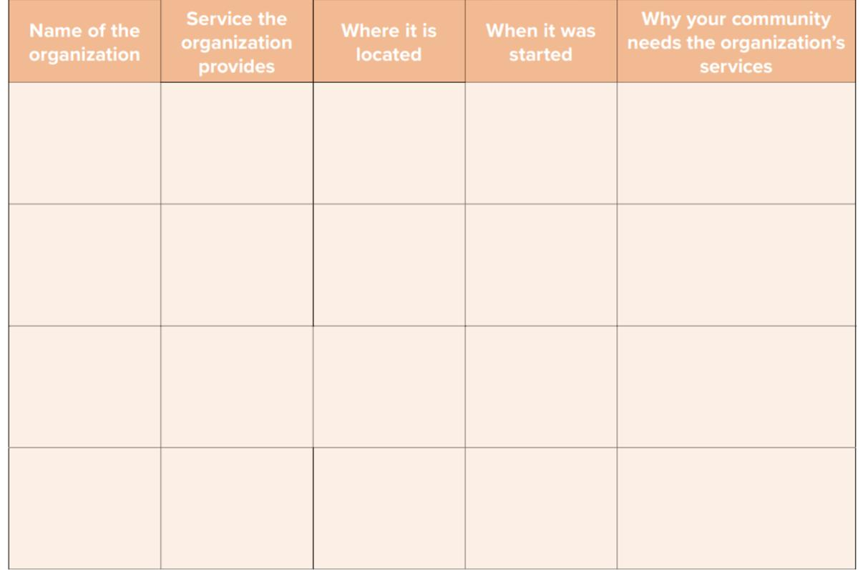

Misk foundation by Prince Mohammed bin Salman
They are focus on 4 main pillars:
1-Education
2-Creative and digital media
3-Techonology
4-Culture and arts
To develop and empower Saudi youth to become active participants in the future economy of the region
In Riyadh
In 2011

Slide 14





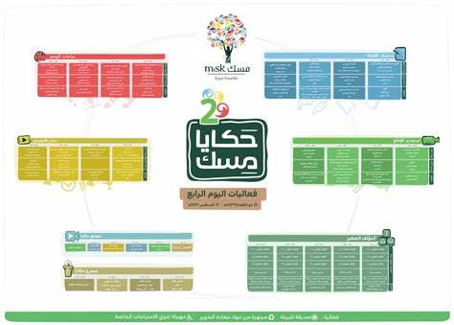
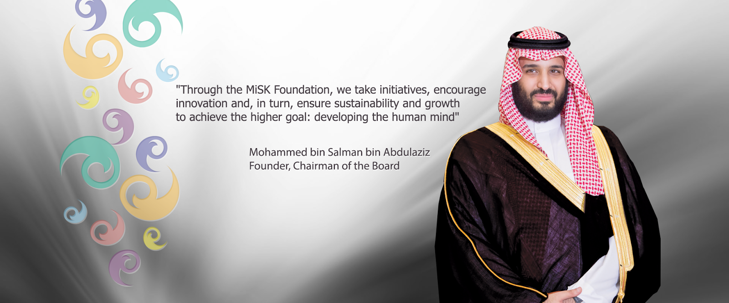

Slide 15
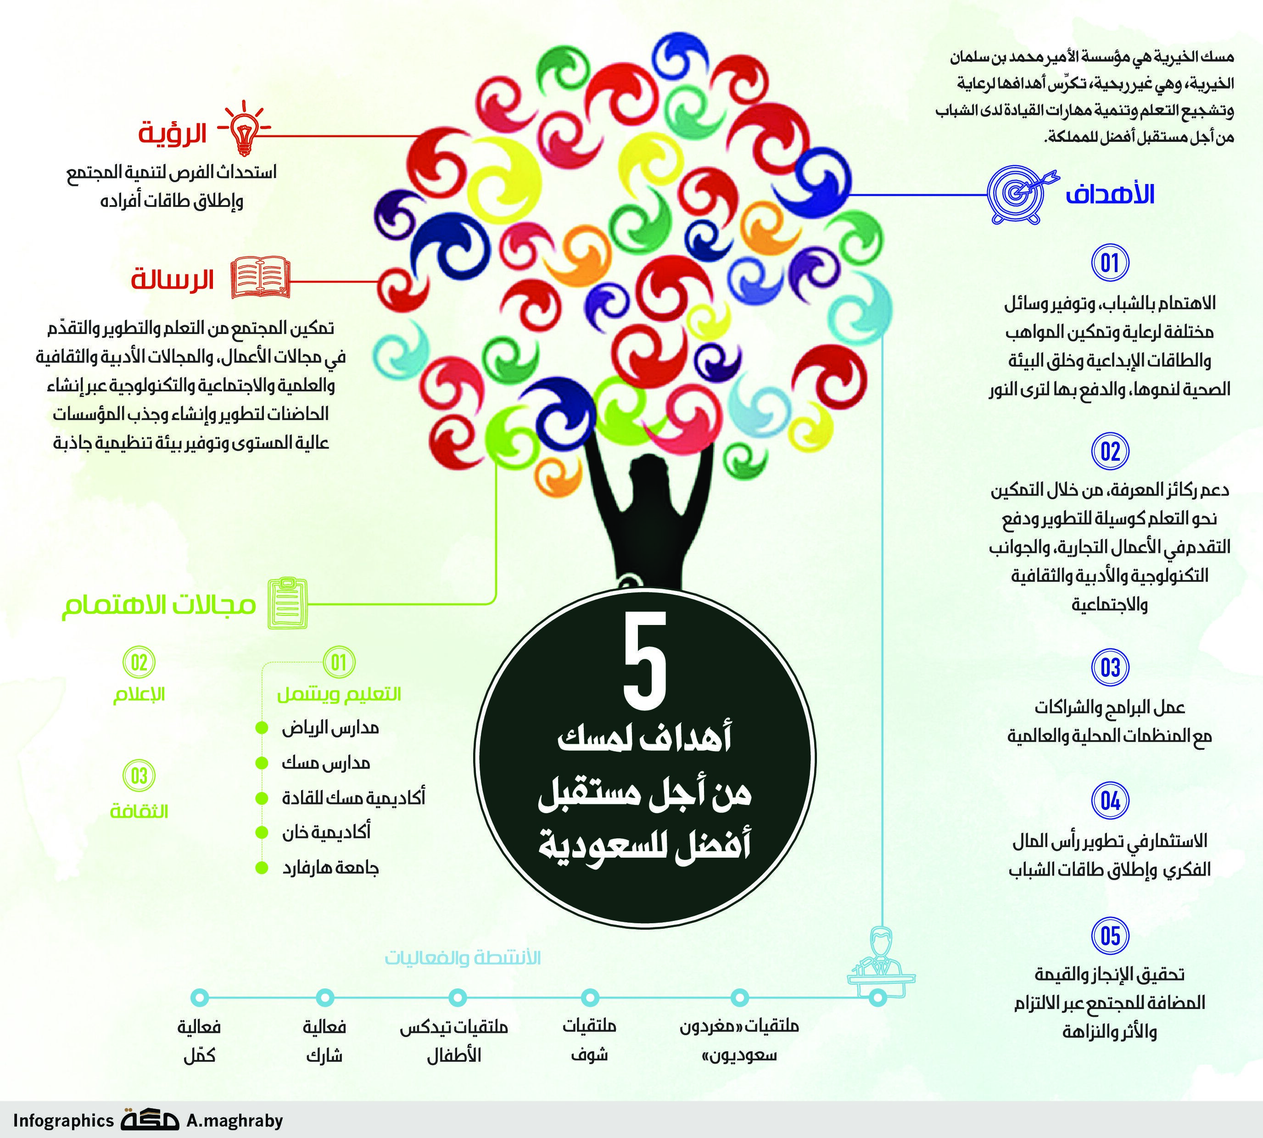
I love English

Slide 16
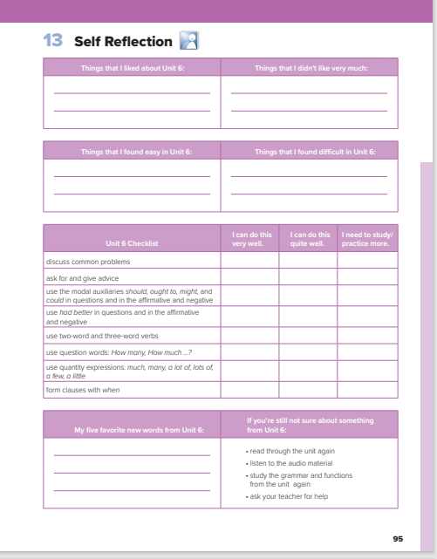
I love English
Open your Student’s book page:95

Slide 17
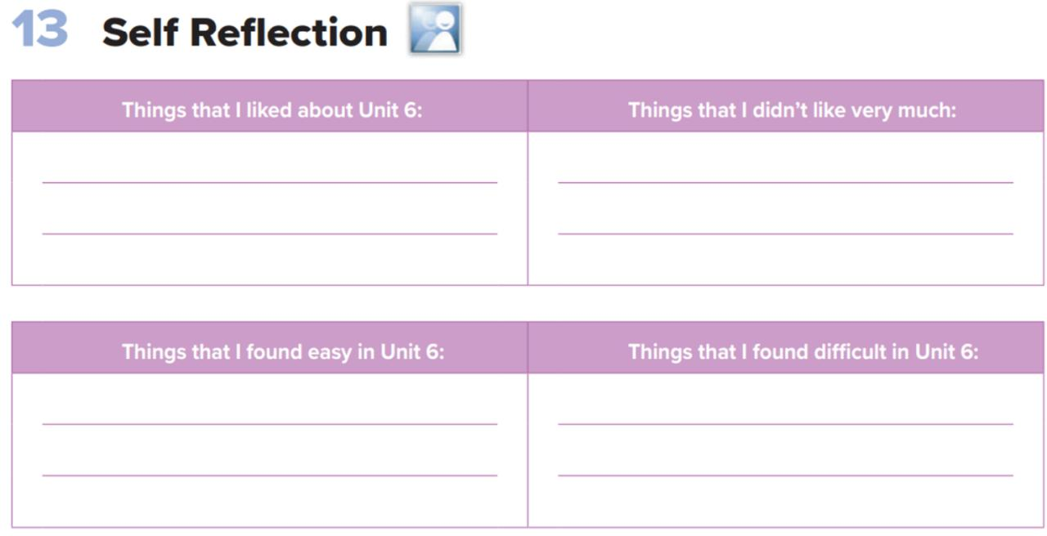
I love English

Slide 18
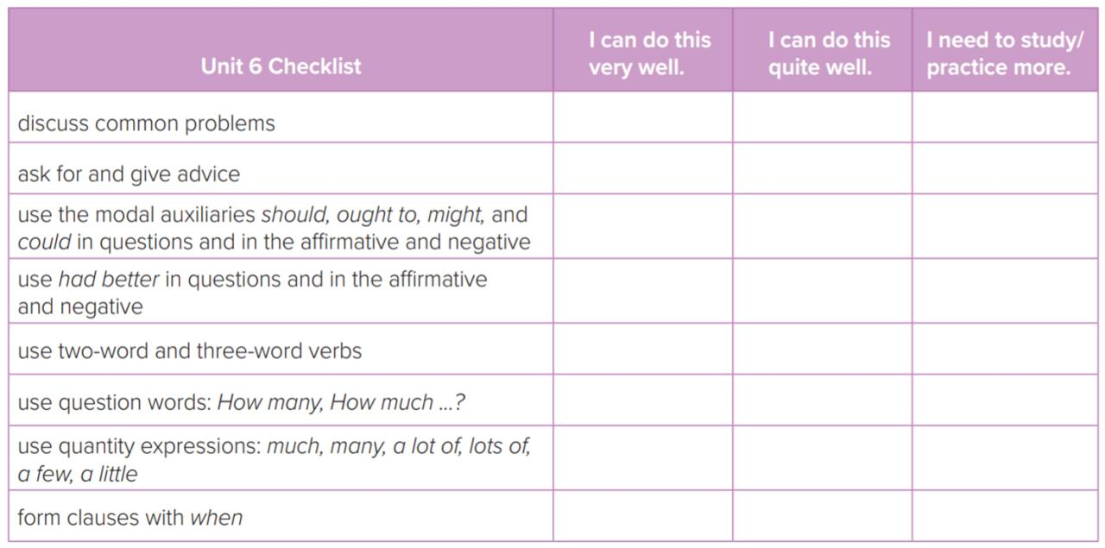
I love English

Slide 19
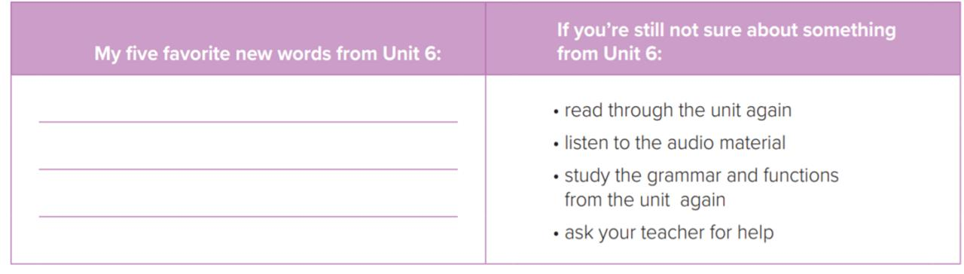
I love English

Slide 20



Homework
I love English

Slide 21

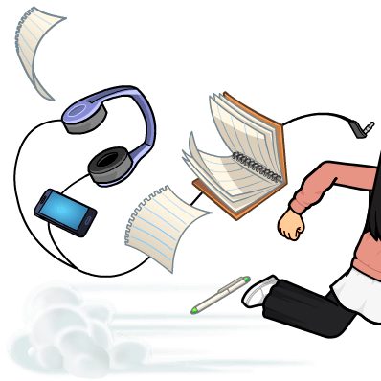
Homework

Slide 22
Homework

Slide 23
Homework

Slide 24
Homework

Slide 25
Homework

Slide 26

Homework

