Slide 1
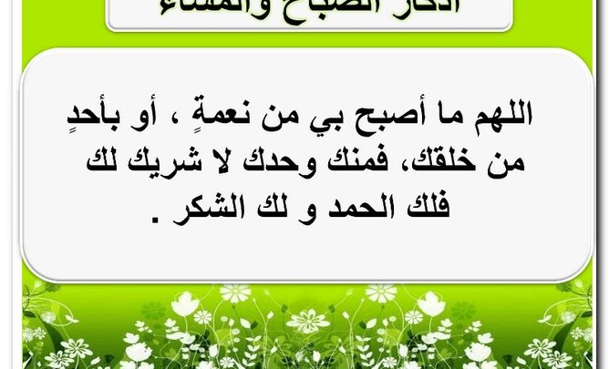

Slide 2


Slide 3
Unit-2
Take My Advice
L-11- Form, Meaning & Function

Slide 4
Question Words:
How many ,
How much,,?
Quantity Expressions:
Much , many ,a lot of ,lots of, a few ,
a little
Words Connected with Medicine
Clauses with When

Slide 5

Objectives:
Ask a question about quantity .
Express quantity in a sentence .
Connect clauses with “ When “ .
Use words connected with medicine .
Share positively in pair work.
Differ between count & noncount nouns.
Form sentences using expressions for count & noncount nouns.

Slide 6

How many…?
How much…?

Slide 7




How many....
How much….
Count nouns
Noncount nouns
We use How many to ask about the plural count nouns.
1- friend friends.
2- brother brothers
3- riyal riyals
We use How much to ask
about the quantity of something we can’t count.
family, money, exercise
Water rice milk

Slide 8

How many sisters do you have?
I have three sisters
How much exercise do you do?
I go to the gym twice a week

Slide 9
Quantity Expressions

Slide 10
Quantity Expressions
Count nouns
Noncount nouns
We use much, a lot of, lots of, a little for noncount nouns
1-How much fruit do you usually eat?
A: I eat a lot of (lots of) fruit every day
2-How much salt do you eat?
I eat little salt. It’s not good for you.
I don’t eat much salt. It’s not good for you.
We use many , a lot of, lots of, a few. For
count nouns.
1-How many vegetables do you eat?
I eat a few green vegetables every day.
I don’t eat many vegetables.

Slide 11

Practice
Time

Slide 12
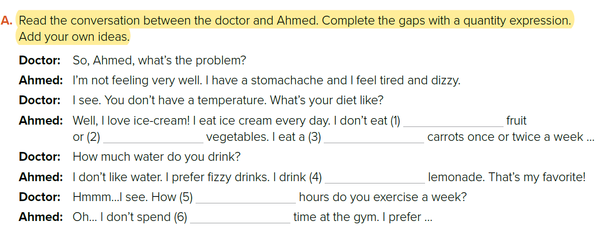

much
many
few
a lot of/ lots of
many
much

Slide 13
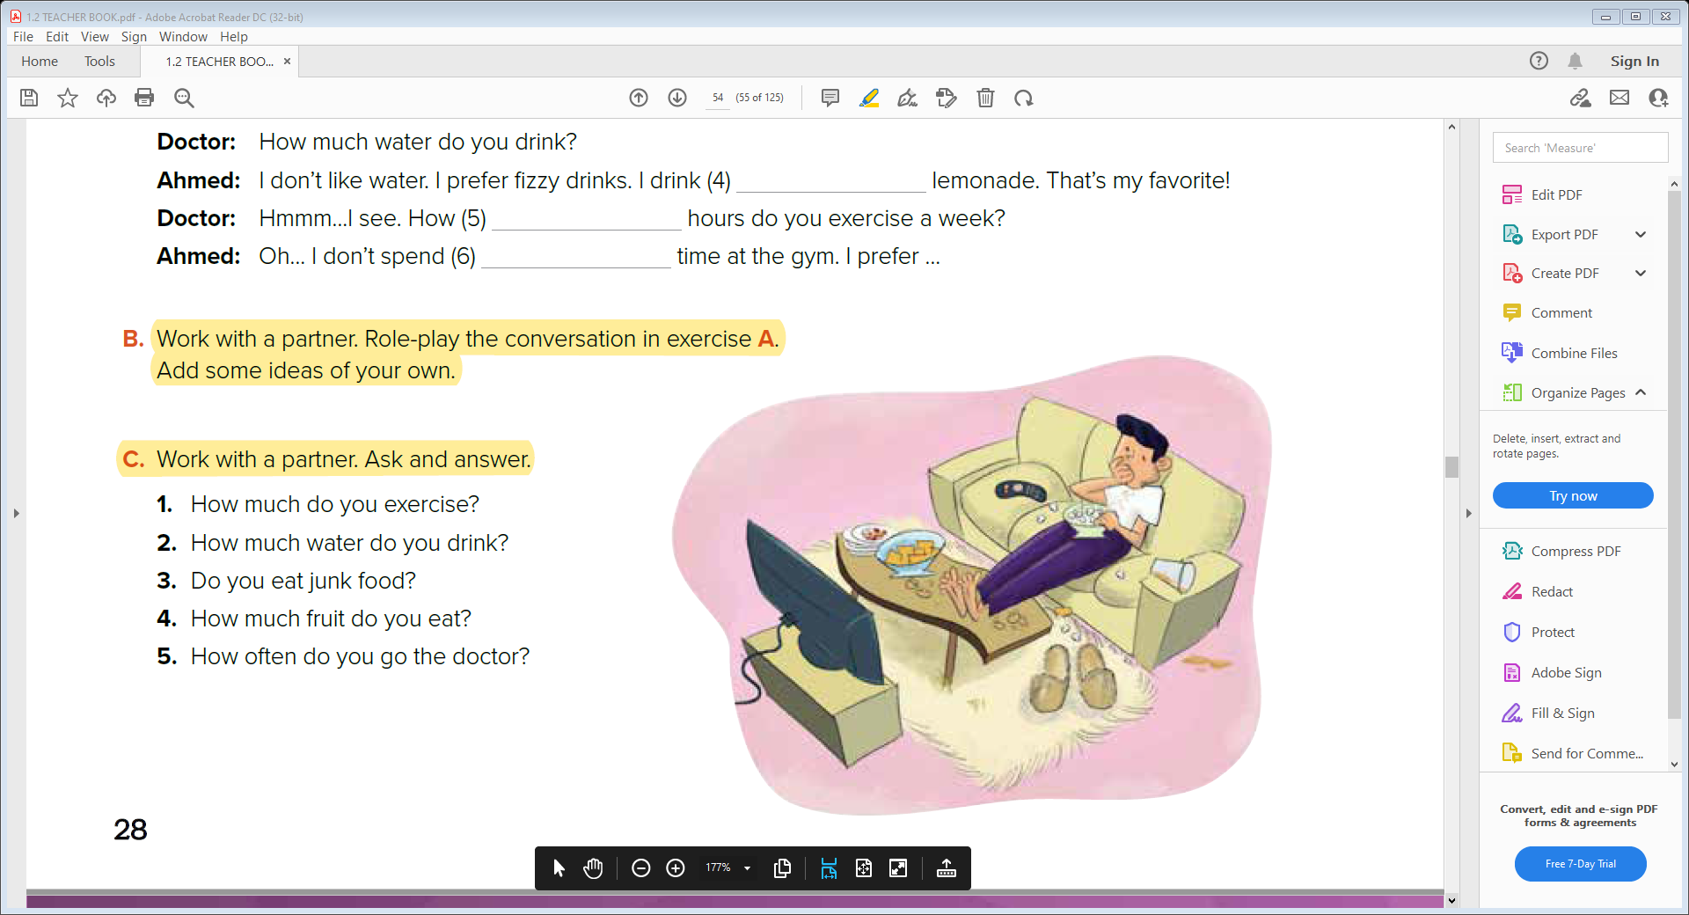


Slide 14
Words Connected with Medicine
Clauses with When

Slide 15
Q: What do you do when you have a cold?
I usually take some aspirin
How do you feel when you exercise?
I feel great!

Slide 16
Practice
Time

Slide 17
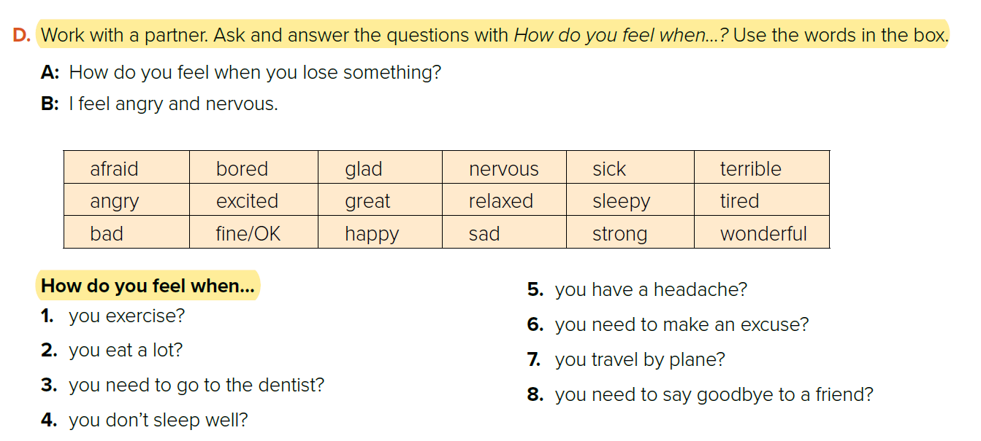
شريحة صورة كبيرة
17
تسمية توضيحية هنا

Slide 18
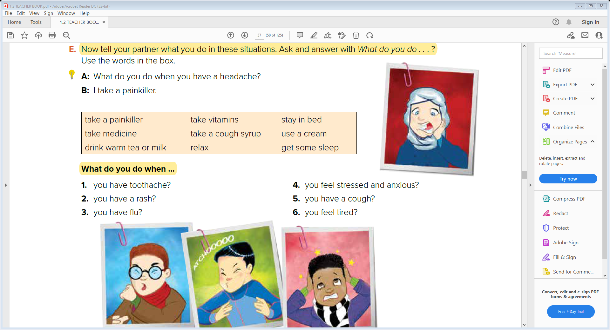

Slide 19


