Slide 1
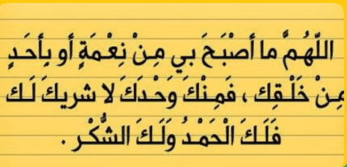

Slide 2


Slide 3

Unit-2-
Take My Advice
9 - Reading

Slide 4


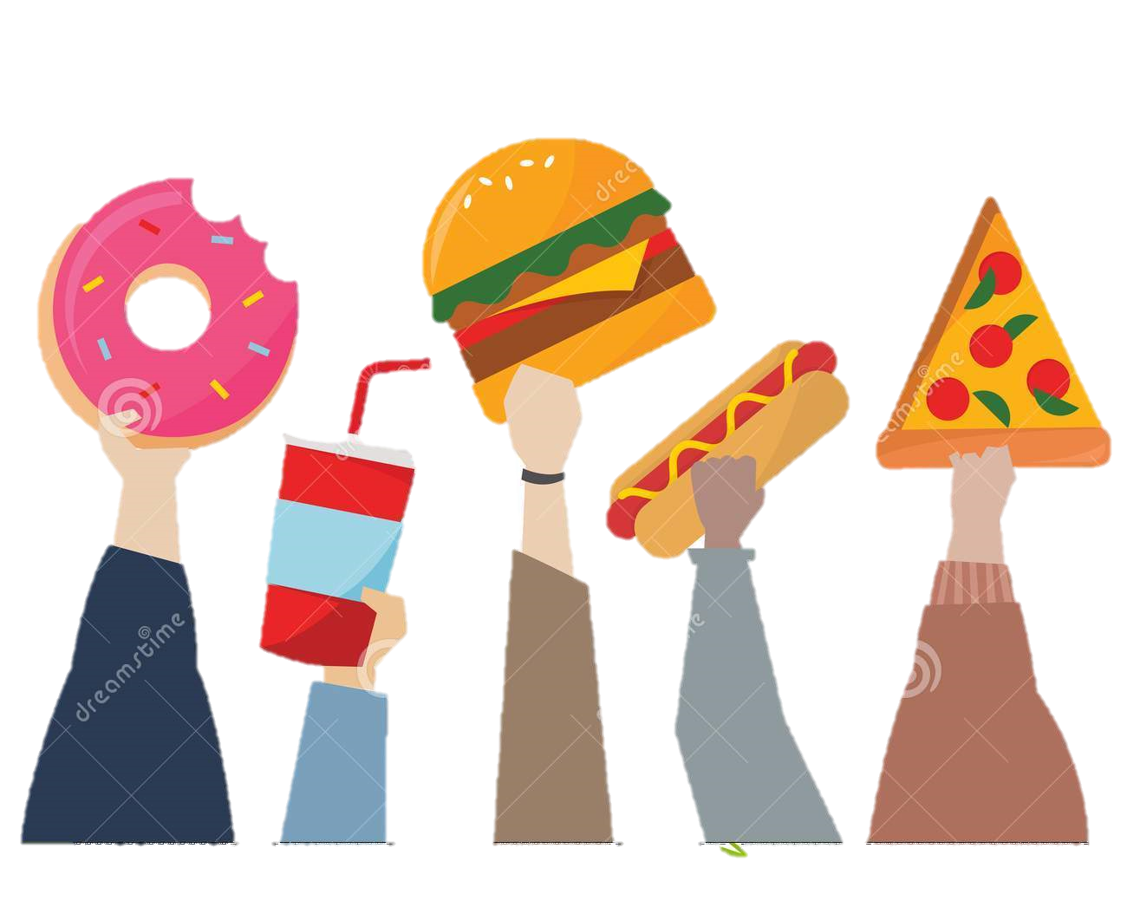
Objectives:
List junk food attractive ingredients .
List factors that led to addiction to junk food .
Find signs of junk food addiction .
Answer some questions.

Slide 5
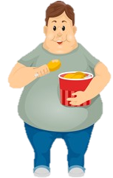
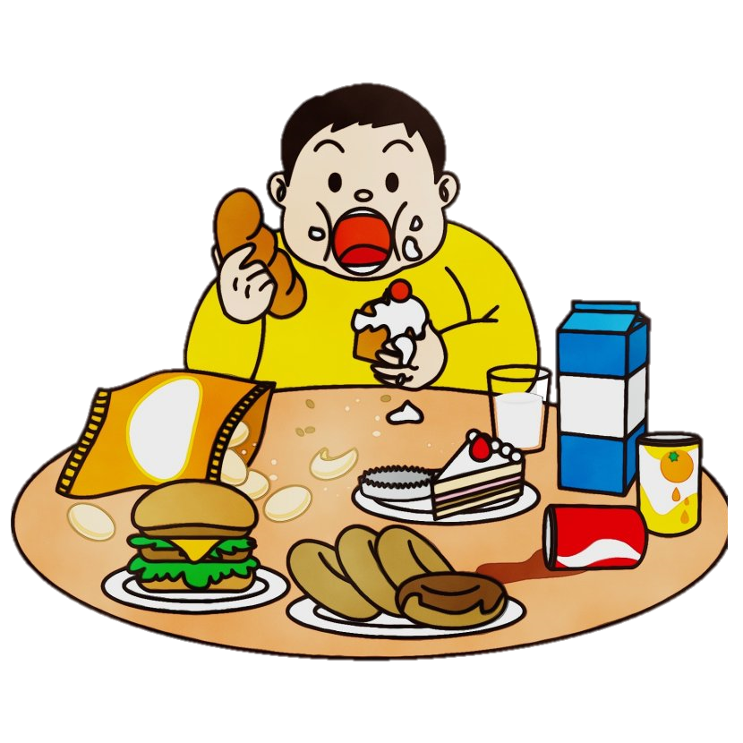
Revision:
What advice do you give them?
What should they do?

Slide 6
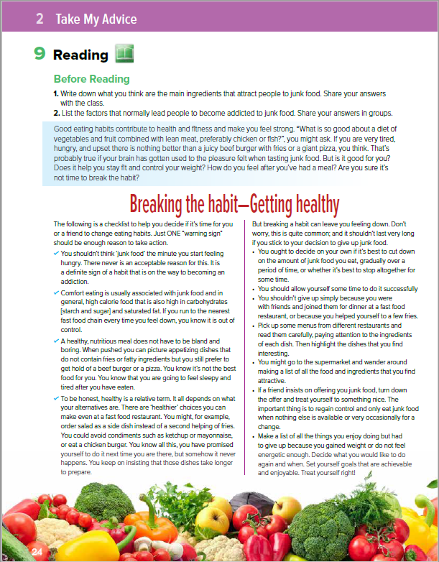

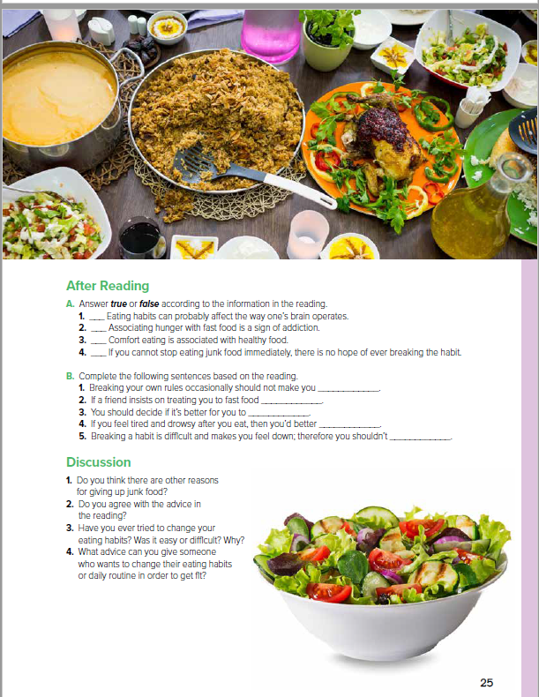
Students Book
p.24-25

Slide 7
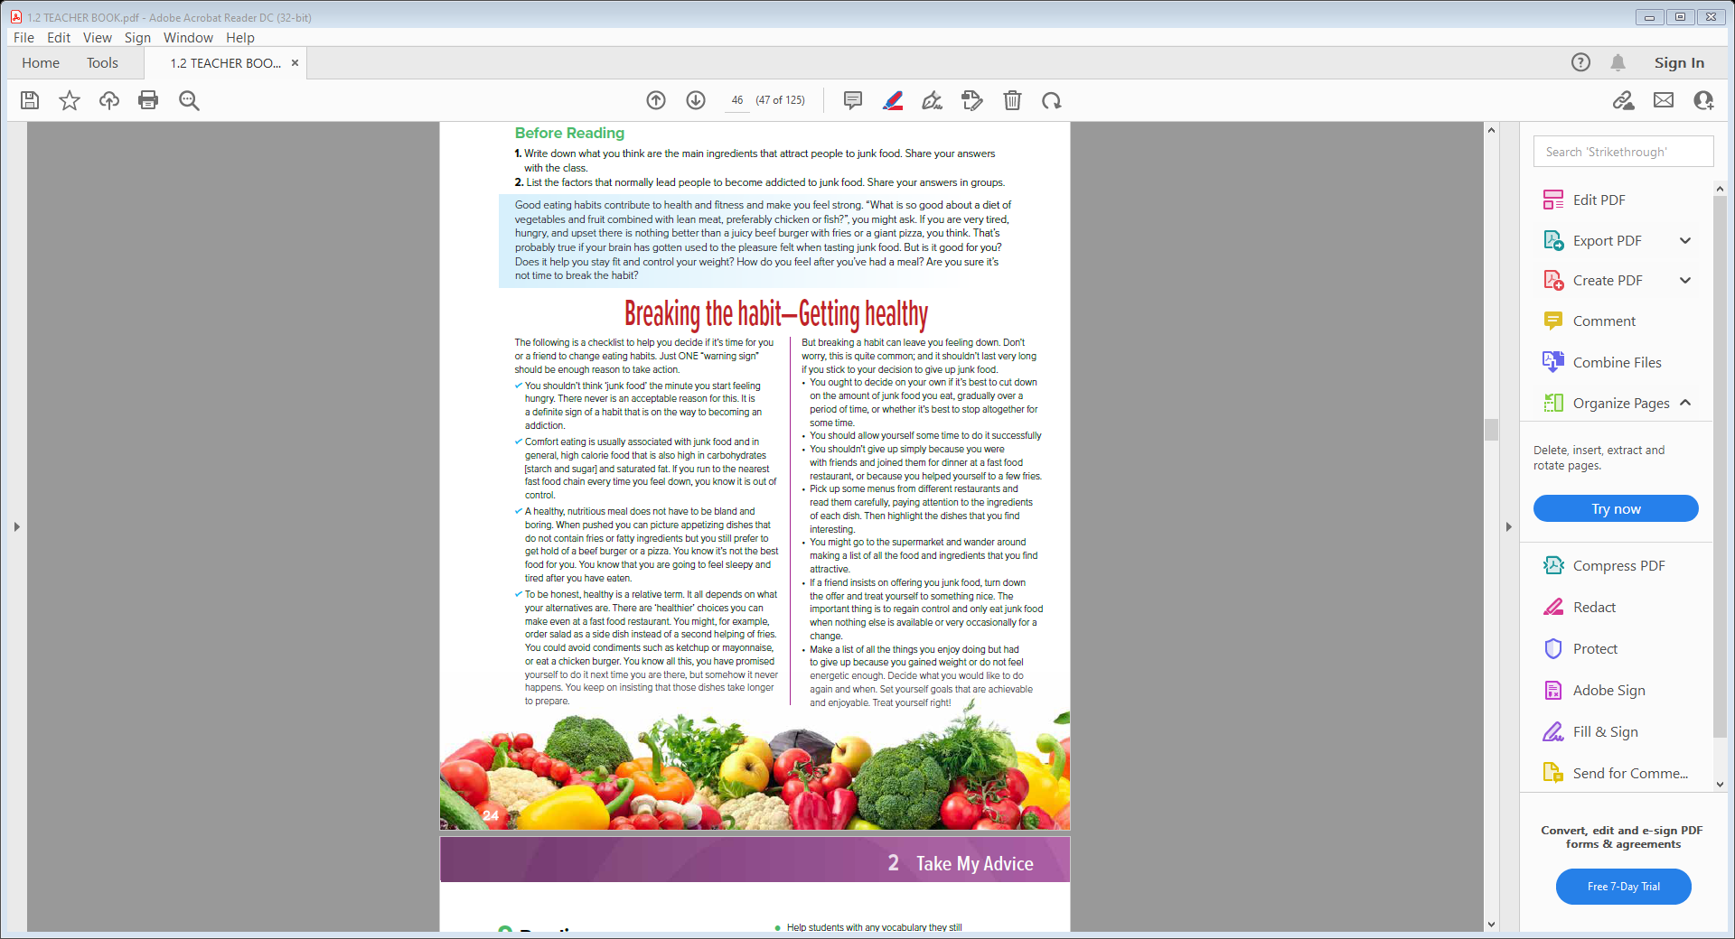
Skimming:
..Sections?
…..title?
..checklist?
..advices?
..vegetables?

Slide 8


Read & Listen

Slide 9
Scanning:
What is diet ?
What is lean meat ?
What is meant by “ checklist “ ?
What is the main idea ?
How is healthy a relative term ?

Slide 10
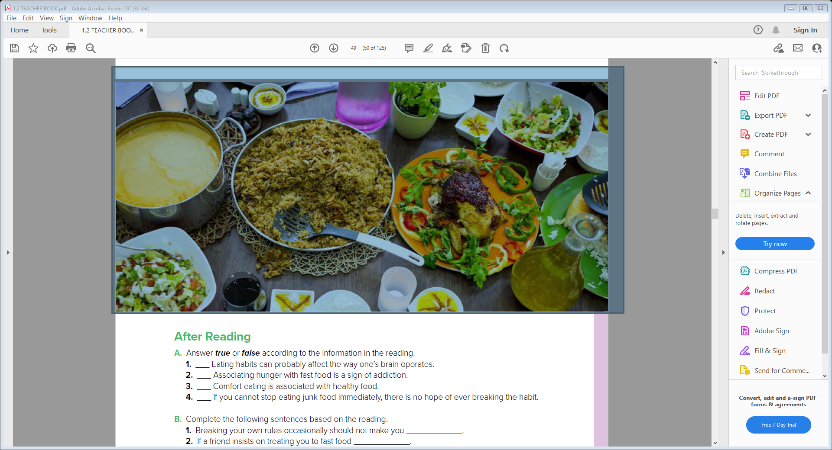
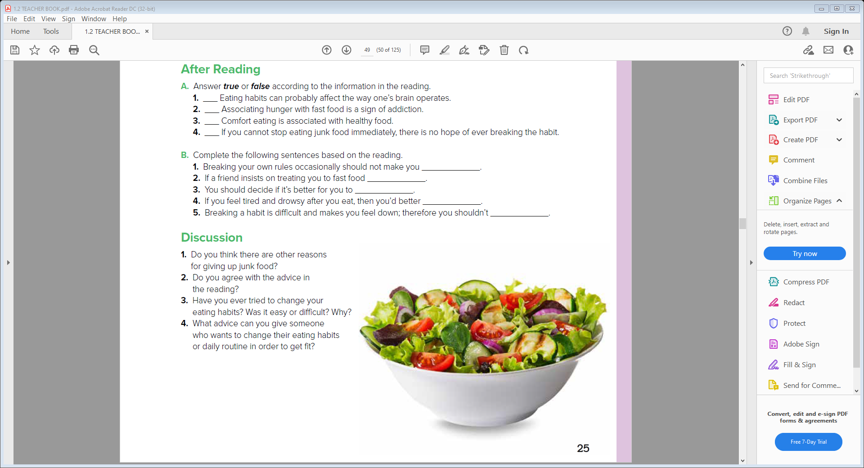
After Reading
true
true
false
false
worry
turn down the offer
cut down food gradually or altogether
change your eating habits
give up

Slide 11


Slide 12


