Slide 1
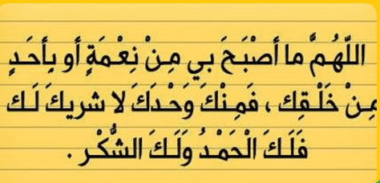

Slide 2


Slide 3
Unit-2-
Take My Advice
8- Conversation

Slide 4

Objectives:
Read the conversation with a partner .
Use the real talk phrases in a conversation .
Answer questions in a conversation
Share positively in pair work.

Slide 5
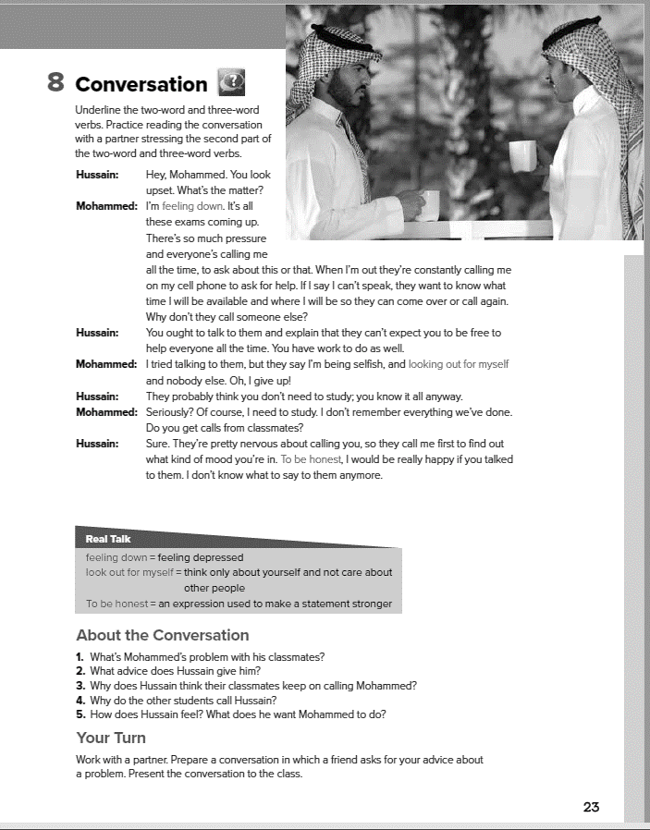

Students Book
P-23

Slide 6
Skimming
What do you think their relationship is? How
do you know?

Slide 7
Scanning
Hussain: Hey, Mohammed. You look
upset. What’s the matter?
Mohammed: I’m feeling down. It’s all
these exams coming up.
There’s so much pressure
and everyone’s calling me
all the time, to ask about this or that. When I’m out they’re constantly calling me
on my cell phone to ask for help. If I say I can’t speak, they want to know what
time I will be available and where I will be so they can come over or call again.
Why don’t they call someone else?
Hussain: You ought to talk to them and explain that they can’t expect you to be free to
help everyone all the time. You have work to do as well.
Mohammed: I tried talking to them, but they say I’m being selfish, and looking out for myself
and nobody else. Oh, I give up!
Hussain: They probably think you don’t need to study; you know it all anyway.
Mohammed: Seriously? Of course, I need to study. I don’t remember everything we’ve done.
Do you get calls from classmates?
Hussain: Sure. They’re pretty nervous about calling you, so they call me first to find out
what kind of mood you’re in. To be honest, I would be really happy if you talked
to them. I don’t know what to say to them anymore.
Hussain: Hey, Mohammed. You look
upset. What’s the matter?
Mohammed: I’m feeling down. It’s all
these exams coming up.
There’s so much pressure
and everyone’s calling me
all the time, to ask about this or that. When I’m out they’re constantly calling me
on my cell phone to ask for help. If I say I can’t speak, they want to know what
time I will be available and where I will be so they can come over or call again.
Why don’t they call someone else?
Hussain: You ought to talk to them and explain that they can’t expect you to be free to
help everyone all the time. You have work to do as well.
Mohammed: I tried talking to them, but they say I’m being selfish, and looking out for myself
and nobody else. Oh, I give up!
Hussain: They probably think you don’t need to study; you know it all anyway.
Mohammed: Seriously? Of course, I need to study. I don’t remember everything we’ve done.
Do you get calls from classmates?
Hussain: Sure. They’re pretty nervous about calling you, so they call me first to find out
what kind of mood you’re in. To be honest, I would be really happy if you talked
to them. I don’t know what to say to them anymore.
two-word, three-word verbs?
What’s Hussain’s advice to Mohammed?

Slide 8

Hussain: Hey, Mohammed. You look
upset. What’s the matter?
Mohammed: I’m feeling down. It’s all
these exams coming up.
There’s so much pressure
and everyone’s calling me
all the time, to ask about this or that. When I’m out they’re constantly calling me
on my cell phone to ask for help. If I say I can’t speak, they want to know what
time I will be available and where I will be so they can come over or call again.
Why don’t they call someone else?
Hussain: You ought to talk to them and explain that they can’t expect you to be free to
help everyone all the time. You have work to do as well.
Mohammed: I tried talking to them, but they say I’m being selfish, and looking out for myself
and nobody else. Oh, I give up!
Hussain: They probably think you don’t need to study; you know it all anyway.
Mohammed: Seriously? Of course, I need to study. I don’t remember everything we’ve done.
Do you get calls from classmates?
Hussain: Sure. They’re pretty nervous about calling you, so they call me first to find out
what kind of mood you’re in. To be honest, I would be really happy if you talked
to them. I don’t know what to say to them anymore.

Slide 9

So, What is your advice to Mohammed?
Hussain: Hey, Mohammed. You look
upset. What’s the matter?
Mohammed: I’m feeling down. It’s all
these exams coming up.
There’s so much pressure
and everyone’s calling me
all the time, to ask about this or that. When I’m out they’re constantly calling me
on my cell phone to ask for help. If I say I can’t speak, they want to know what
time I will be available and where I will be so they can come over or call again.
Why don’t they call someone else?
Hussain: You ought to talk to them and explain that they can’t expect you to be free to
help everyone all the time. You have work to do as well.
Mohammed: I tried talking to them, but they say I’m being selfish, and looking out for myself
and nobody else. Oh, I give up!
Hussain: They probably think you don’t need to study; you know it all anyway.
Mohammed: Seriously? Of course, I need to study. I don’t remember everything we’ve done.
Do you get calls from classmates?
Hussain: Sure. They’re pretty nervous about calling you, so they call me first to find out
what kind of mood you’re in. To be honest, I would be really happy if you talked
to them. I don’t know what to say to them anymore.

Slide 10
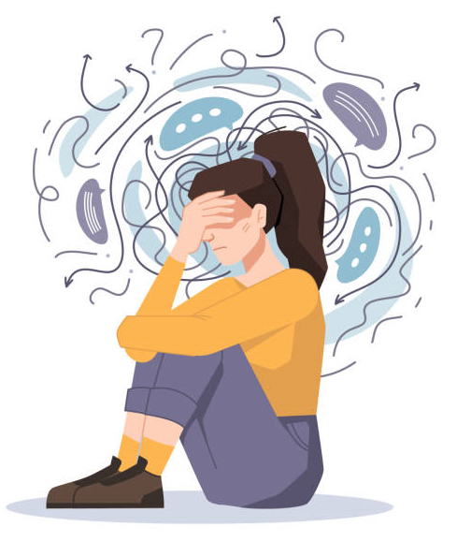
Real Talk
think only about yourself and not care about
other people
feeling down
feeling depressed
an expression used to make a statement stronger
look out for myself
To be honest

Slide 11
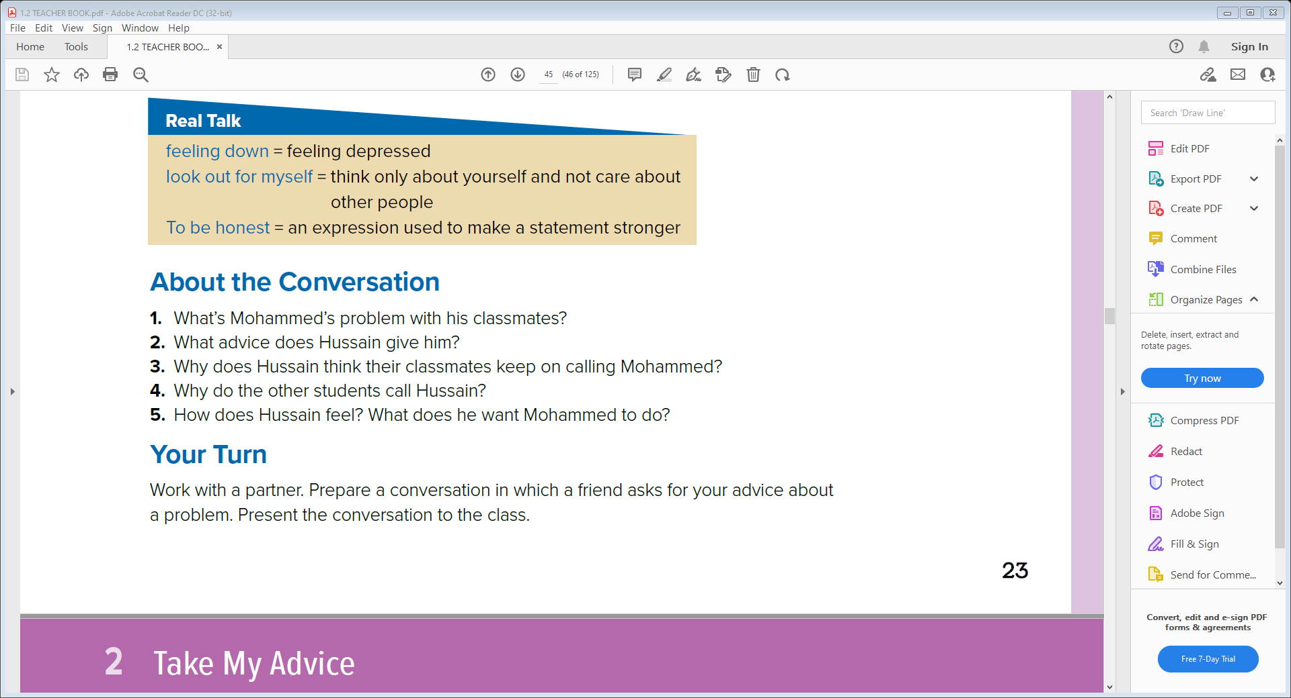
About The Conversation
1- Mohammed’s classmates keep calling him to ask questions or ask him to help them prepare for the exam .
2- He says that Mohammed ought to talk to their classmates and explain that he has to work / study
as well so they can’t expect him to be free all the time .
3- They think Mohammed knows everything and doesn’t need time to study .
4- To find out what kind of mood Mohammed is in before they call him
5- He is fed up with people calling him and has run out of things to say. He wants Mohammed to talk their classmates and explain that he needs time to prepare before the exams as well

Slide 12


