Slide 1
Unit 1 Did You Hurt Yourself ? Grammar
Mega Goal 1.2
Done by: Entisar Al-Obaidallah

Slide 2
Lesson Objectives
01
02
03
04
Use
Distinguish
Differentiate
reflexive pronouns correctly.
Between the use of so and because
Between the use of : so and Neither
Apply
the rules to do the exercises correctly

Slide 3


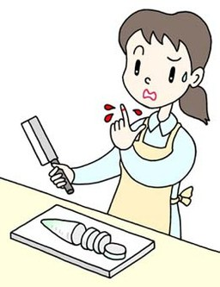
Reflexive Pronouns
Used when the subject and the object of a verb are the same person.
Example:
The boy cut himself in the art lesson.
More Examples
She looked at herself in the mirror.
He teach himself English with an app.
They bought themselves a new games.
I cut myself when I was making dinner last night.
I hope you enjoy yourselves at the party tonight!
We need to believe in ourselves more.

Slide 4
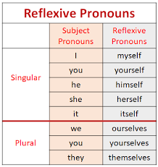

Used to say that something is done without anyone’s help.
Examples:
The children got dressed by themselves.
I prepared the whole meal by myself.
The door was locked. I locked it myself.
You must finish the work by yourself.
Reflexive pronouns end in"-self" (singular) or
"-selves " (plural).

Slide 5
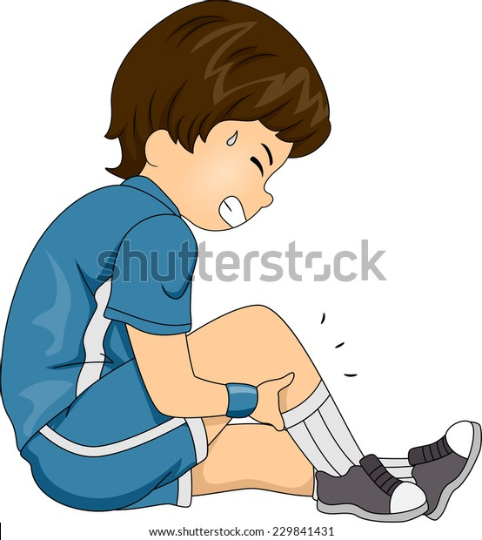
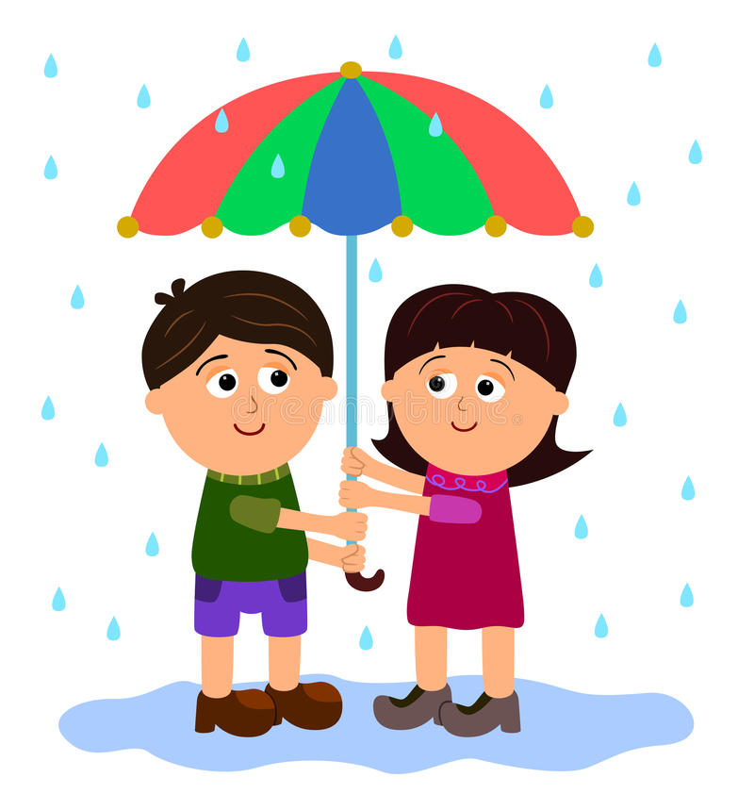
Complete using Reflexive Pronouns :
himself
He hurt _______ when he was playing.
ourselves
We protect __________from the rain with
an umbrella.

Slide 6
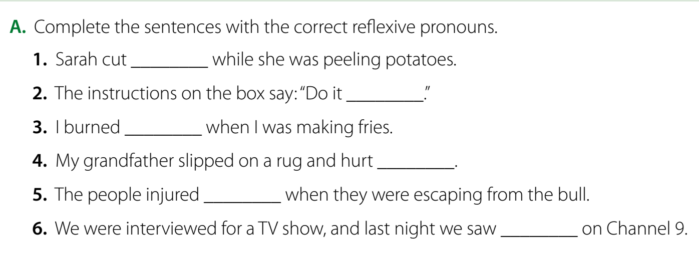
Student’s book p.(6)
herself
yourself
myself
himself
themselves
ourselves

Slide 7


Because vs So
because a reason
so a result
Example:
They missed the plane because they were late.
Reason
They were late, so they missed the plane
Result

Slide 8
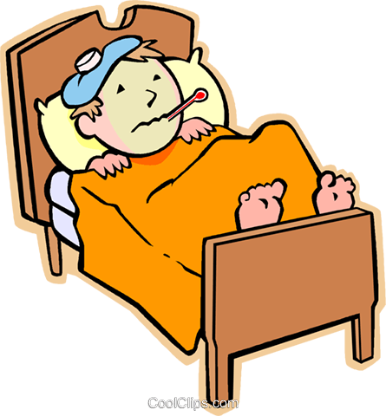
Because
because used to give the Reason for something
Example:
He is in bed because he’s got the flu.
Result
Reason
We can change the order using “so”
He’s got the flu , so he is in bed

Slide 9

SO
so used to talk about the result of something;
Example:
I’m tired so I’m going to bed.
Reason
Result
We can change the order using “because”
I’m going to bed because I'm tired

Slide 10
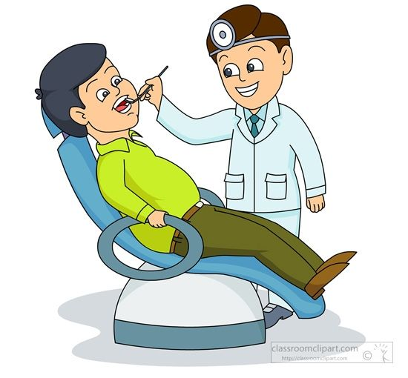
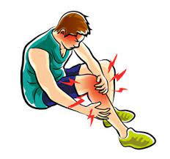

So or because??
so
My father has toothache ____ he went to the dentist
because
I stopped running___________ my knees started hurting .
so
My uncle’s car was very old _________ he sold it.

Slide 11
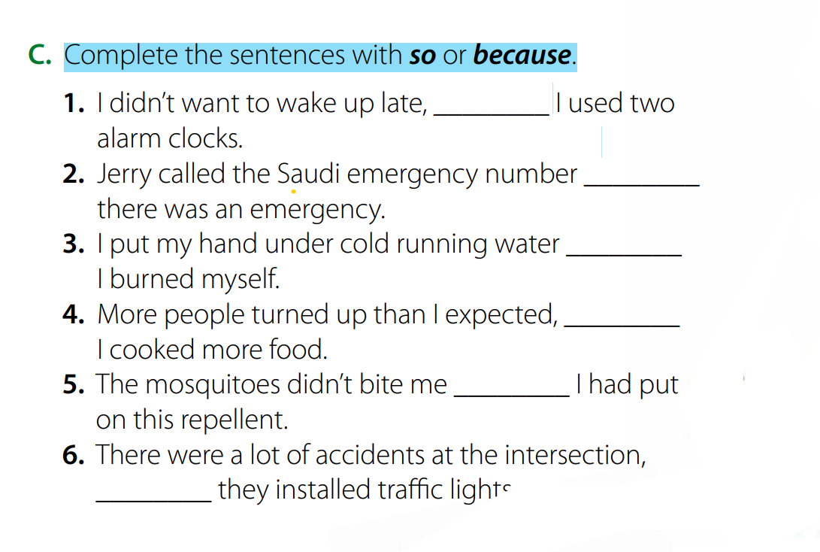
Student’s book p.(7)
so
because
because
so
because
so

Slide 12
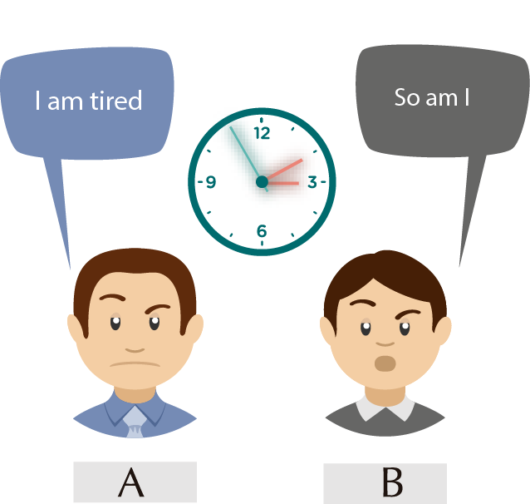
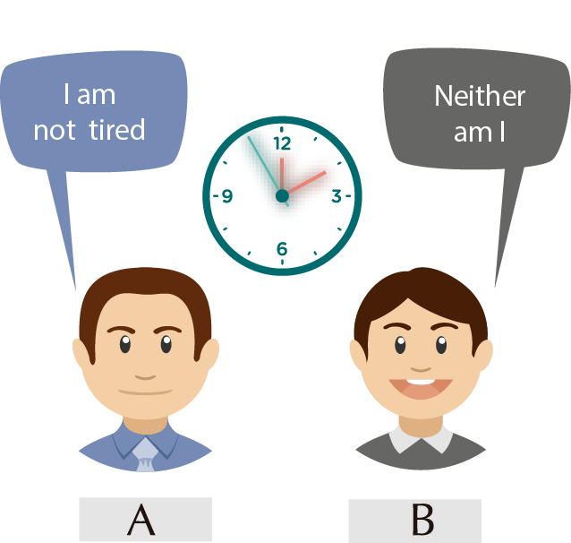
So & Neither
to express agreement with the speaker.
so
affirmative
Neither
negative
Example:
Affirmative
Negative

Slide 13
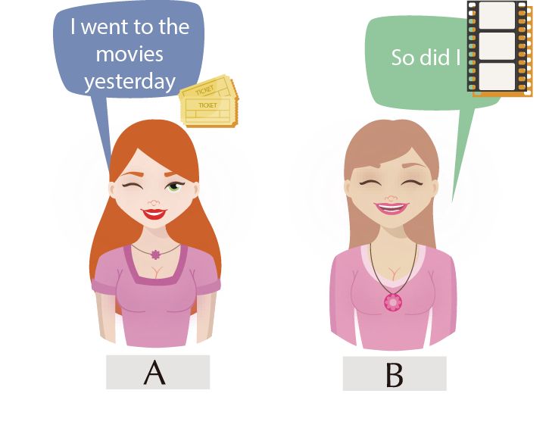
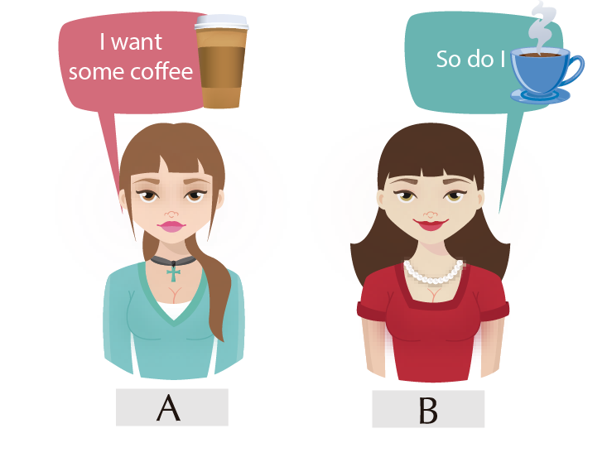
So
When we agree with an affirmative statement but we don´t want to repeat it
we use the following form:
SO + affirmative aux. verb + subjects
Example:

Slide 14
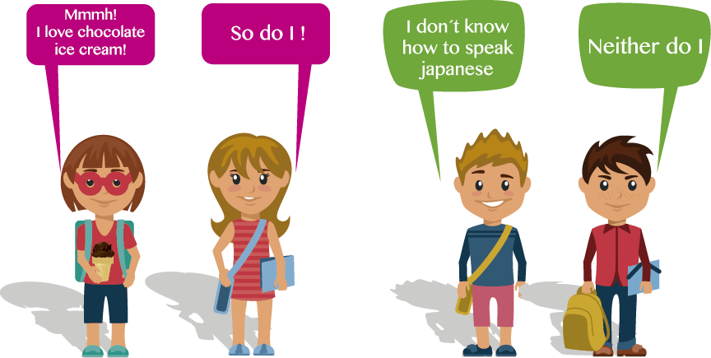
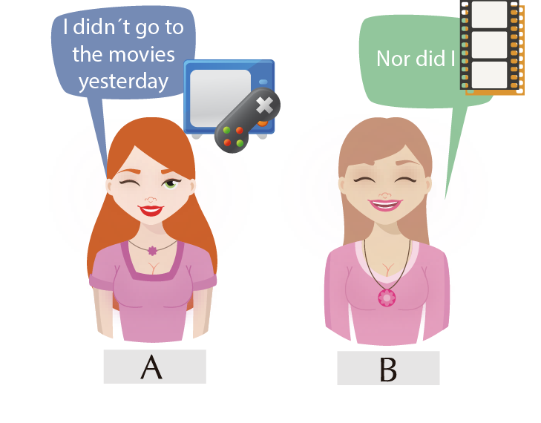
Neither
➔When we agree with a negative statement, but we don´t want to repeat it
we use the following form:
Neither + affirmative aux. verb + subject
Example:

Slide 15
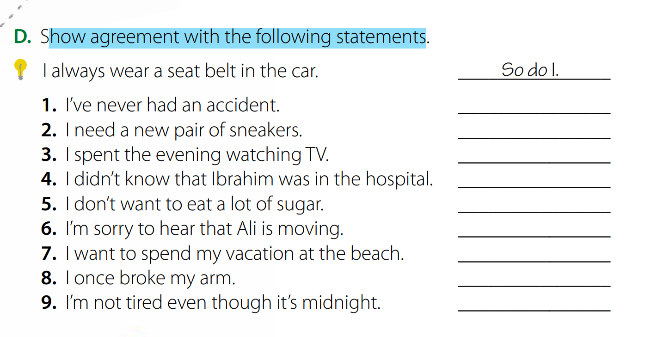
Student’s book p.(7)
Neither have I.
So do I
So did I
Neither did I
Neither do I
So am I
So do I
So did I
Neither am I

Slide 16
Extra Activities
https://www.liveworksheets.com/ix1071119qg
https://www.liveworksheets.com/xt767237kg

Slide 17
Homework
Workbook P. (79 ) , exercises ( C-D)

Slide 18

Thanks!

