Slide 1
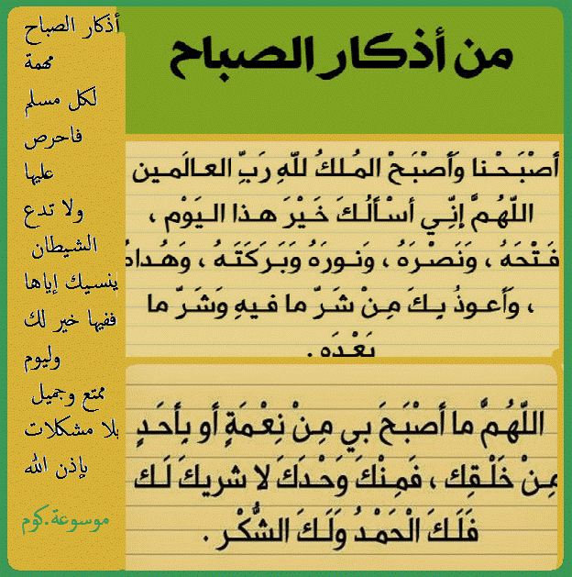

Slide 2

GOOD MORNING

Slide 3
Unit-1-
Did You Hurt Yourself
Done by Hissah Alotaibi

Slide 4
9 Reading

Slide 5
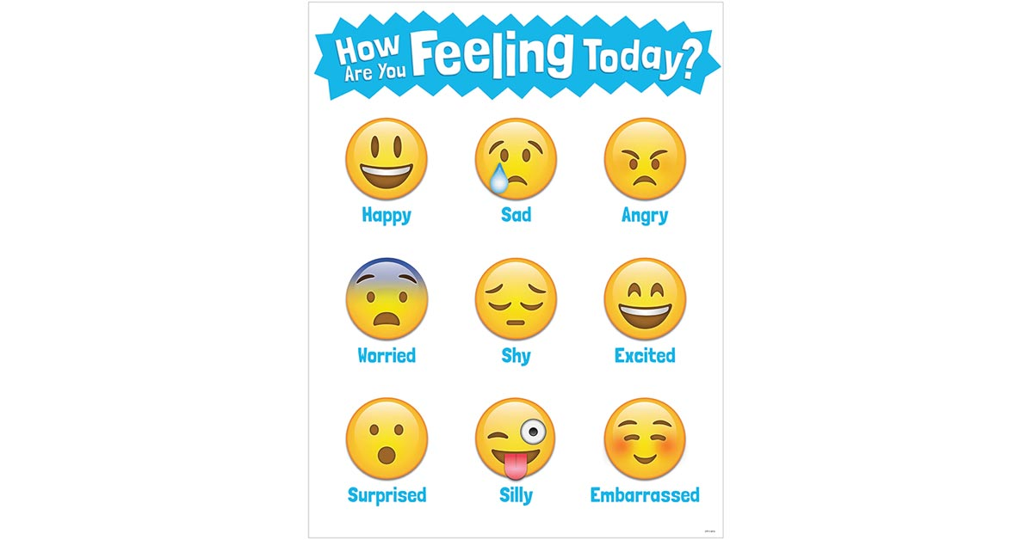

Slide 6
Objectives
Match words with their meanings
Share positively in group work
3
1
Reead the text
Skim & scan the text
For details
5
2
4
Give their opionion about the given questions

Slide 7
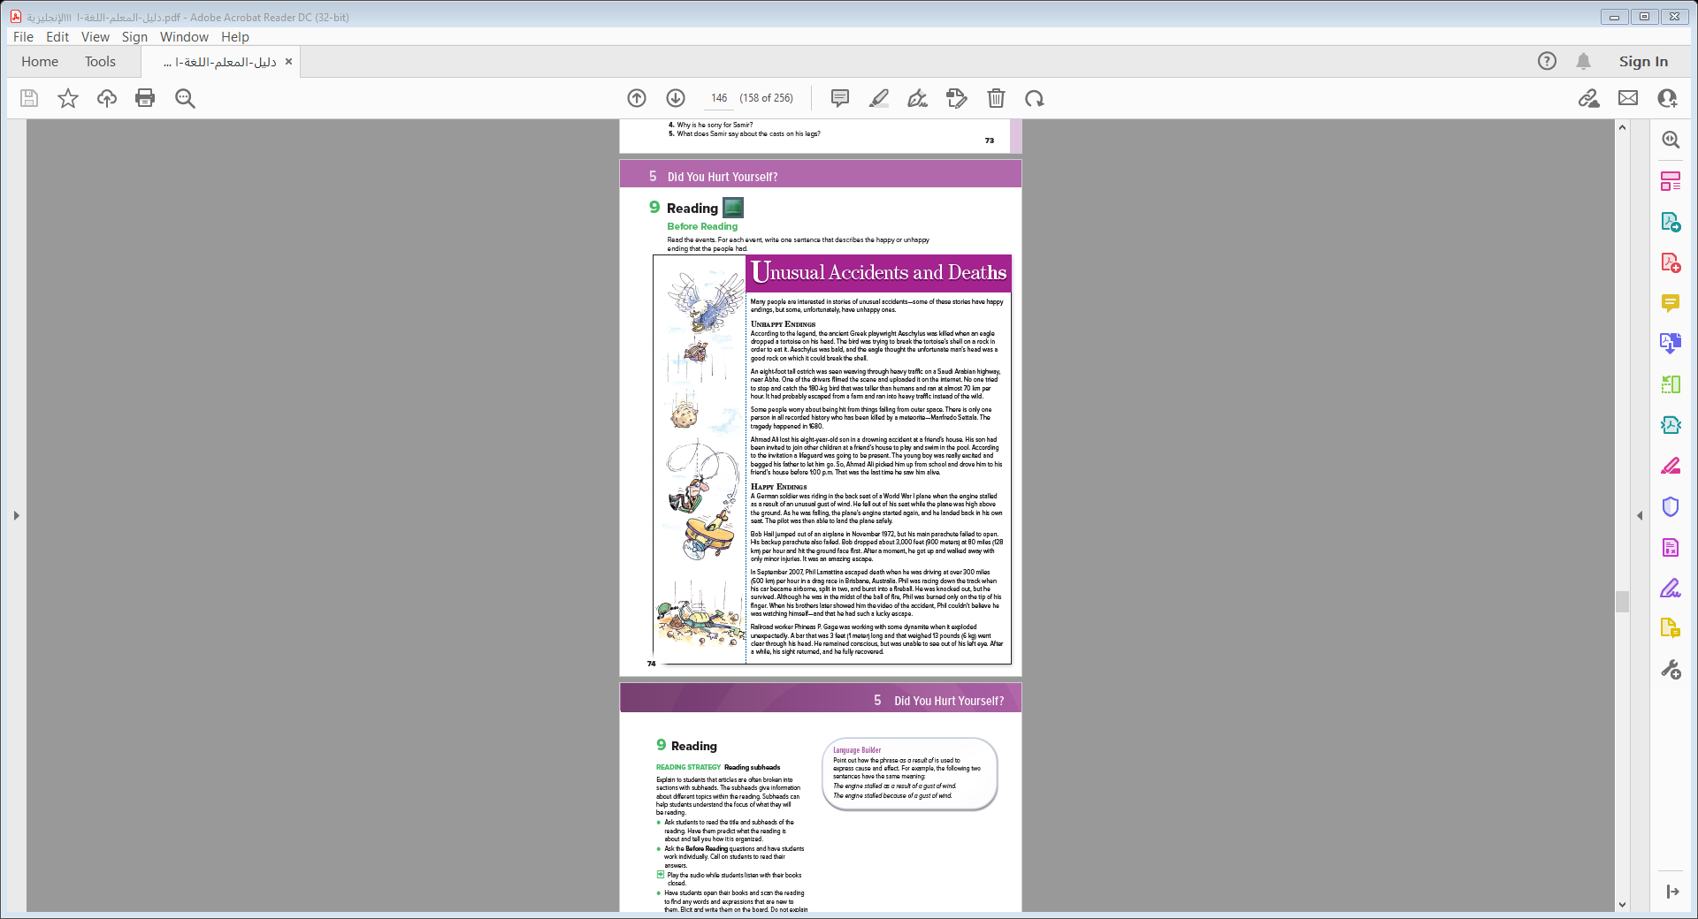
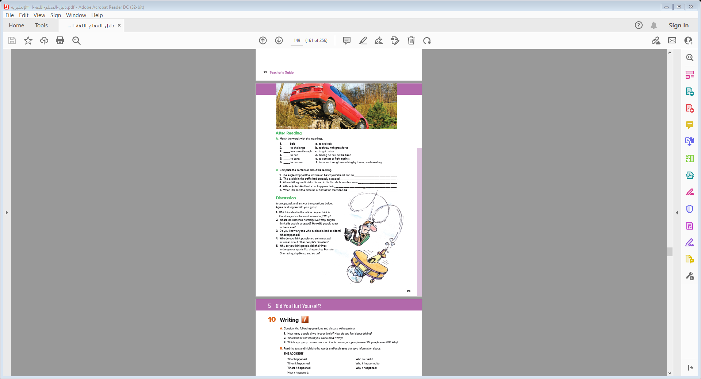
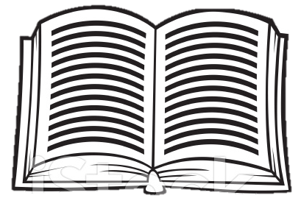
Students Book
p.10-11

Slide 8
Skim
1
2
…title
…accident
3
4
…sections
5
…Names
6
…paragraphs
7
…Dates
8
9

Slide 9
Scan
New words
underline
the sentences that express the unhappy or
happy endings.

Slide 10
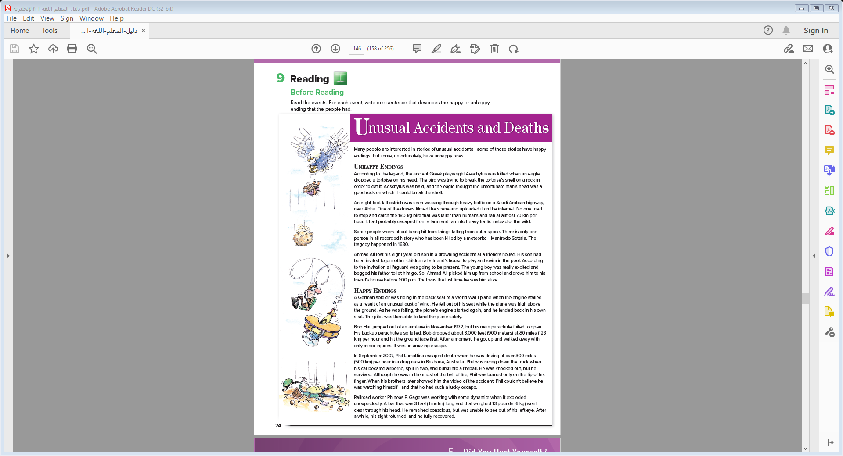

Many people are interested in stories of unusual accidents—some of these stories have happy endings, but some, unfortunately, have unhappy ones
UNHAPPY ENDINGS
Many people are interested in stories of unusual accidents—some of these stories have happy endings, but some, unfortunately, have unhappy ones. Unhappy endings According to the legend, the ancient Greek playwright Aeschylus was killed when an eagle dropped a tortoise on his head. The bird was trying to break the tortoise’s shell on a rock in order to eat it. Aeschylus was bald, and the eagle thought the unfortunate man’s head was a good rock on which it could break the shell.
An eight-foot tall ostrich was seen weaving through heavy traffic on a Saudi Arabian highway, near Abha. One of the drivers filmed the scene and uploaded it on the internet. No one tried to stop and catch the 180-kg bird that was taller than humans and ran at almost 70 km per hour. It had probably escaped from a farm and ran into heavy traffic instead of the wild.
Some people worry about being hit from things falling from outer space. There is only one person in all recorded history who has been killed by a meteorite—Manfredo Settala. The tragedy happened in 1680.
Ahmad Ali lost his eight-year-old son in a drowning accident at a friend’s house. His son had been invited to join other children at a friend’s house to play and swim in the pool. According to the invitation a lifeguard was going to be present. The young boy was really excited and begged his father to let him go. So, Ahmad Ali picked him up from school and drove him to his friend’s house before 1:00 p.m. That was the last time he saw him alive.
Notes:
Language Builder
Point out how the phrase as a result of is used to express cause and effect. For example, the following two sentences have the same meaning:
The engine stalled as a result of a gust of wind.
The engine stalled because of a gust of wind.

Slide 11
HAPPY ENDING
A German soldier was riding in the back seat of a World War I plane when the engine stalled as a result of an unusual gust of wind. He fell out of his seat while the plane was high above the ground. As he was falling, the plane’s engine started again, and he landed back in his own seat. The pilot was then able to land the plane safely.
Bob Hail jumped out of an airplane in November 1972, but his main parachute failed to open. His backup parachute also failed. Bob dropped about 3,000 feet (900 meters) at 80 miles (128 km) per hour and hit the ground face first. After a moment, he got up and walked away with only minor injuries. It was an amazing escape.
In September 2007, Phil Lamattina escaped death when he was driving at over 300 miles (500 km) per hour in a drag race in Brisbane, Australia. Phil was racing down the track when his car became airborne, split in two, and burst into a fireball. He was knocked out, but he survived. Although he was in the midst of the ball of fire, Phil was burned only on the tip of his finger. When his brothers later showed him the video of the accident, Phil couldn’t believe he was watching himself—and that he had such a lucky escape.
Railroad worker Phineas P. Gage was working with some dynamite when it exploded unexpectedly. A bar that was 3 feet (1 meter) long and that weighed 13 pounds (6 kg) went clear through his head. He remained conscious, but was unable to see out of his left eye. After a while, his sight returned, and he fully recovered
Notes:
meteorite = a mass of stone or metal from space that
reaches Earth
They thought they saw a UFO in the sky, but it was
a meteorite.
on the spot = immediately
He had a heart attack and died on the spot.
stall = when a motor stops working
The car suddenly stalled in the middle of the road.
weave through (traffic) = run in and out of the way of
obstacles (cars), zigzag
airborne = in the air
The snowboarder flew off a jump and was airborne.
conscious = awake and able to understand
what is going on
The man fell and hit his head hard, but he remained
conscious.

Slide 12
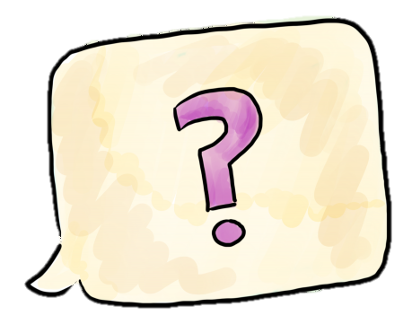

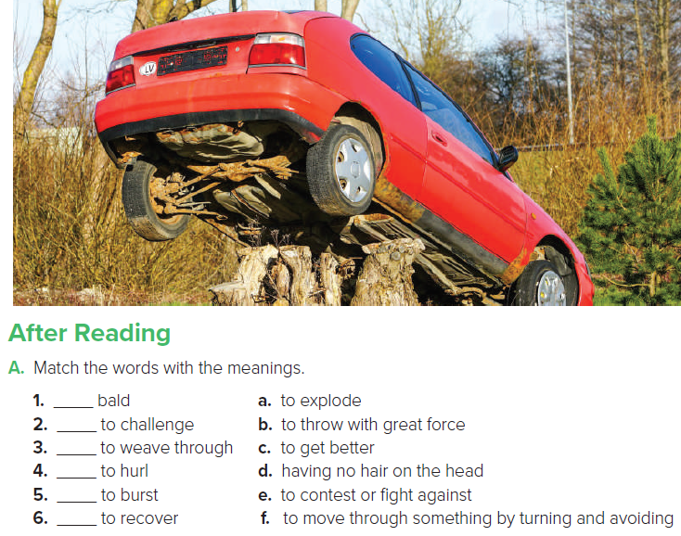
d
e
f
b
a
c

Slide 13
B. Complete the sentences about the reading.
1. The eagle dropped the tortoise on Aeschylus’s head, and so Aeschylus was killed .
2. The ostrich in the traffic had probably escaped you will get hurt
3. Ahmad Ali agreed to take his son to his friend’s house because many children were invited and a lifeguard was going to be present
4. Although Bob Hail had a backup parachute it didn’t open
5. When Phil saw the pictures of himself on the video, he couldn’t believe he survived .

Slide 14


Discussion
In groups, ask and answer the questions below.
Agree or disagree with your group.
1. Which incident in the article do you think is
the strangest or the most interesting? Why?
2. Where do ostriches normally live? Why do you
think this ostrich escaped? How did people react
to the scene?
3. Do you know anyone who avoided a bad accident?
What happened?
4. Why do you think people are so interested
in stories about other people’s disasters?
5. Why do you think people risk their lives
in dangerous sports like drag racing, Formula
One racing, skydiving, and so on?

Slide 15
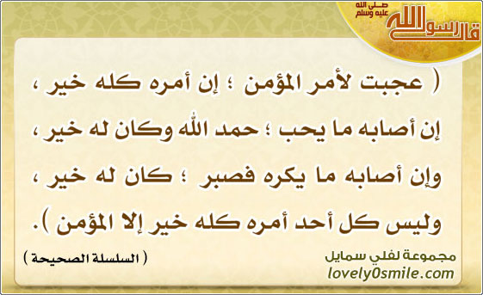

Slide 16


Slide 17


Tell a story about you with a happy ending

Slide 18


