Slide 1
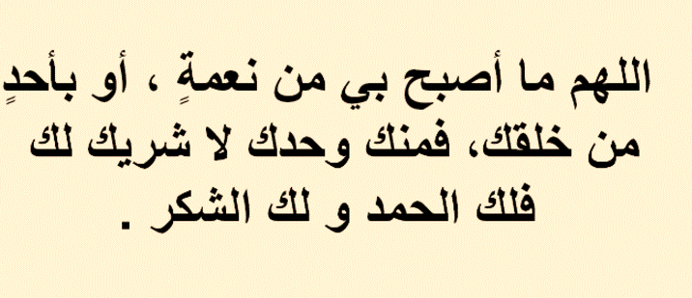

Slide 2


Slide 3
Unit-1-
Did You Hurt Yourself
Done by Hissah Alotaibi

Slide 4
8 Conversation

Slide 5
Objectives
1
Listen to the audio
2
Form sentences using the real talk
3
answer questions about conversation details
4
Describe an accident by imagining the same situation of Jasim & Samir
5
Discuss the pictures
6
Read the conversation

Slide 6
Where are they?

Slide 7
Skimming
What happened to them
Samir
Jasem

Slide 8

Practice reading the conversation in pairs
Samir: So, how did you hurt yourself?
Jasem: I fell off my bike.
Samir: Really? So did I. My motorcycle skidded on a patch of oil on the road, and I crashed into a car. The last thing I remember was flying through the air and hitting the windshield. I woke up in the hospital.
Jasem: Were you wearing a helmet?
Samir: Yes, luckily I was. That’s what probably saved my life. How about you? Jasem: I was cycling in the park, so I didn’t think I’d need a helmet. I don’t like wearing helmets—they’re uncomfortable and unattractive. This squirrel came out of nowhere. I swerved, lost my balance, and hit a tree. I got off lightly—only a few bruises and a bump on my head.
Samir: It was your lucky day!
Jasem: Yeah. That’s too bad you broke both legs. You’re going to be stuck in that wheelchair for a while, I guess.
Samir: Look at it this way—if I broke only one leg, there might not be enough room for all my friends to write their names on the cast. Hey, would you like to sign your name?

Slide 9
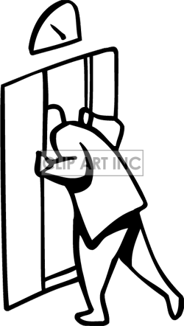
Real Talk
lucky day = a day of good fortune
stuck in = caught and unable to move out
I guess = expression to show that you’re not totally sure about a statement
Look at it this way = There’s a different way to think about something

Slide 10

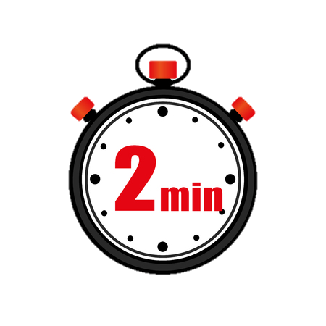
About the Conversation
1-How did Samir hurt himself?
2. Why was he lucky?
3. How did Jasem hurt himself?
4. Why is he sorry for Samir?
5. What does Samir say about the casts on his legs?
1. Samir’s motorcycle skidded on a patch of oil, and it crashed into a car.
2. He was lucky because he was wearing a helmet, and it probably saved his life.
3. Jasem was cycling in the park. A squirrel ran in front of him, so he swerved to avoid it and hit a tree.
4. Jasem is sorry for Samir because he is going to be stuck in a wheelchair for a while.
5. He says that with two casts, he has enough room for all his friends to write their names on his casts.

Slide 11

Read the conversation again. Imagine you are Samir or Jasem. Describe your accident to a friend.

Slide 12
