Slide 1


Super Goal 4
Unit 3 - There’s No Comparison
8. Reading
By: Sara Alamri
Designer: Artstudio.24
0505899184

Slide 2

Objectives
Answer questions about a text
Read
a text about Saudi Vision 2030
01
02
03
Match
the new
words with their meanings

Slide 3
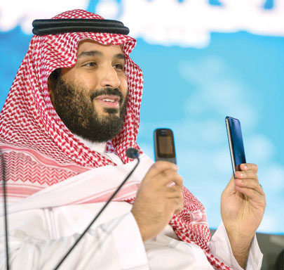


Warm Up
WHOSE idea is 2030 Vision?
?

Slide 4
Warm Up
Imagine the Kingdom of Saudi Arabia in 2030.
(people, housing, jobs, schools, universities)

Slide 5

Books Open @ 23

Slide 6



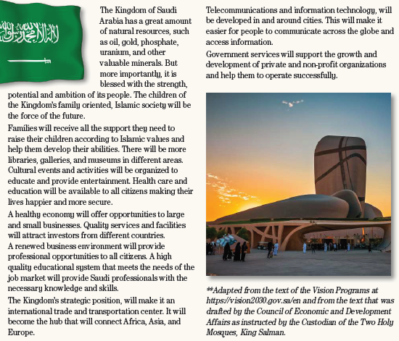

Listen & read a long
1
5
6
Find out
- Places to visit in Saudi Arabia
- Names of continents
2
3
https://www.liveworksheets.com/sl1596241pt
4

Slide 7


Listen & read a long
1
5
Choose
6
The meaning of valuable
worth a great deal of money
2. has many disadvantages
2
3
4

Slide 8
Listen & read a long
1
5
Choose
6
The meaning of opportunities
duties
2. chances
2
3
4

Slide 9
Make Wh
questions
what
when
where
which
Saudi Arabia has a great amount of natural resources.
2. Islamic society will be the force of the future.
3. The Kingdom’s strategic position, will make it an international trade and transportation center.
1. What does Saudi Arabia have?
who
2. What will be the force of the future?
3. What will make Saudi Arabia an international trade
& transportation centre?
Notes:
يُذكر الهدف الوجدني قوله تعالى(الْيَوْمَ أَكْمَلْتُ لَكُمْ دِينَكُمْ وَأَتْمَمْتُ عَلَيْكُمْ نِعْمَتِي وَرَضِيتُ لَكُمُ الْإِسْلَامَ دِينًا)

Slide 10


