Slide 1

There’s No comparison
Unite 3
Lesson : 1
By: ET Asma AlMjlad

Slide 2
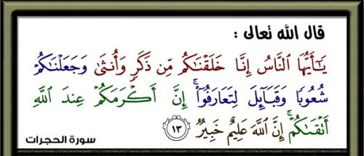

Slide 3
objectives
Give amazing facts around the world
Judge the given information
Answer the question in student book

Slide 4
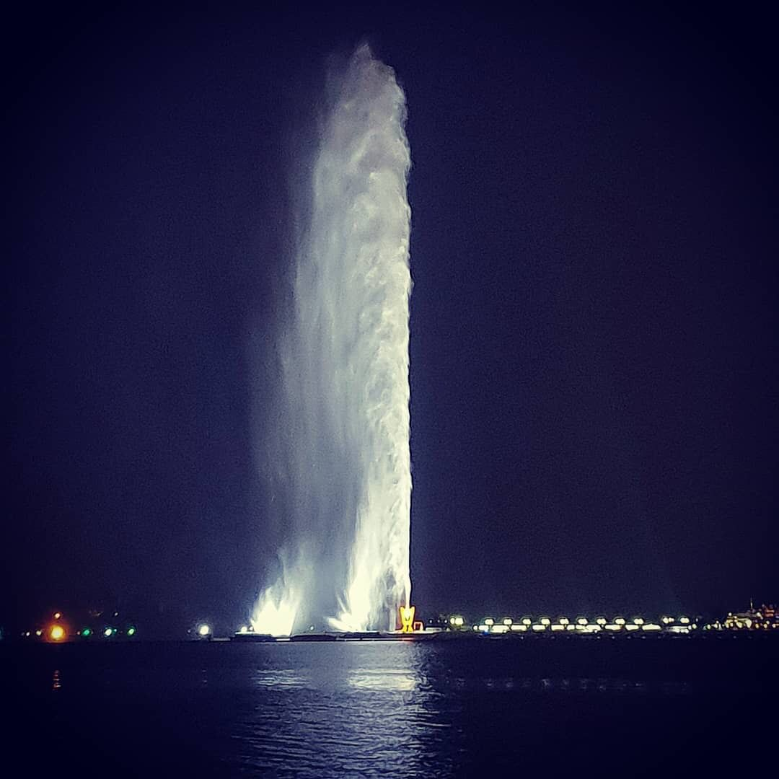



King Fahd's Fountain
What is the tallest fountain in the world?

Slide 5
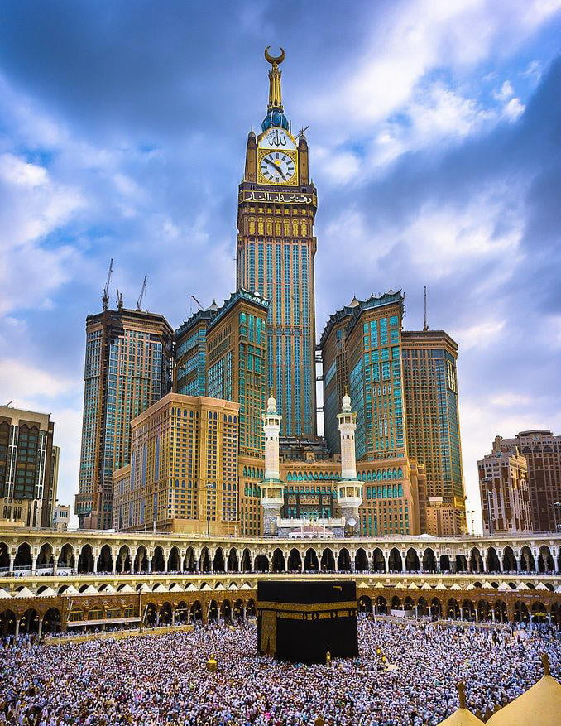
What is the tallest tower in Saudi Arabia?
The clock tower

Slide 6
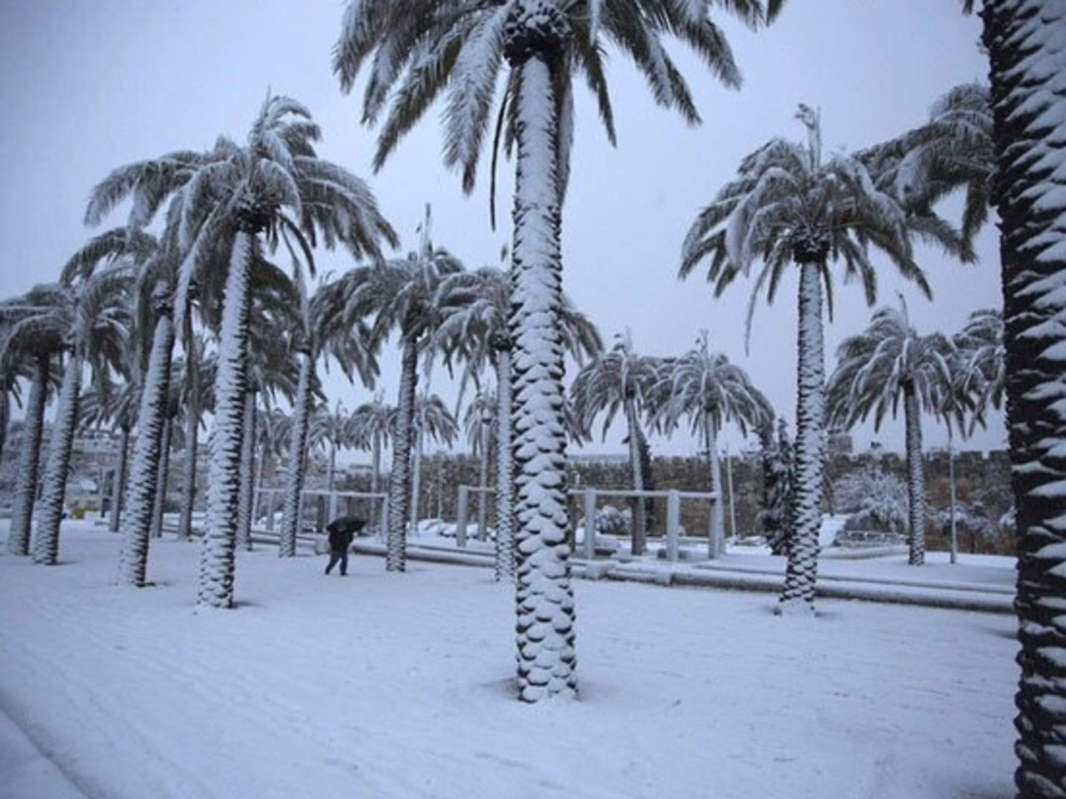
What is the coldest city in Saudi Arabia
Turaif
The clock tower

Slide 7
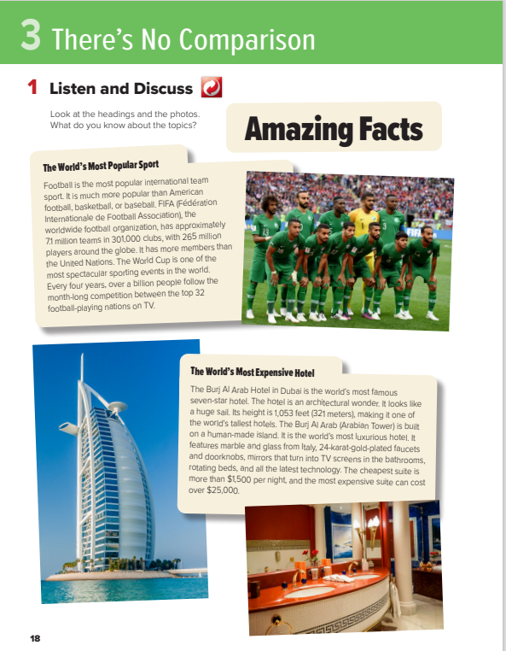
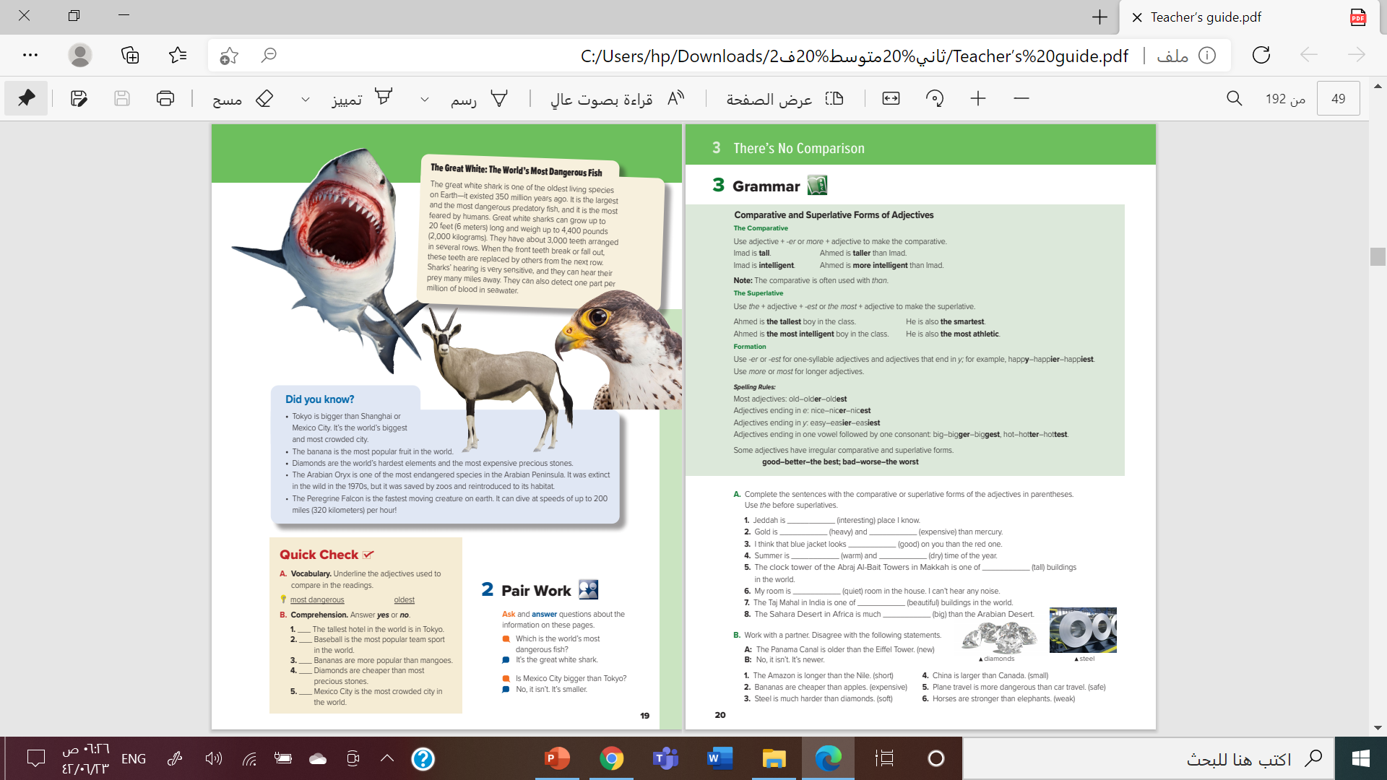


Open your book page 18

Slide 8
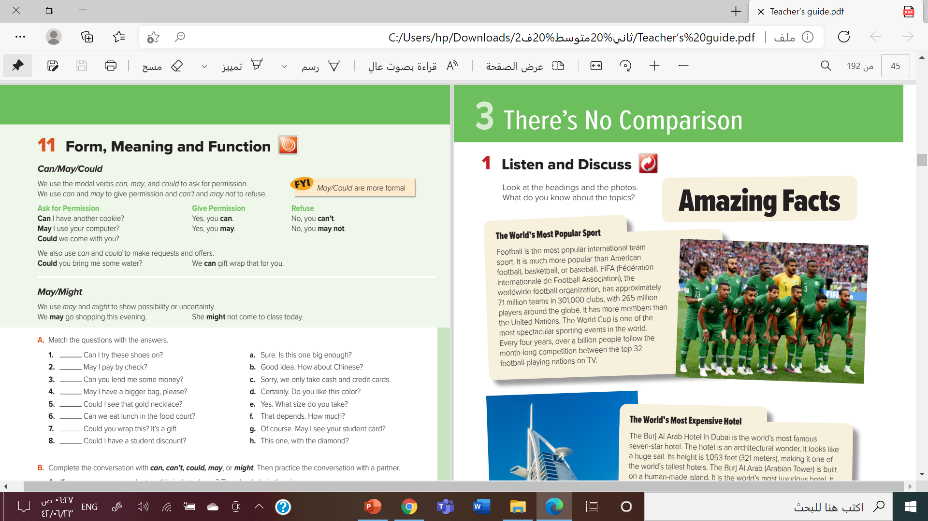

What is the most popular team sport?
How many teams are there around the world?
How many clubs are there?
How many teams play in the world cup?

Slide 9
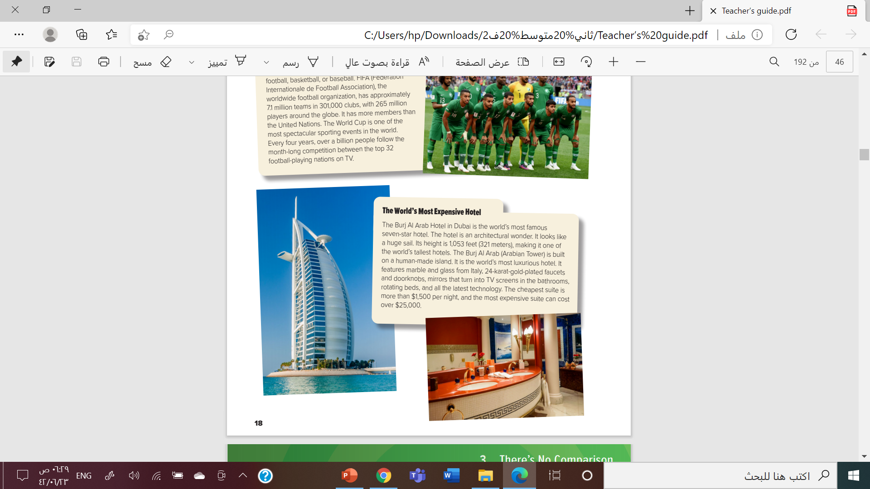
What makes the hotel special?
Where is it located?
How tall is it?
How much does it cost to stay there for a night?

Slide 10
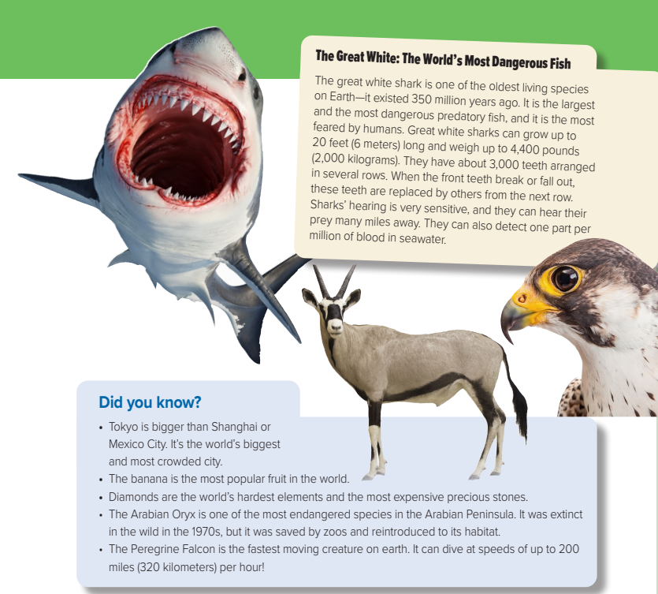
What do you think makes the great white shark so special?
How long the great white sharks are?
How many teeth they have?
Do you think they have a good or bad sense of blood?

Slide 11
The most dangerous fish in the world is…………….
White shark

Slide 12
The biggest city in the world is ………………..
Tokyo

Slide 13
The most popular fruit in the world is ………………..
Banana

Slide 14
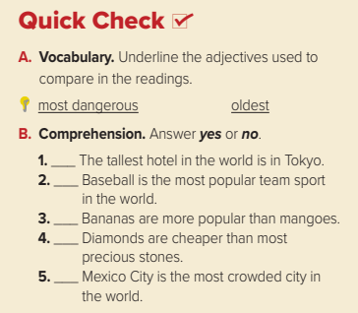
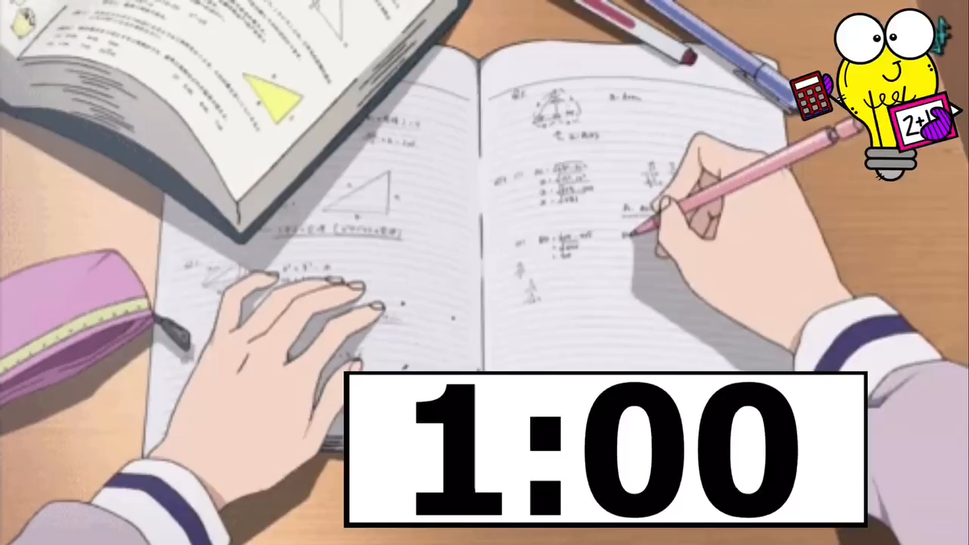


Slide 15


The biggest project in Saudi Arabia

Slide 16




Slide 17

By : ET Asma

