Slide 1




Slide 2



U10:
It’s a Bargain!
Travel
shopping
Conversation
Page: 86
Smile!
Smile!

Slide 3
Learning Objectives:
01
02
!
!
☞ Practice conversation about shopping.
Answer questions about the conversation

Slide 4
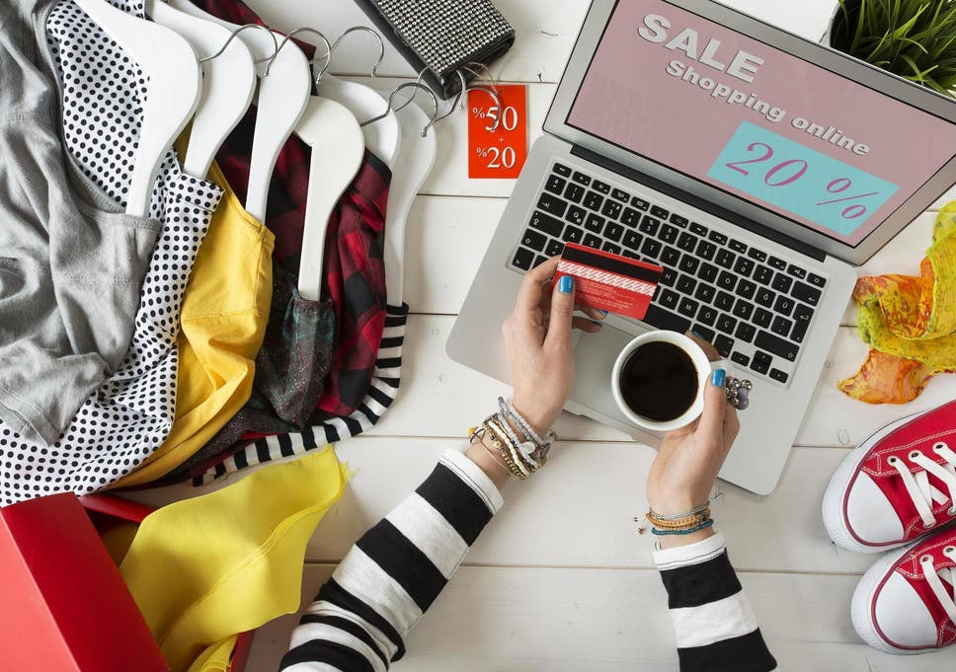

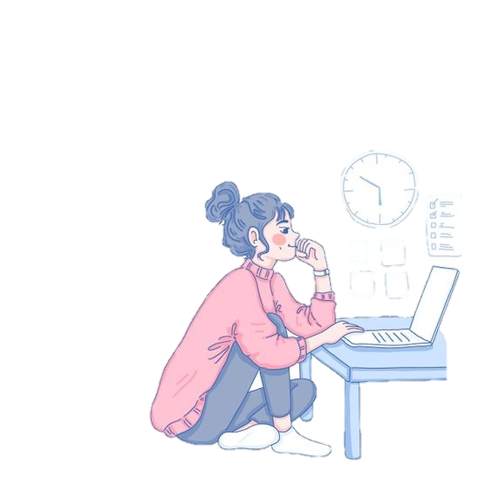
What is your favorite site to shop online?

Slide 5

Is the brand name of the clothes you wear important to you
?
?
Travel
shopping

Slide 6
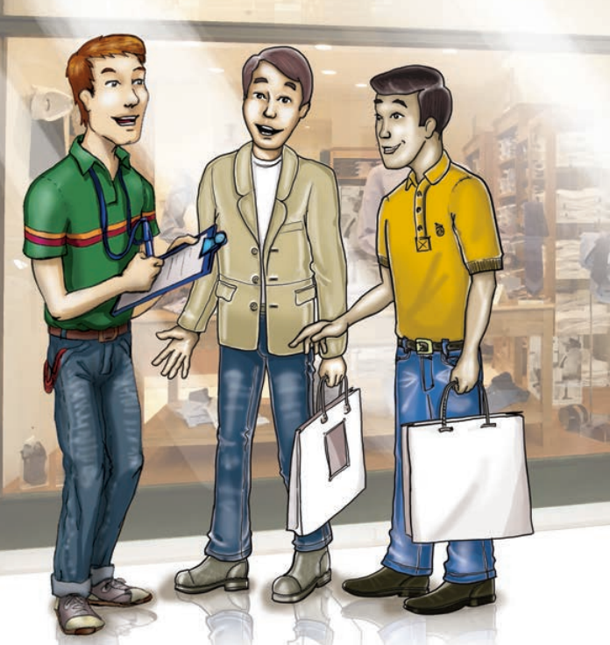

?
?
Where are the people talking?
What is the man doing?

Slide 7
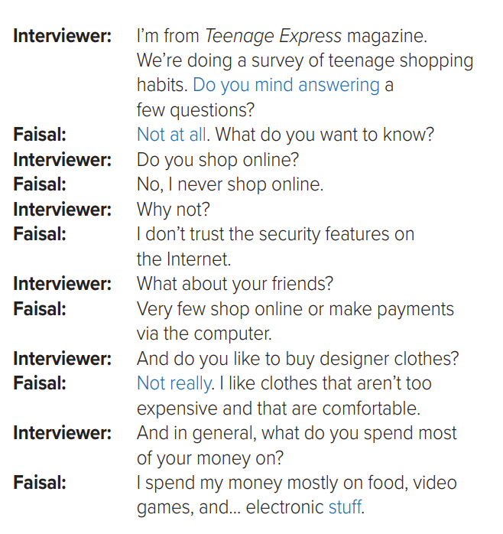

Listen

Slide 8
a polite request
Do you mind..?
Do you mind + verb + -ing..?

Slide 9

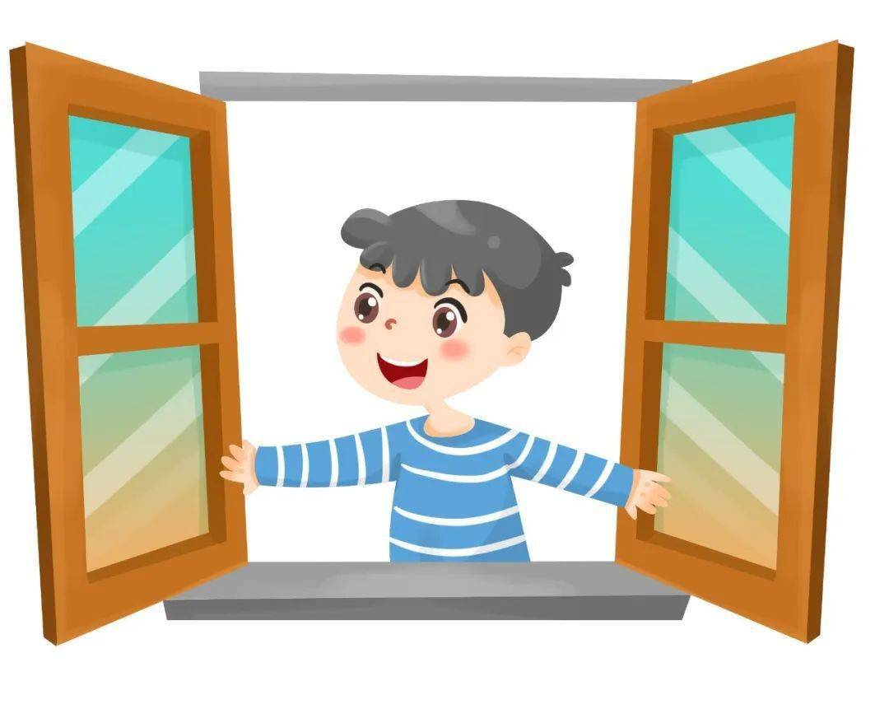
Do you Mind…..?
Do you mind opening the window?

Slide 10
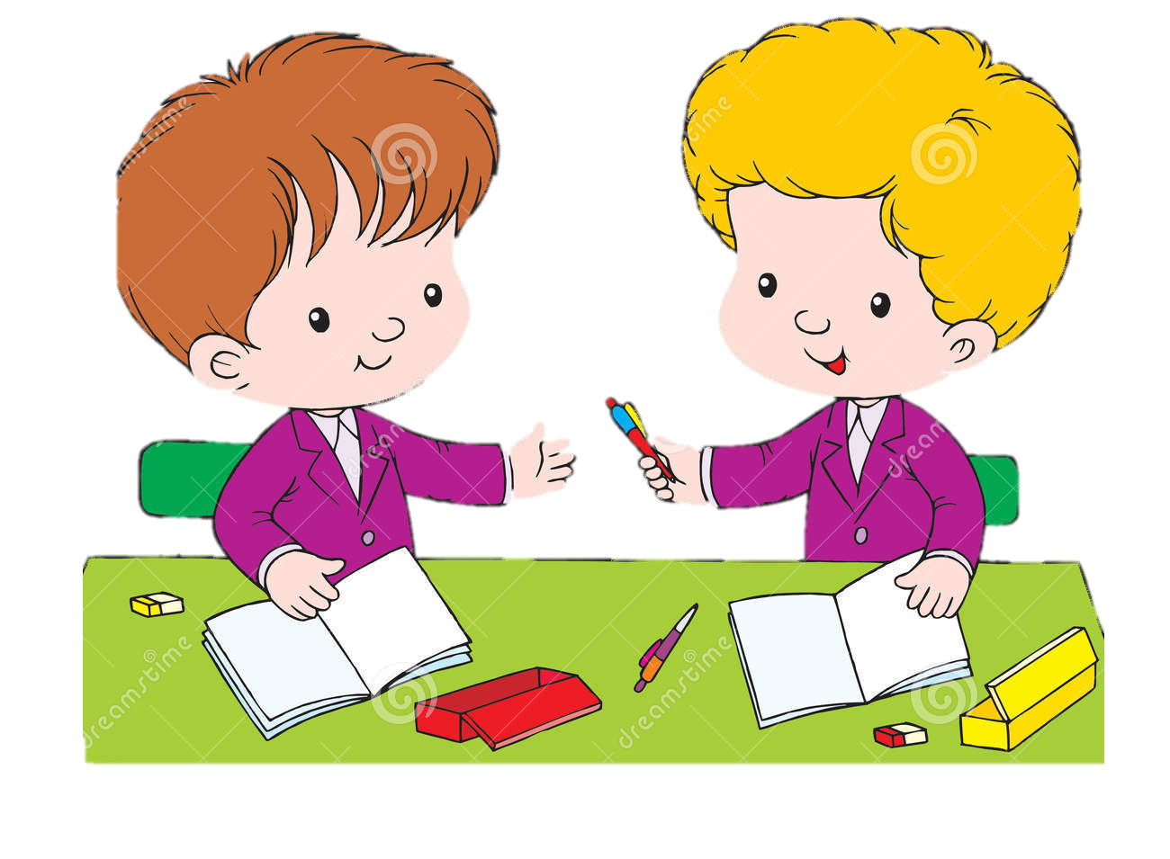
Do you Mind…..?
Do you mind lending me your pen?

Slide 11
Real Talk…
Not at all
Stuff
Not really
a response to “Do you mind?” to agree to the request
a polite way to answer “no”
things in general

Slide 12




About the Conversation
?
?
What is the interviewer doing in the mall?
What does he want to know?
He is doing a survey of teenage shopping habits.
He wants to know if Faisal shops online.

Slide 13


About the Conversation
?
?
Why doesn’t Faisal shop online?
What does he spend his money on?
Faisal doesn’t trust the security features on the Internet.
Faisal spends his money on food, video games, and electronic stuff.

Slide 14

Thank you
Do you have any questions?
عبير العنزي

