Slide 1






Slide 2
U10: It’s a Bargain!
Grammar 84-85

Slide 3




Lesson Objectives:
1
3
Use
Possessive adj.
and possessive pronouns.
Differentiate between one and ones.
Ask questions by using “whose”.
Use “too” correctly.
2
4

Slide 4



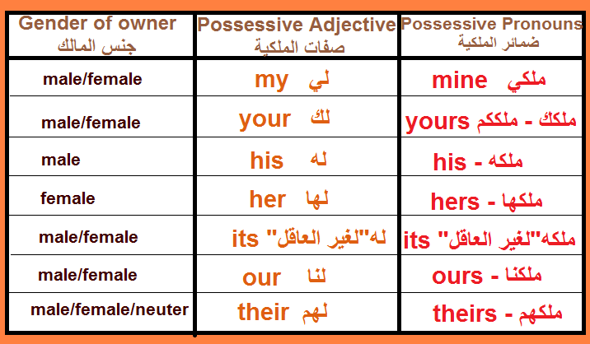
Page:73

Slide 5

Page:73

Slide 6
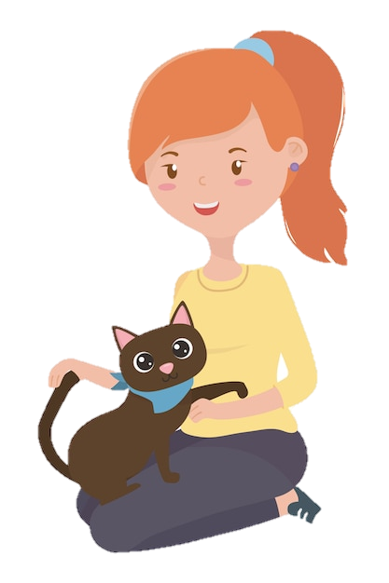




Possessive Adjective
It`s my cat.
Possessive Pronoun
It`s mine.

Slide 7





Possessive Adjective
It`s his car.
Possessive Pronoun
It`s his.

Slide 8


Possessive Adjective
It`s her labtop.
Possessive Pronoun
It`s hers.

Slide 9



Possessive Adjective
It`s our home.
Possessive Pronoun
It`s ours.

Slide 10
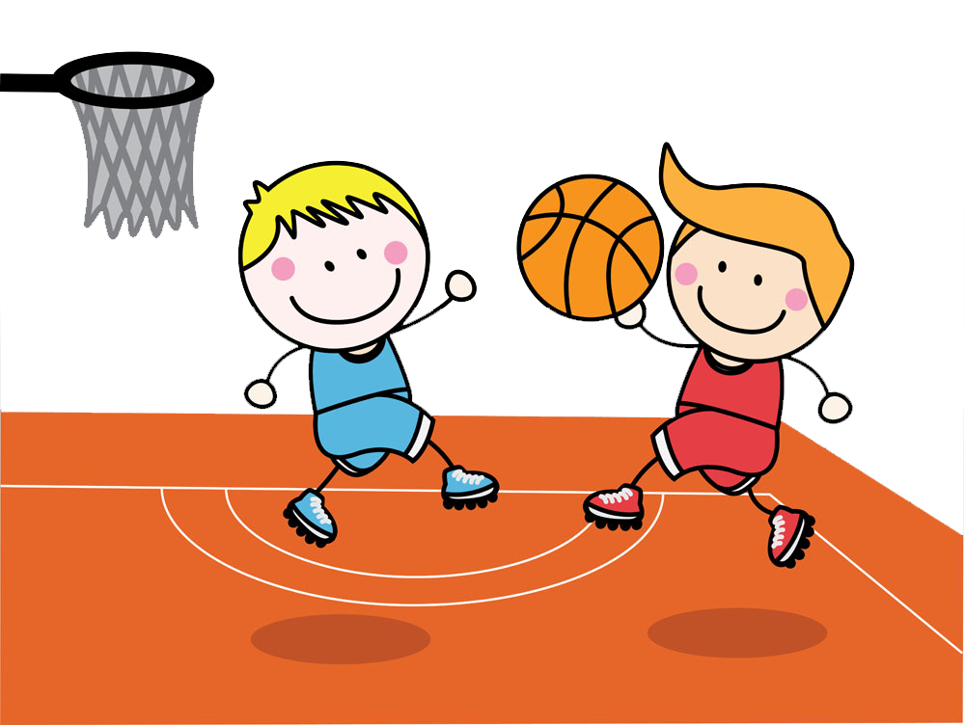
Possessive Adjective
It`s their ball.
Possessive Pronoun
It`s theirs.

Slide 11
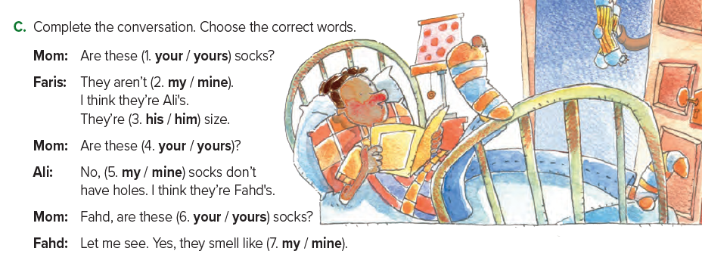

Slide 12

Whose ….?
Whose is a possessive pronoun.
Whose book is this?
Use it when you’re asking to whom something belongs.
It’s mine

Slide 13



structure
singular
plural
Whose + noun + is + it/this ?
Whose + noun + are + they/these ?
Whose pencils are they ?
Whose pen is it ?
Whose pencils are these ?
Whose pen is this ?

Slide 14



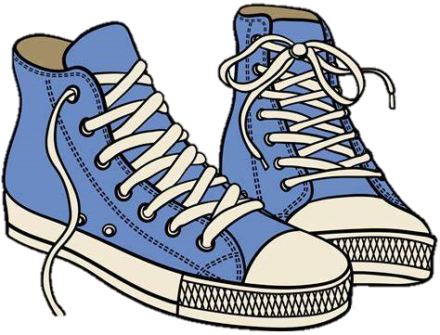
The use of One - Ones
We use one/ones instead of repeating a countable noun.
One
Ones
singular
plural
Which sneakers are yours?
—The blue ones
Which is car yours?
— The red one.

Slide 15











This bag is very old. I need a new___________
Small pineapples are sweeter than big_________
The new smartphones are much faster than the old____________
Jack has three pens – a red__________ and two
green________________ .

Slide 16


Quantitative: Too
Too’, it is used similarly to =‘very’
He was driving too fast.
These shoes are too big for him.

Slide 17



عبير العنزي

