Slide 1

It’s a bargain
Form ,meaning and function
By: ET Asma AlMjlad

Slide 2


Slide 3
Use model verbs can\may \could
objectives
Use may \might

Slide 4

Can I use your phone ?
May I have a cookies?
Could we go with you ?

Slide 5

Model auxiliaries
Can
Could
May
Their form is the same for all persons ( I , you , she , he , it , we, they )

Slide 6
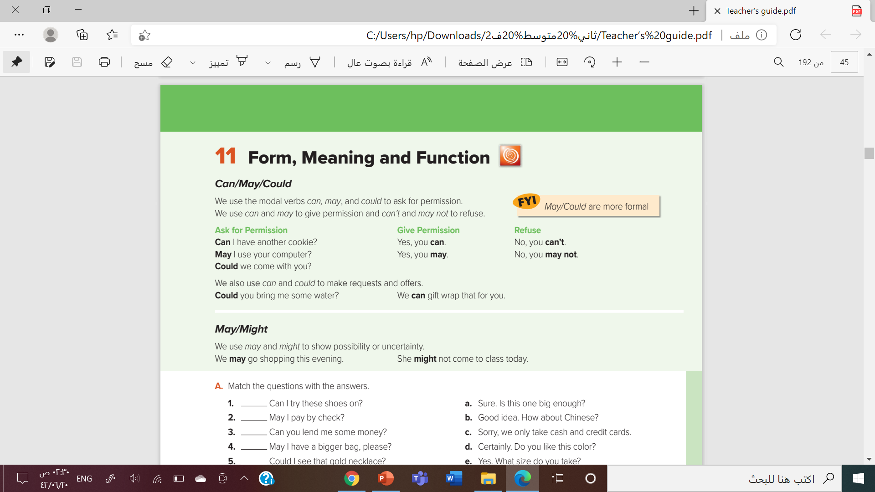

Open you book
page 17

Slide 7


Permission

Slide 8
Permission
the act of allowing someone
to do something

Slide 9
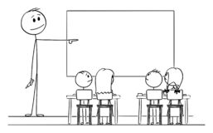

What do you ask your teacher in the class?
what

Slide 10
Can I drink water?
May I go to bathroom?
Could I answer this question?
Can I write on the board?

Slide 11

Give permission
Yes ,you can
Yes ,you may.
sure
Good idea
Of course

Slide 12

Refuse
No, you may not
No, you can’t
sorry

Slide 13


Slide 14

May \ might
To show possibility
%50
%50

Slide 15
We may go to the mall this weekend
She mightn’t stay at home.

Slide 16



Slide 17

For more information

Slide 18

A - page 17

Slide 19

By: ET Asma AlMjlad

