Slide 1



Slide 2

U9:Lets Go out
Conversation
Page 78

Slide 3
Learning Objective
01
02
Answer questions from conversation about making excuses
Practice conversation about making excuses

Slide 4


What are your favorite free time activities?

Slide 5

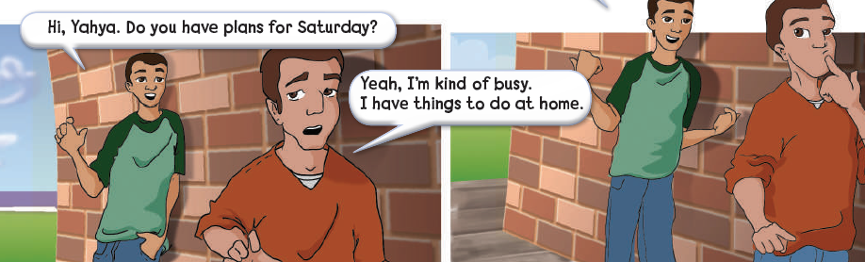
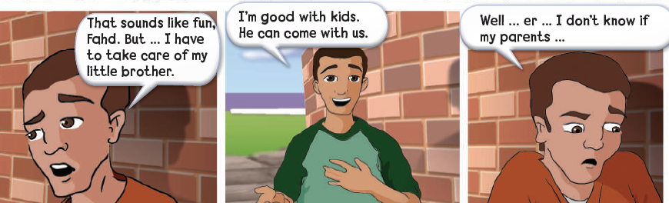
Who is in the cartoon?

Slide 6


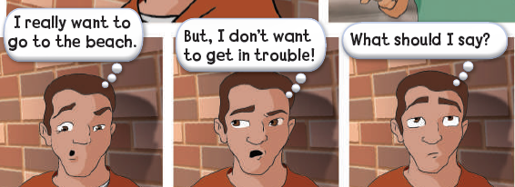
What do you think this conversation is about?

Slide 7


Slide 8
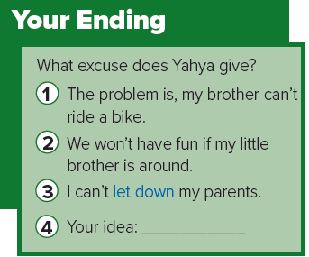

Slide 9
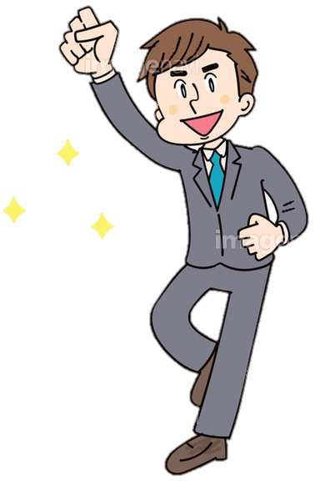
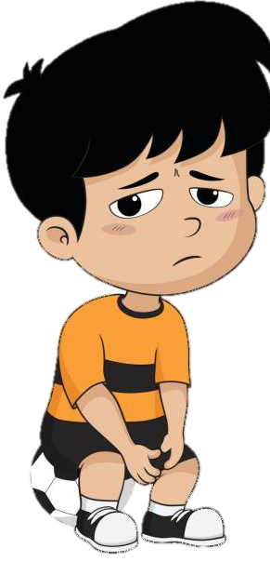
Real Talk
come on
used to encourage someone to do something
let down
disappoint someone

Slide 10



عبير العنزي

