Slide 1
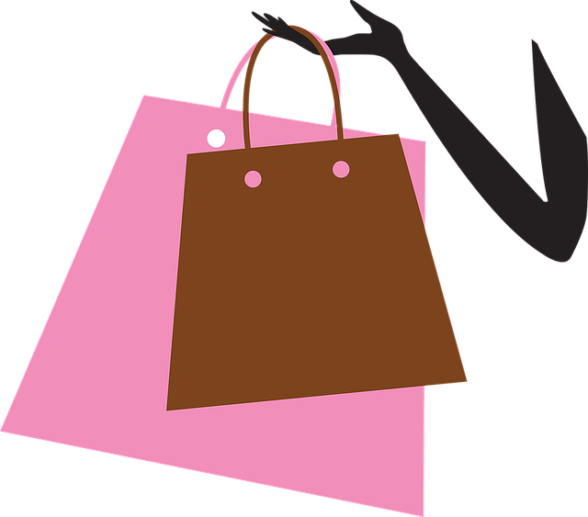
U 2
It’s a Bargain!

Slide 2
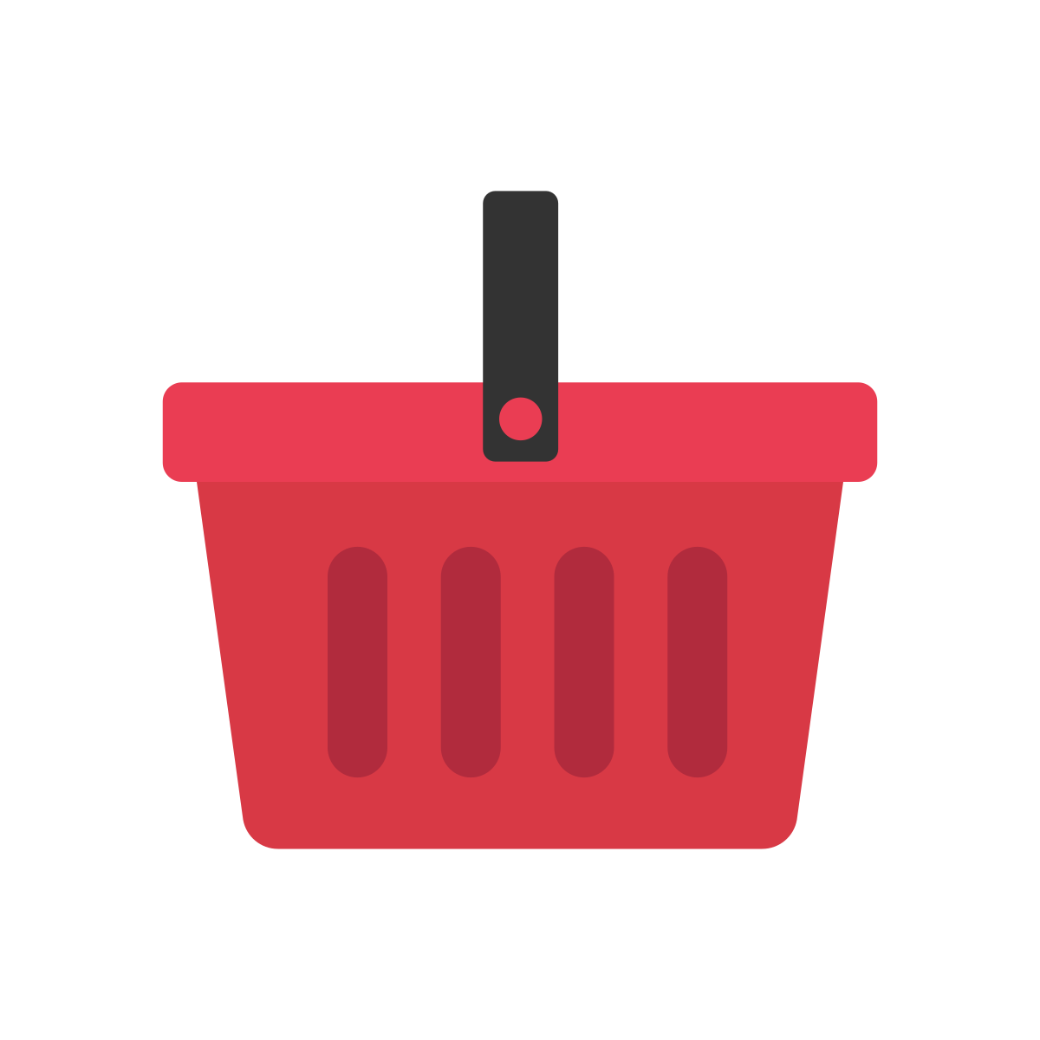
Know some vocabularies about shopping, clothes, jewelry, accessories, materials
Differentiate between for sale and on sale
Answer some questions about the topic of the conversation
Objectives

Slide 3
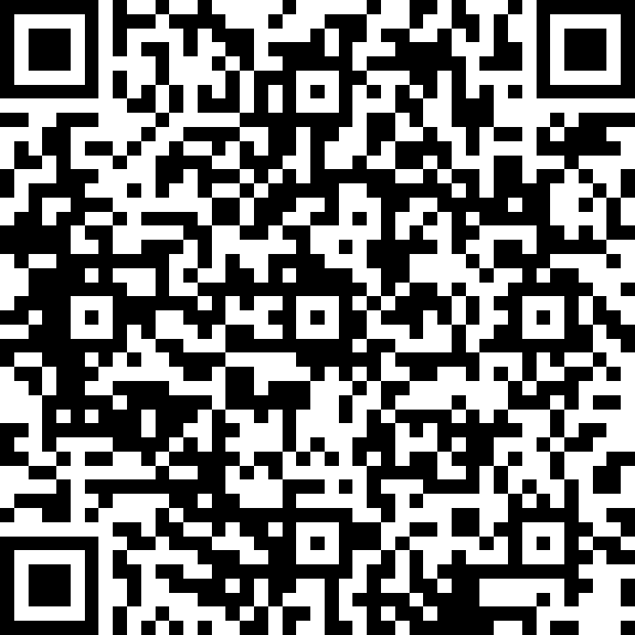
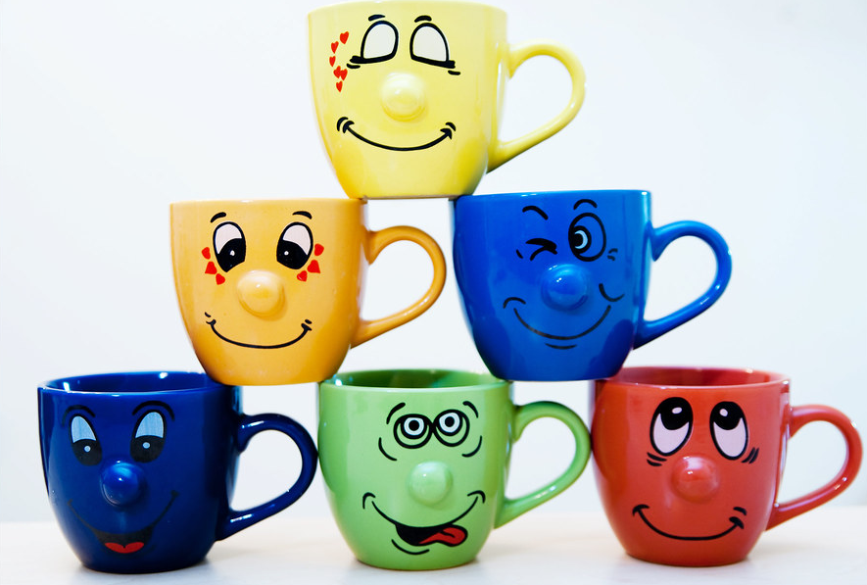

Slide 4
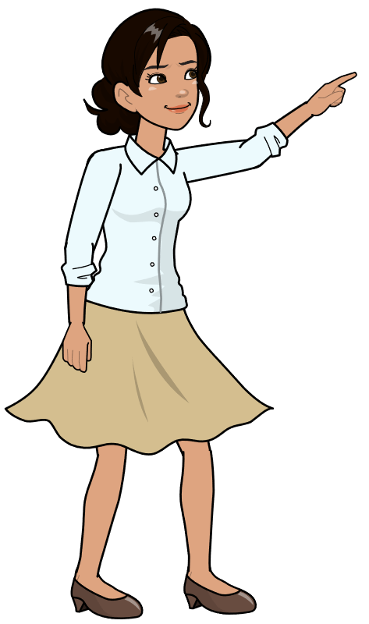
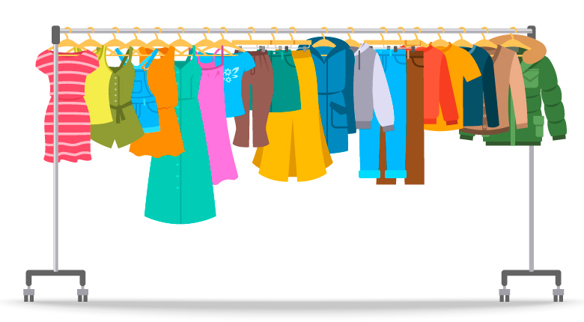
What are you wearing now?
I’m wearing a white shirt and a beige skirt. I’m also wearing a ring.

Slide 5

What is your favorite shopping store?

Slide 6
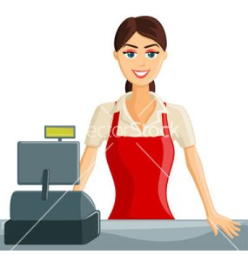
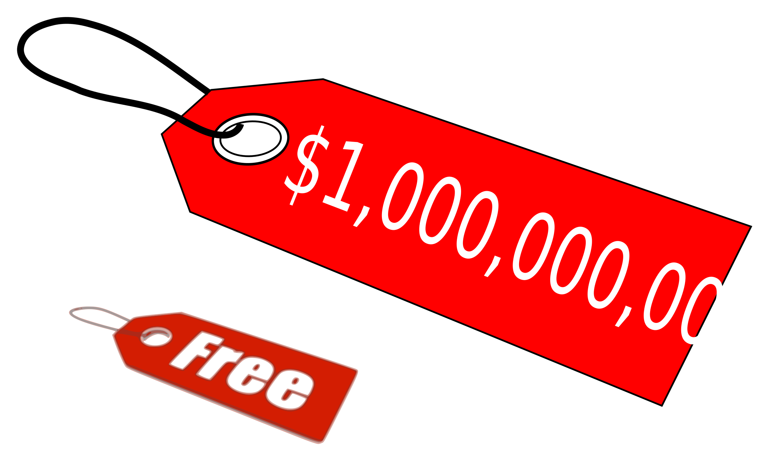

What do you look for when you shop?

Slide 7
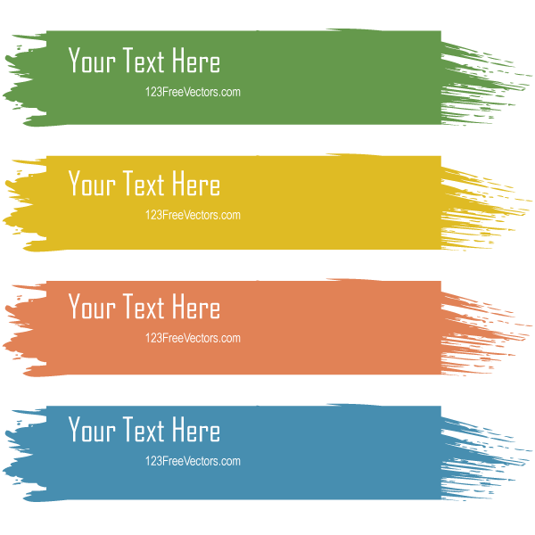
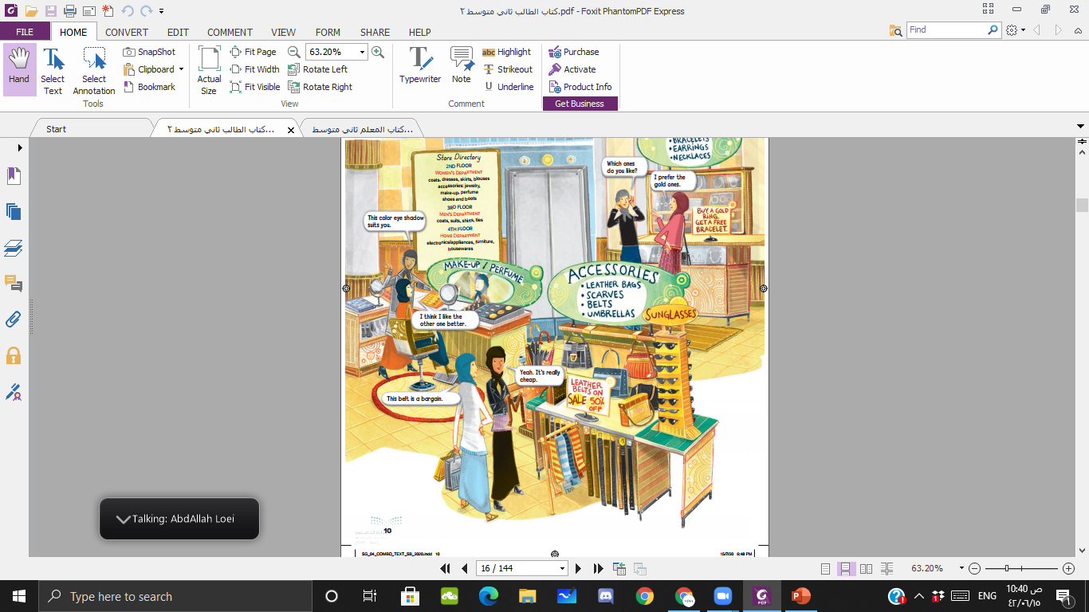
Open your book at page 10

Slide 8
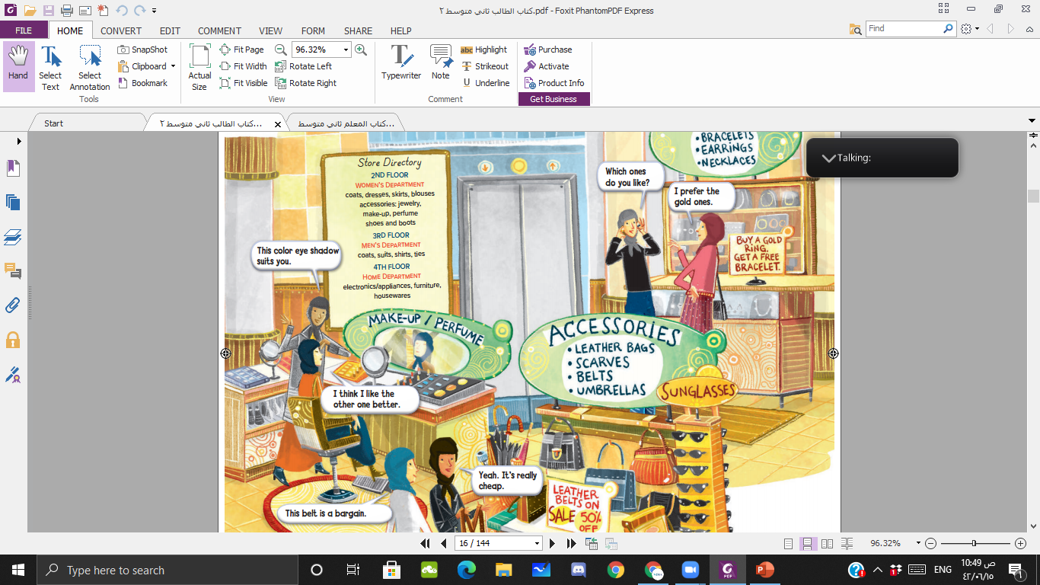
Where are men’s coats?
Where are women’s shoes?

Slide 9
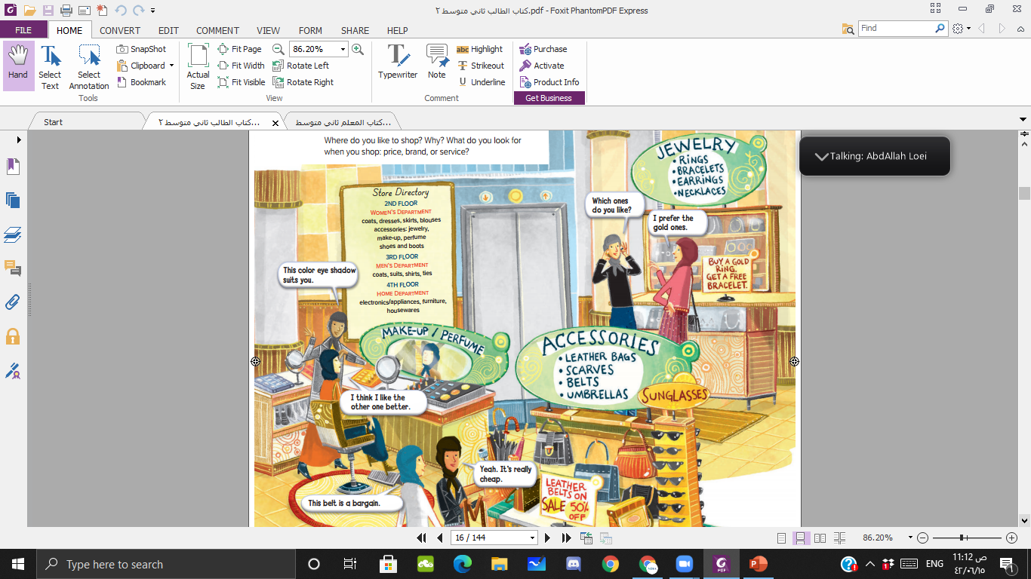

1
2
3
4

Slide 10
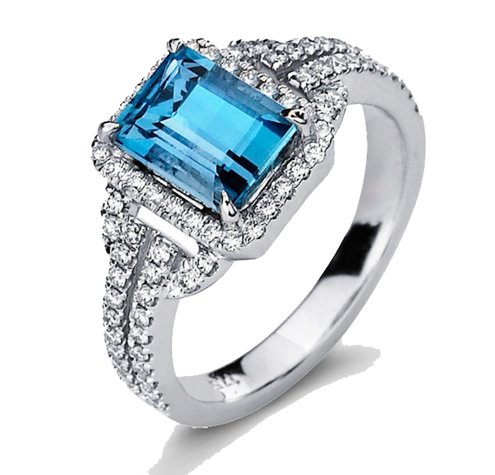
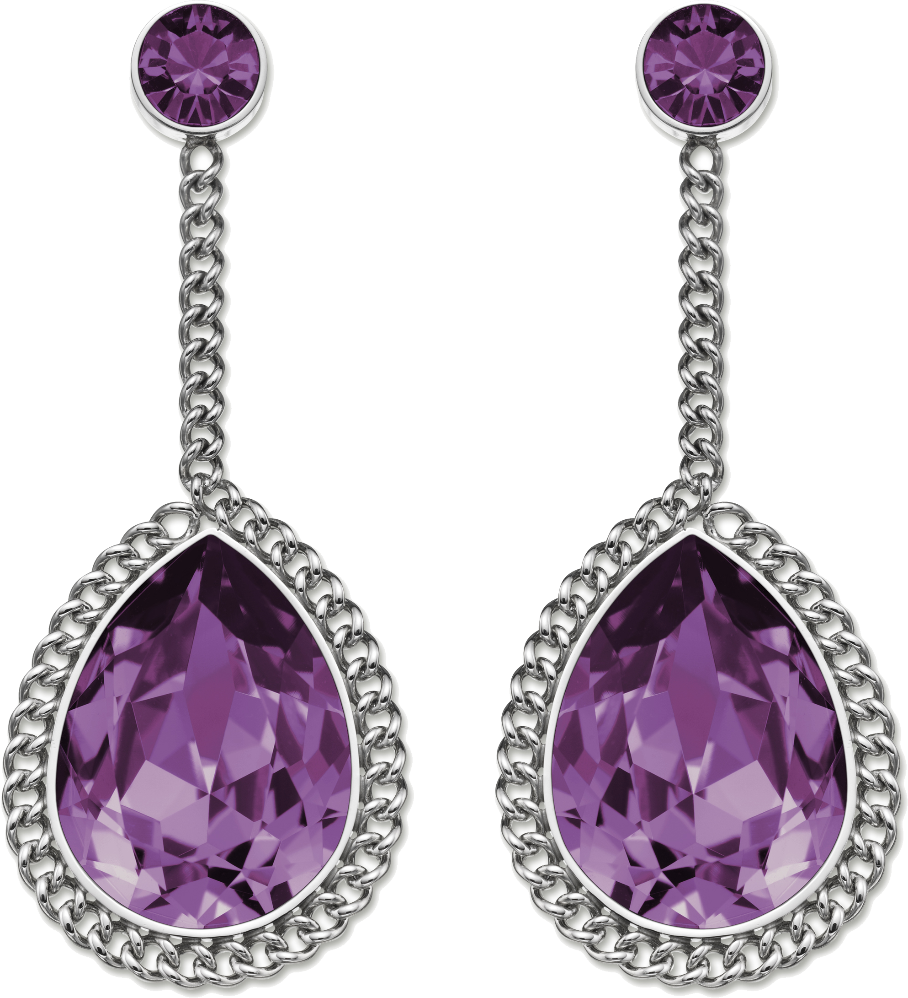
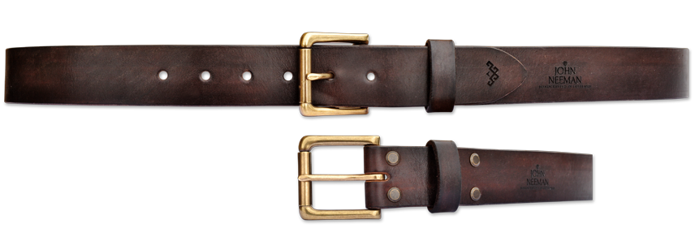
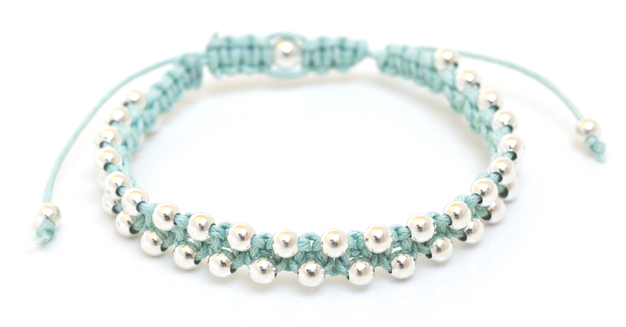
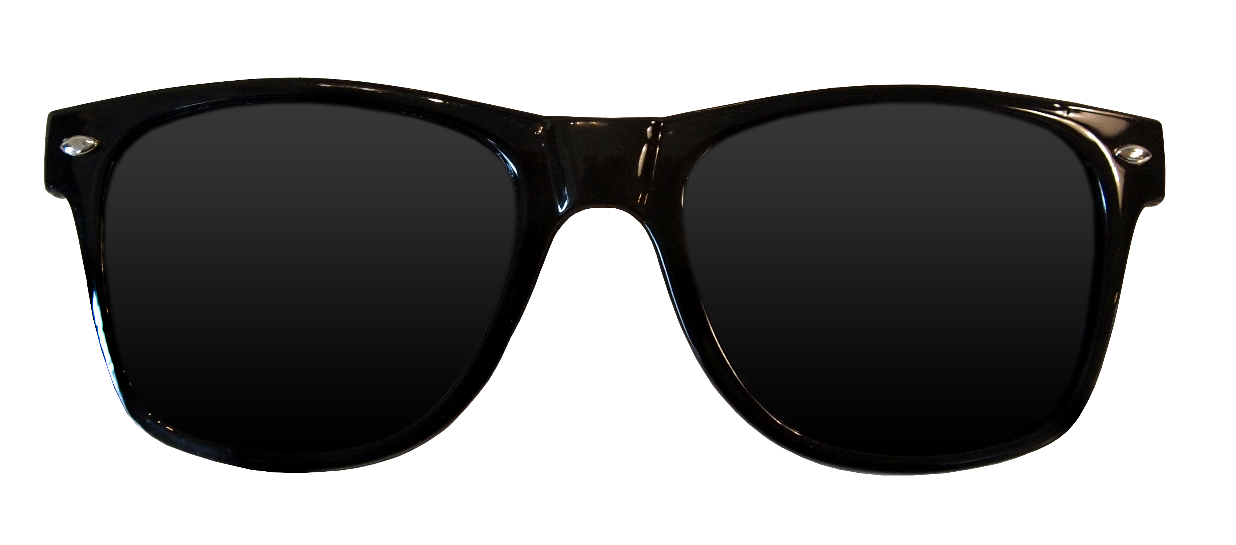
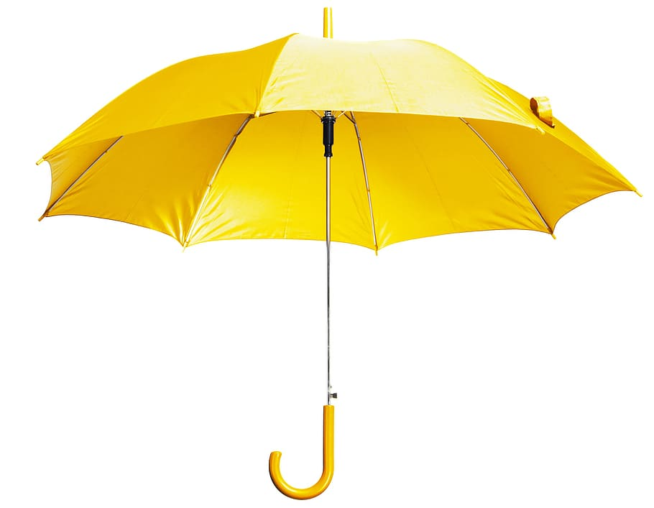
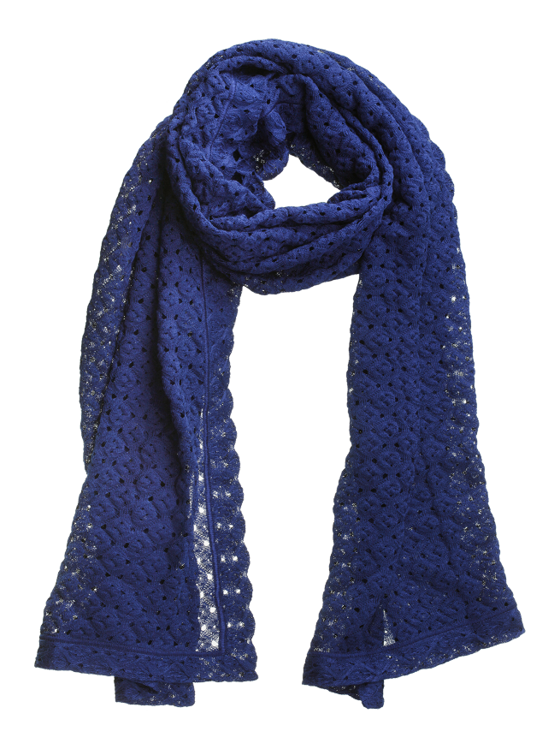
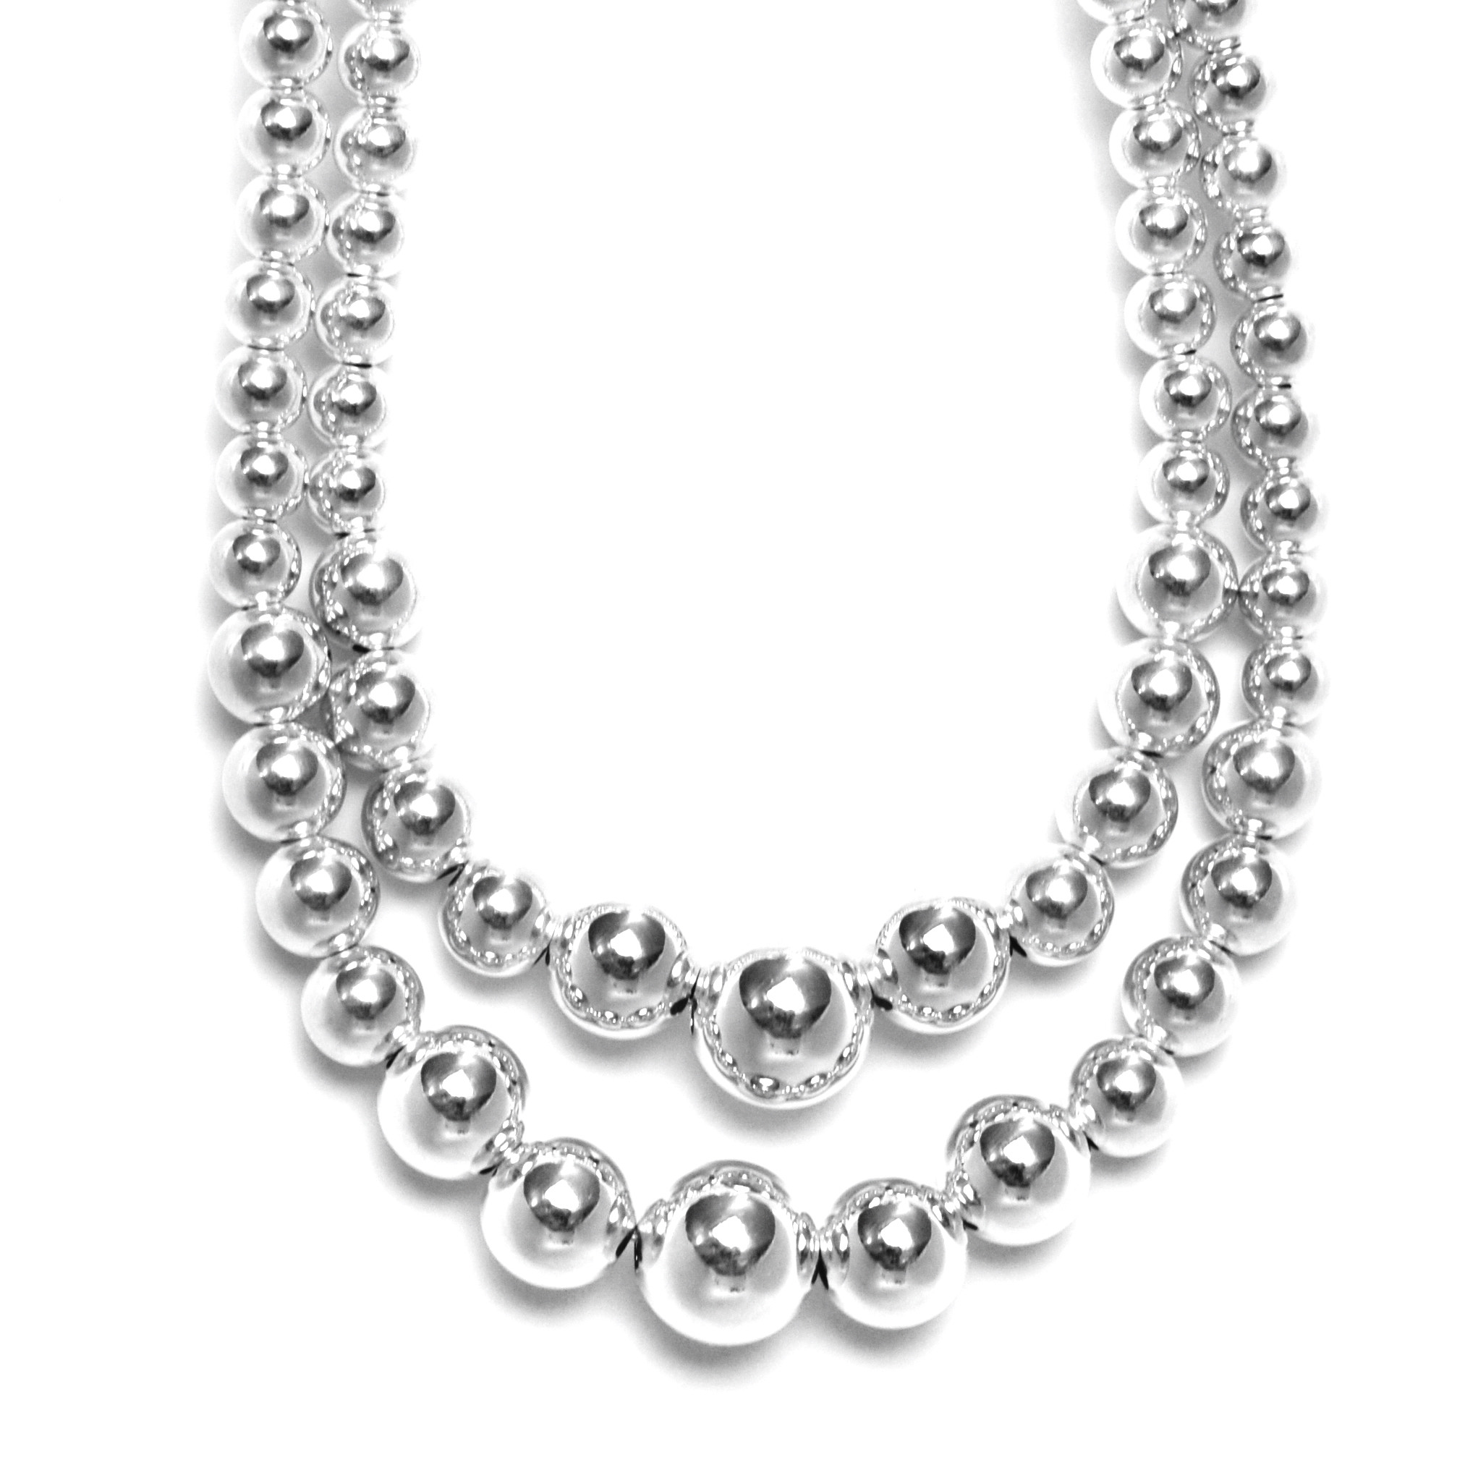
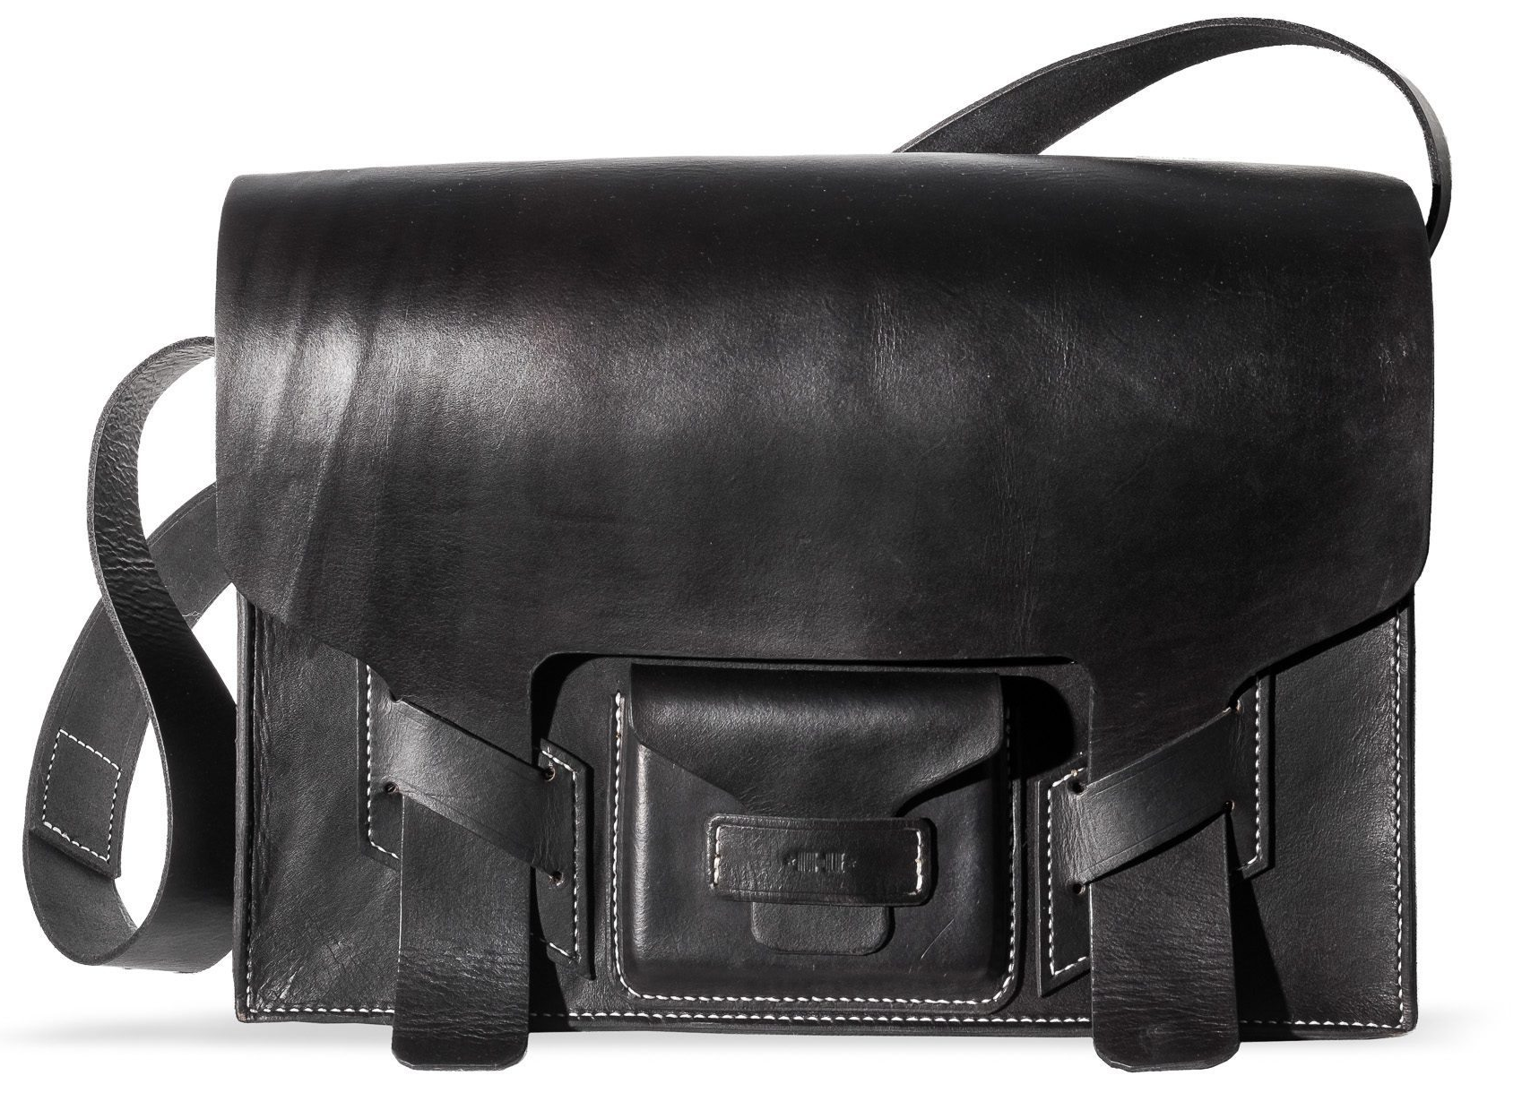
Belt
Ring
Bracelet
Earrings
Sunglasses
Necklace
Umbrella
Scarf
Leather bag

Slide 11
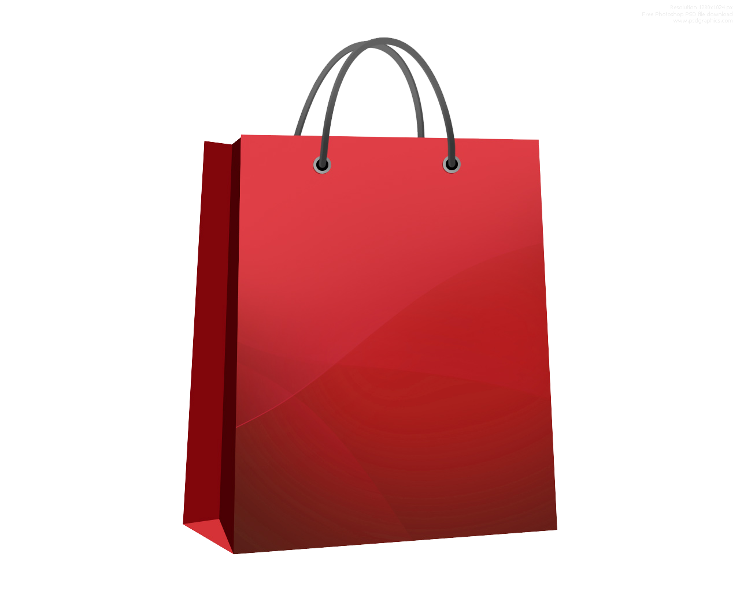
What kinds of things can you buy in Accessories?
Accessories

Slide 12
What kinds of jewelry can you buy in the jewelry department?
Jewelry

Slide 13
What kinds of things can you buy in Outerwear?
Clothes

Slide 14
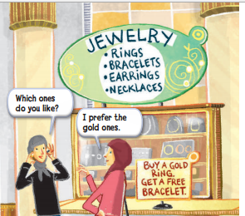
What do you get if you buy a gold ring?

Slide 15
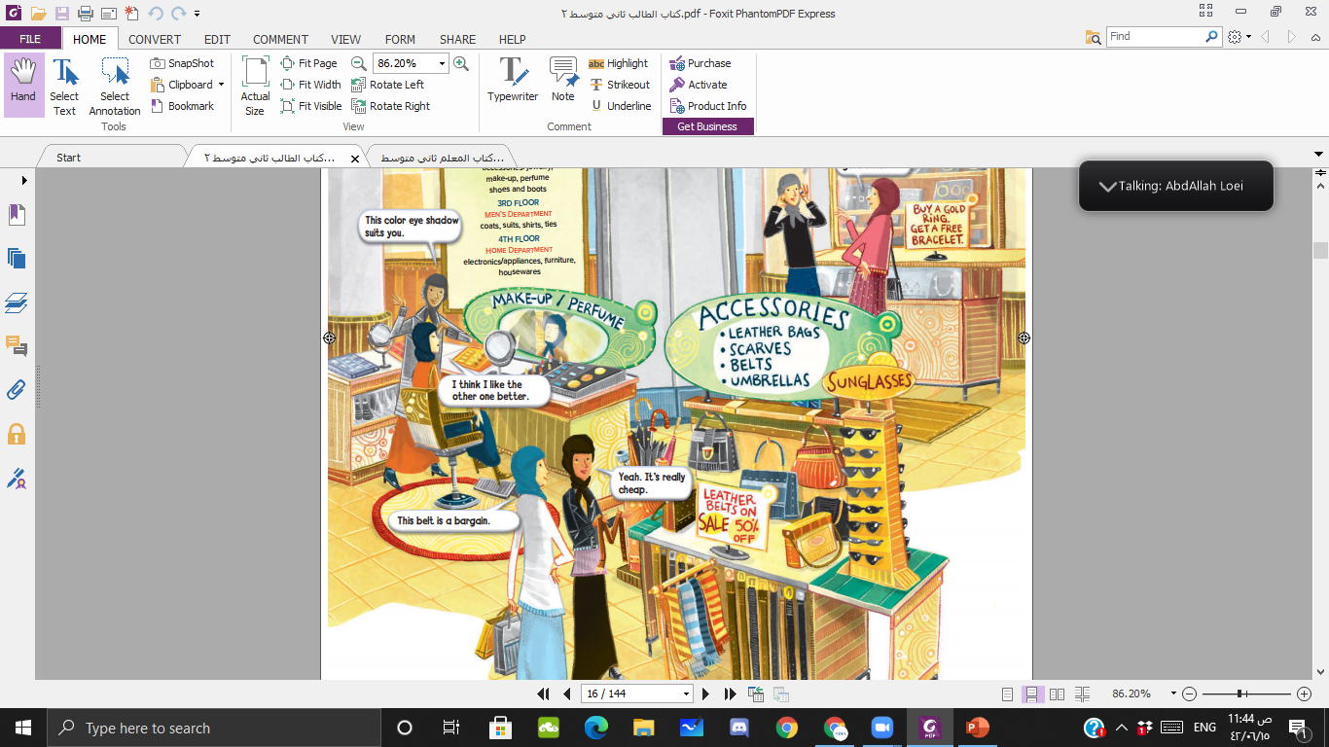
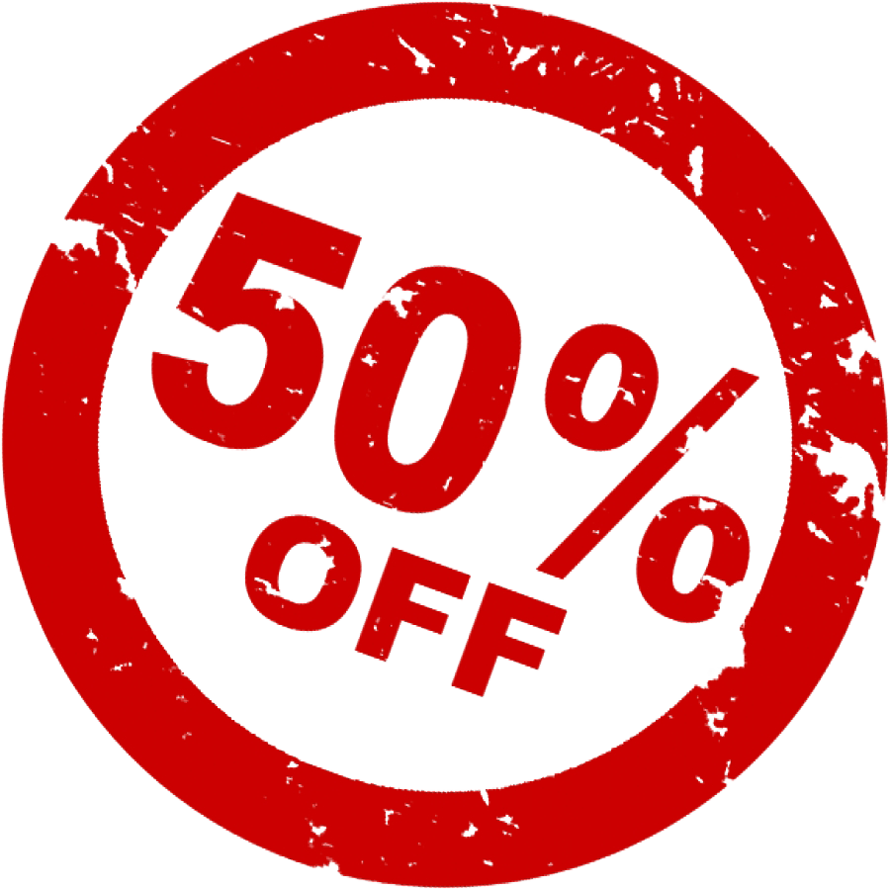
Is there a good sale on leather belts?

Slide 16
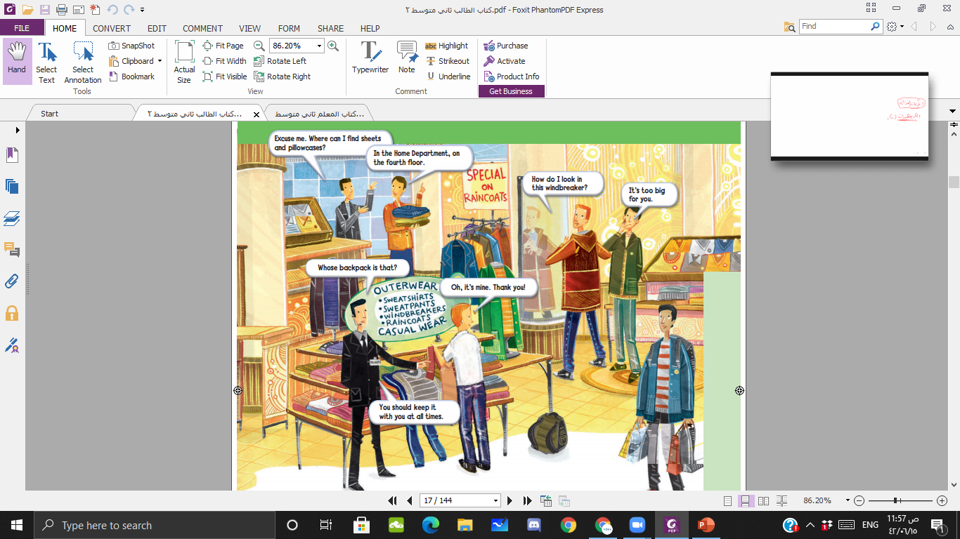

Slide 17
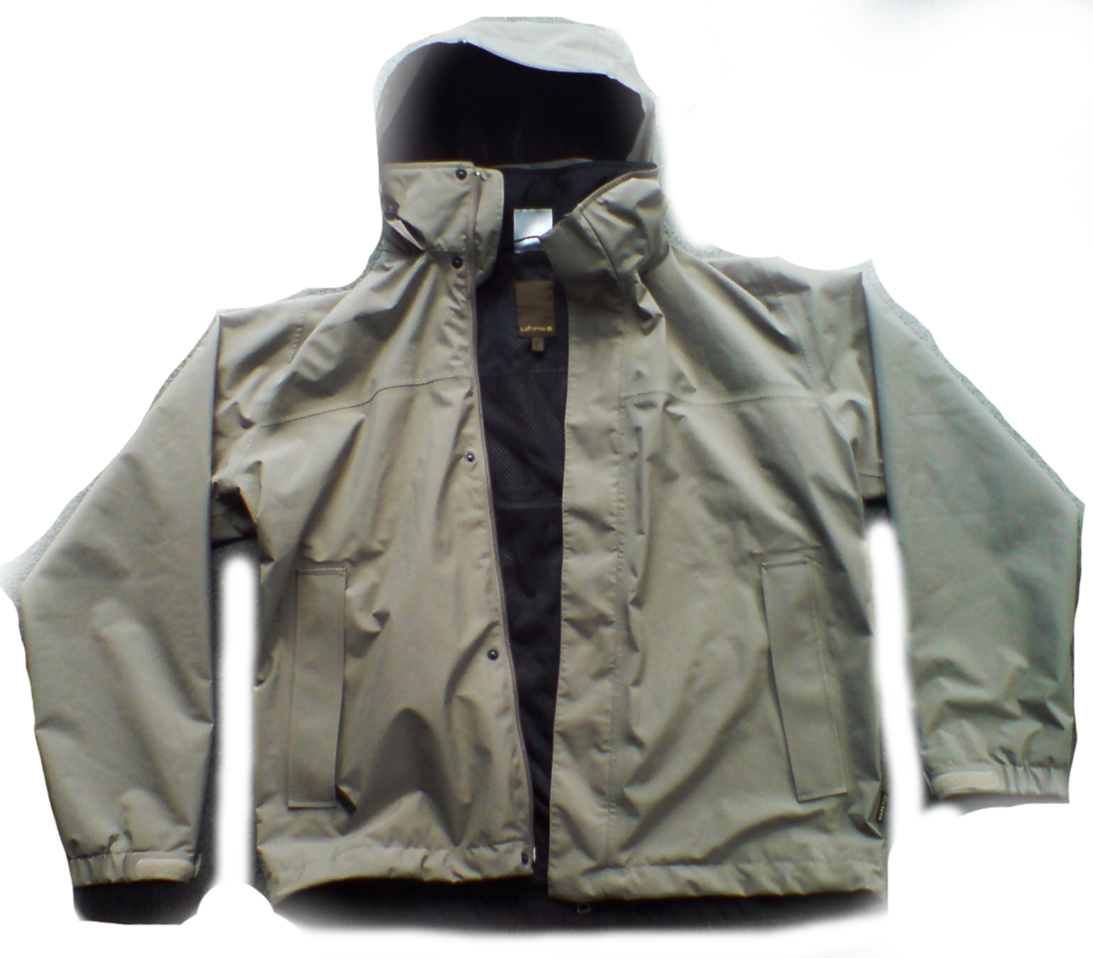
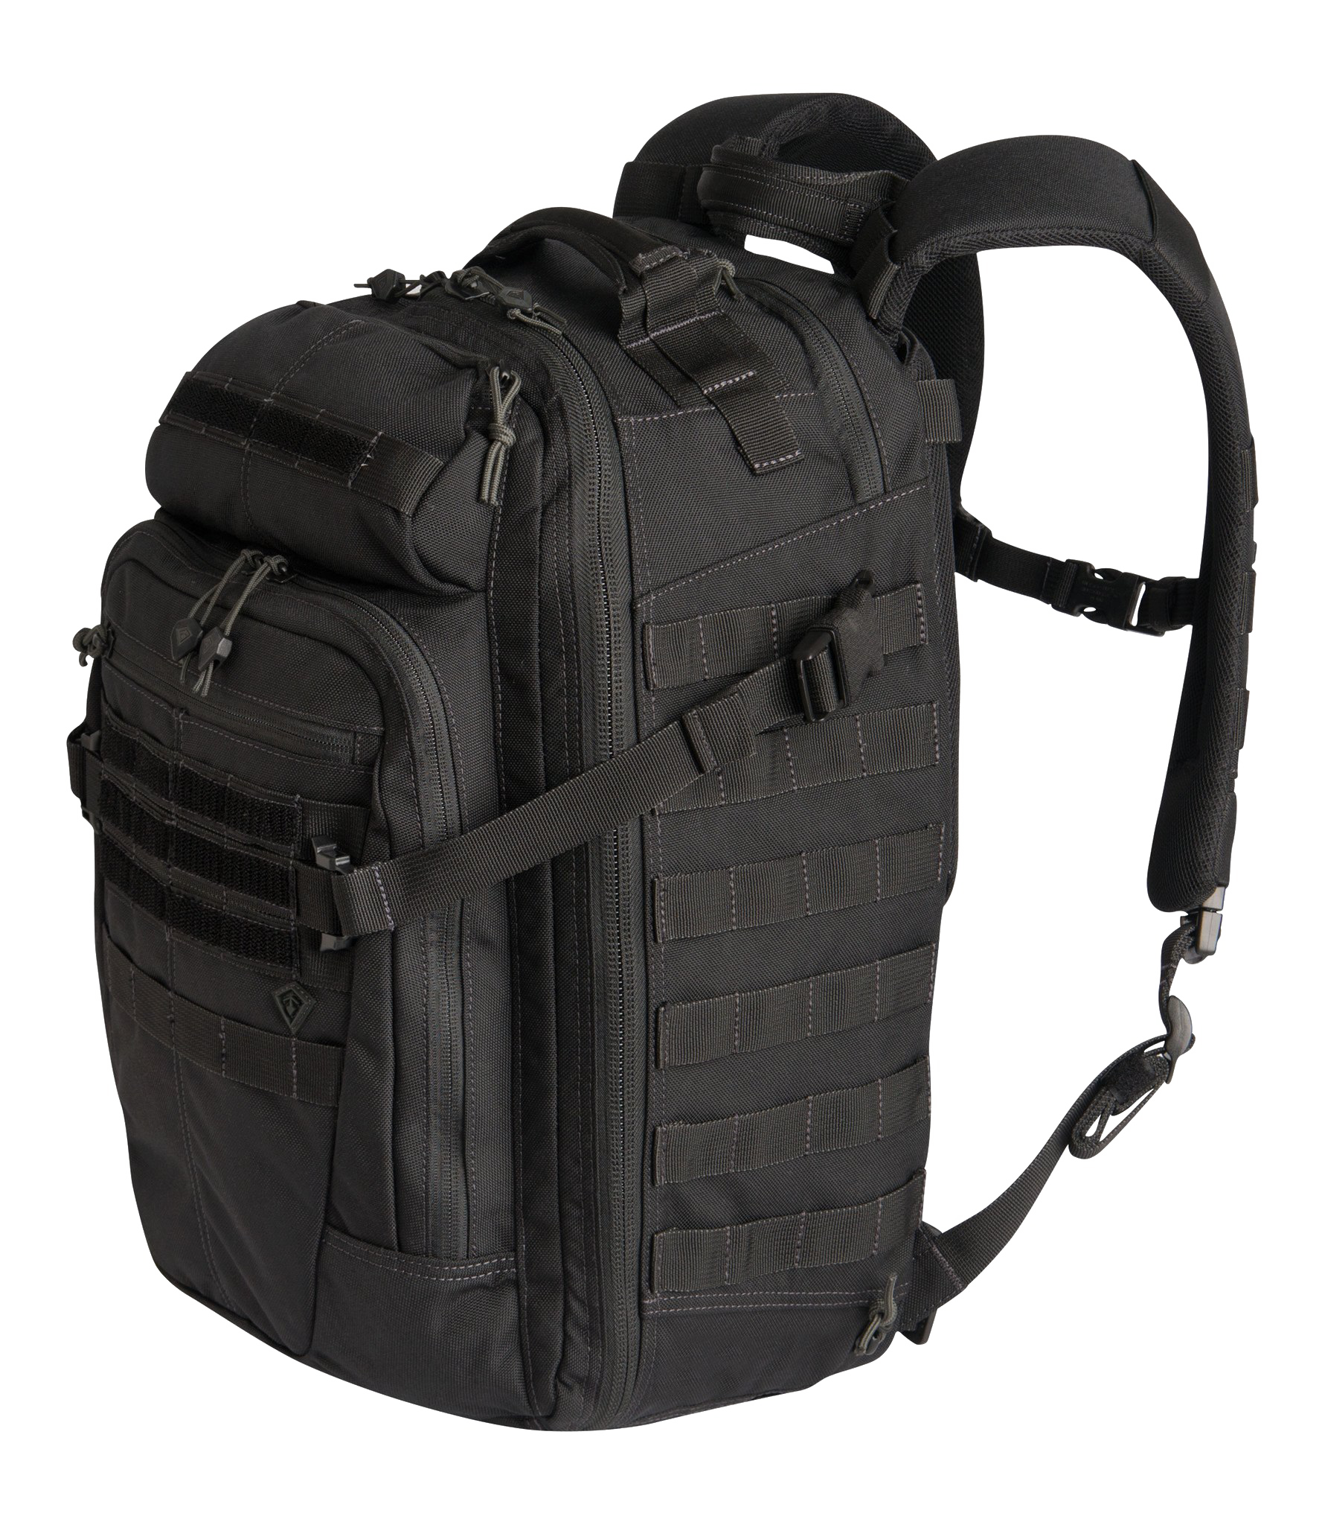
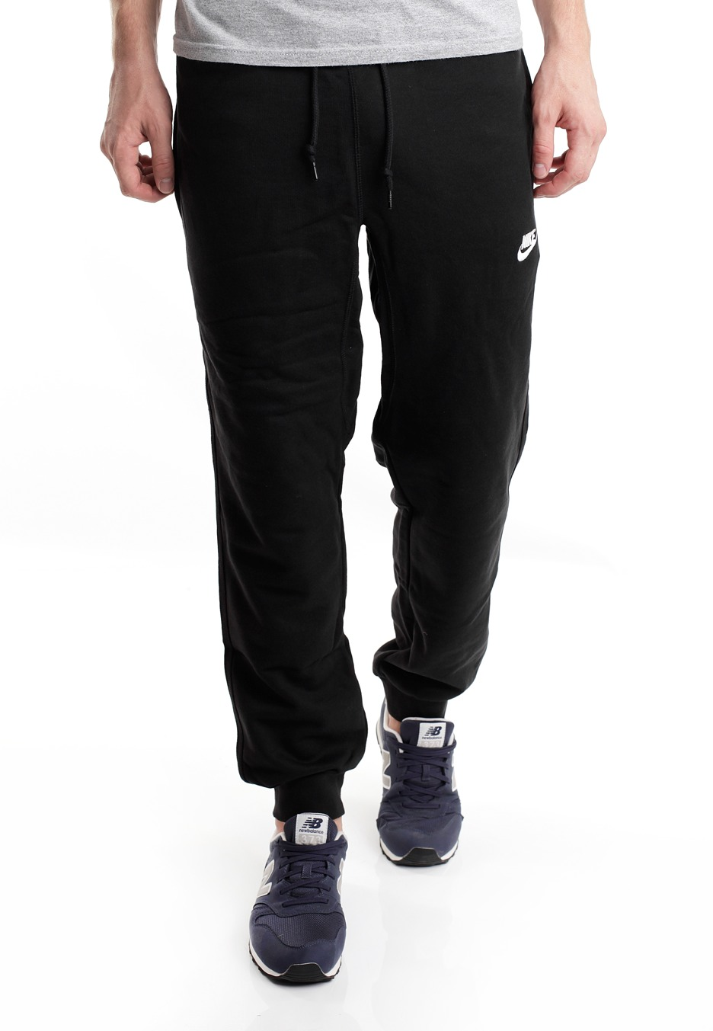
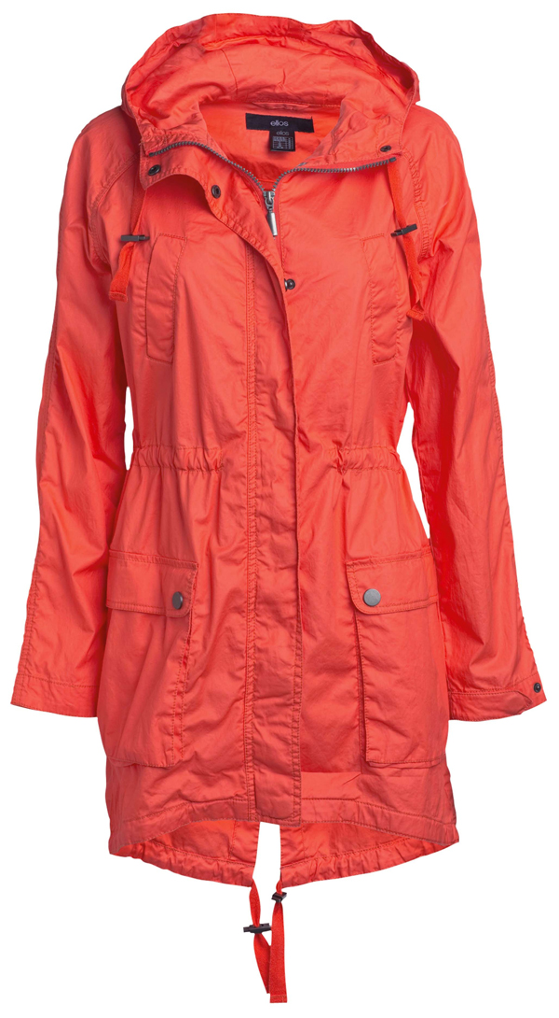
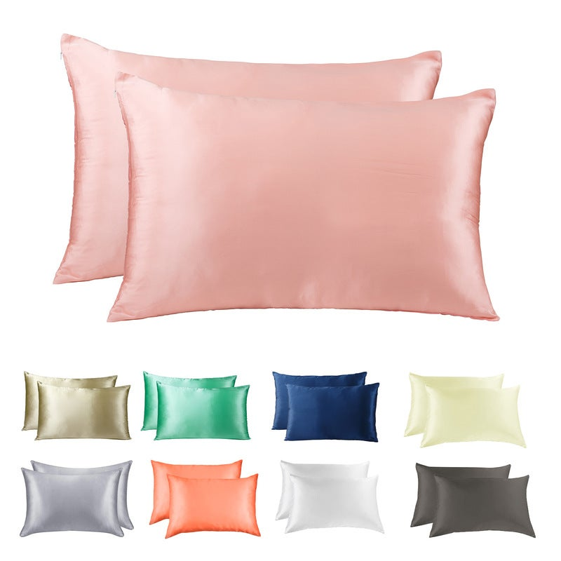
Backpack
Sweatpants
Raincoat
windbreaker
billow cases

Slide 19
What is there a special on?
Do we know what exactly the special is
on raincoats?

Slide 20
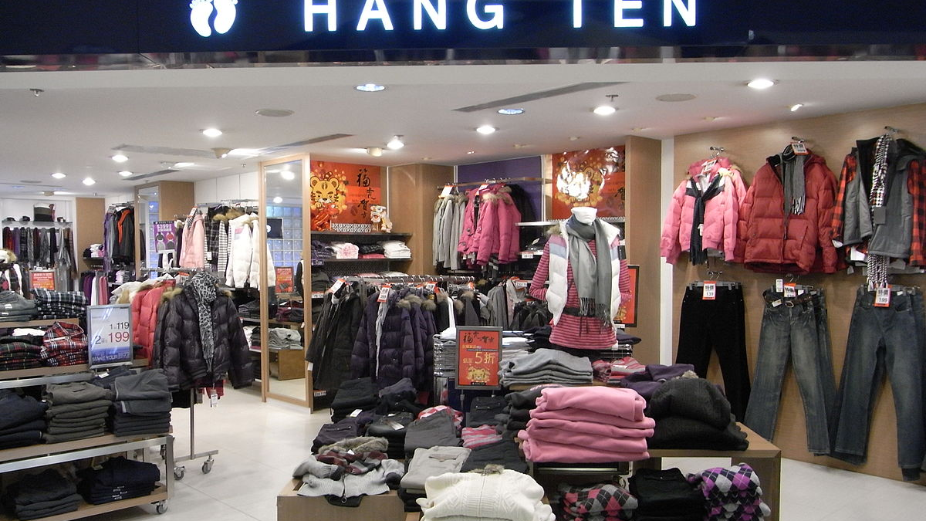
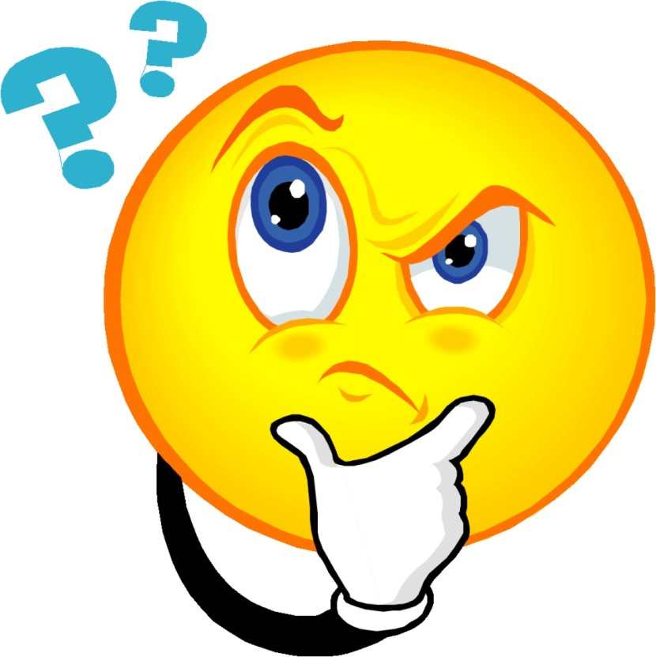
For sale
on sale
for sale describes any merchandise that can be bought,
on sale refers to merchandise that can be bought at a
discount, or at a lower price than the regular selling price.

Slide 21
What departments are there in the departments store?

Slide 22
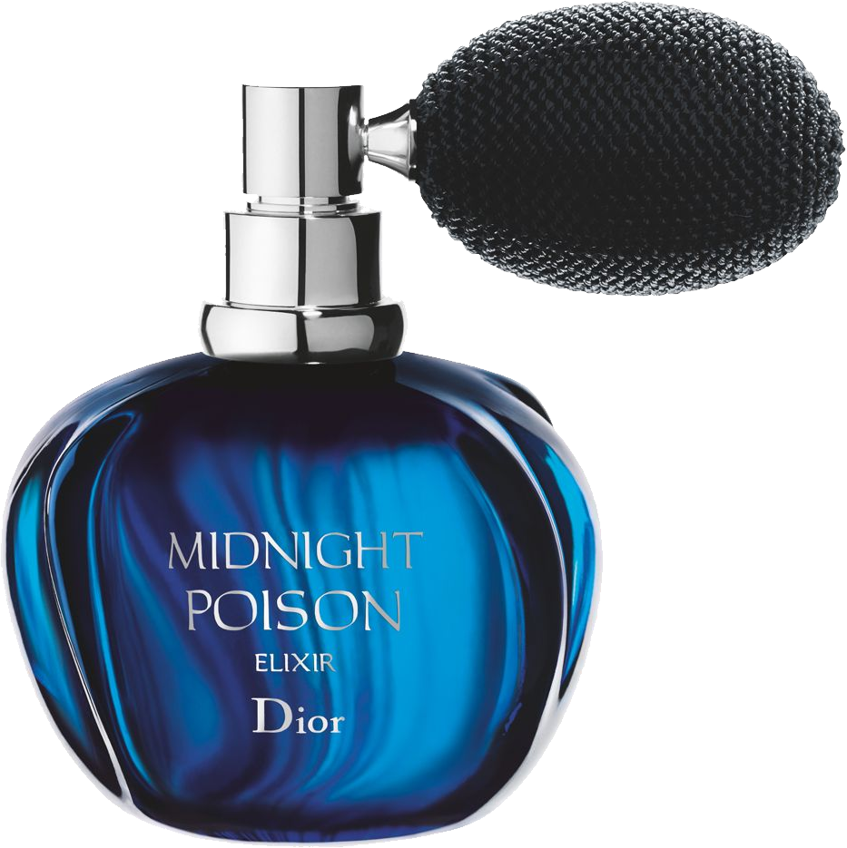
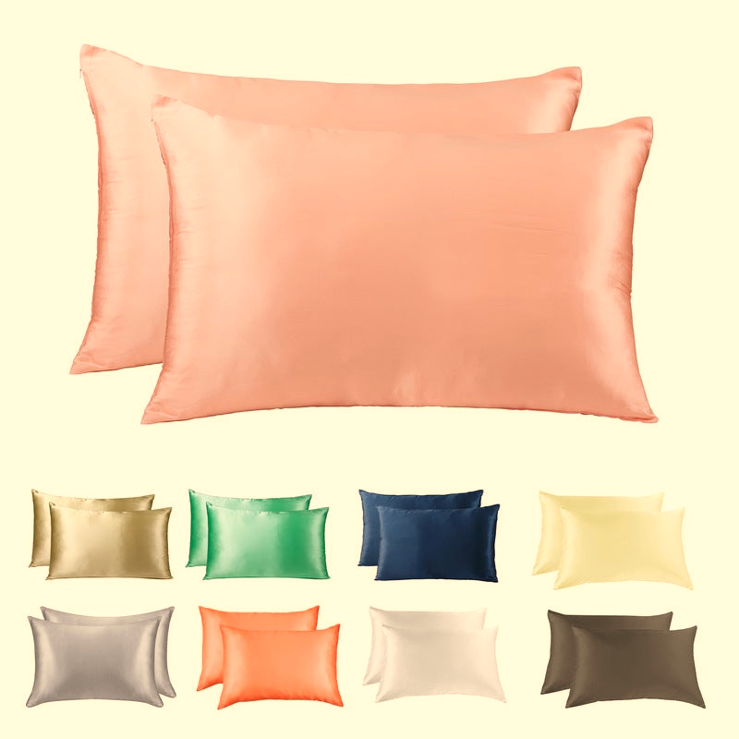
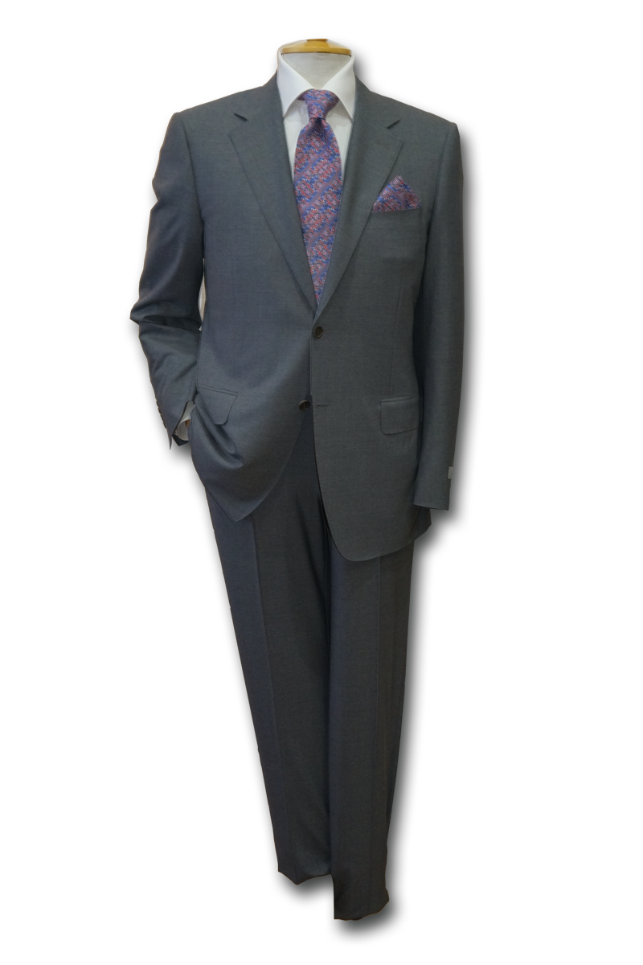
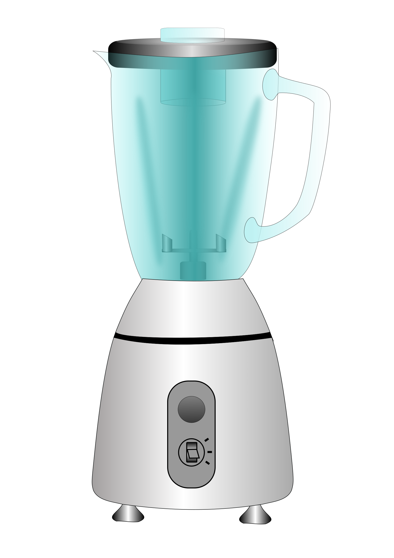
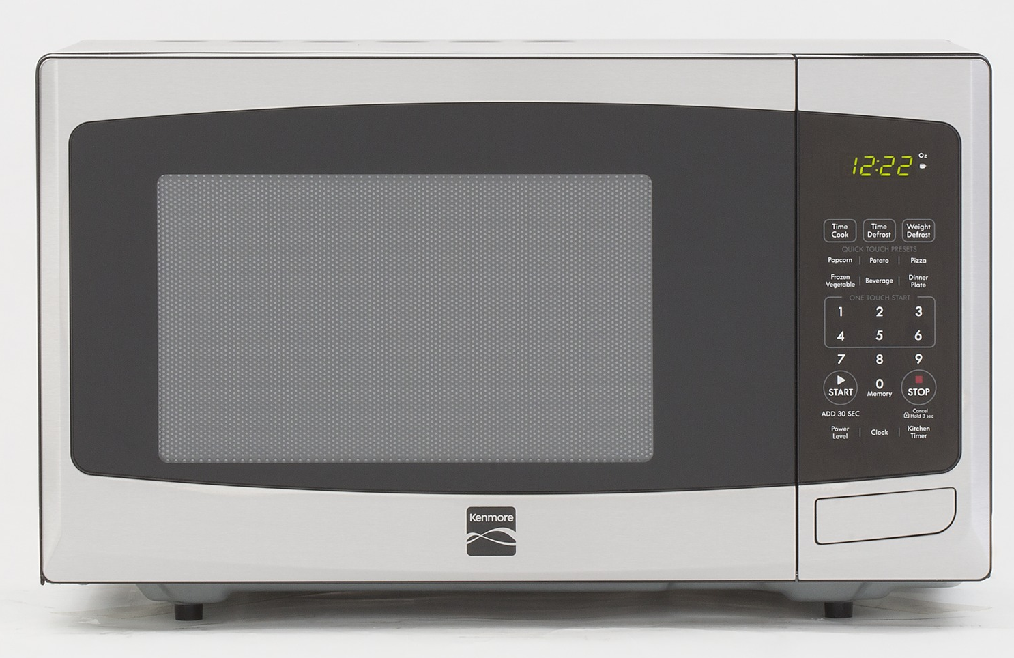
Home department
Make-up
Men’s department
electronics
electronics

Slide 23
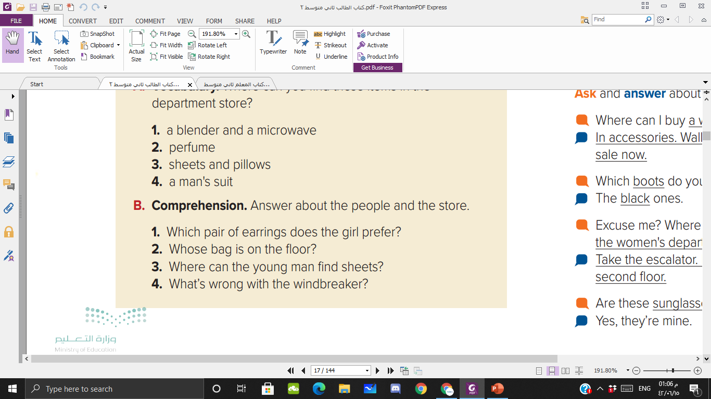

The girl prefers the gold ones
The young man’s bag is on the floor
in the home department, on the fourth floor
The windbreaker is too big for the man.

Slide 24

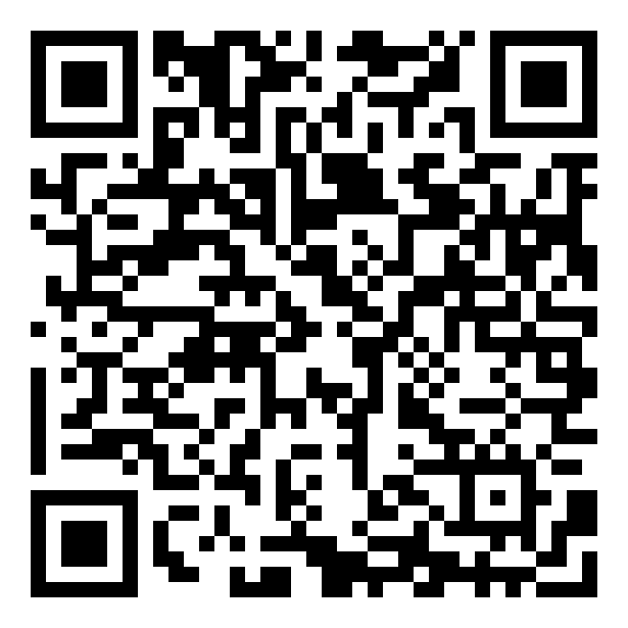

Slide 25
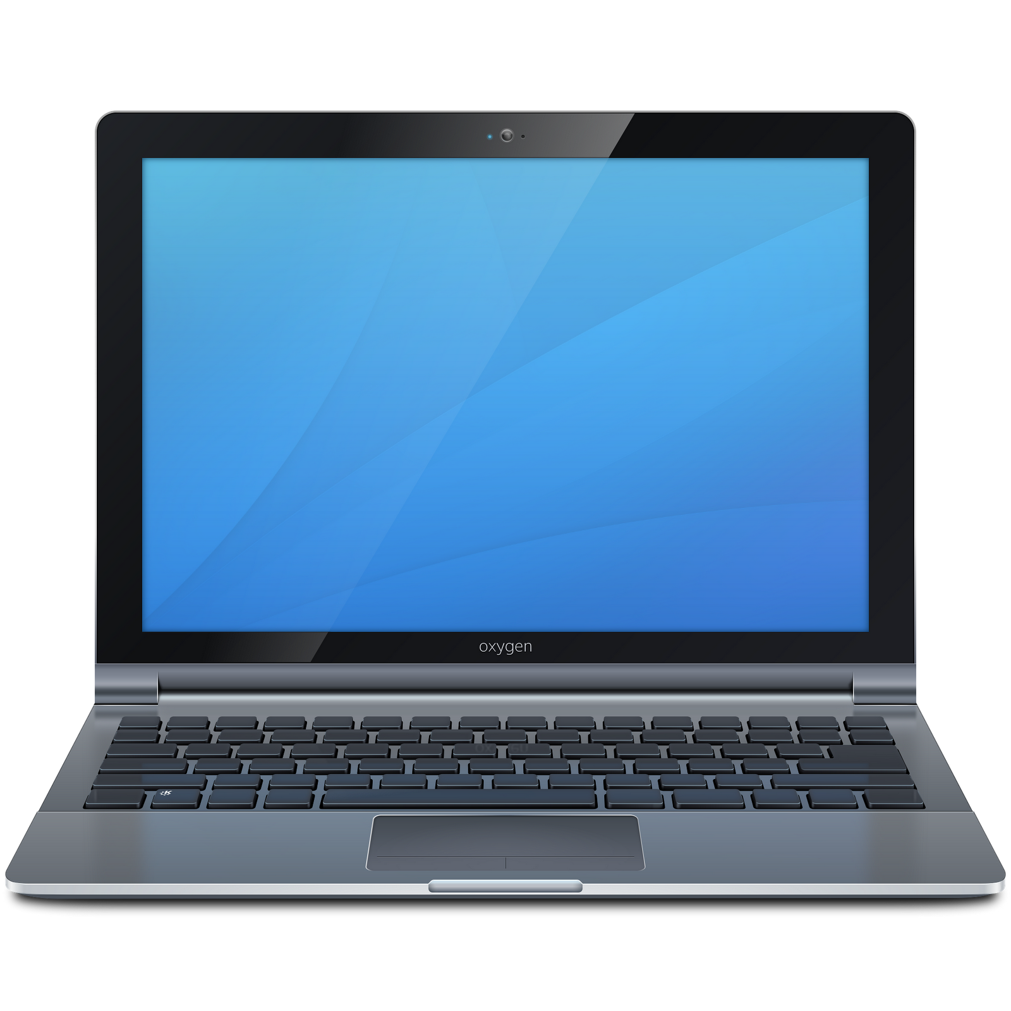

Homework

