Slide 1

P.223

Slide 2
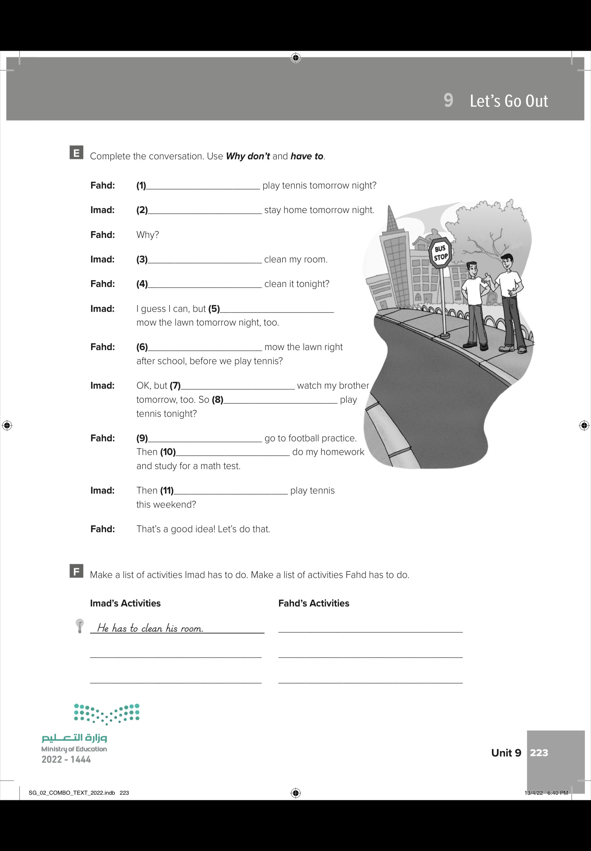
Why don’t we
I have to
I have to
Why don’t you
I have to
Why don’t you
I have to
Why don’t we
I have to
I have to
Why don’t you

Slide 3
He has to go to the football practice
He has to mow the lawn
He has to do his homework .
He has to watch his brother.
He has to study for a math test.

Slide 4
Let’s go out
▪️Reading
Day:
Date:

Slide 5

Goals
Read a text about chores.
Make a list of what parents and what teens think about chores.

Slide 6
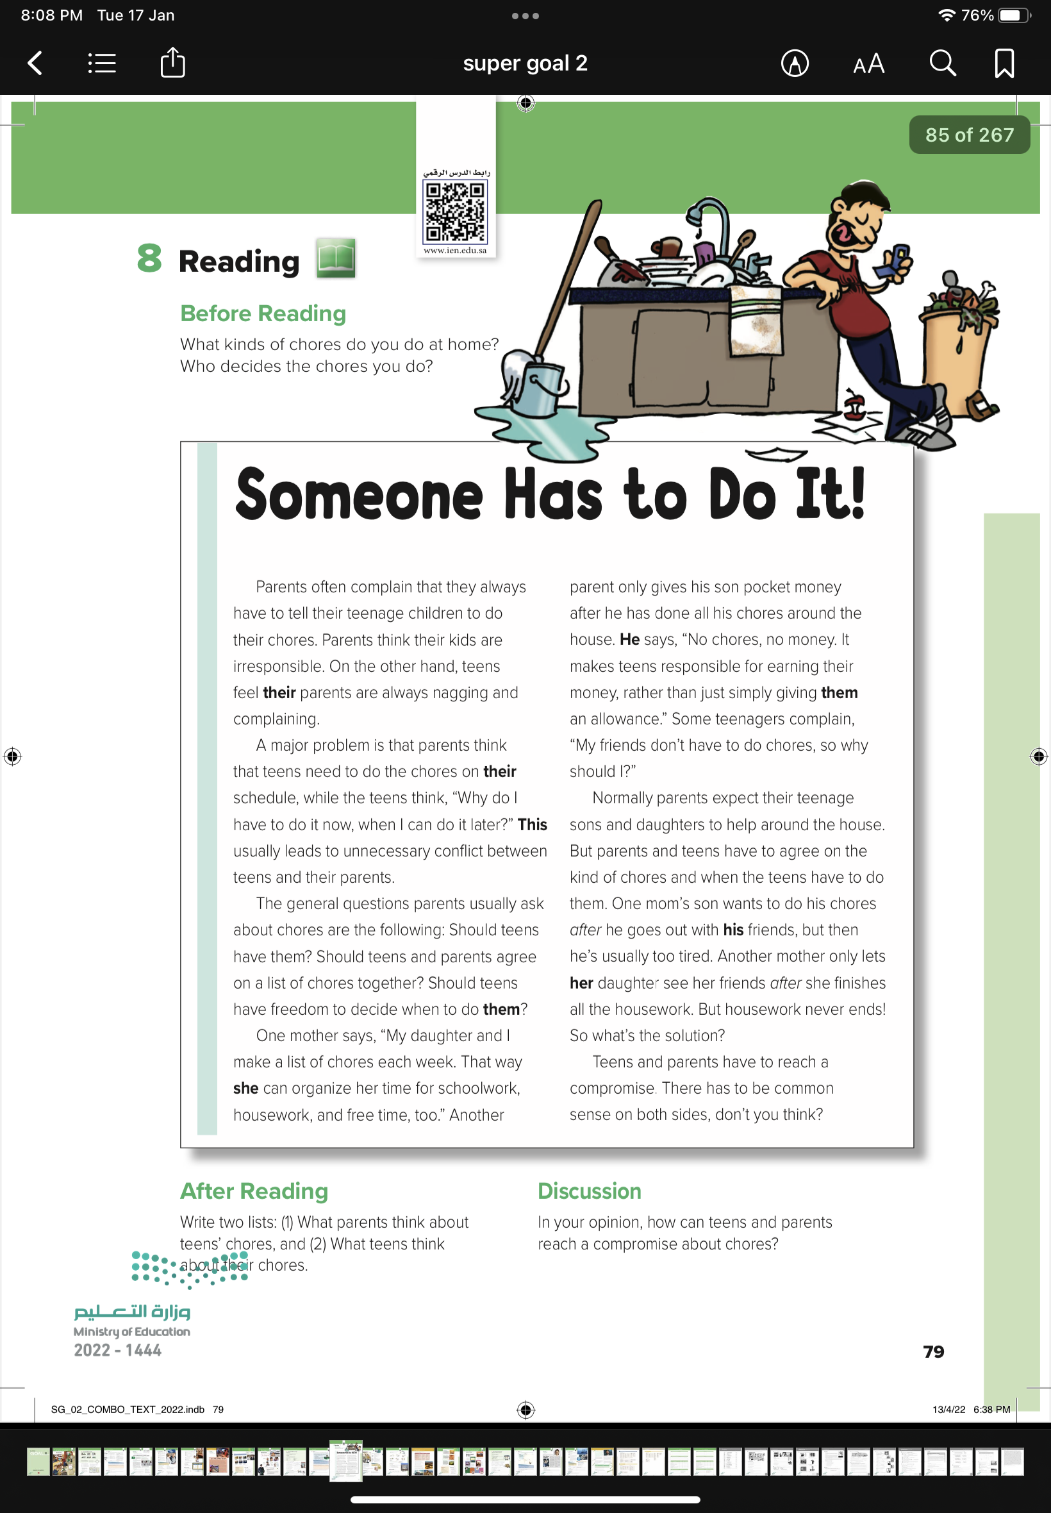
79

Slide 7
Before Reading

Slide 8
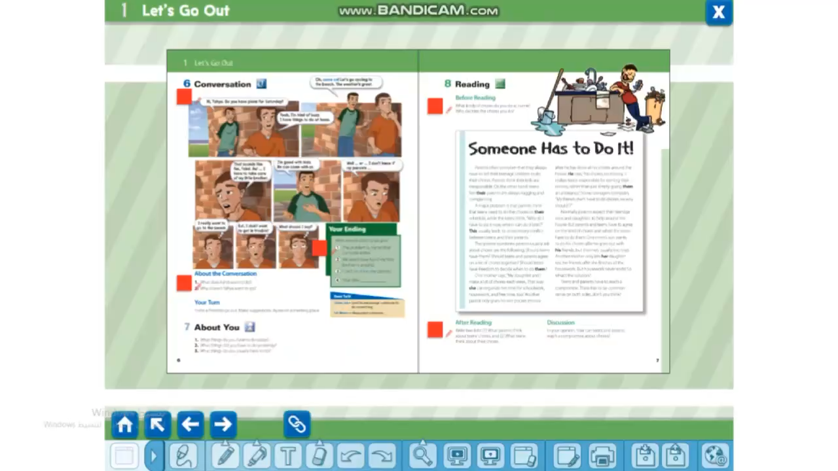

Slide 9
After Reading
Write two lists: 1 What parents think about teens’ chores, and
2 What teens think about their chores

Slide 10
What teens think about their chores
What parents think about teens’ chores

Slide 11
In your opinion how can teens and parents reach a compromise about chores?

Slide 12
Homework
P.224
G

