Slide 1
Grammar Rules

Slide 2
What we will learn
01
02
03
Form suggestions correctly
Use gerunds after " go "
Use has/have to express obligation

Slide 3
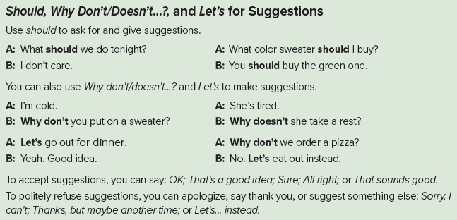

Slide 4


01
suggestions
There are three ways to make suggestions in English
( Should - Why don’t / doesn’t…, - Let’s )
And we can either accept or refuse the suggestion !

Slide 5

Let’s we go to the cinema.
Why don't we see a film?

Slide 6
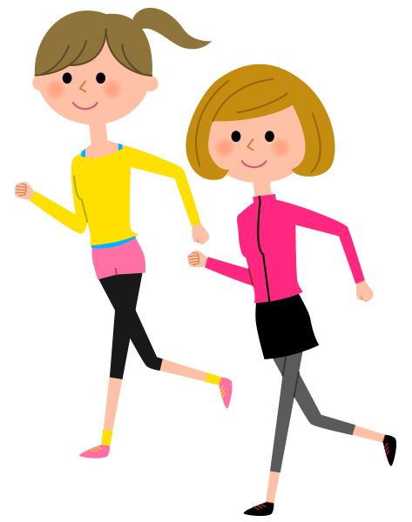
Let’s walk together.

Slide 7
# UNSCRAMBLE WORDS
should / a / game / play / We / .
Should we play a game.
should / game / play / we / What / ?
What game should we play?

Slide 8
1
Play / video game
Read / novel
2
3
Ride / bicycle
Watch/ movie
4
Do / homwork
6
7
8
5
Does / the dishes
Go / dentist
Visit / uncle
Done by T. Talal Alhazmi

Slide 9
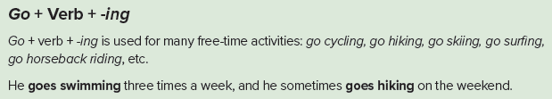
#2. Use gerunds after " go “
Two friends are talking about what to do
on the weekend. Which sentence do they say?
Let’s go swimming
Let’s swim

Slide 10
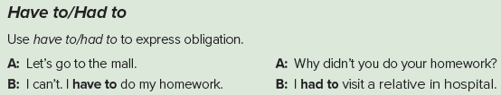
#3. Use has/have to express obligation
Has To
have to
V 0

Slide 11

John has to wear a tie at work

Slide 12

schoolchildren have to wear a uniform

Slide 13
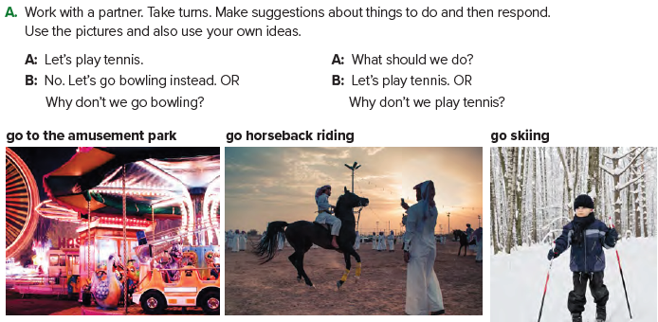

Slide 14
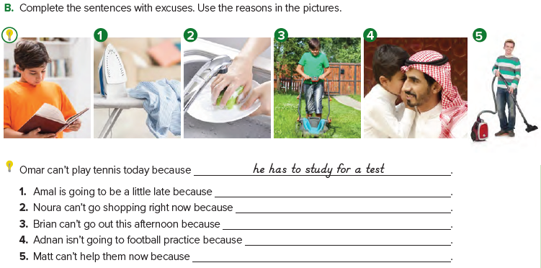
she has to do the laundry
she has to wash the dishes
he has to mow the lawn
he has to babysit
he has to clean the house

Slide 15
homework
P.222

Slide 16
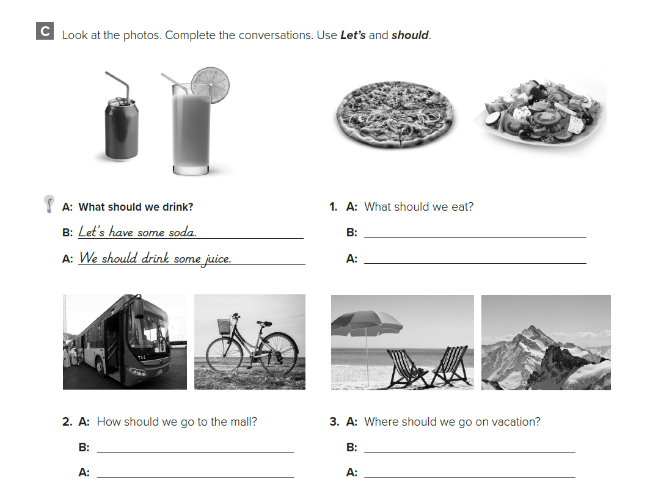
Let’s have some pizza
We should eat some salad
Let’s take the bus
We should ride our bikes
Let’s go to the beach
We should climb the mountain

Slide 17
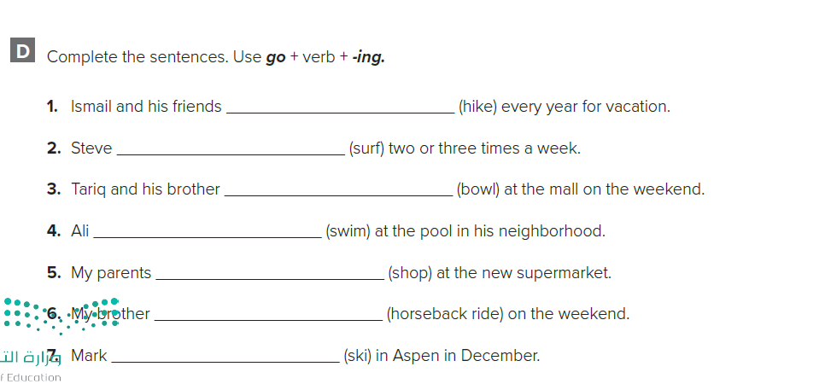
go hiking
goes surfing
go bowling
goes swimming
go shopping
goes horseback riding
goes skilling

