Slide 1


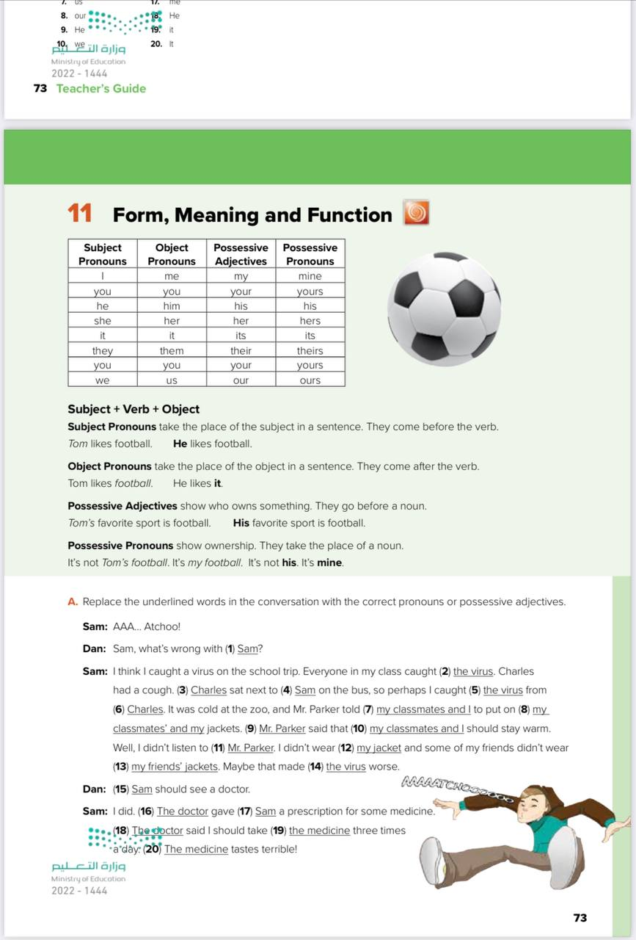
Form ,meaning and function
Student’s Book
73
Done by: Samiah Al Saeed

Slide 2
Objectives: at the end of the lesson you will be able to
Write a sentences by using pronouns
01
02
Recognize the different between pronouns
Done by: Samiah Al Saeed

Slide 3



It is a __________.
PENCIL
his
her
It is _____ pencil.
It is _____ pencil.

Slide 4


It is a __________.
BOOK
his
her
It is _____ book.
It is _____ book.

Slide 5
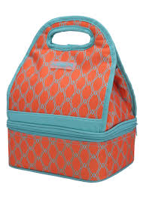

It is a __________.
LUNCH BOX
his
her
It is _____ lunch box.
It is _____ lunch box.

Slide 6


It is a __________.
CAR
his
her
It is _____ car.
It is _____ car.

Slide 7
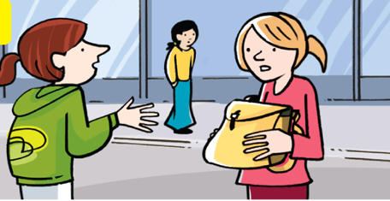
Whose rucksack is it ? It is (her – my – their ) rucksack. It is (hers – mine– theirs).

Slide 8
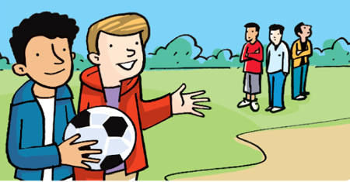
Whose ball is it ? It is (her – my – their ) ball. It is (hers – mine – theirs ).

Slide 9
pronouns

Slide 10
Subject and Object pronouns

Slide 11
Possessive adjectives and poossessive pronouns

Slide 12
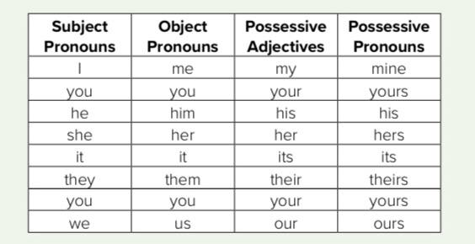

Slide 13




1/10
He
This is my friend Tom. ____ is from Britain.
He
Him

Slide 14
2/10
him
I met ____ at the beach last Summer.
he
him

Slide 15

3/10
His mother is a doctor.
____ works in that hospital.
She
She
Her

Slide 16
4/10
her
I saw ____ yesterday.
she
her

Slide 17
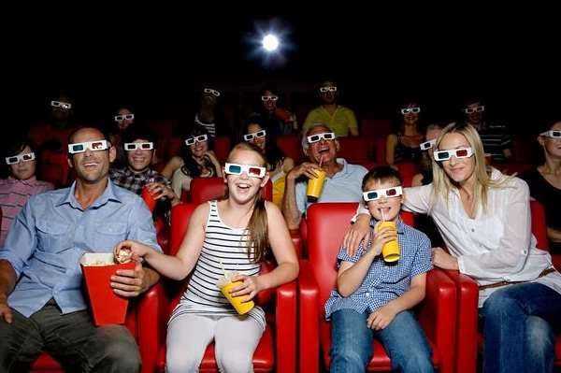
5/10
My parents like watching films.
I often go to the cinema with _____ .
them
they
them

Slide 18
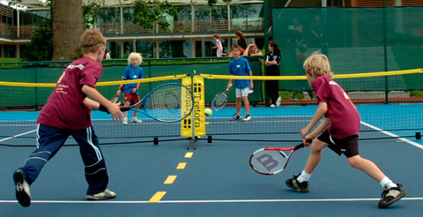
6/10
Bob and I usually play tennis together. ____ are good at it.
We
We
Us

Slide 19
We won the match.
So they gave ___ a trophy.
7/10
us
we
us

Slide 20
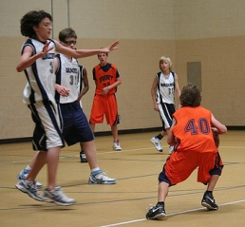
8/10
Bill and Joe are very tall.
_____ play in the basketball team.
They
They
Them

Slide 21
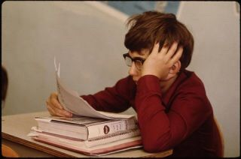
9/10
I’m studying English now because
____ have an exam tomorrow.
I
I
me

Slide 22

I told her the truth but she didn’t believe ____.
10/10
me
I
me
EXIT

Slide 23
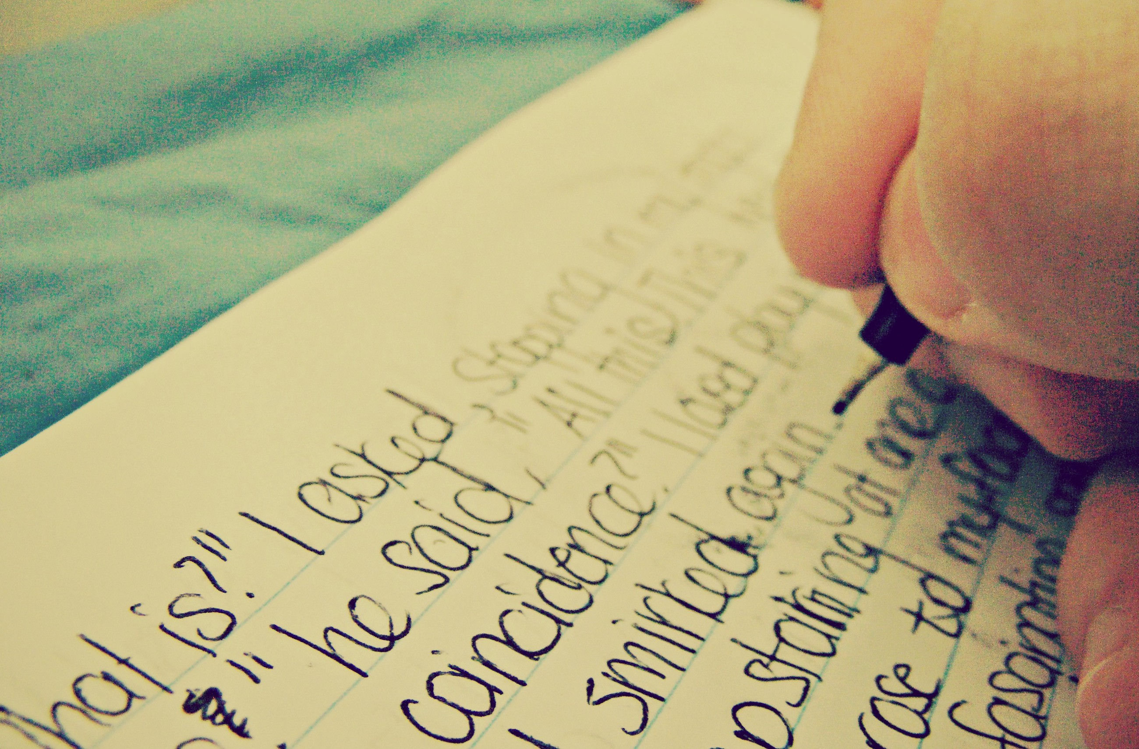
10/10
Write a sentence
EXIT

Slide 24

10/10
EXIT

Slide 25
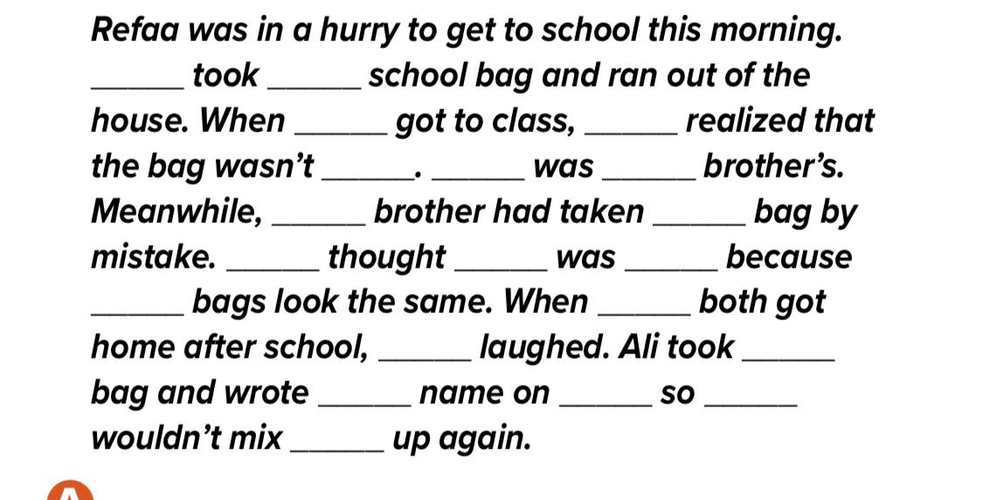
pronouns
she
her
she
she
hers
It
her
her
her
she
it
hers
their
they
they
his
his
it
they
them

Slide 26
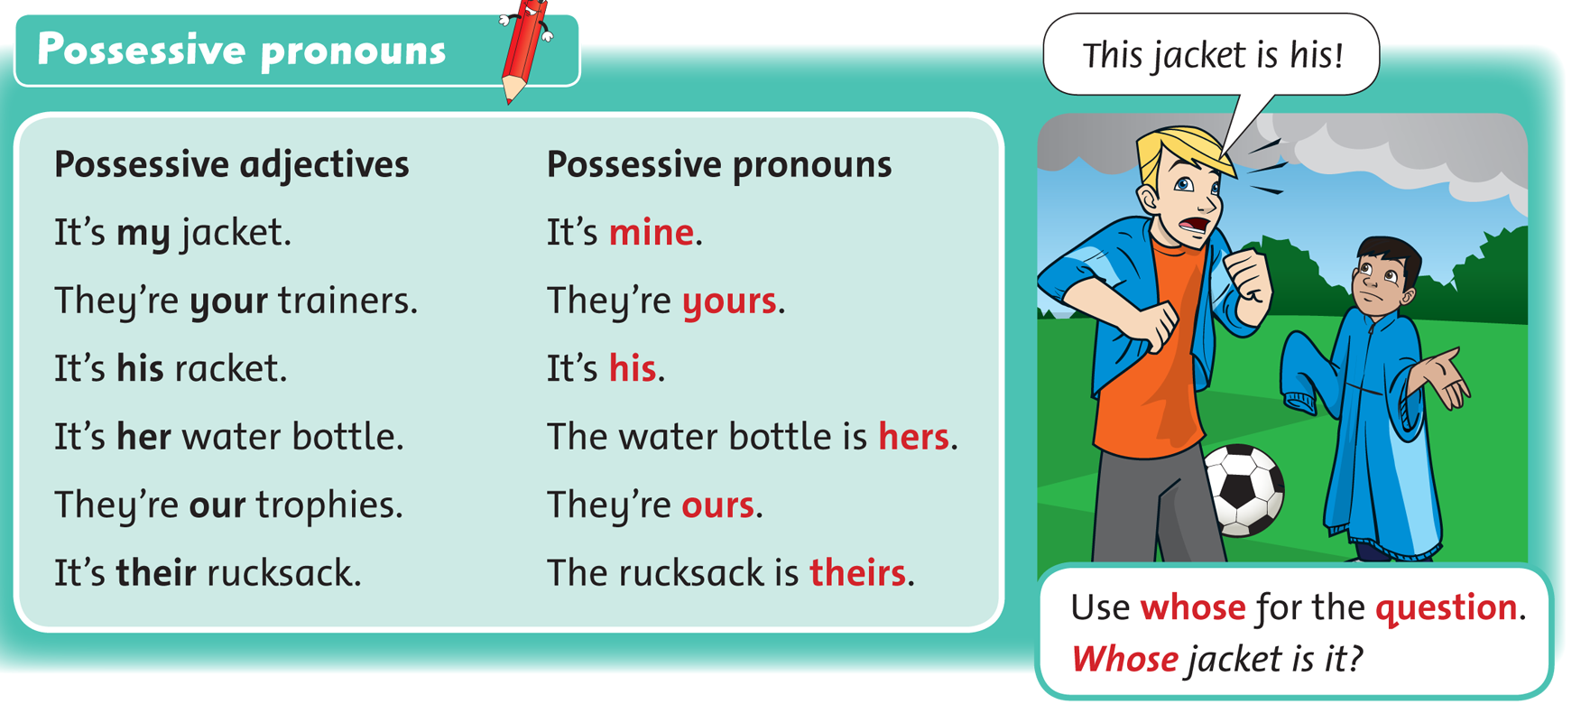

Slide 27

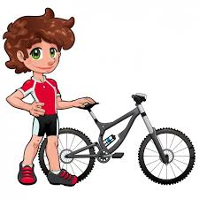




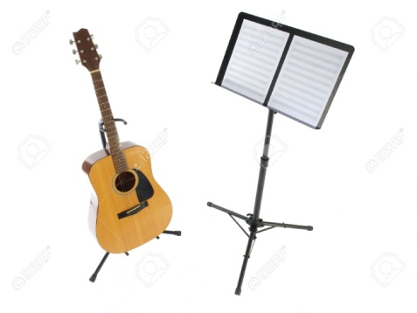

his
It’s …… bicycle
her
It’s …… guitar,
It’s ……..
hers

Slide 28

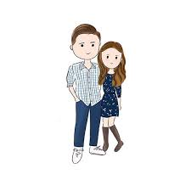
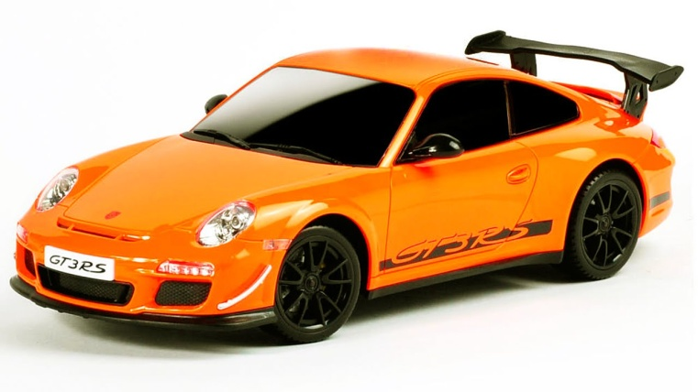




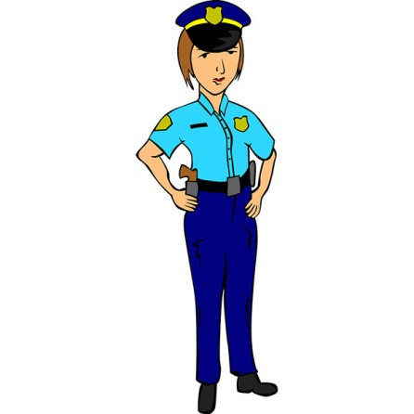
That is
…… car
our
ours
It’s ……..
Is that car ……….…?
theirs
They go on
Holiday with
………….. car
their

Slide 29
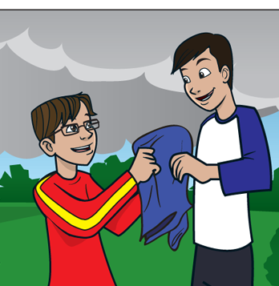
Whose jacket is it ? It is (her – my – their ) jacket. It is (hers – mine– theirs).

Slide 30
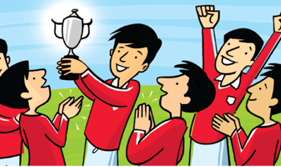
Whose trophy is it ? It is ( my – our – her ) trophy. It is ( mine – ours – hers ) .

Slide 31
https://en.islcollective.com/english-esl-video-lessons/grammar-practice/general-grammar-practice/personal-pronouns/gru-subject-and-object-pronouns/39165
Done by: Samiah Al Saeed

