Slide 1
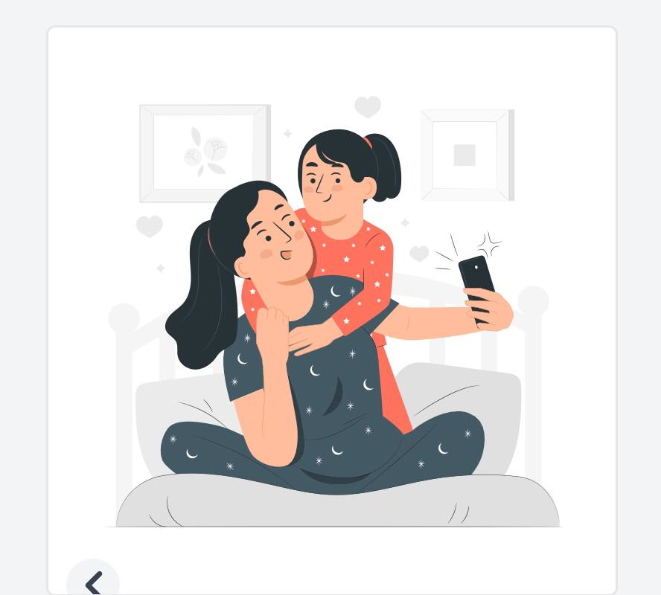


Slide 2
Unit 9 Let,s Go out
Listen and discuss
Super goal 2
Done by: Samiah Al Saeed

Slide 3
Let's clean and wash our clothes
Or
Why don't we go to cinema to watch a movie

Slide 4
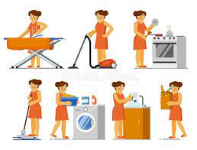


Slide 5


page.(74)

Slide 6

Lesson Goals
01
02
03
Recognize
Listen
Answer
04
Learn new words
The different between
Freetimes activities and chores
To the sentences
Some questions correctly
the words with their meanings correctly

Slide 7
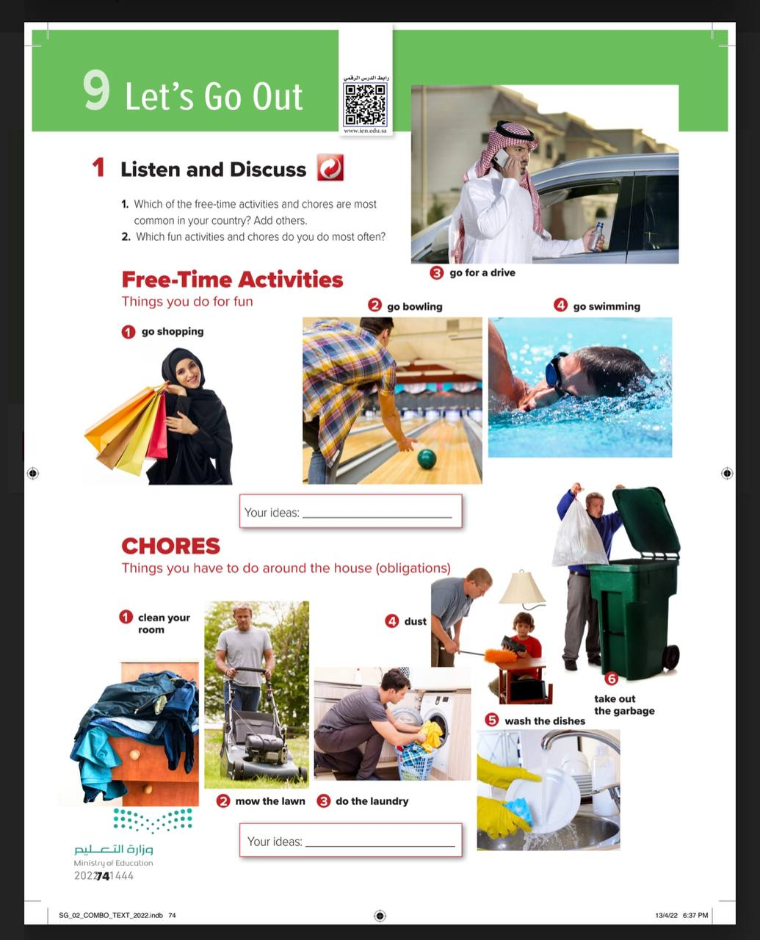
What is the difference between the two groups of pictures ?
1
2
6
What are chores ?
How many of the pictures show people having a good time
7
3
How many pictures show people doing chores
8
4
5

Slide 8
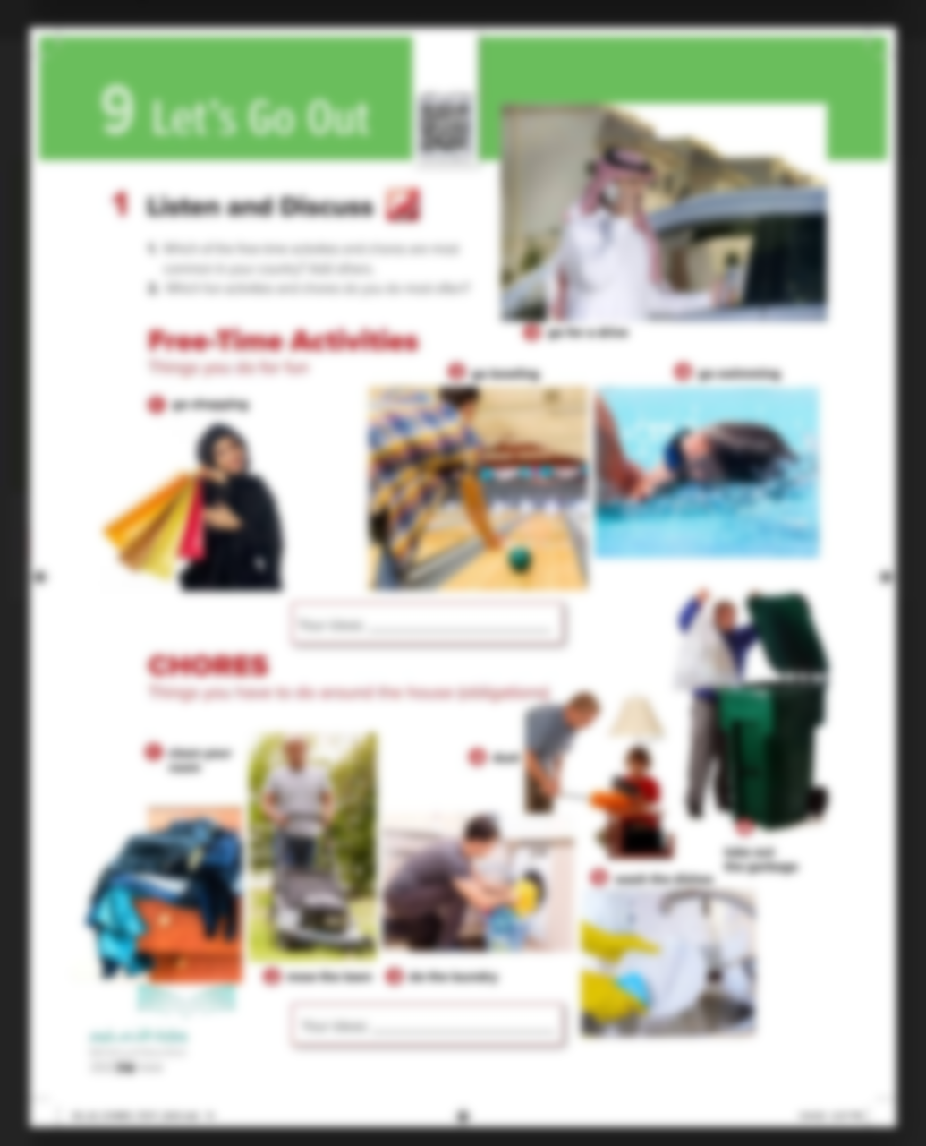



Read along as you Listen

Slide 9
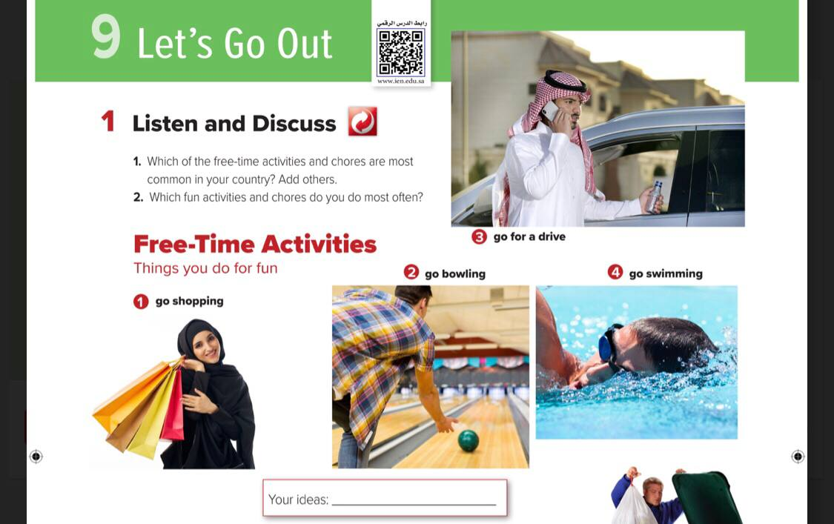

1
According to our religion
2

Slide 10


Slide 11
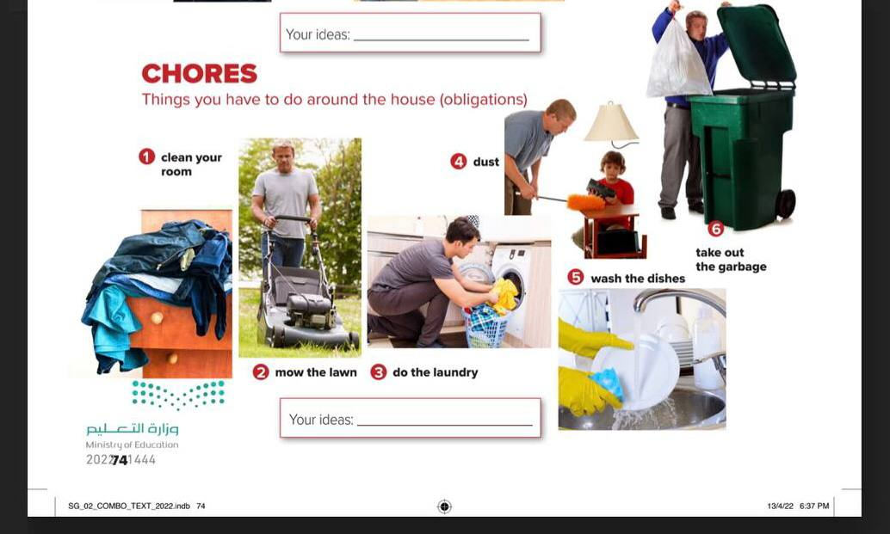

1
Accoring to our religion
2

Slide 12
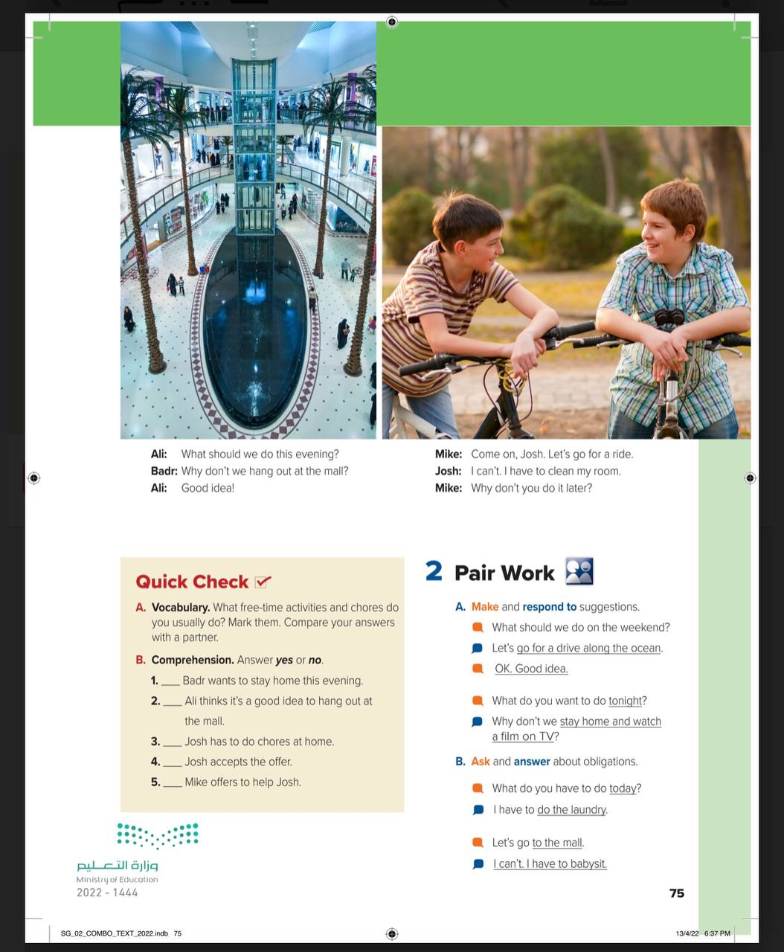


1
Where are the people in the first picture
What about the people in the second picture ?
2

Slide 13


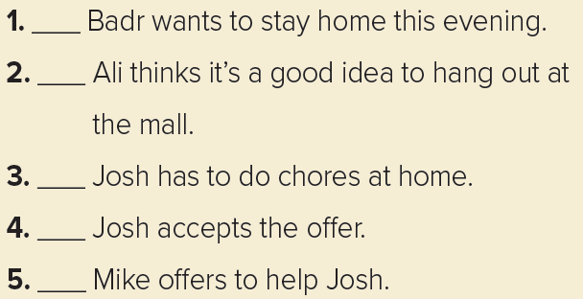
no
yes
yes
no
no

Slide 14


Have
a nice
day

Slide 15

Read the picture ?

Slide 16


Slide 17


Slide 18


Slide 19

Homework
page.(), exercise ( )

Slide 20
THANKS
Have
a nice
day

Slide 21


