Slide 1
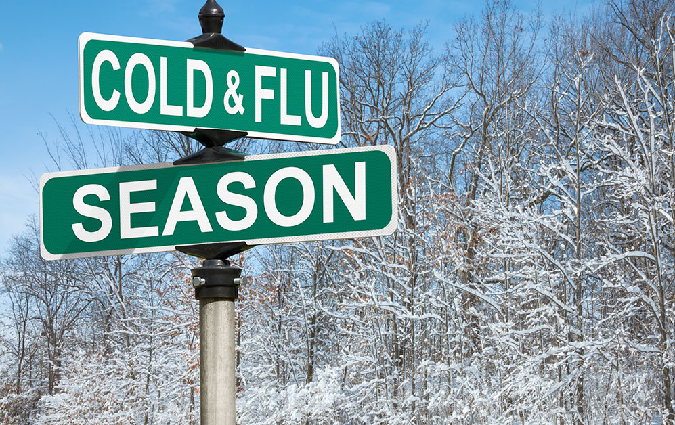
Reading u 8

Slide 2
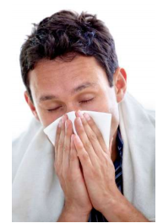
What’s matter with this man?
Does he has flu or cold?

Slide 3

Goals
To read a topic about “cold and flu” using finding the topic strategy.

Slide 4
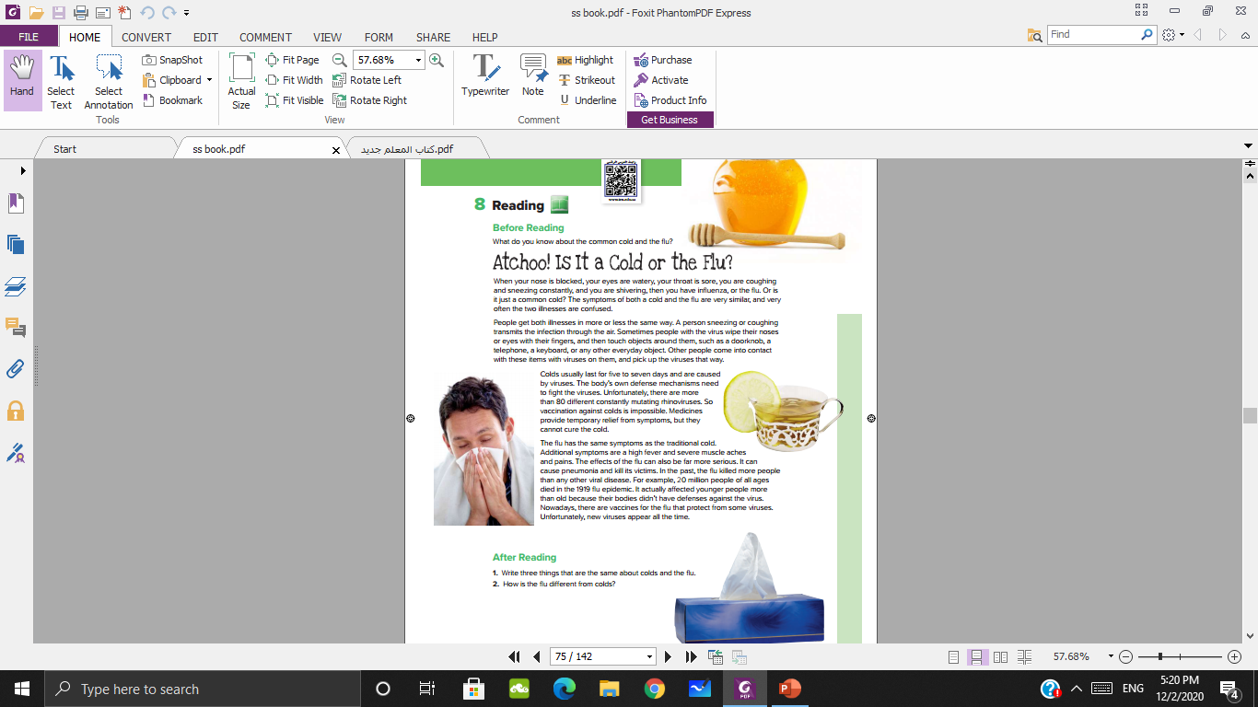
What else do you see in the pictures?
Honey
Tea
Tissues

Slide 5
What does “atchoo” mean?

Slide 6
What do you think the reading is about?

Slide 7
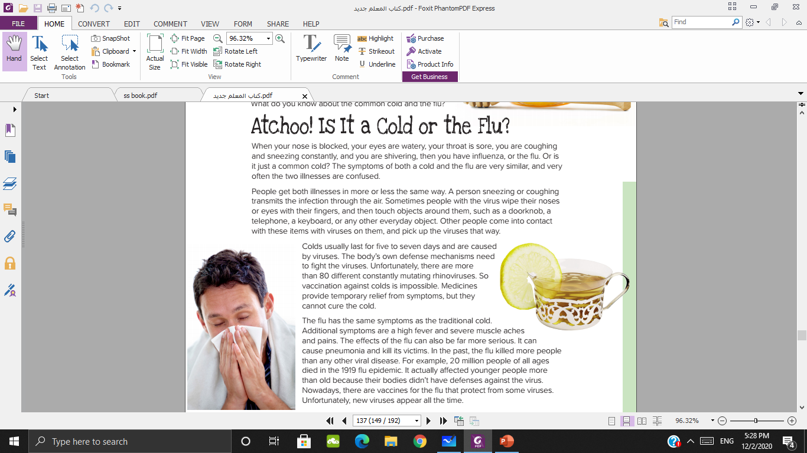


Slide 8
Which paragraph talks about cold?

Slide 9
Which paragraph talks about flu?

Slide 10
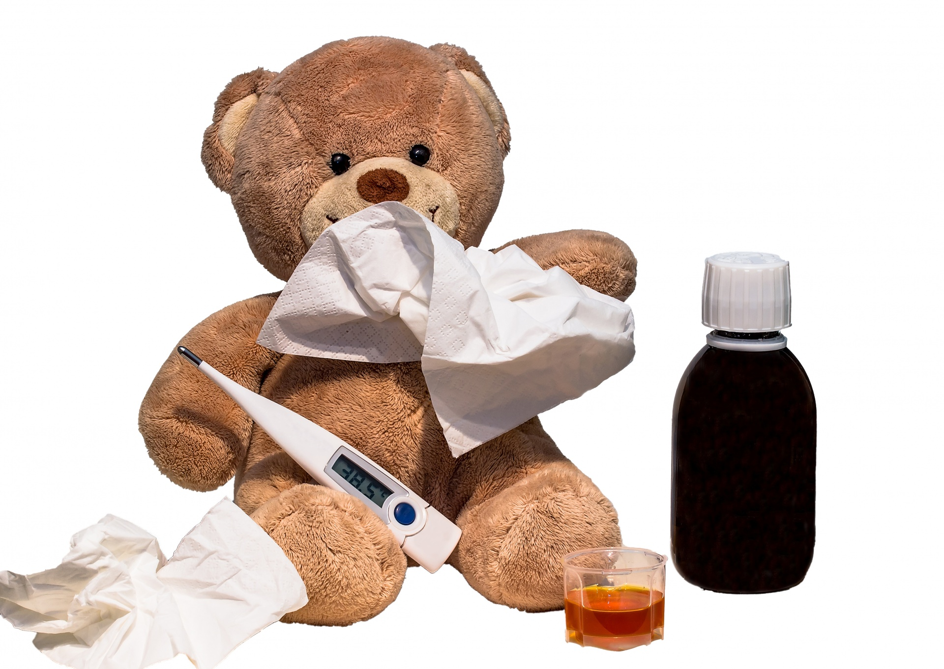
Write three things that are the same about colds and the flu?
your nose is blocked; your eyes are watery; your throat is sore;
you are coughing and sneezing constantly; you are shivering

Slide 11
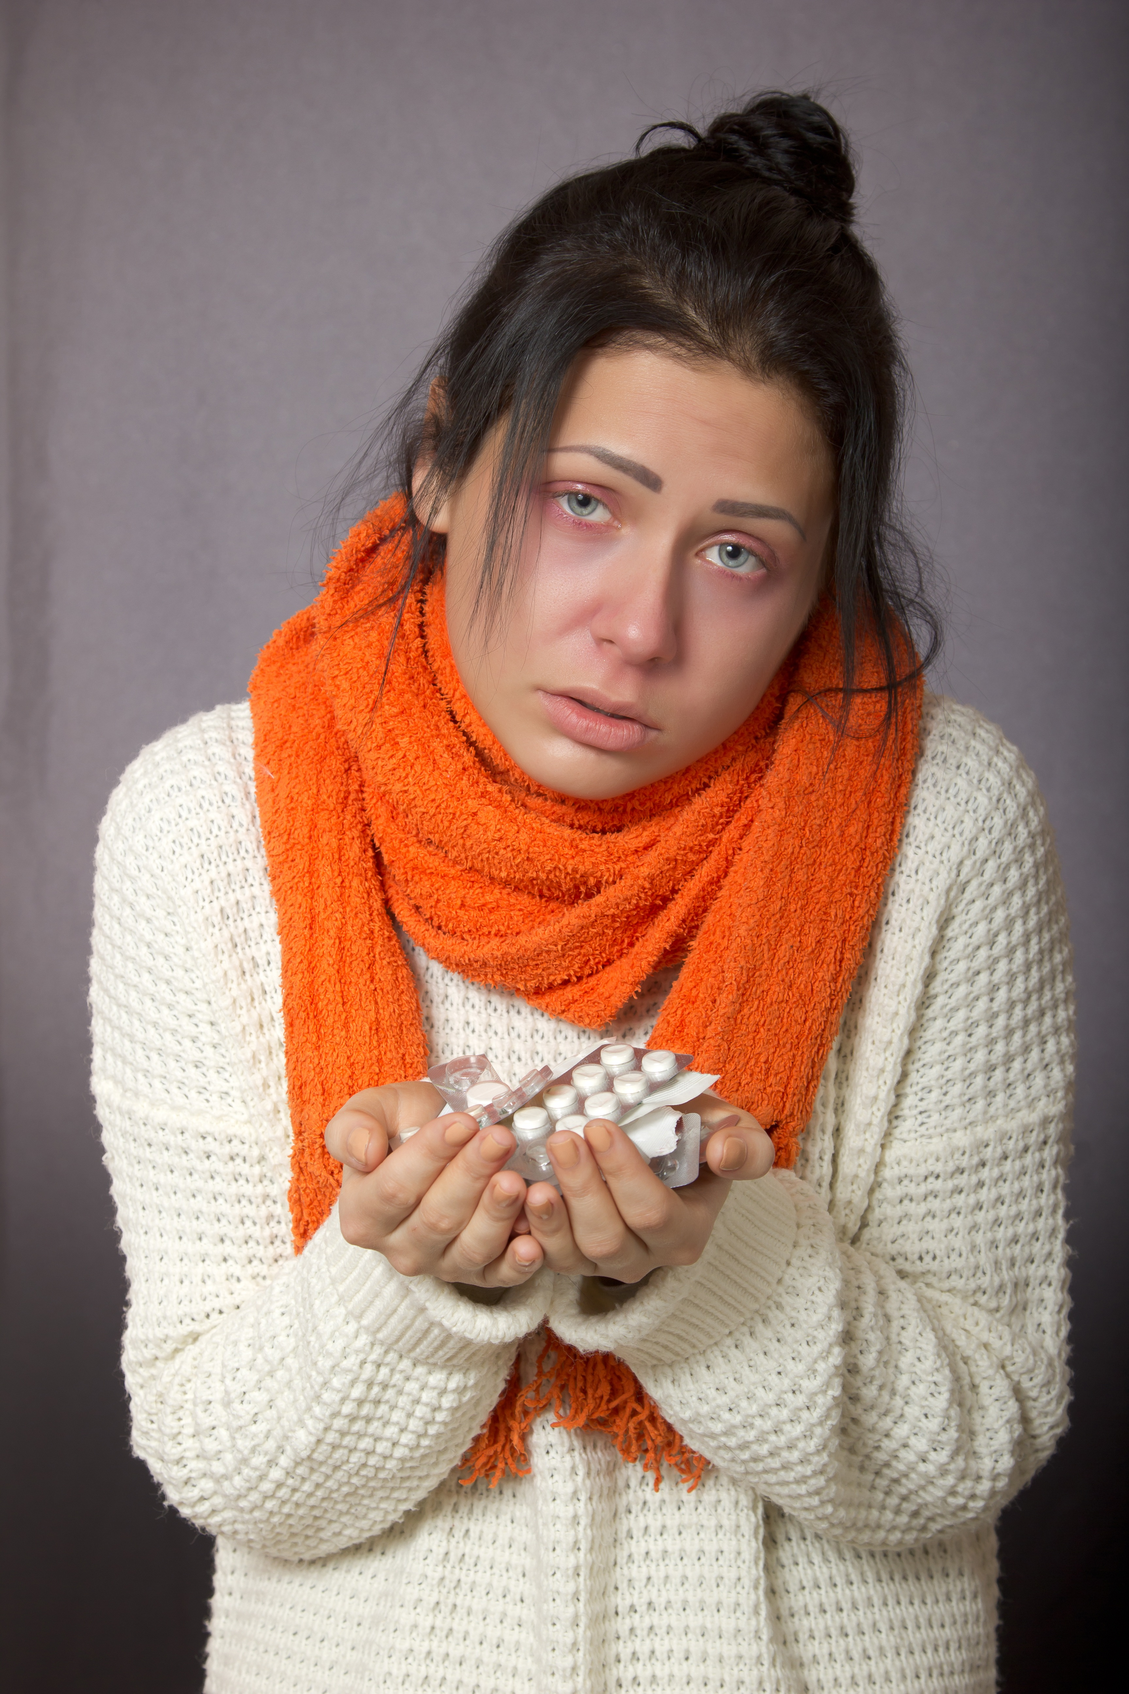
How is the flu different from colds?
With flu, they can have a high fever and severe muscle aches and pains. The flu can cause pneumonia and kill its victims. There are vaccines for the flu but not for colds.

Slide 12


THANK YOU

