Slide 1

Unit 1
Let’s go out
Grammar
Tr. Nora Khalid

Slide 2
Goals
Make and give suggestions using “why don’t / should / let’s” + accept and refuse suggestions.
Use Go + Verb + -ing
Use have to / had to
Listen to phone conversations for excuses
Pronounce “have to”

Slide 3
Suggestions

Slide 4
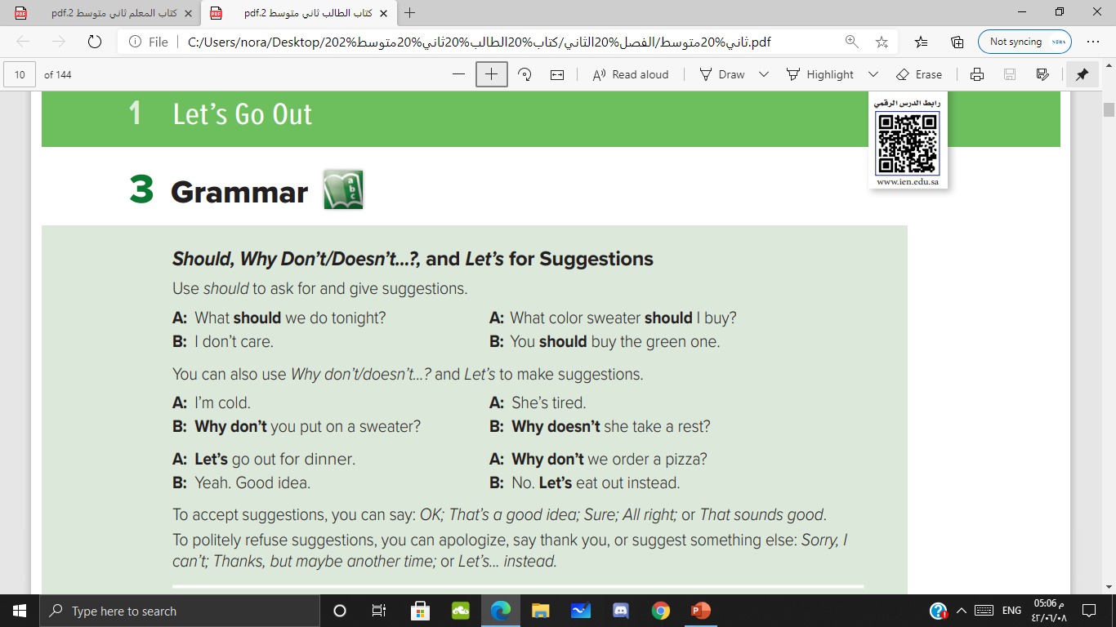
How do we ask for suggestions?

Slide 5

How do we ask for suggestions?

Slide 6
For make suggestions
we can use:
Should
Why don’t / why doesn’t
Let’s + verb

Slide 7
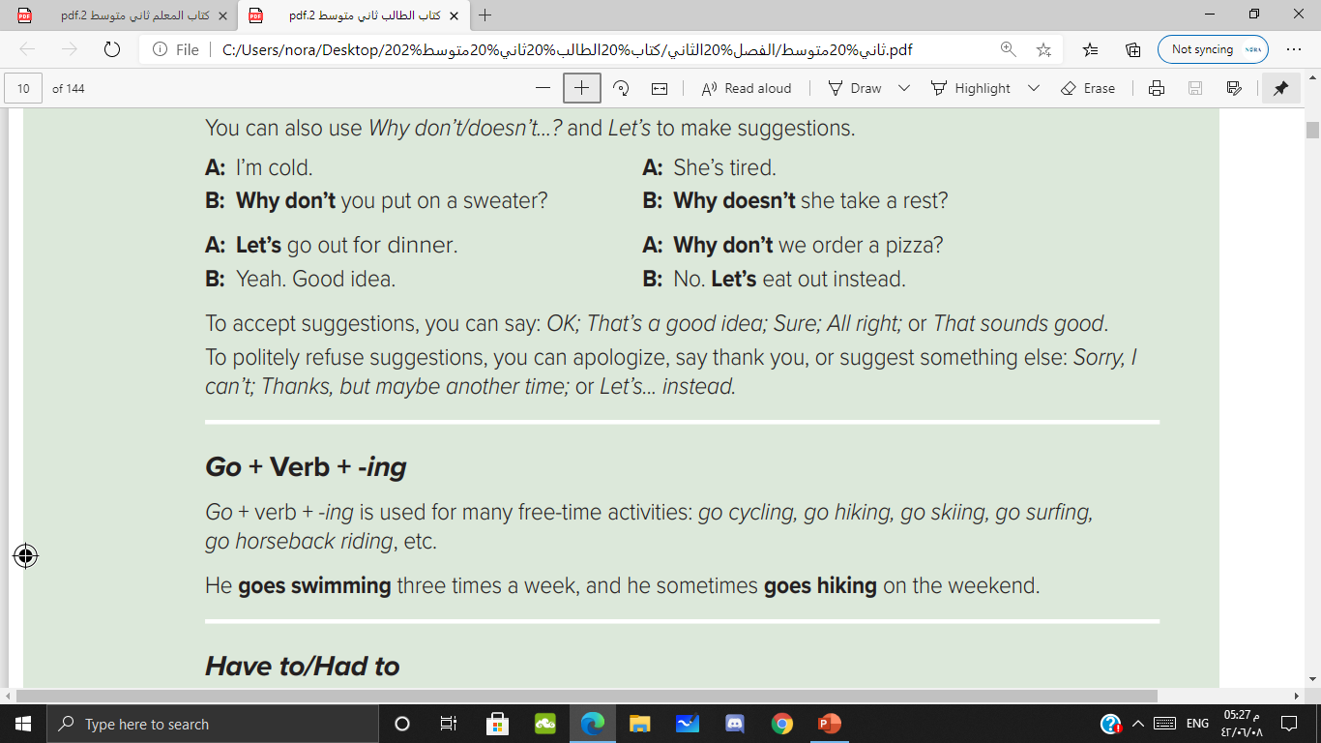
How do we accept and refuse suggestions?

Slide 8


Slide 9
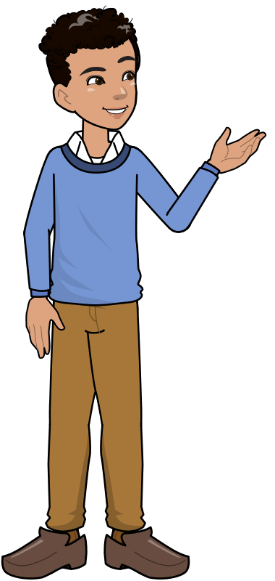

Let’s eat pizza outside.
Ok; That’s a good idea

Slide 10


Slide 11

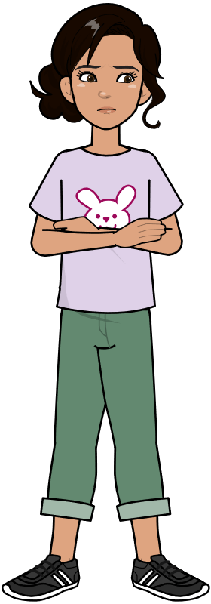

Slide 12




Slide 13
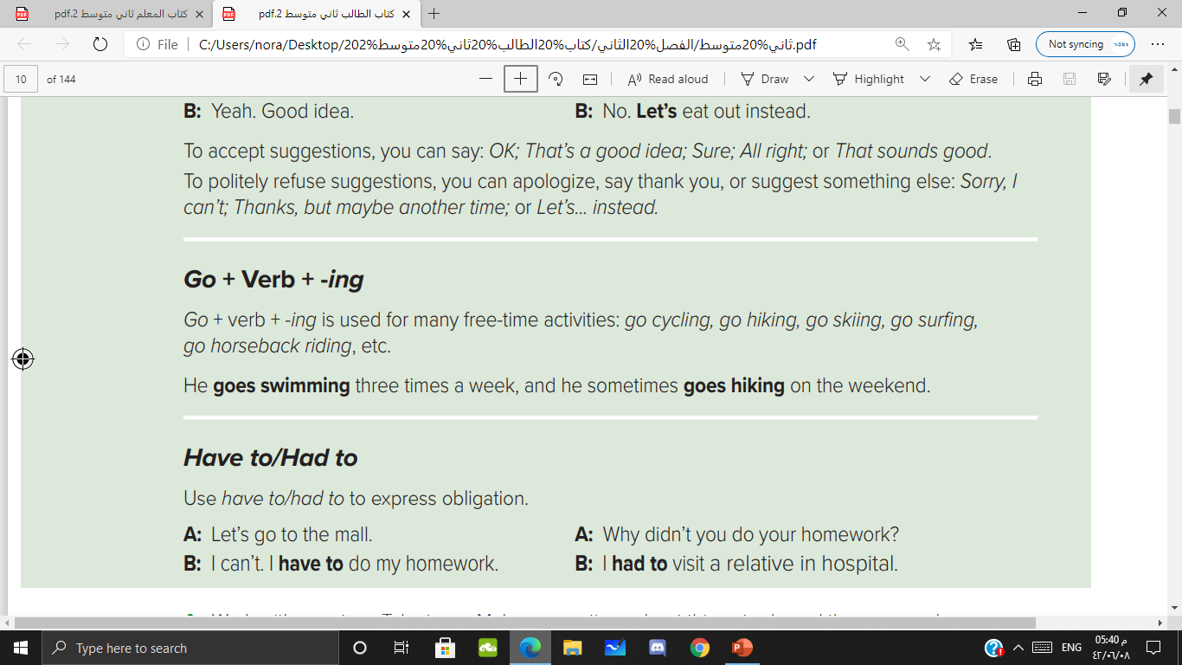

Slide 14
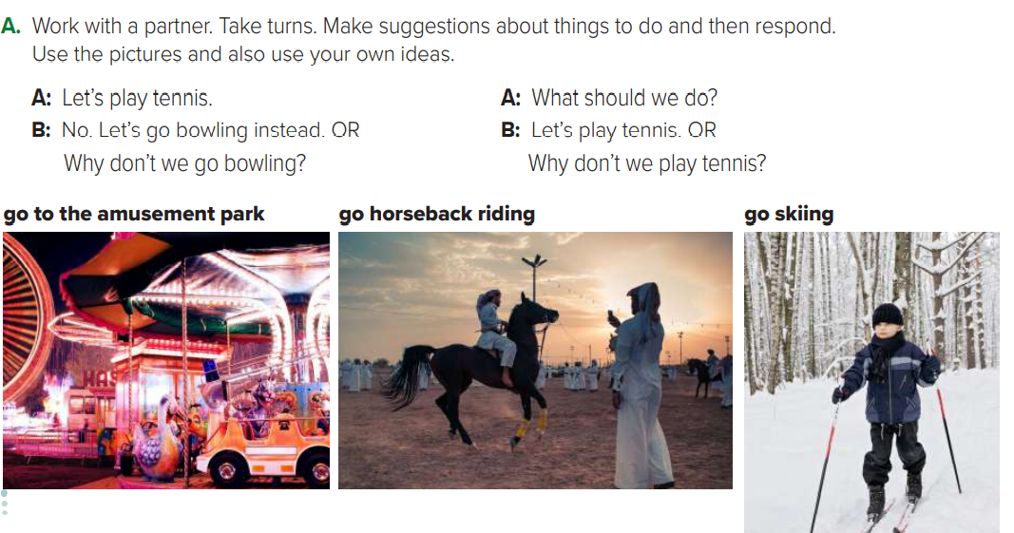

Slide 15
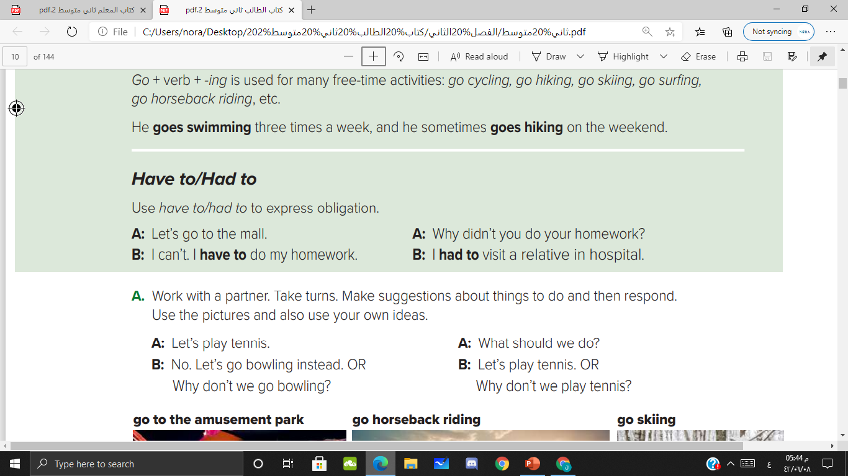

Slide 16
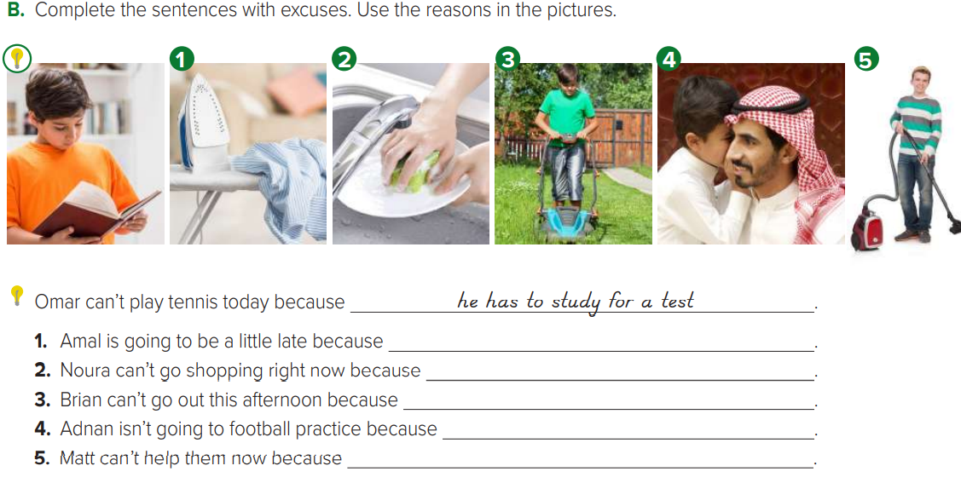
she has to do the laundry
she has to wash the dishes
he has to mow the lawn
he has to babysit
he has to clean the house

Slide 17
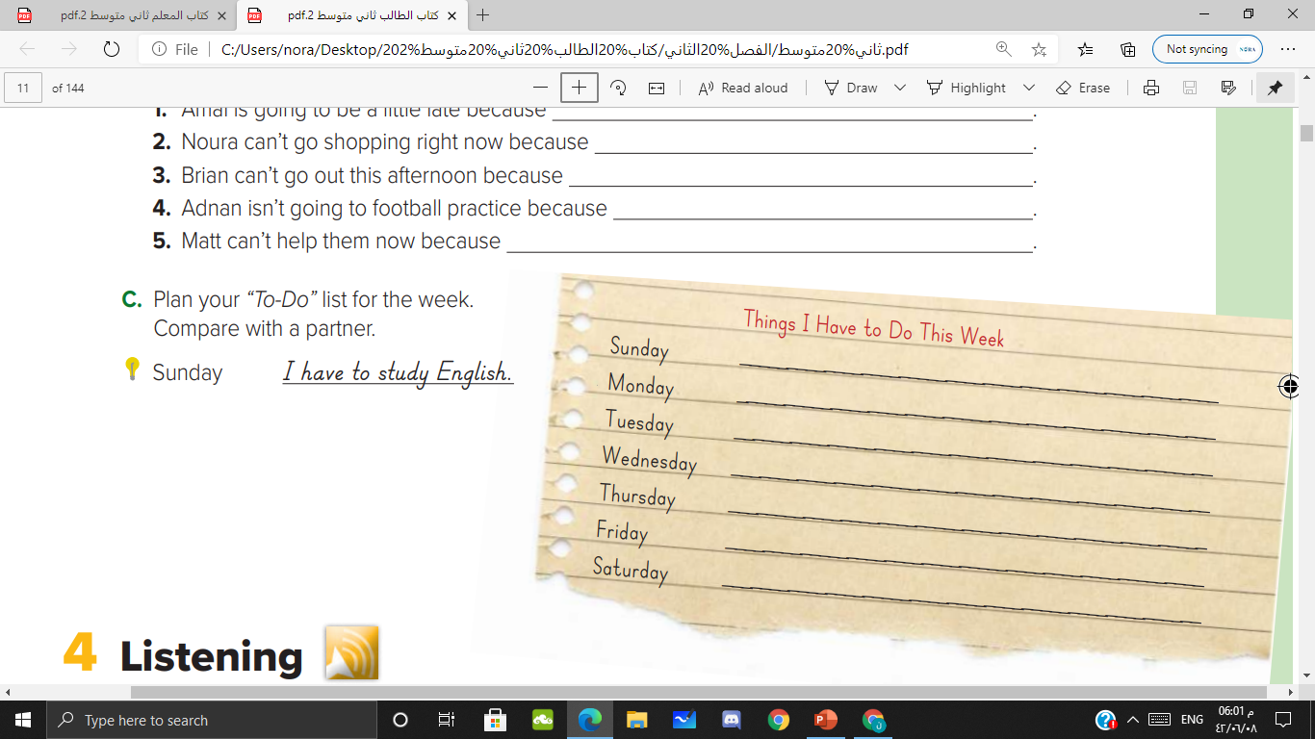

Slide 18
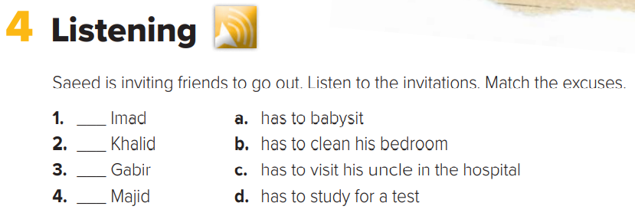

d
a
c
b

Slide 19
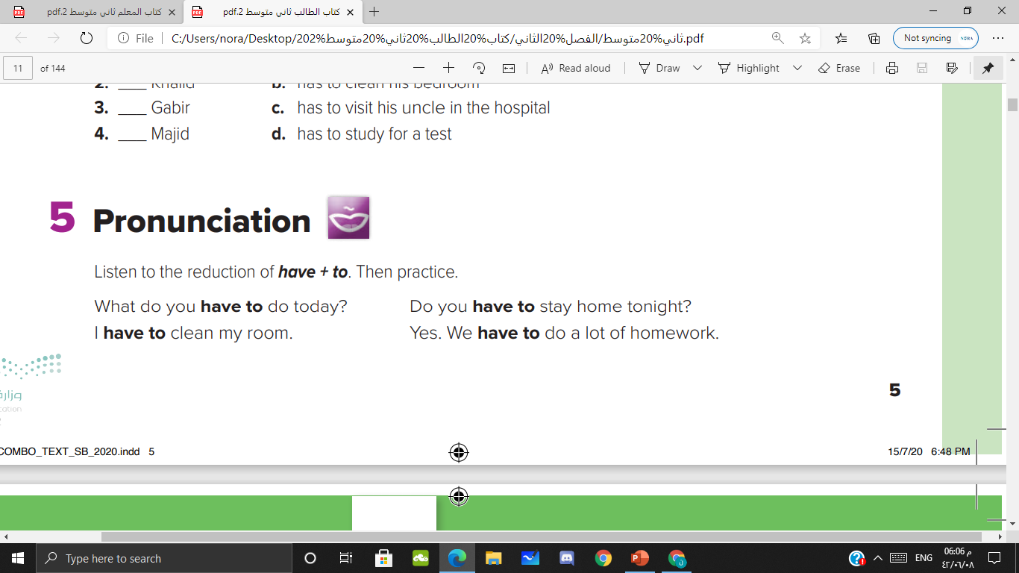

Slide 20

Homework
P 90

