Slide 1

UNIT 1 Form, meaning and function
Tr. Nora Khalid

Slide 2

goals
Use must/mustn’t correctly
Use have to / has to correctly in present and past situation
Recognize the difference between have to / has to

Slide 3


What should we do to avoid COVID 19?

Slide 4

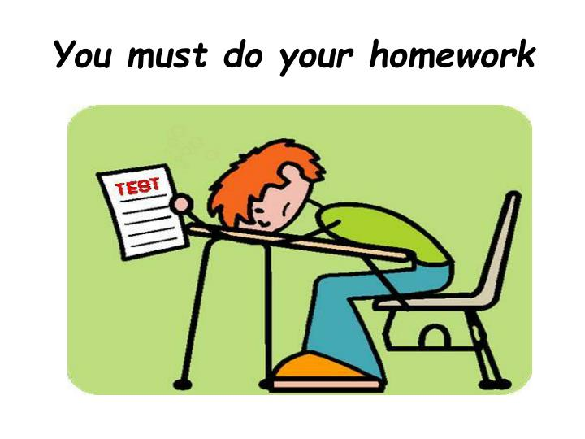
You – I – she – he – they – we – it

Slide 5

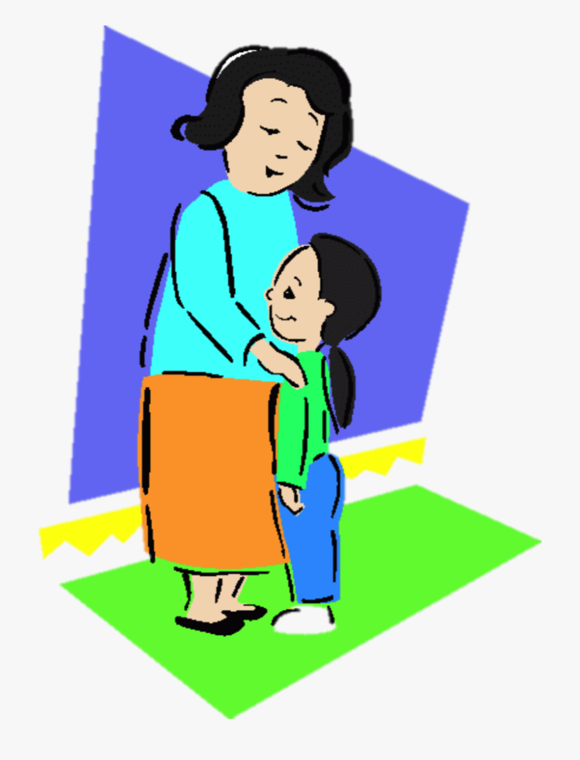
You – I – she – he – they – we – it

Slide 6
You – I – she – he – they – we – it

Slide 7

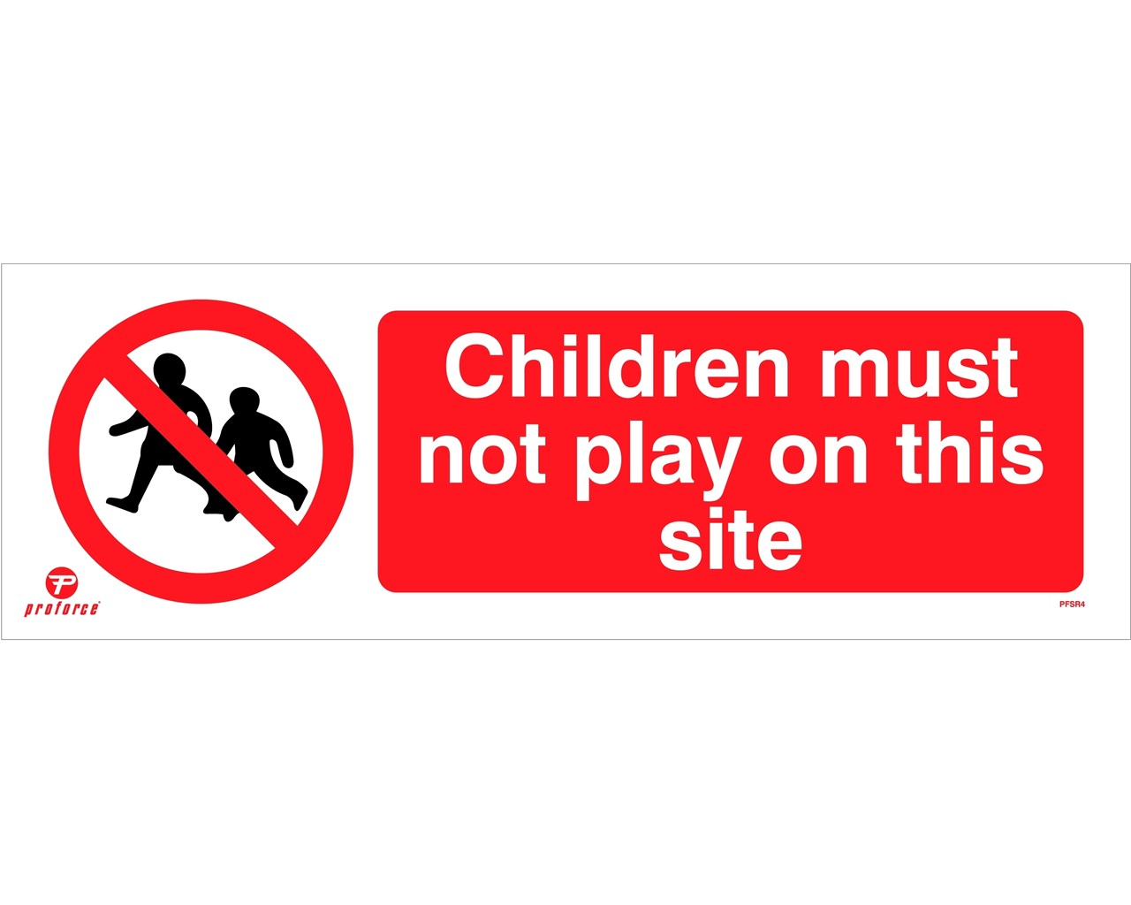
You – I – she – he – they – we – it
not

Slide 8
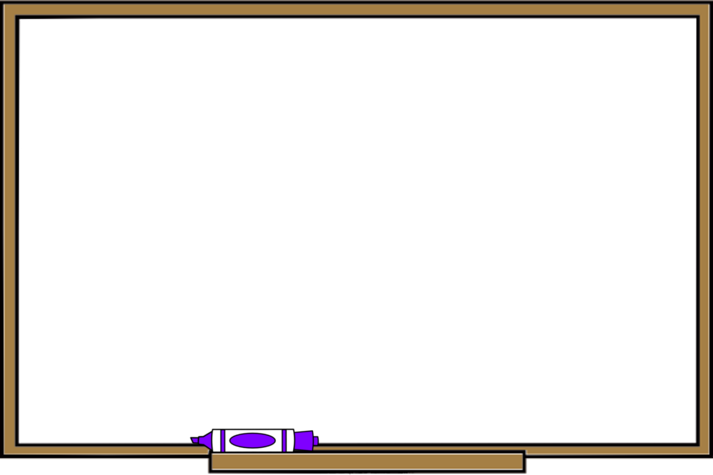
Must expresses obligation, or something that is
necessary and very important to do. There is no
choice.
Must not (or mustn’t) means that something is
prohibited; it is not allowed. There is no choice.

Slide 9
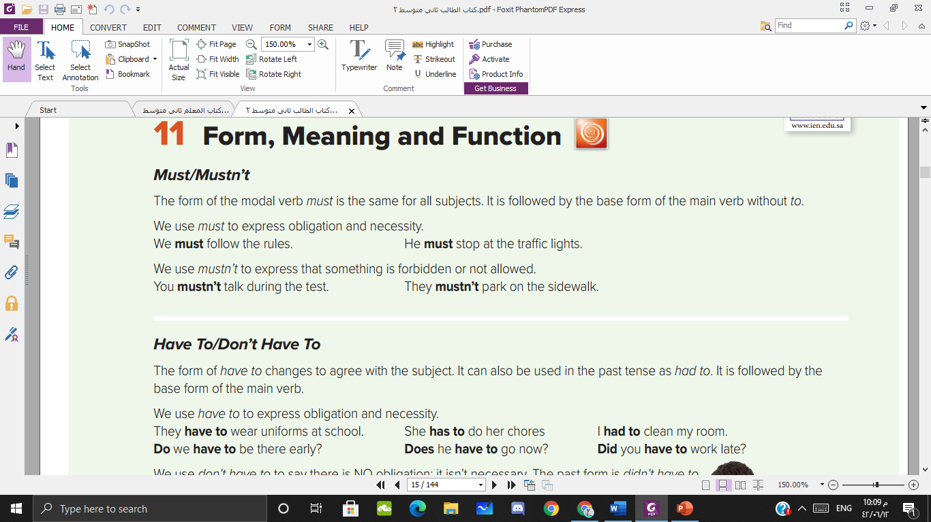


Slide 10

You – I – they – we
have to
Have to / has to

Slide 11
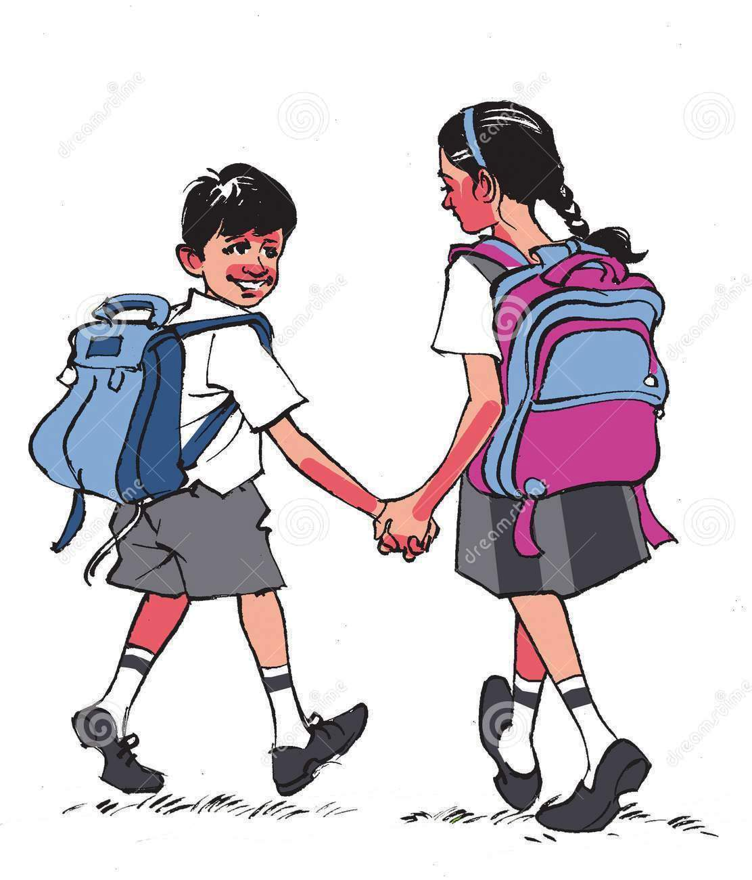
You – I – they – we
have to
Have to / has to

Slide 12

she – he – it
has to
Have to / has to

Slide 13
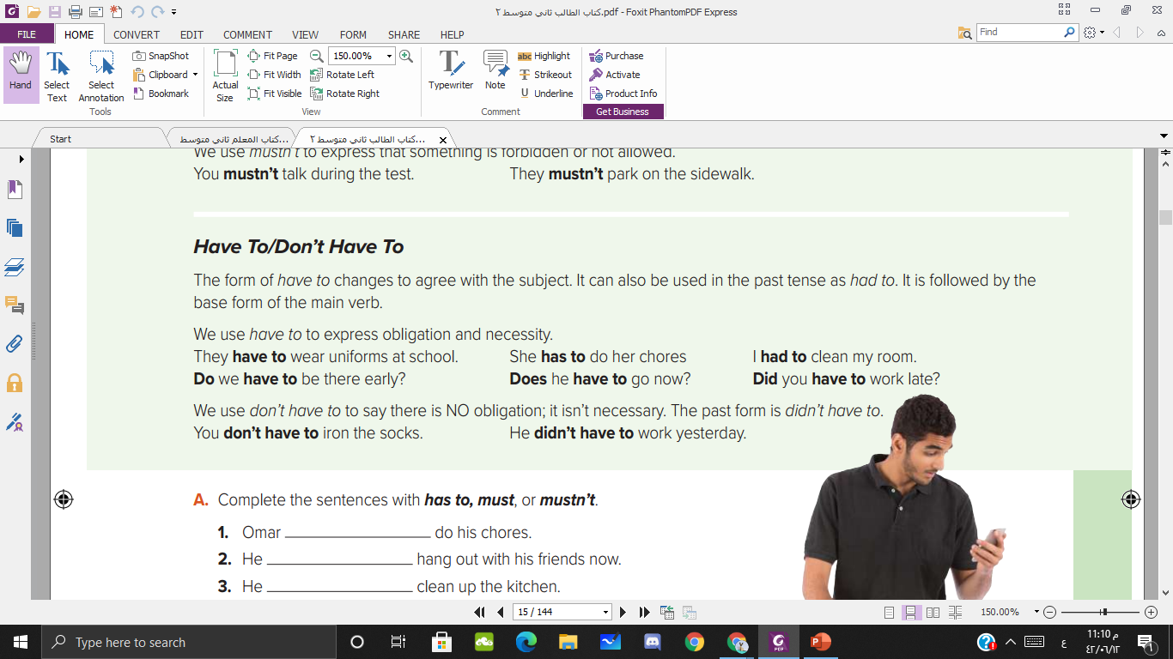

Slide 14
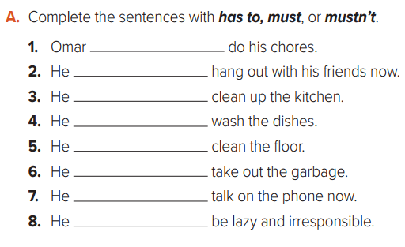
must/has to
mustn’t
must/has to
must/has to
must/has to
must/has to
mustn’t
mustn’t

Slide 15
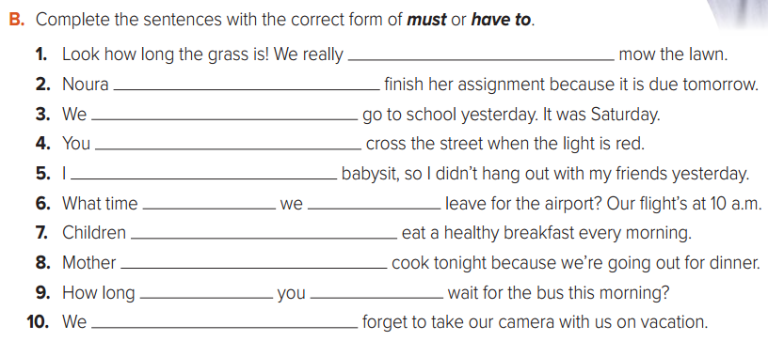
must / have to
must / has to
did have to
mustn’t
had to
do
have to
must / have to
doesn’t have to
did have to
mustn’t

Slide 16
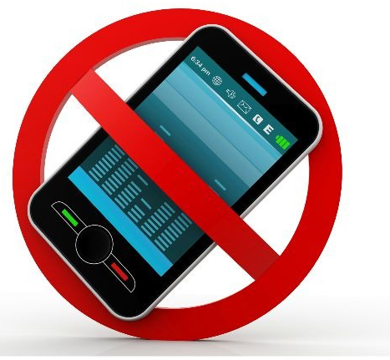




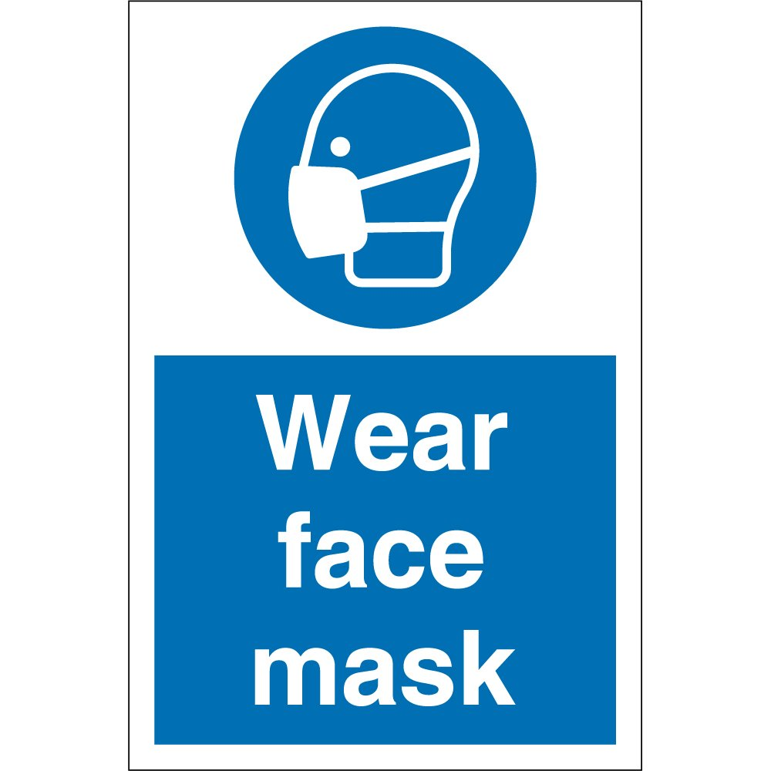

Slide 17

Thank you

