Slide 1
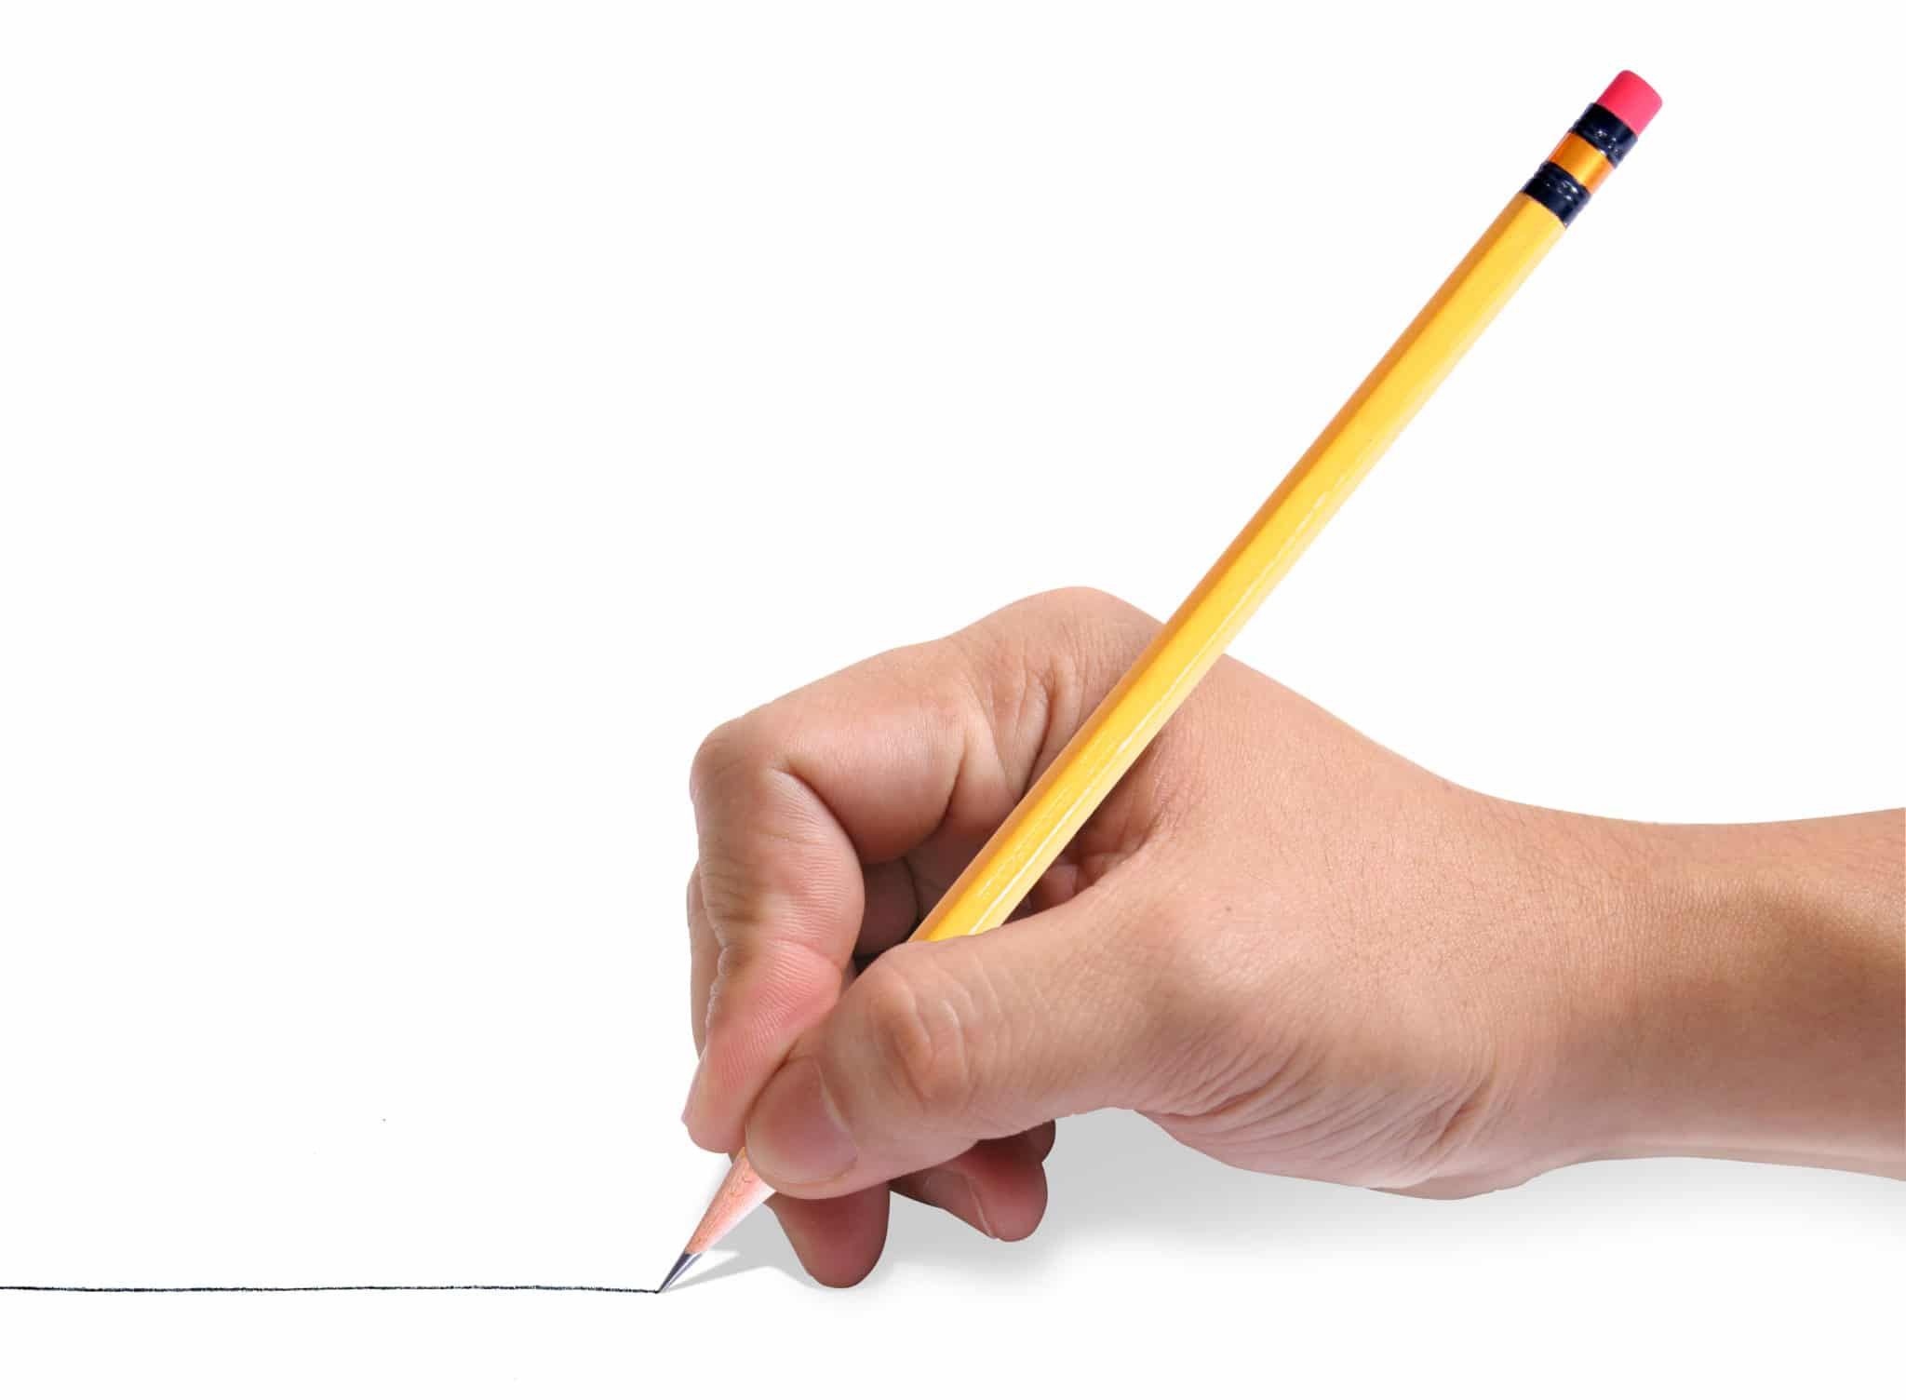
Unit 1
Let’s go out
Writing
Tr. Nora Khalid

Slide 2

Write about how parents and teenagers feel about homework

Slide 3
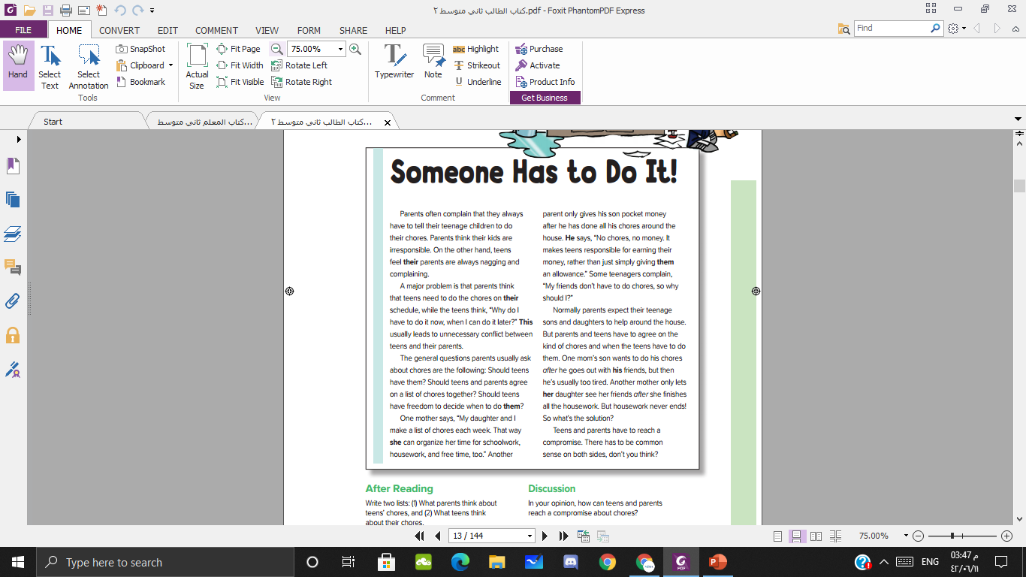
Look back at the Reading on page 7
look for the boldfaced pronouns and adjectives.

Slide 4
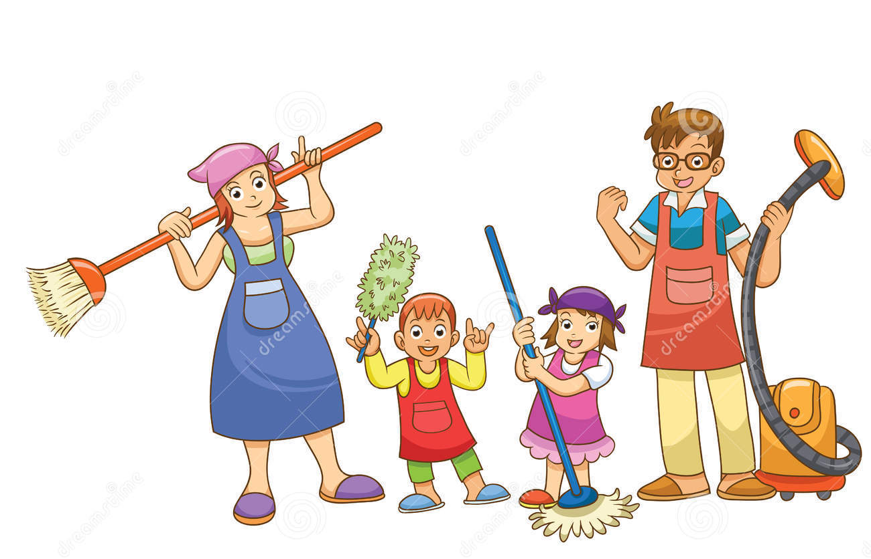
Refers to …….

Slide 5
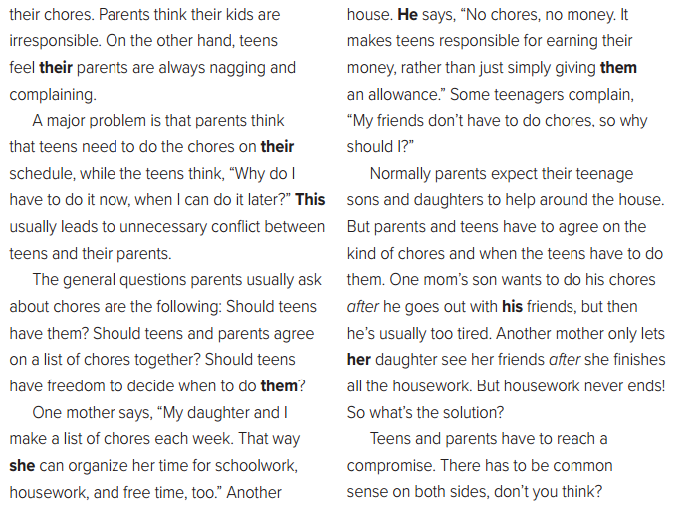
A parent
Teen’s
Teens
Parents’
A major problem
son’s
chores
mother’s
daughter

Slide 6
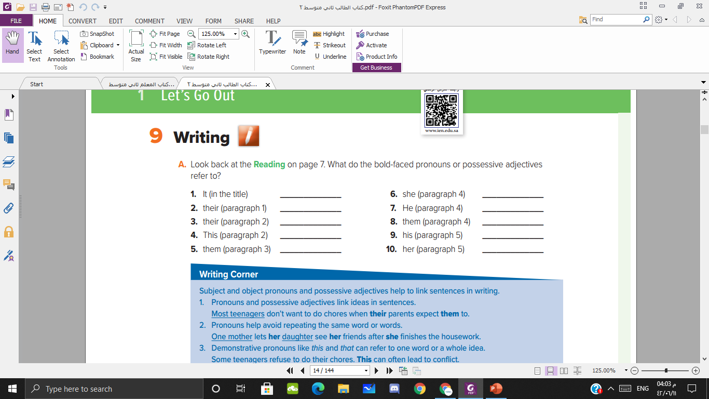
Housework
daughter
Teen’s
A parent
Parents’
Teens
A major problem
son’s
chores
mother’s

Slide 7
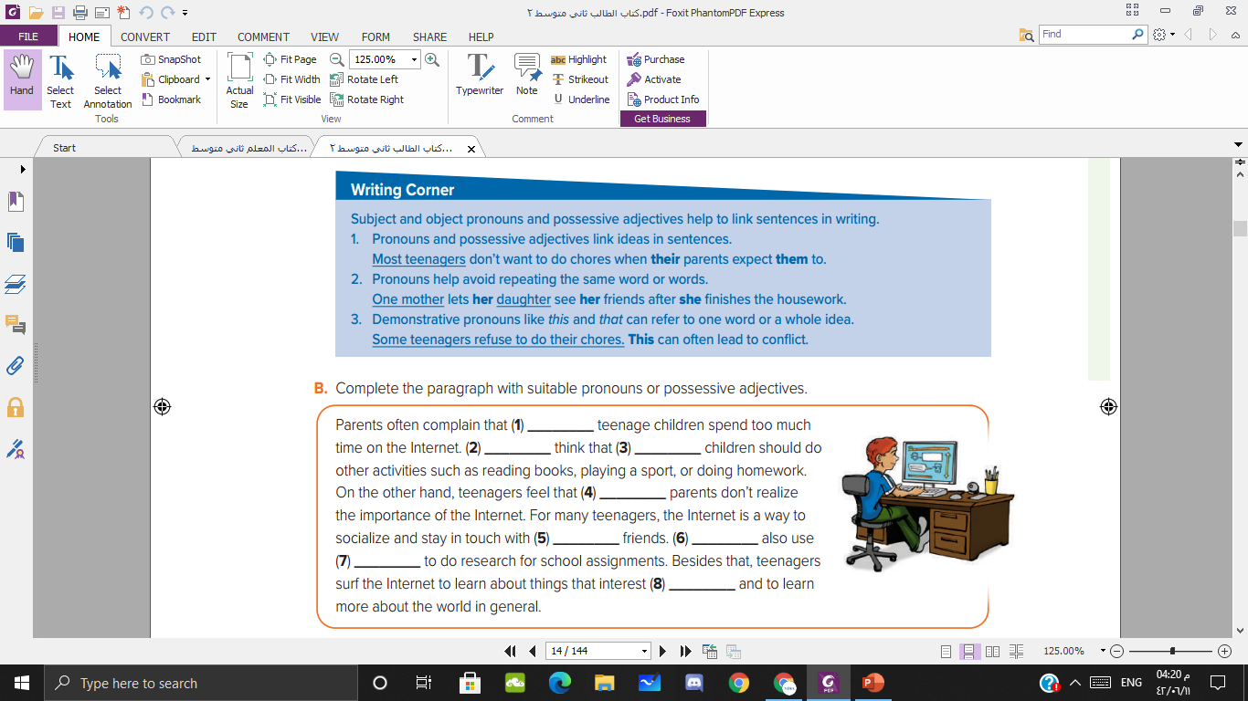


Slide 8


https://www.youtube.com/watch?v=l89qYOSXKck

Slide 9
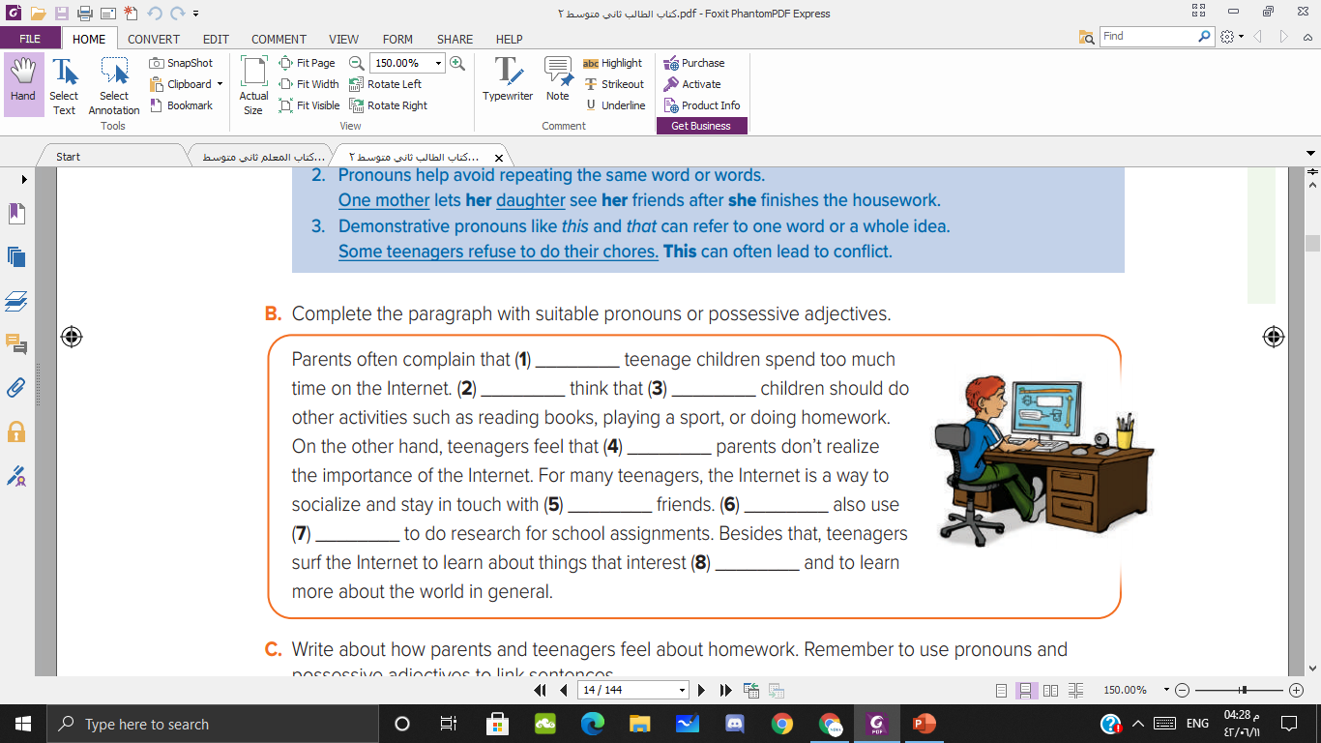
their
They
their
their
their
They
it
them

Slide 10


Write about how parents and teenagers feel about homework. Remember to use pronouns and possessive adjectives to link sentences

Slide 11


