Slide 1


Slide 2
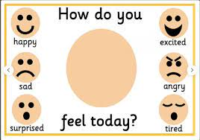

Slide 3
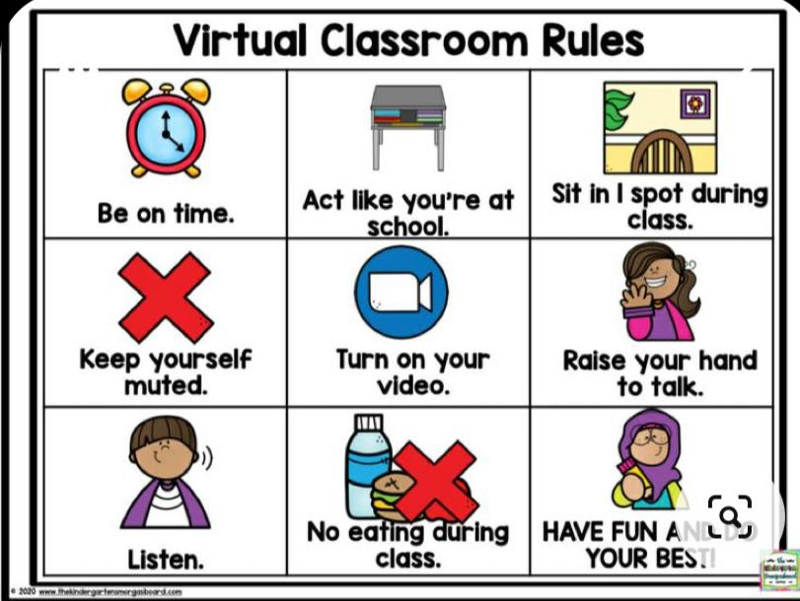

Slide 4



Slide 5

Memories strategy
What is Unit 6 about ?
What is Unit 7 about ?

Slide 6

U 8 what’s wrong?
Day…………
Date………...

Slide 7
Goals:
Match body parts with illnesses
Find illness of each students
Listen to a conversation between a patient and a doctor

Slide 8
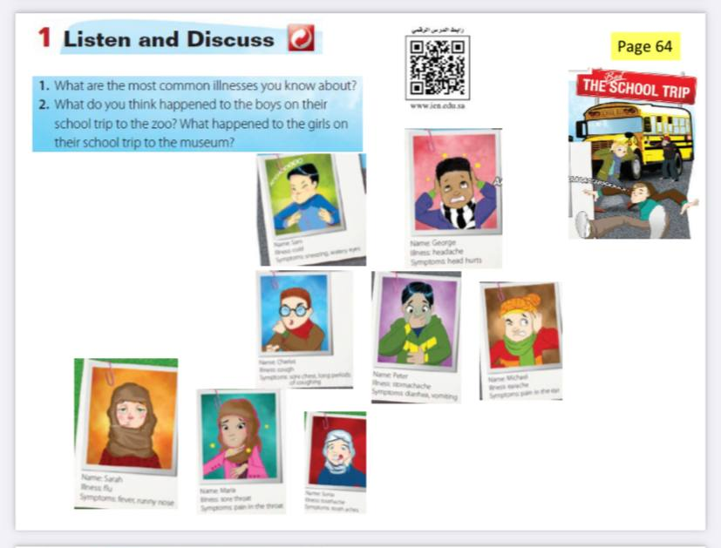

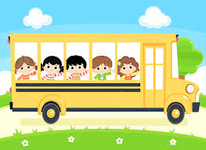
66
What happened to the kids?

Slide 9

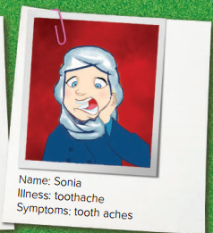
Who had toothache?

Slide 10
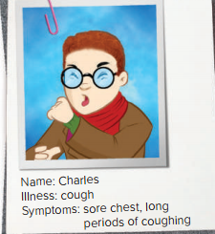
Who has a cough?

Slide 11

Who has a stomachache ?

Slide 12
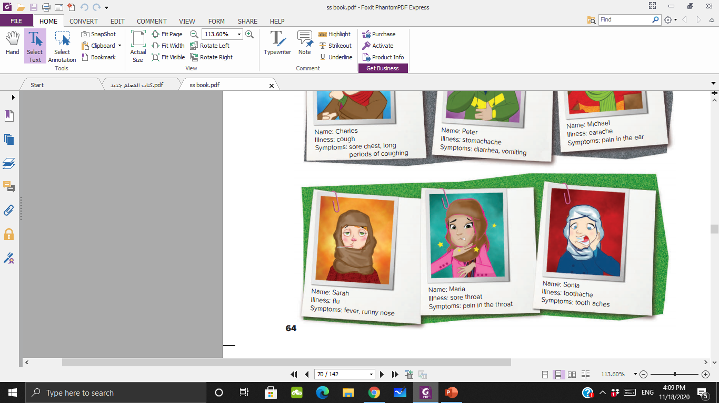
Who has a flu ?

Slide 13
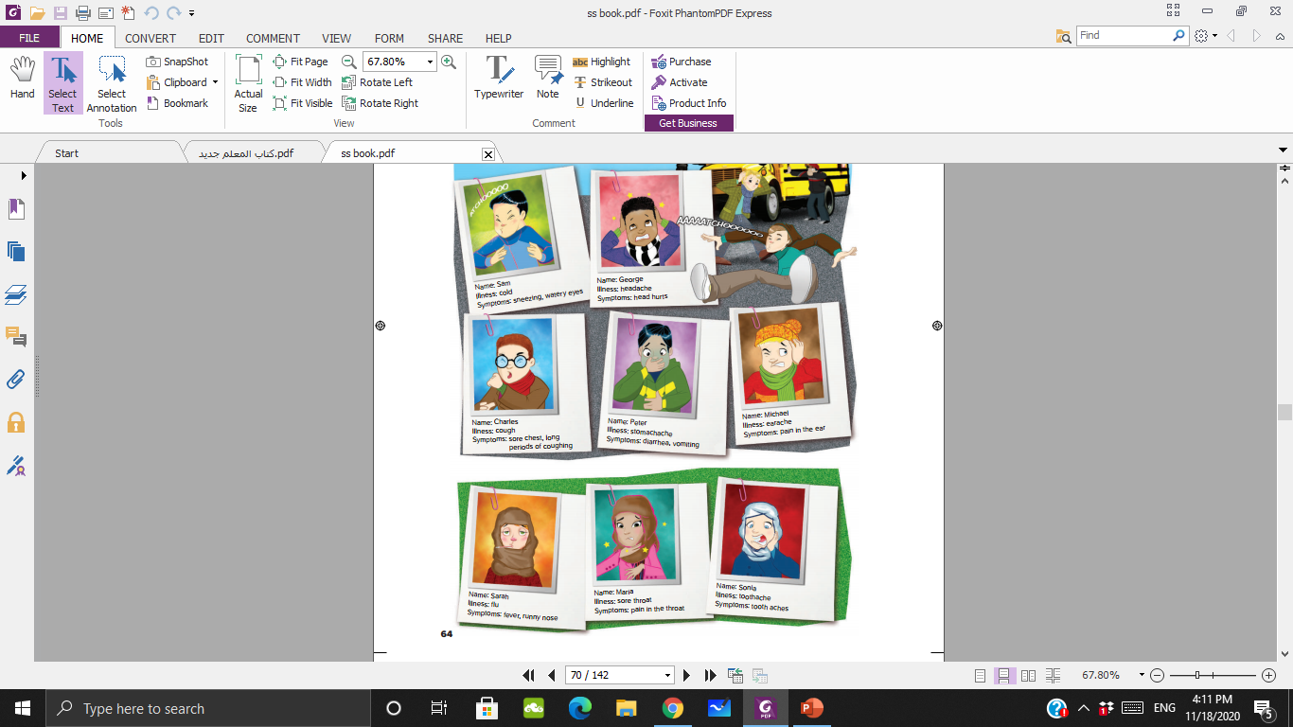


Slide 14

Illnesses Symptoms
1- Cold sneezing-watery eyes
2- Headache head hurts
3- Cough sore throat – long periods of coughing
4- Stomachache diarrhea - vomting
5- Earache pain in the ear
6- Flu fever – runny nose
7- Sore throat pain in the throat
8- Toothache tooth aches
Write 3 words in your chat
►►►What is the most illnesses today ?

Slide 15


SG2 U8 L1 - مطابقة (wordwall.net)
مسابقة

Slide 16
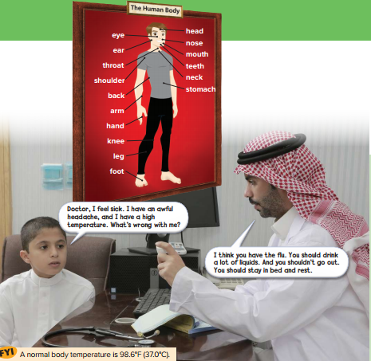
Where are the people?
What are they talking about?

Slide 17
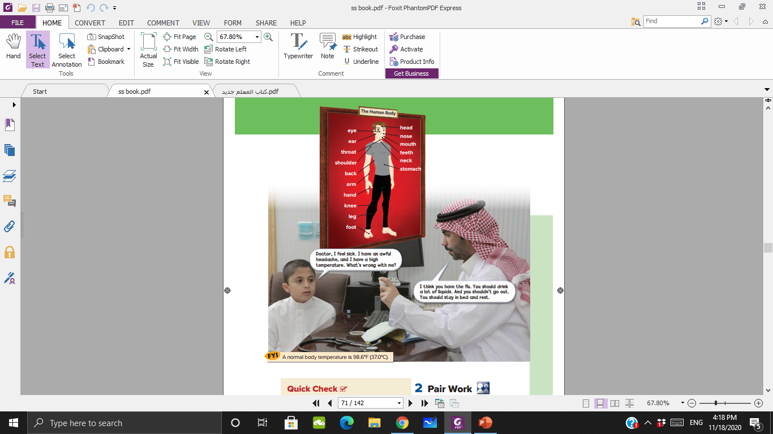
What are the patient’s symptoms?

Slide 18
What is the illness?

Slide 19
What does the doctor suggest?

Slide 20
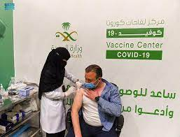
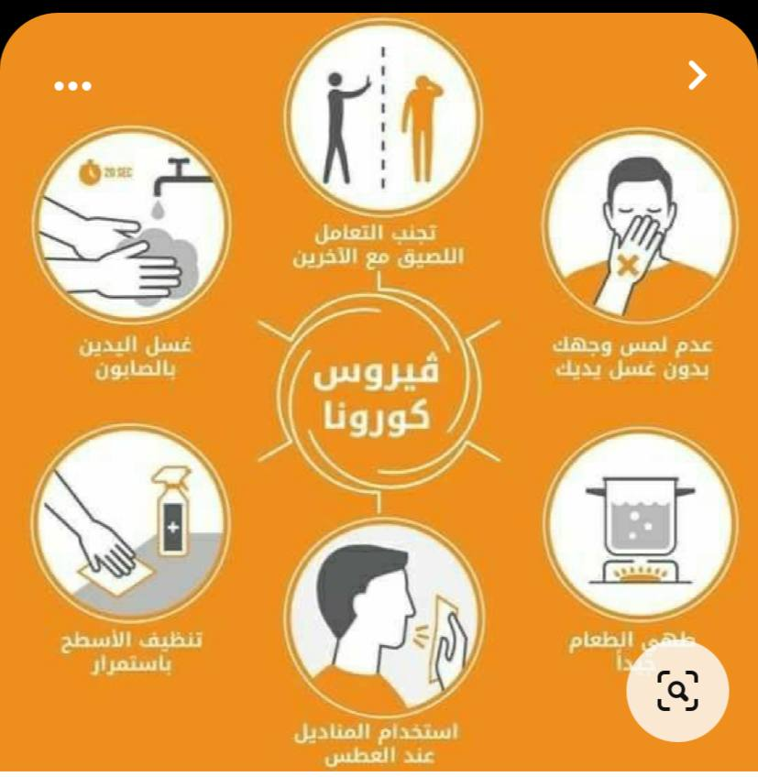
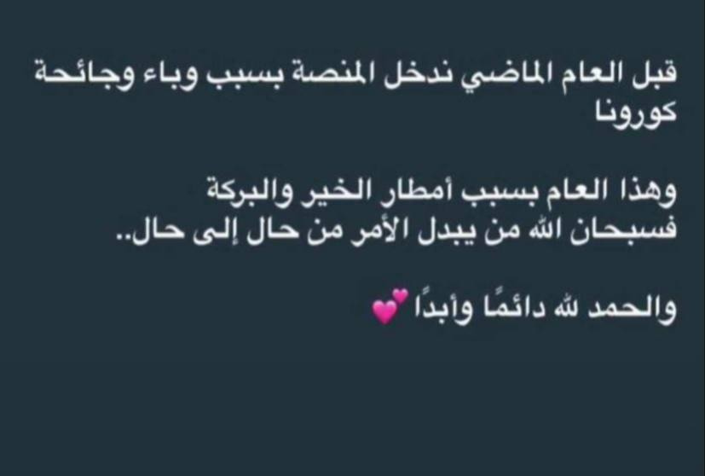
Look at this picture.Can you remember what illness is it ?
How old were you ?
Did you come to school or study online ?

Slide 21
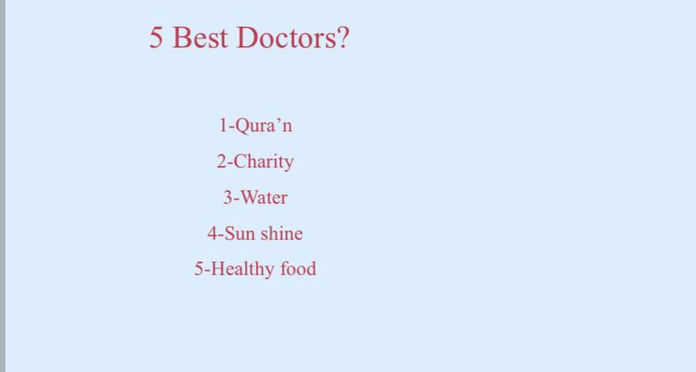


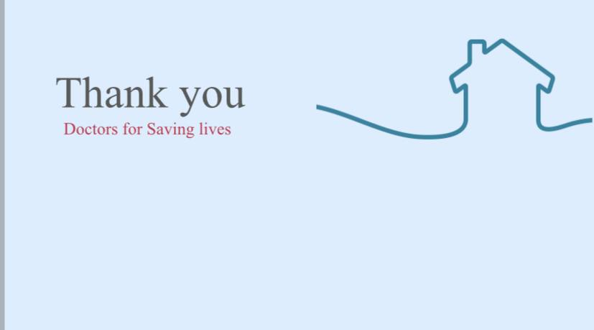


Your message to doctors?

Slide 22
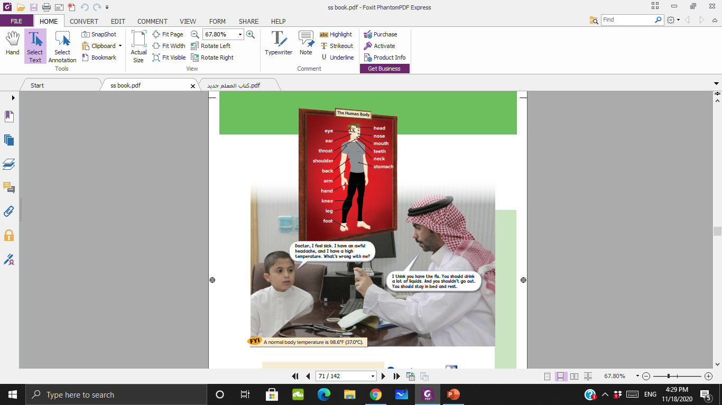
A normal body temperature is 98.6°F (37.0°C)

Slide 23
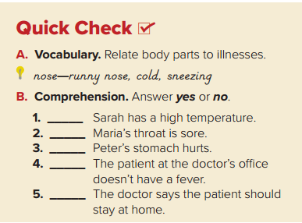

Head – headache- fever
Mouth - toothache
Throat – sore throat
Stomach - stomachache
Eyes – watery eyes – cold
Yes
Yes
Yes
No
Yes

Slide 24

Thank you homework p 217

