Slide 1


What’s wrong?
Reading

Slide 2




♥
Listen to the initial consonant blend with s
Listen to the conversation
Answer some questions for specific information
Use the "real talk" in new conversation
Ask about symptoms (any feeling of illness)

Slide 3




Page 67
initial sounds: /sn/, /st/, /sw/, and /sl/.
at the beginning

Slide 4

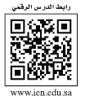

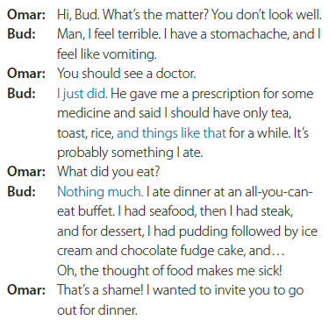
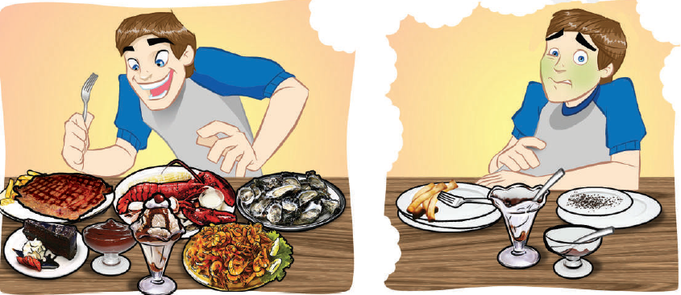
Page 68

Slide 5
Page 68

Slide 6
Page 68
Who is talking?
How does the boy feel in each picture?
What do you think the conversation will be about?

Slide 7
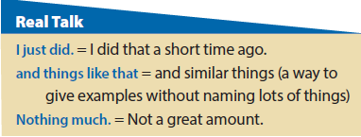
Page 68
Who says I just did? (Bud)
What did he just do? (He just saw a doctor.)
When did he do it? (A short time ago.)
Who says and things like that? (Bud)
You: (Ali), ask me what is in my bag.
Ali: What is in your bag?
You: My books, some pens, and things like that.
What did you do this weekend?
(I talked on the phone, saw some friends, and things like that.)
Who says Nothing much? (Bud)
Do you agree that he had nothing much for dinner?
(Disagree. Bud actually had a lot for dinner.)

Slide 8

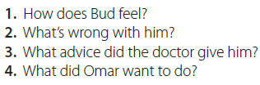
Page 68
1. He feels terrible.
2. He has a stomachache, and he feels like vomiting.
3. He should take some medicine and have only tea, toast, rice, and things like that for a while.
4. He wanted to invite Bud to go out for dinner.

Slide 9


Page 68
How do we ask what is wrong?
What’s wrong? and What’s the matter?
How to respond to advice
That’s a good idea.
Yeah, I think I’ll do that.
Yeah, I should.
No, I don’t think so.
I saw a doctor yesterday.
I just did.
in pairs to role-play the situation.

Slide 10





Page 68
Yes, I am.
I were ill last week.
I had a headache.
I took aspirin and stayed in bed.
I eat healthy food, drink a lot of water and exercise.
Maha says: I’m usually a healthy person. I was ill with a bad cold
about two years ago. I stayed in bed, drank juice, took aspirin, and slept.
Maha is usually a very healthy person. She was ill with a bad cold about two years ago. She stayed in bed, drank juice, took aspirin, and slept.

Slide 11


The end

Slide 12
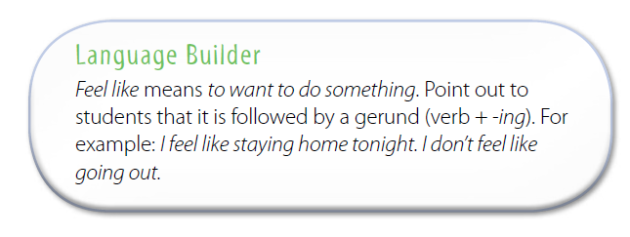

Slide 13
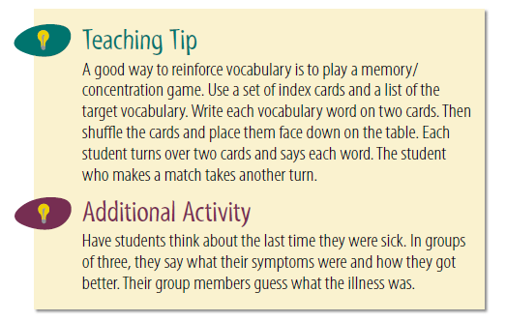

Slide 14
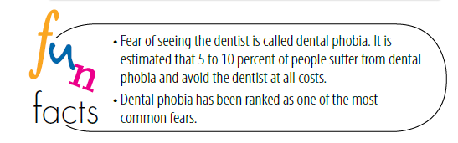

Slide 15

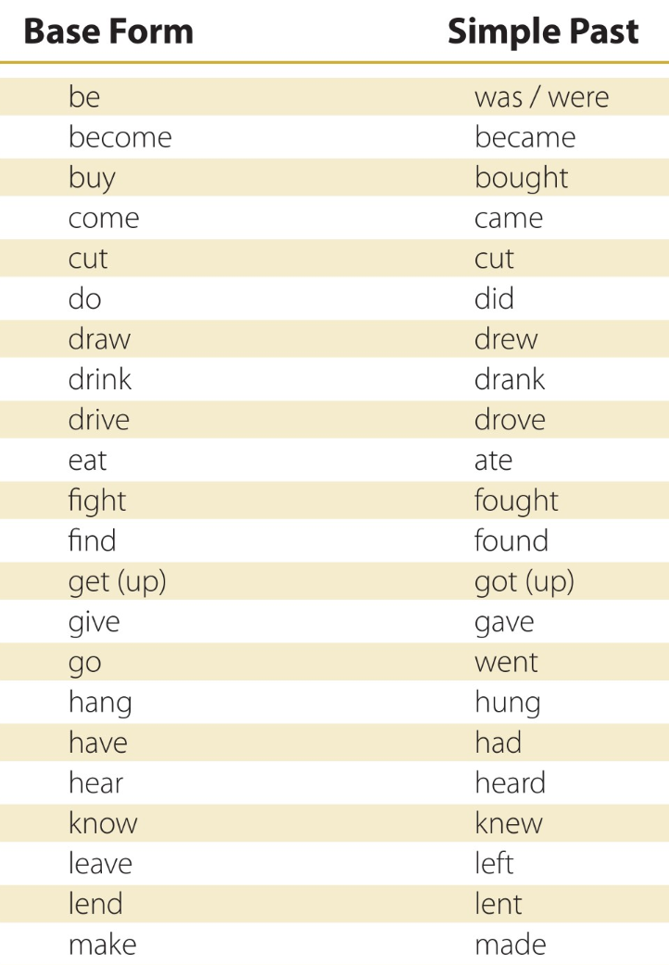
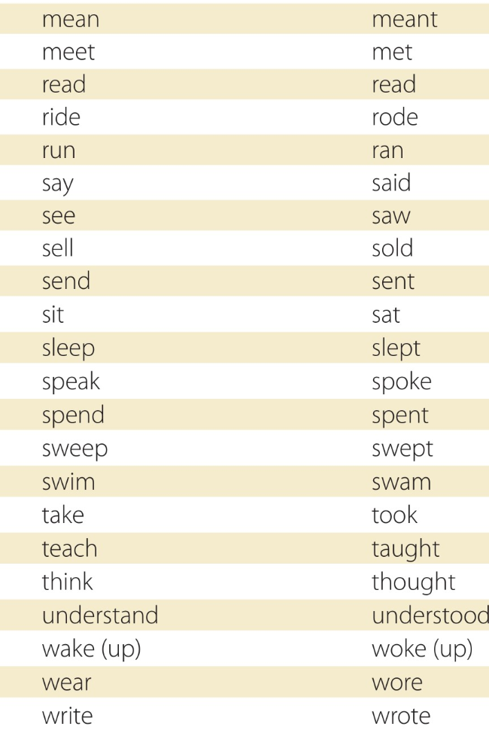
Page 83

