Slide 1
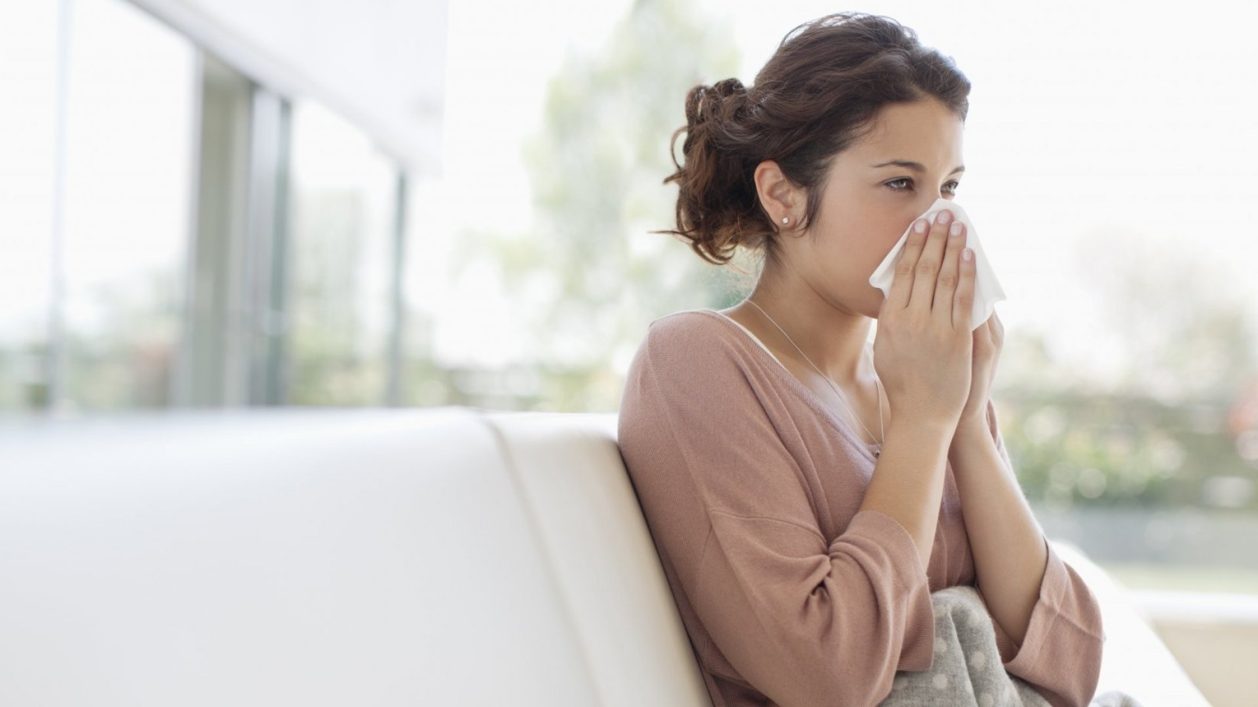

what’s Wrong?
Writing

Slide 2


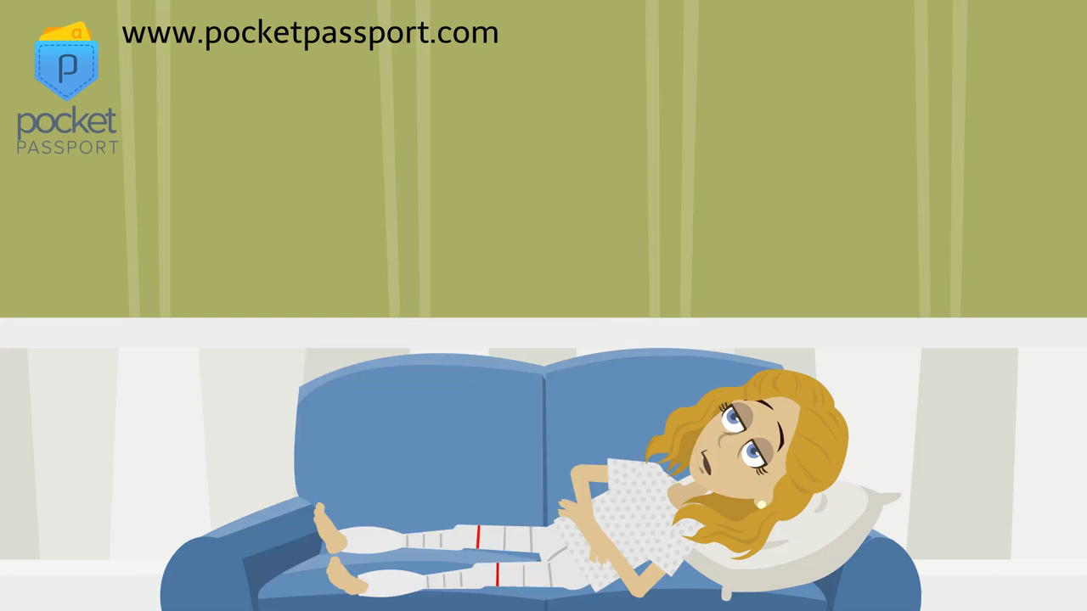
SG2 U8
Page 72
Then answer the questions:

Slide 3


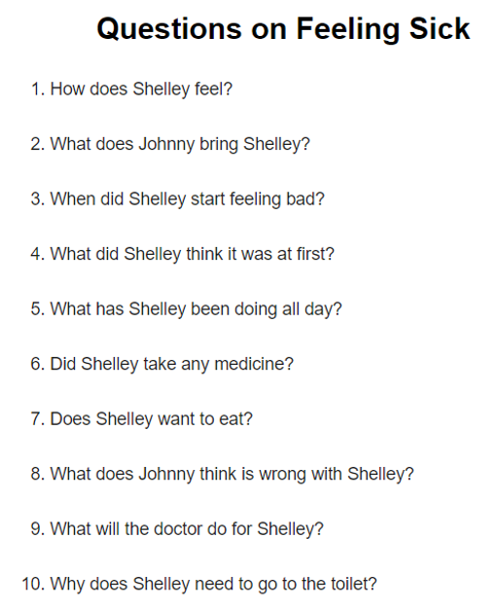


SG2 U8
Page 72
Then answer the questions:

Slide 4

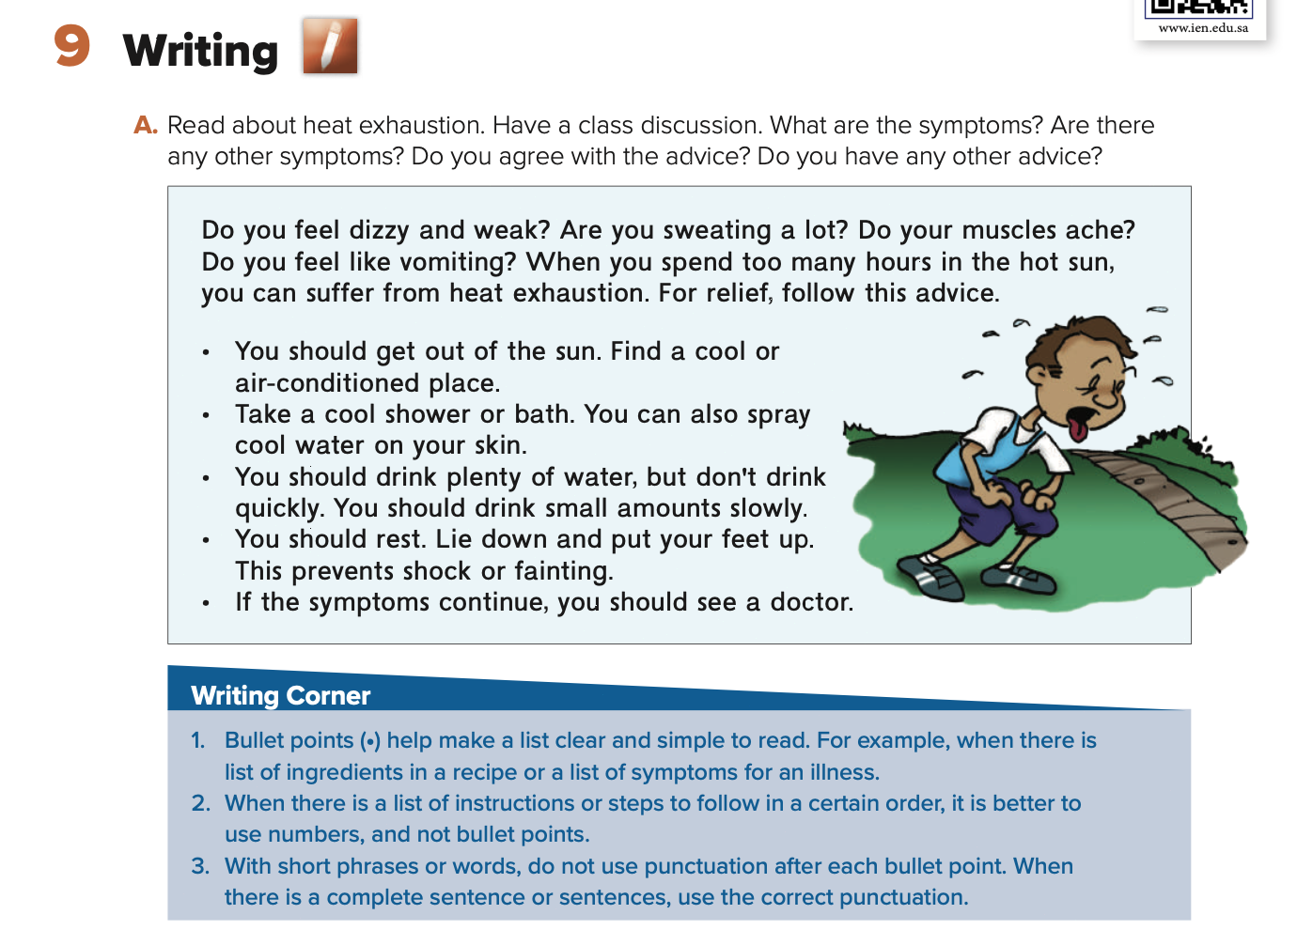
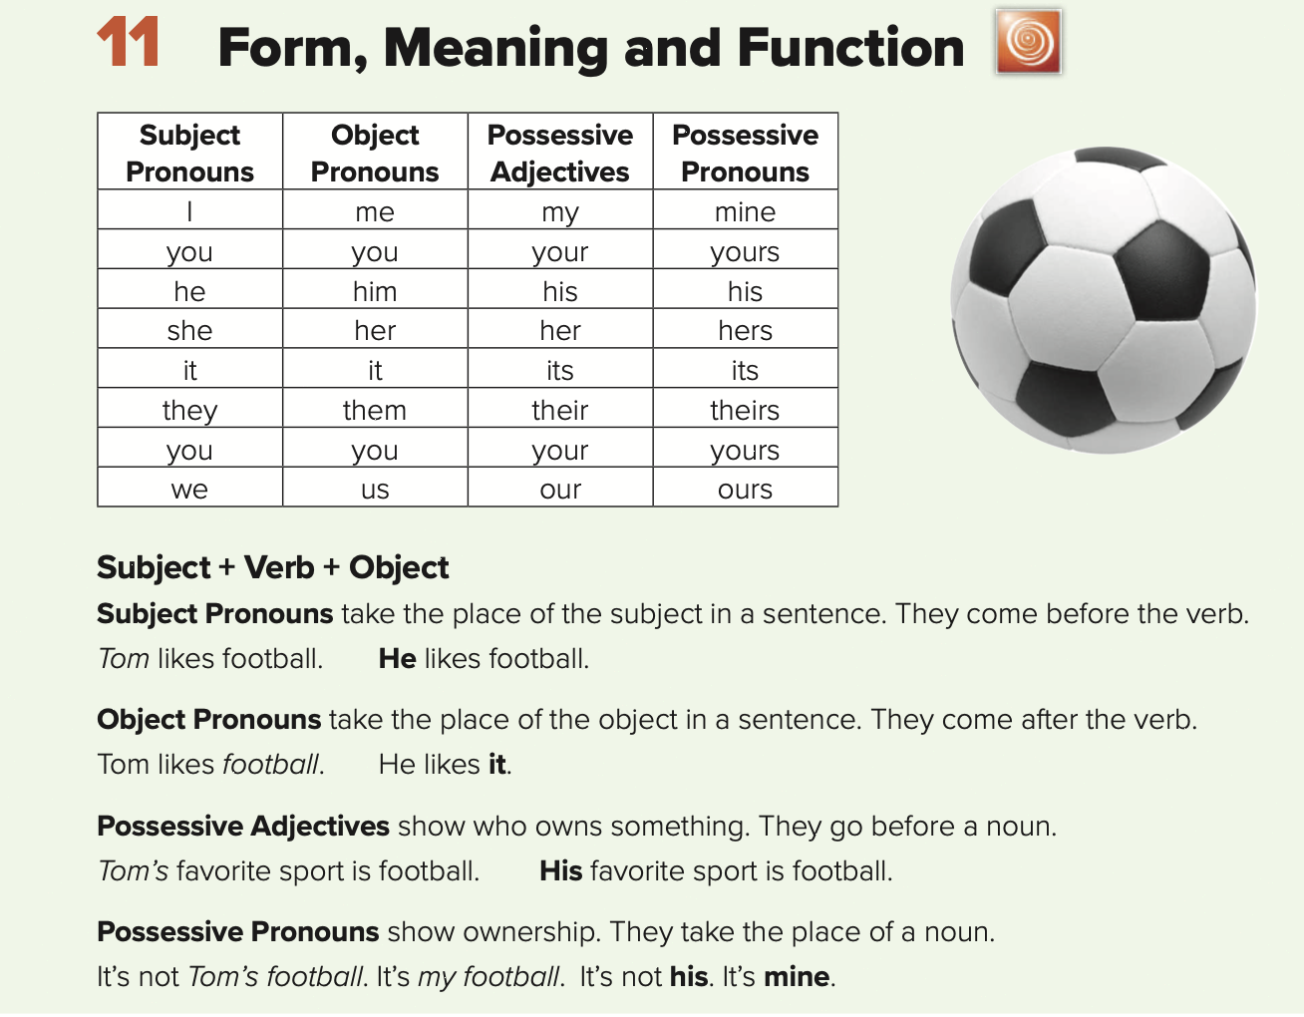
Use subject pronouns
Use subject pronouns
Use object pronouns
Use possessive adjectives and pronouns

Slide 5

Symptoms: dizzy, weak, sweating, muscles ache, vomiting

Slide 6

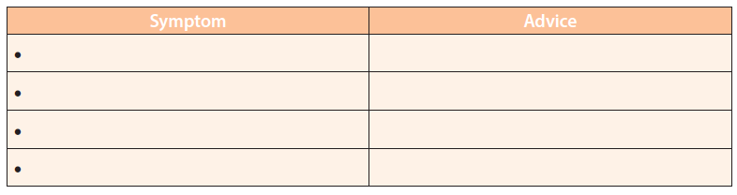
SG2 U8
Page 72
a headache
Take some aspirin
a stomachache
You shouldn't eat anything right now
a sore throat
You should drink warm liquids.

Slide 7


SG2 U8
Page 72
● I should get the flu shot.
●I should wash my hands frequently.
●I should stay in bed.
☺Stay at home and rest.
☺Avoid close contact with well people in your house so you won't make them sick.
☺Drink plenty of water.
☺Treat fever and cough with medicines you can buy at the store.

Slide 8
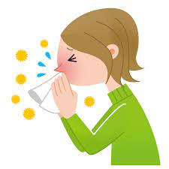
SG2 U8
Page 72
U8\Composition
*Write a paragraph about Feeling Sick . Give your opinion about it.
When was the last time you were sick?
What did you feel?
What do you do when you have a fever?
What do you do to feel better when you are sick?
What are some foods that help you feel better?
How can you protect yourself from the flu? Why?
I was sick last week. I don't feel well. Because I have a fever. I have a runny nose and a cough .I take some medicine and stay home and rest. I eat well and drink ginger and tea. I feel better in a few days. I think flu viruses spread so quickly by people when they cough or sneeze. We should wash our hands and avoid being around sick people.

Slide 9




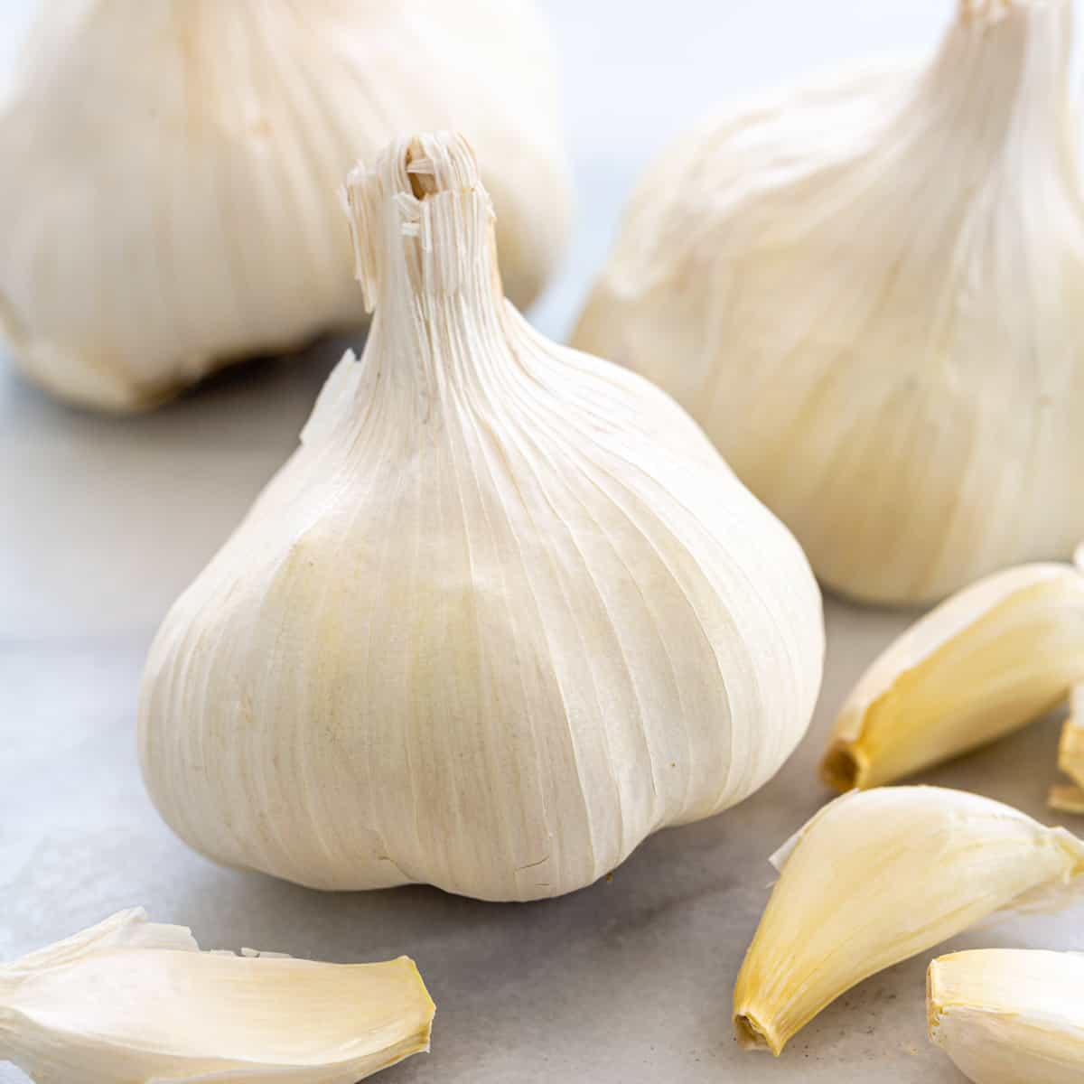
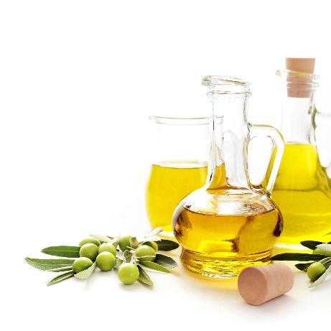
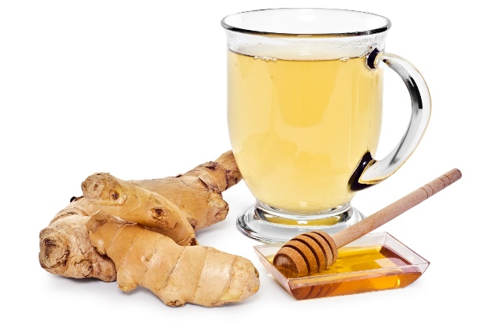
SG2 U8
Page 72
illnesses
lemon
garlic
ginger drink
honey
olive oil

Slide 10

Page No.122

Slide 11
What’s wrong?
Form, meaning, and function

Slide 12


Slide 13
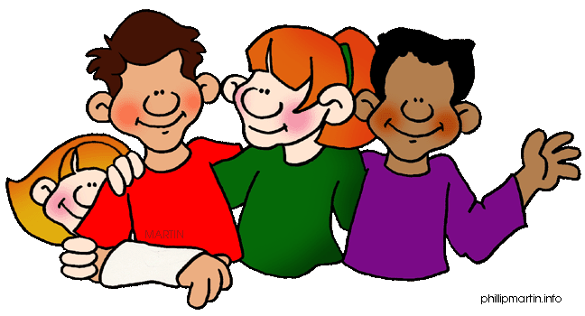
Personal or subject
Pronouns

Slide 14

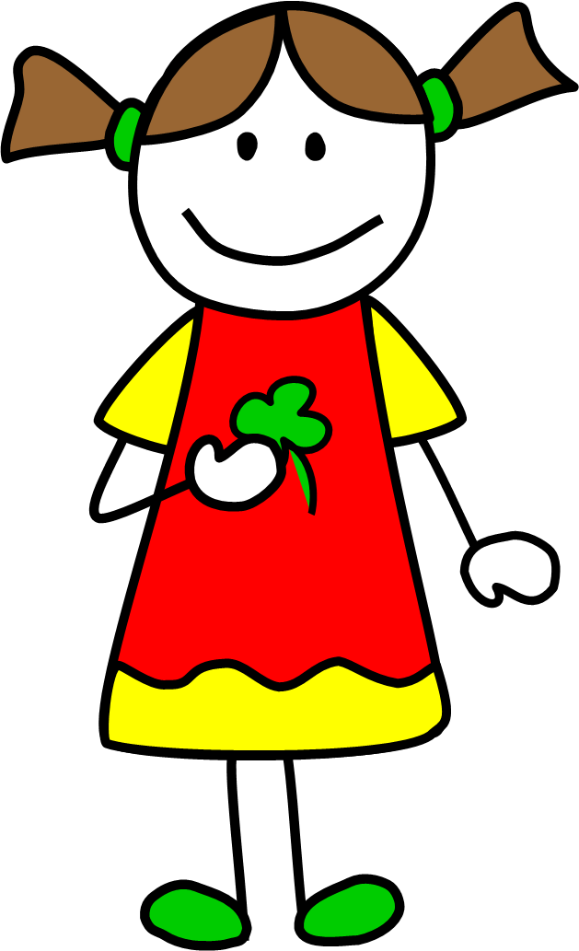



Slide 15
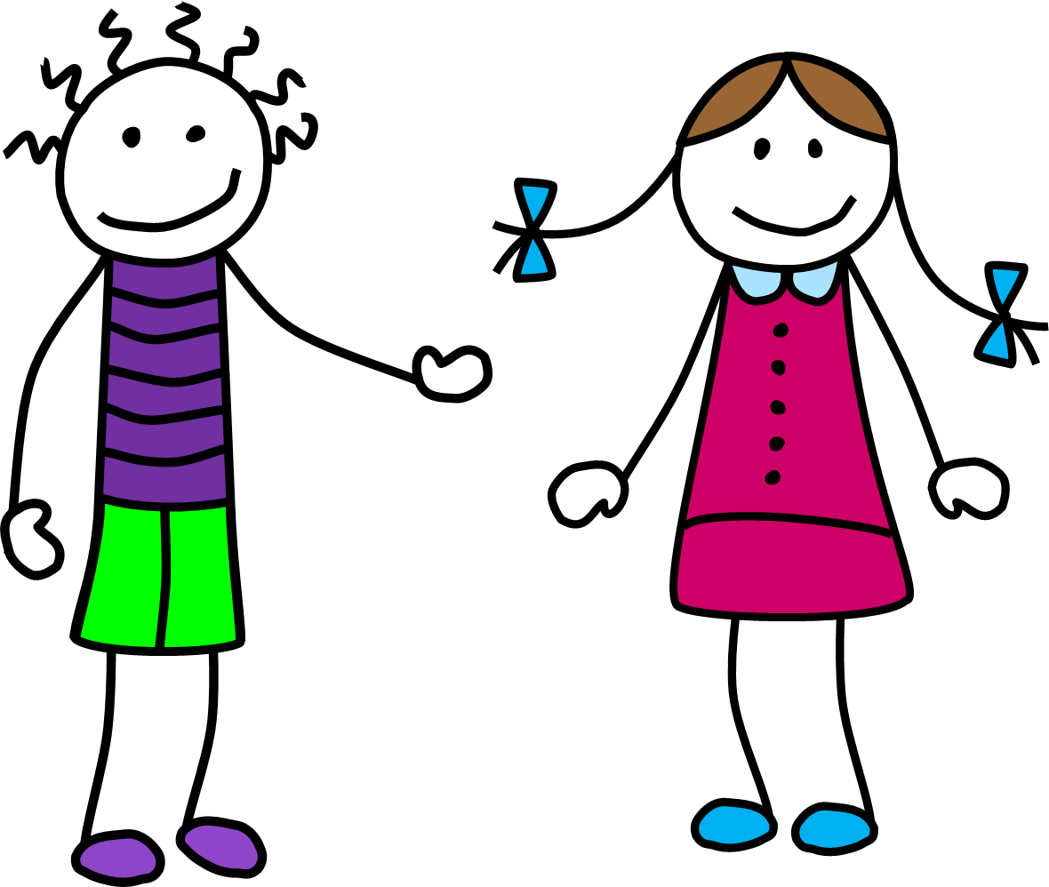


Slide 16
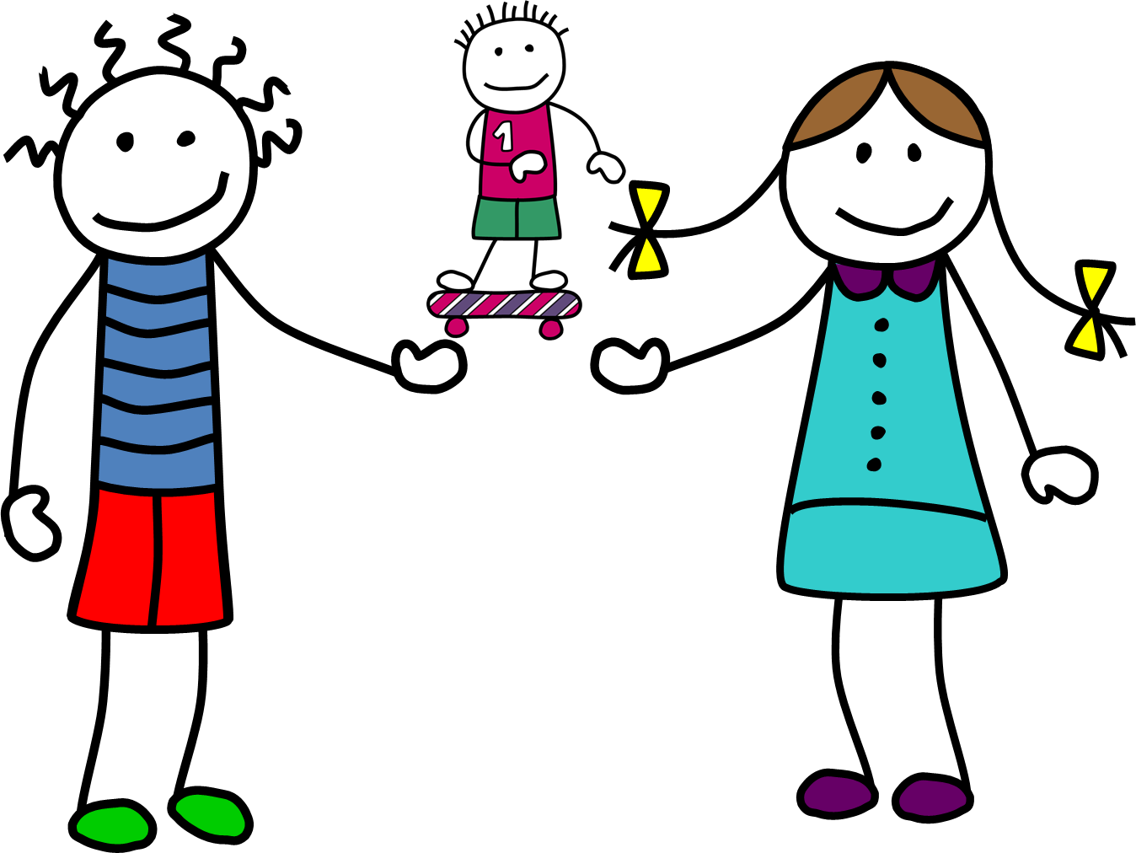


Slide 17
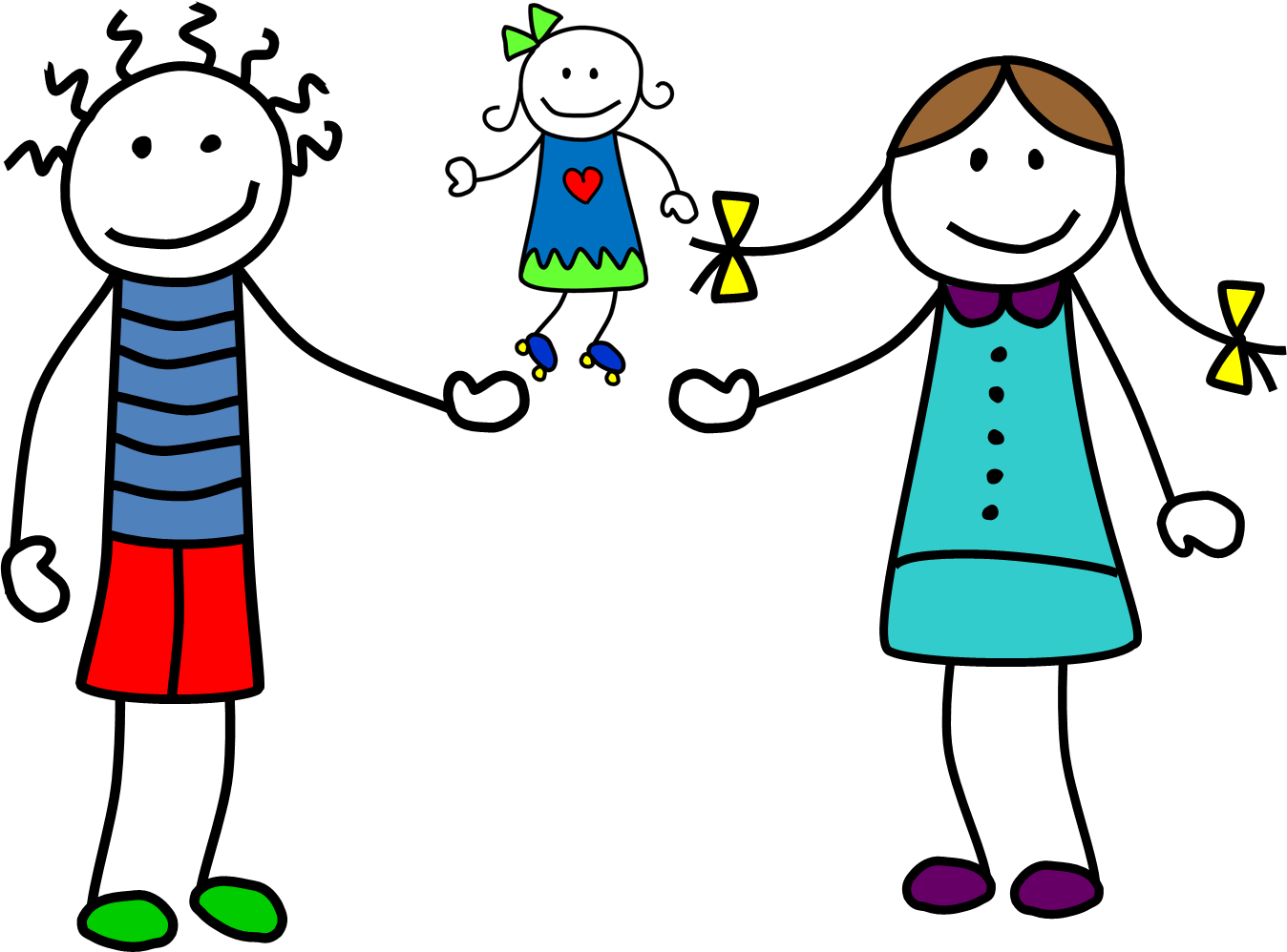


Slide 18
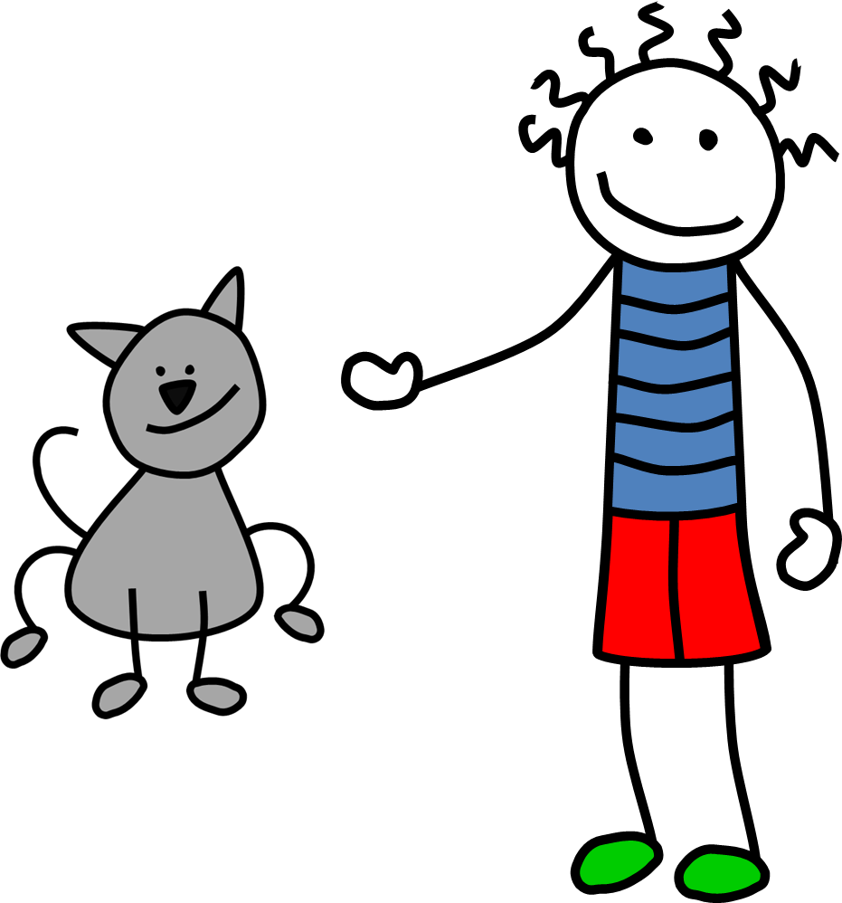


Slide 19



Slide 20
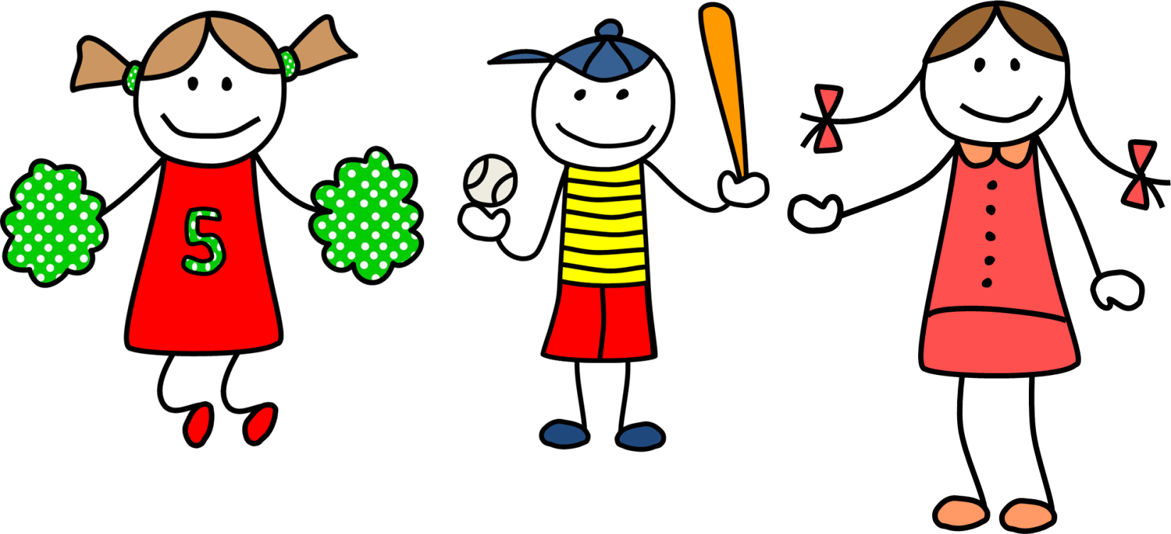

Slide 21
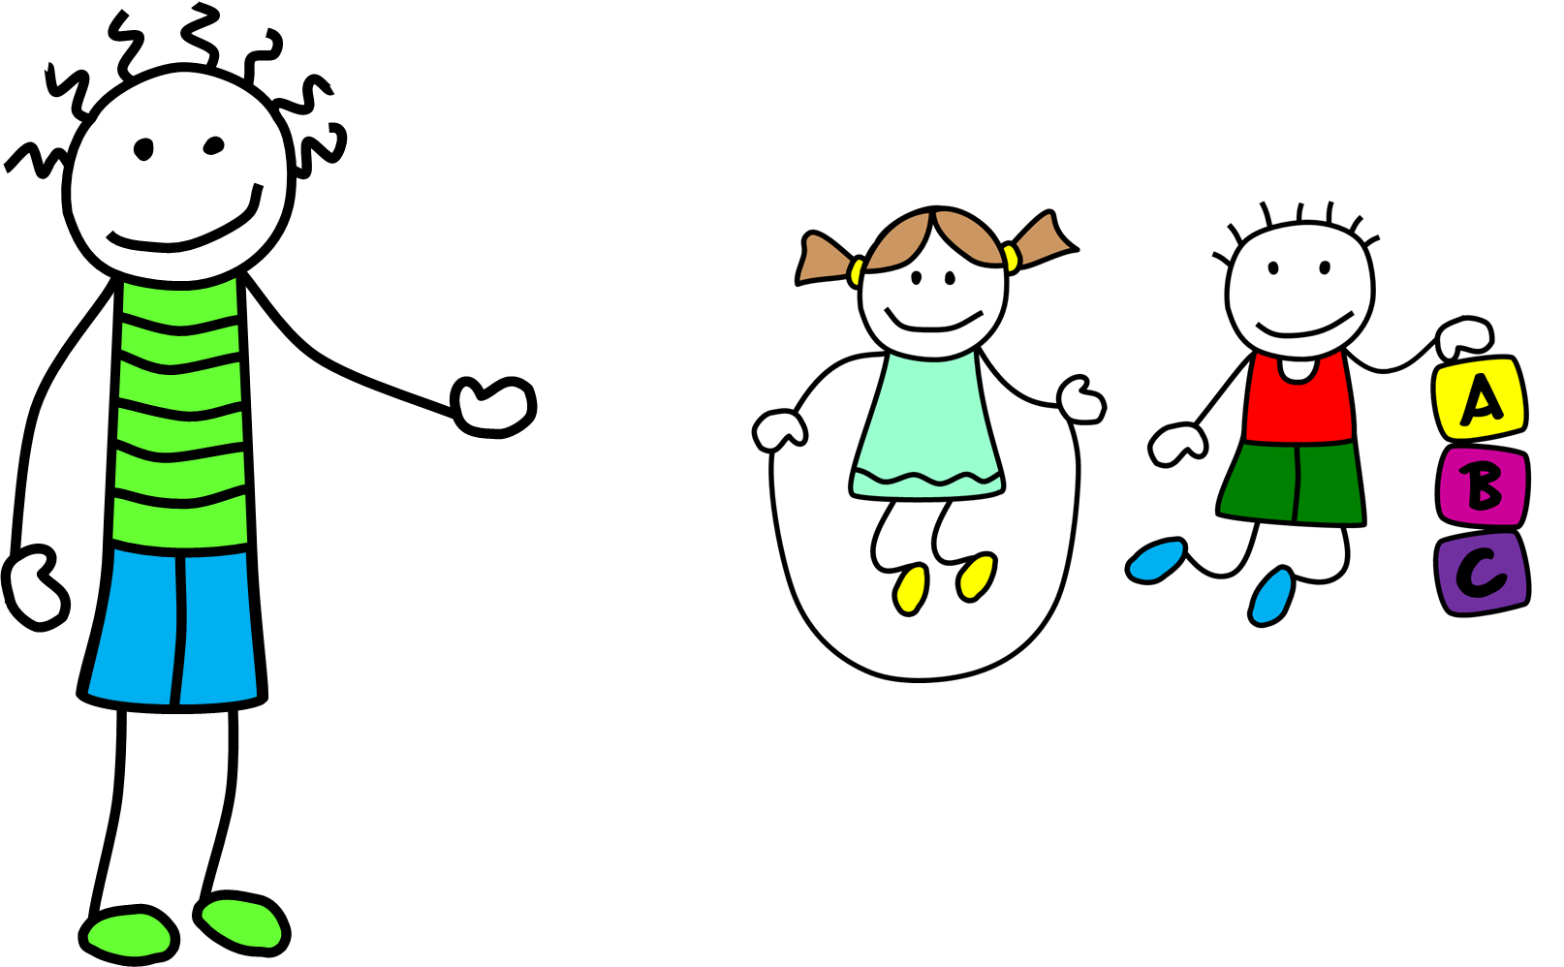


Slide 22
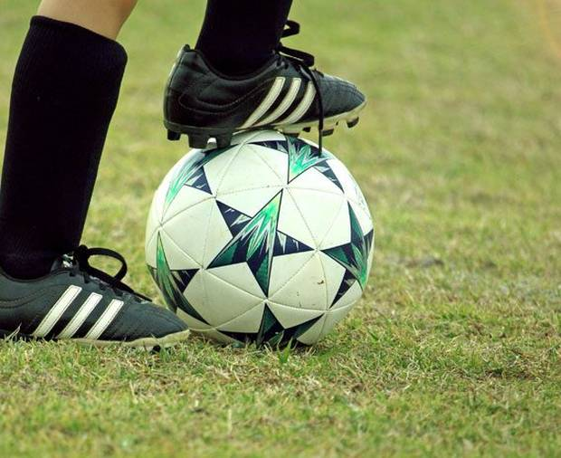
Personal Pronouns
Singular | Plural
I | We
You | You
He | They
She | They
It | They
Personal pronouns are always before
Tom likes football
Ex.: I am a student He likes football
Personal pronoun
Verb be
Pesrsonal pronome
verb

Slide 23
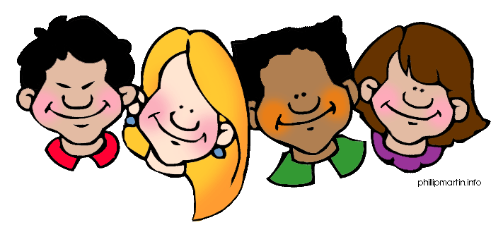
objective
pronoun

Slide 24

Tom likes football.
Ex.: He likes it.
Object pronouns

Slide 25
Possessive
Adjectives

Slide 26
Possessive adjectives
Singular | Plural
My | Our
Your | Your
His | Their
Her | Their
Its | Their
Possessive pronouns are always before a noun and indicate possession.
Eg.: his favorite sport is footbal That is his ball
noun
noun
Possessive adj.
Possessive adj.

Slide 27
Personal pronouns
Possessive adjectives
I
My
You
Your
He
His
She
Her
It
Its
We
Our
You
Your
They
Their

Slide 28
Possessive
pronoun

Slide 29
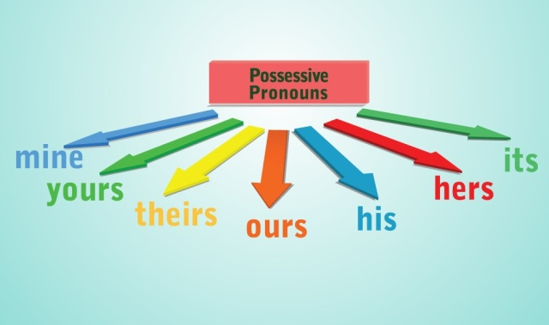
It is not Tom’s foorball. It is my football.
Ex.: It is not his. It is mine
Possessive pronouns

Slide 30
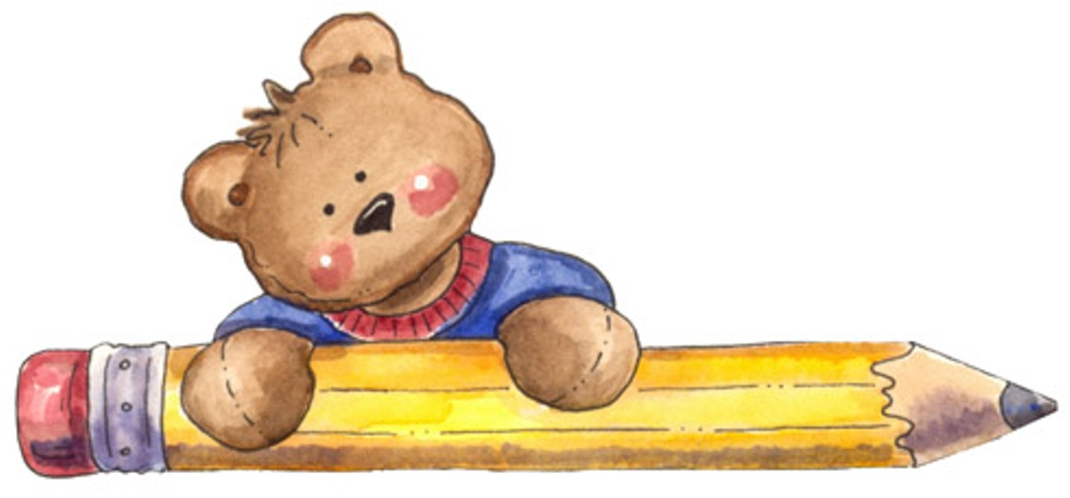
Let's practice

Slide 31

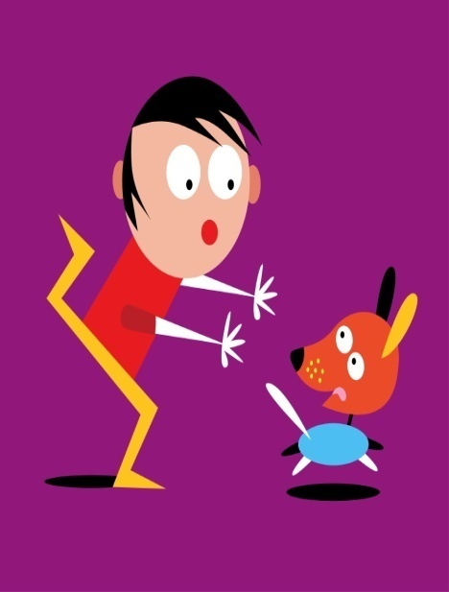
Complete with the correct personal pronoun and possessive adjective
This is _________ friend, Sally. _______ is a student and _________ is 11 years old. This is __________ house.
my
She
she
her
This is Joe. __________ ´s from the UK. __________is 10 years old. This is ___________ dog. __________ name is Rex.
He
He
his
its

Slide 32
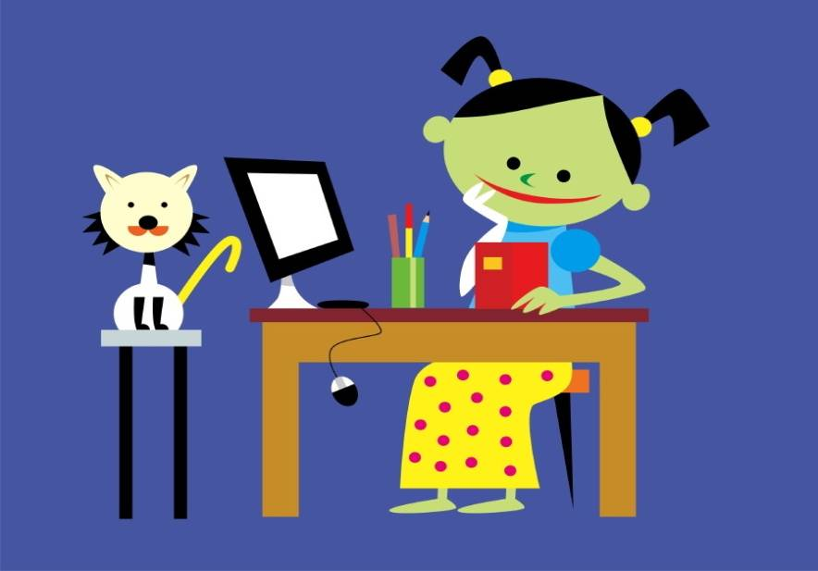
I
Hello! __________ ´m Carla. _______´m from Italy. _________ favourite colour is blue. This is ________ cat. _________ is white.
I
My
my
It

Slide 33
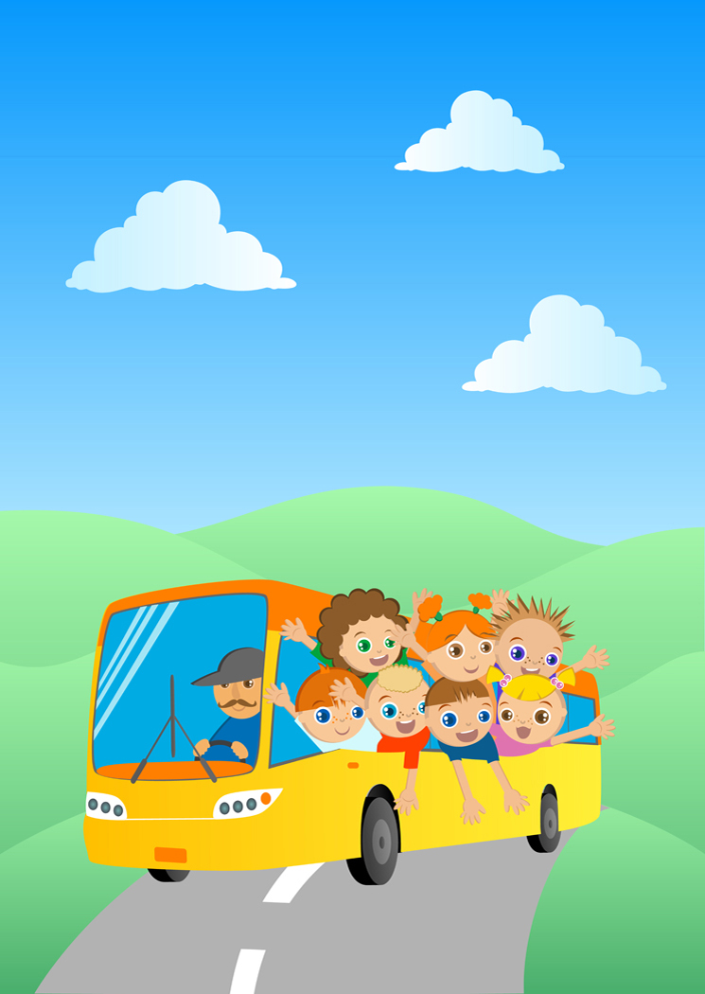
Hello, everyone! ________ are all friends. __________ ´re in the same school. __________ school is fantastic. This is ________ school bus. _______´s yellow.
We
We
Our
our
It

Slide 34
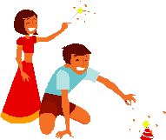
These children are from India. ___________ names are Ken and Mia. ___________ are twins. __________ ´re 12 years old. __________ favourite colour is red.
Their
They
they
Their

Slide 35
What about you?
By answering these questions, write a short paragraph about you in your notebook
What is your name?
How old are you?
Where are you from?
What’s your favourite colour?

Slide 36
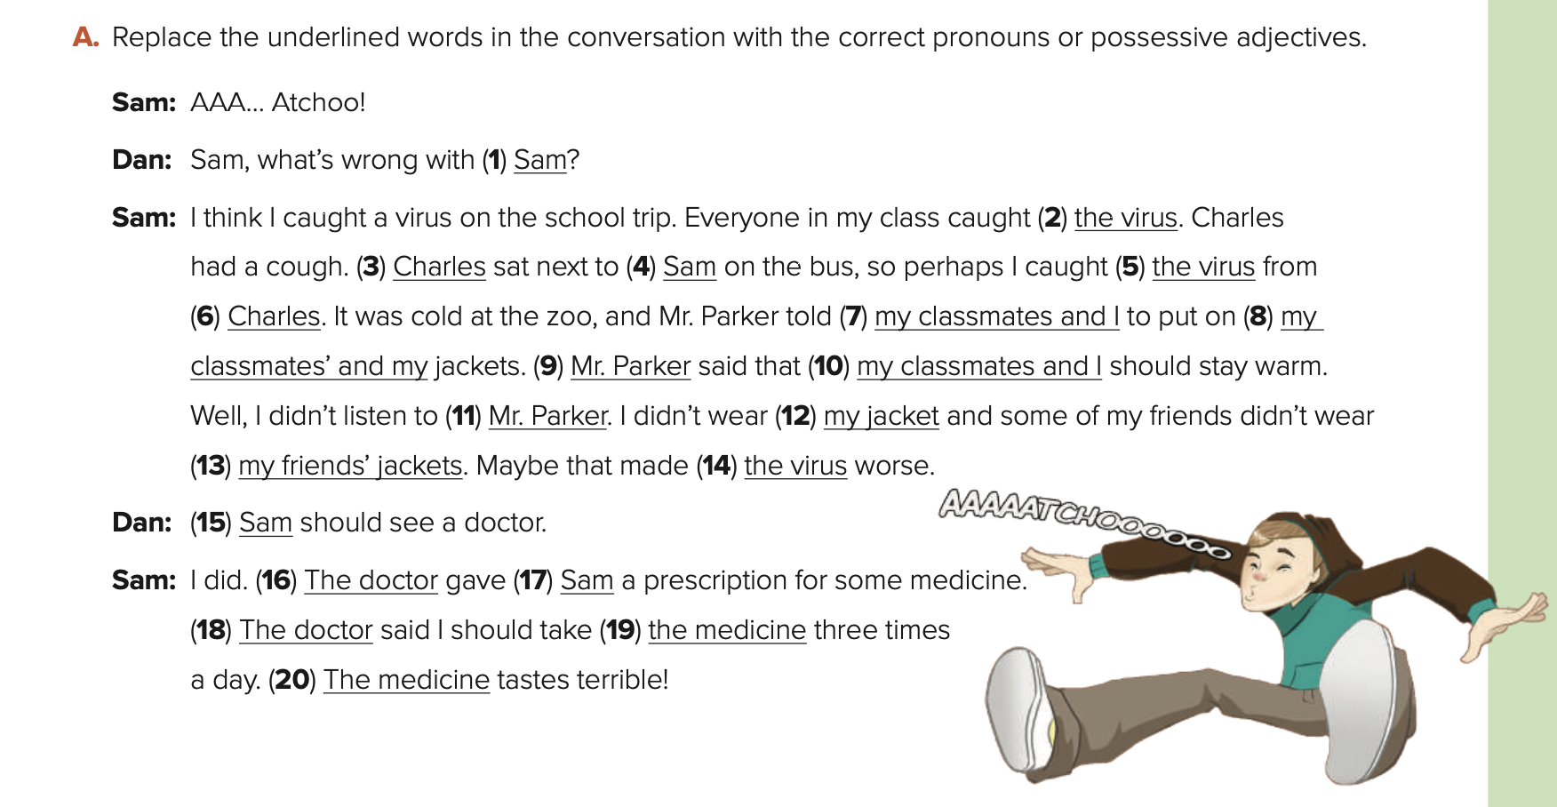
you
it
He
me
it
him
us
our
He
We
him
mine
theirs
it
You
He
me
He
it
it

Slide 37
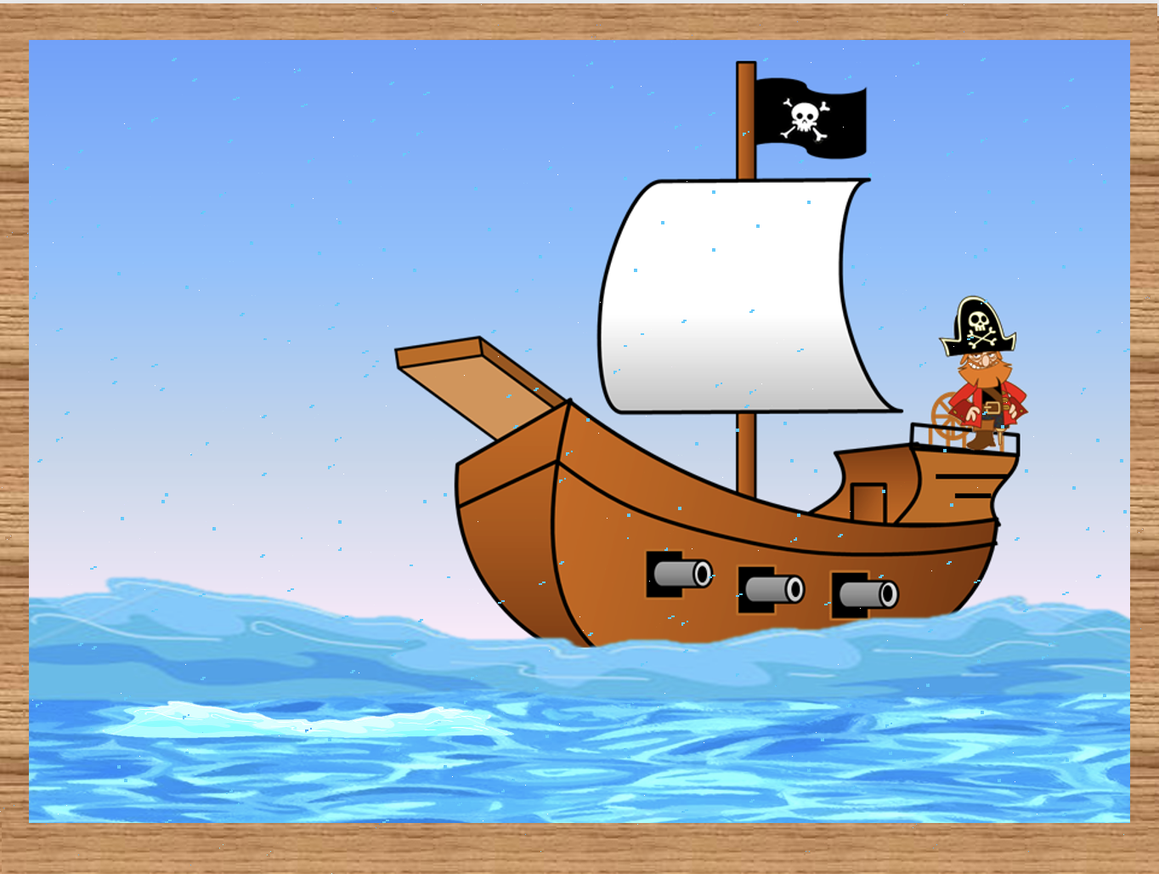
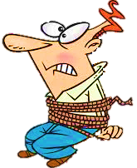


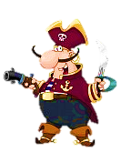



SUBJECT / OBJECT PRONOUNS

Slide 38
Click on the right option to save Peter
1/10
I
me
NEXT
Peter and ____ were exploring an island.
I

Slide 39
2/10
we
us
NEXT
We
______ were birdwatching when a ship appeared in the distance.

Slide 40
3/10
we
us
NEXT
Some pirates came and chased _______.
us

Slide 41
5/10
I
me
NEXT
He told _____ that he was in danger.
me

Slide 42
4/10
he
him
NEXT
The pirates catched _______ at the beach.
him

Slide 43
6/10
he
him
NEXT
______ was really frightened.
He

Slide 44
7/10
she
her
NEXT
His wife was at home.
I talked to ______ in the evening.
her

Slide 45
8/10
she
her
NEXT
______ was really surprised.
She

Slide 46
10/10
they
them
EXIT
They have two children.
Peter was thinking of _______ .
them

Slide 47
9/10
they
them
NEXT
______ live in a house on the coast.
They

