Slide 1


Slide 2


Slide 3




♥
☺
☺
♥

Slide 4
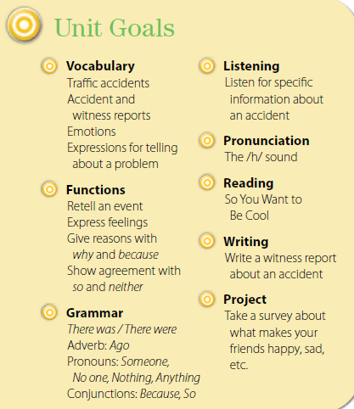

Slide 5
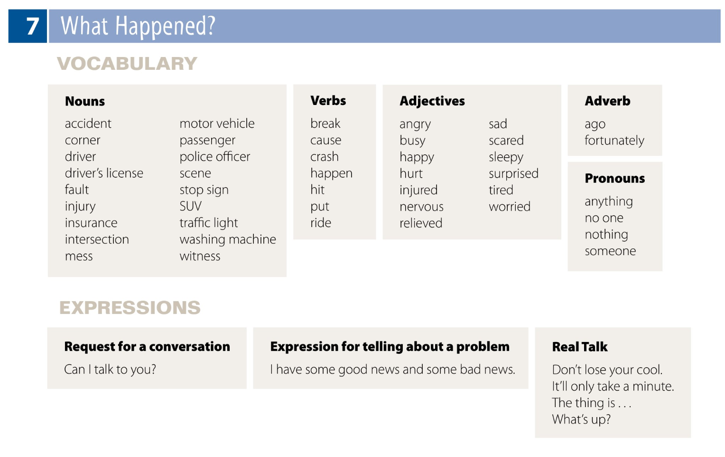

Slide 6

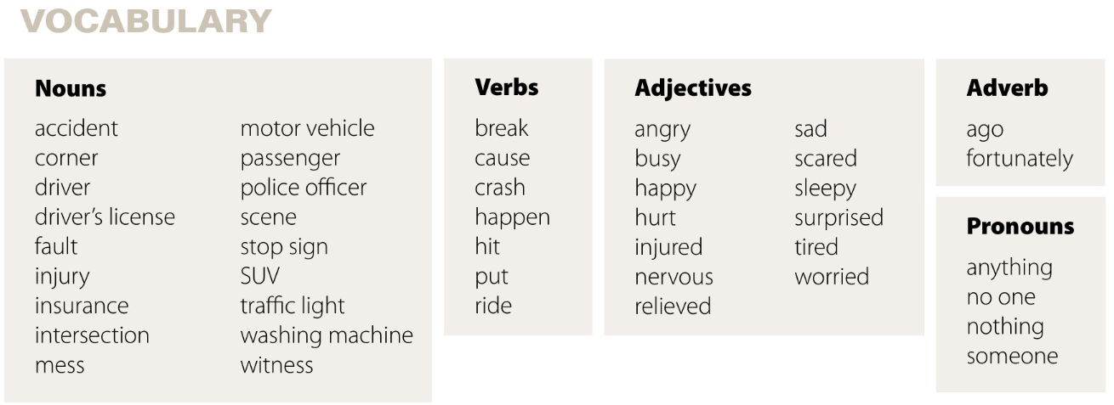

Slide 7

Nouns
accident
corner
driver
driver’s license
fault
injury
insurance
intersection
mess
Adjectives
angry
busy
happy
hurt
injured
nervous
relieved
sad
scared
sleepy
surprised
tired
worried
Adverb
ago
fortunately
Verbs
break
cause
crash
happen
hit
put
ride
Nouns
motor vehicle
passenger
police officer
scene
stop sign
SUV
traffic light
washing machine
witness
Pronouns
anything
no one
nothing
someone

Slide 8

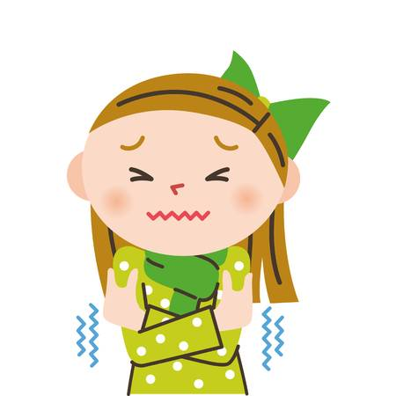
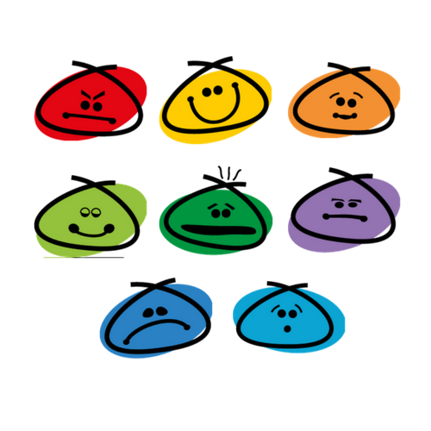
cold

Slide 9
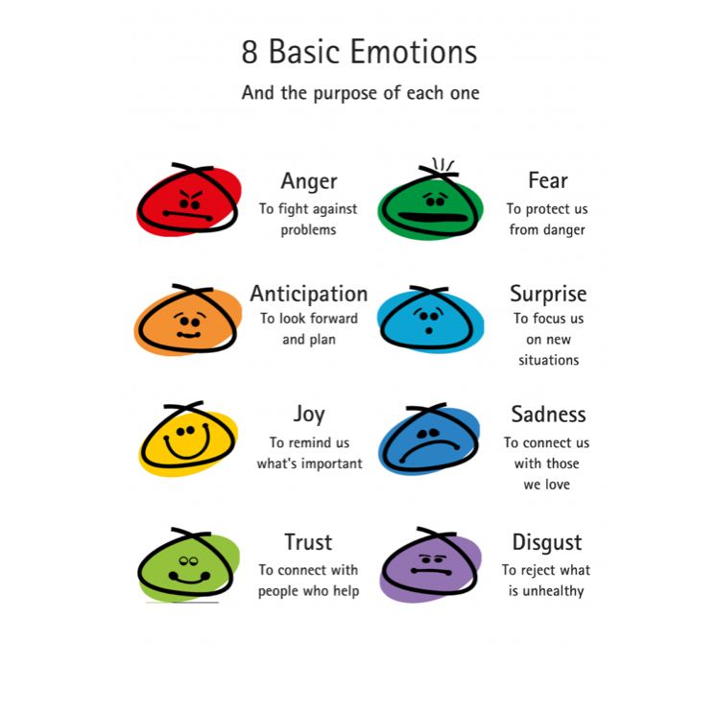

Slide 10

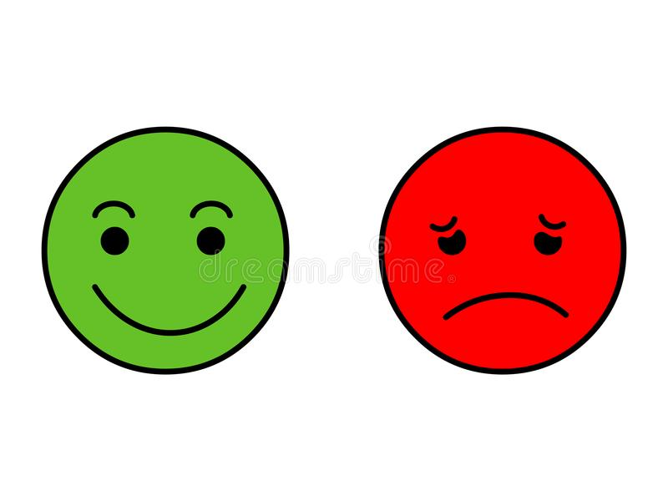
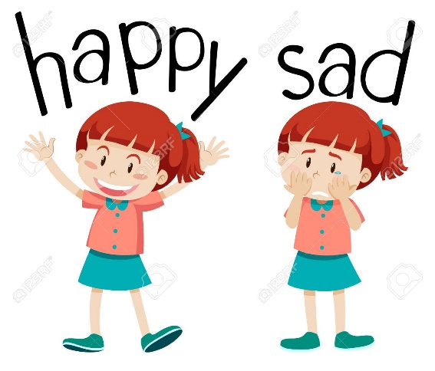

These sentences about
why you might be happy.
For example:
I’m happy because I’m going to a restaurant this evening.
I’m also happy because I saw an old friend yesterday.
Why are you happy or sad?

Slide 11

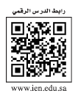



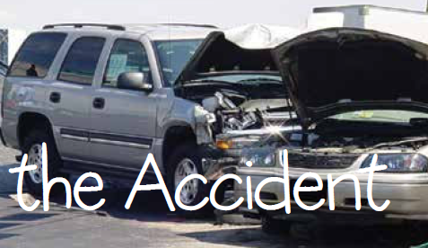

Page 56
An SUV is a Sport Utility Vehicle.
The photo shows a picture of an SUV.
It is a vehicle that is larger than a car, rides higher off the ground, and can carry more than four people.
☺

Slide 12

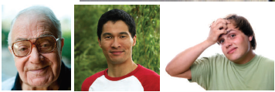
Page 56
at the people on page 56.
1.Do you think any of these people are happy?
no
How do you think they feel?
Varied responses including( worried, relieved, nervous.
the introductory questions and other questions such as the following:
What happened?
There was an accident. An SUV crashed into a car.
Does the accident look very serious?
Do you think anyone was hurt?
How do accidents often happen?

Slide 13



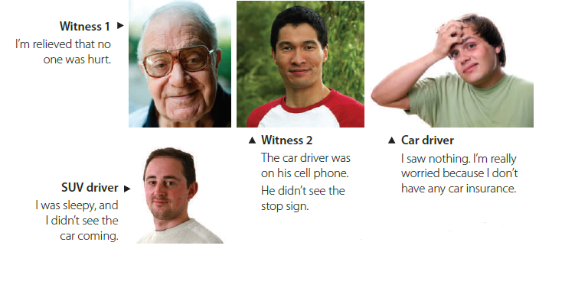
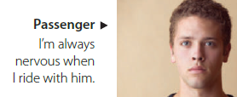
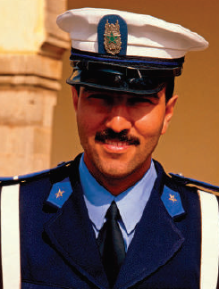

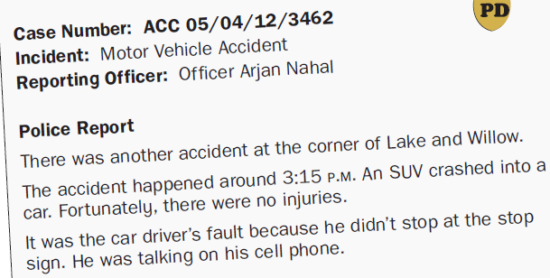
Page 56
1.Did the car driver stop at the stop sign?
2.Did the SUV driver see the car coming?
3.Was the car driver on his cell phone?
How do the people on page 56 feel
and why they feel this way?
Why is the witness relieved?
No one was hurt.
Why is the car driver worried?
He doesn’t have any car insurance.
Why didn’t the SUV driver see the car coming?
He was sleepy.
Why is the passenger always nervous when he rides with the car driver?
He’s a bad driver. This is implied, not stated.
Why isn’t the police officer surprised there was another accident?
There is no traffic light at the intersection.
☺
☺

Slide 14
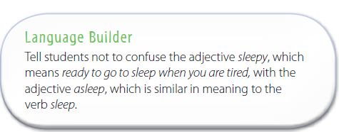

Slide 15
Page 56

Slide 16
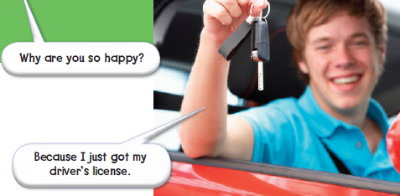

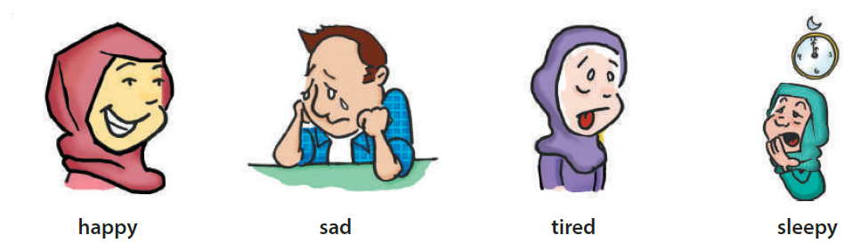
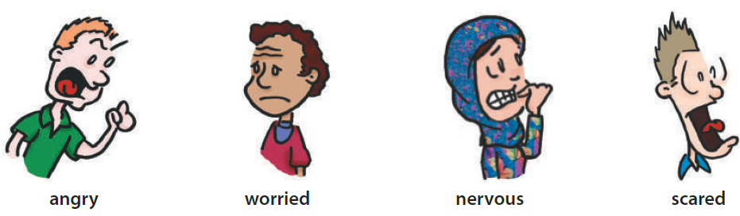
Page 57
What do the pictures show?
Listen to the second part of the
audio for Feelings.
Listen then repeat chorally and individually.

Slide 17

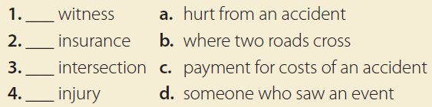
Page 57
Find and circle the words
witness, insurance, intersection, and injury on page 56.
Work individually to match the words with their meanings and use the context to guess the meanings.
d
c
b
a

Slide 18

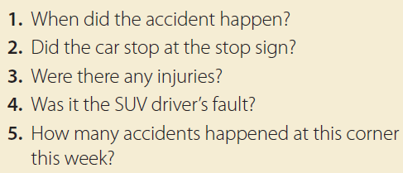
Page 57
☺

Slide 19

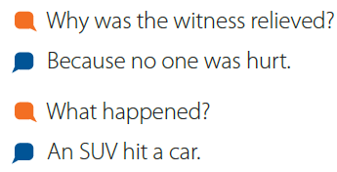
Page 57
☺

Slide 20

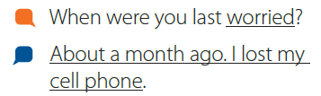
Page 57
☺

Slide 21


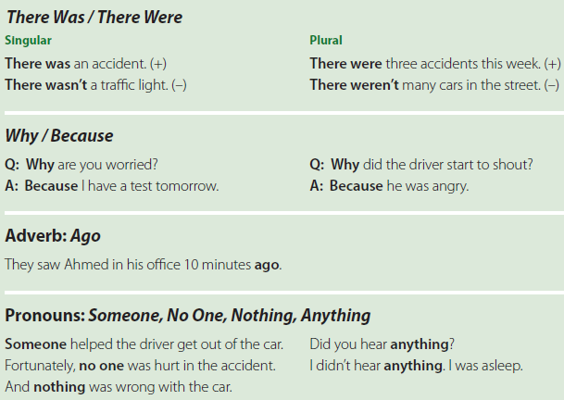
Page 58
☺

Slide 22
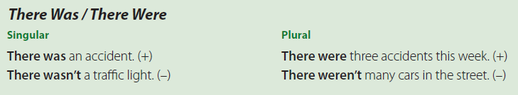
Page 58
☺

Slide 23
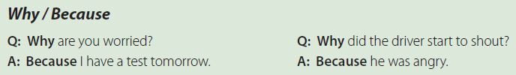
Page 58
☺

Slide 24

Page 58
☺

Slide 25
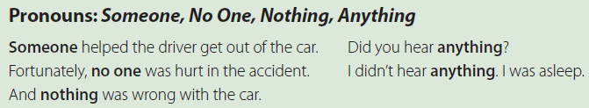
Page 58
☺

Slide 26
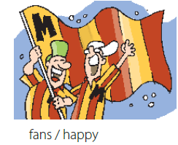
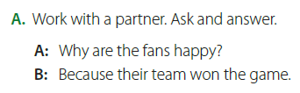
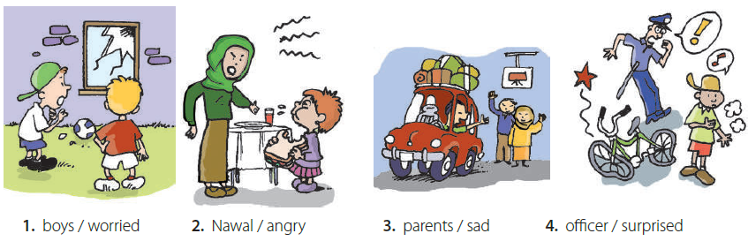
Page 58
☺

Slide 27
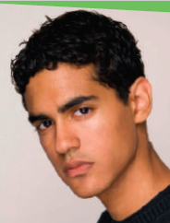

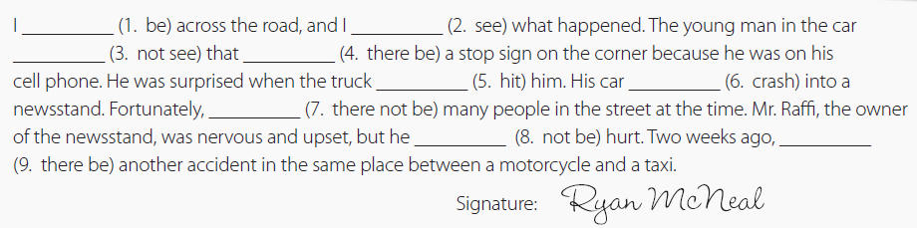
Page 59
☺

Slide 28
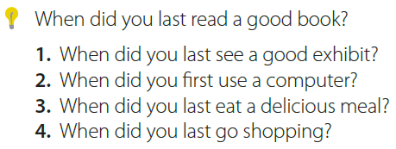
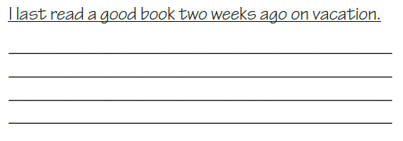
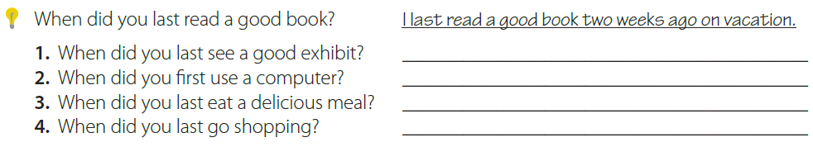
Page 59
☺

Slide 29
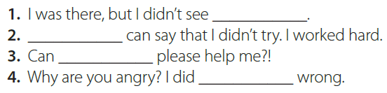
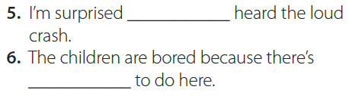
Page 59
☺

Slide 30

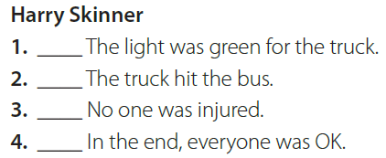
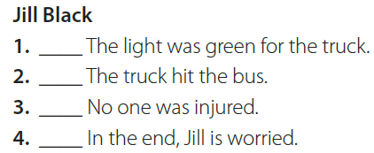
Page 59
☺

Slide 31


Page 59
☺

Slide 32


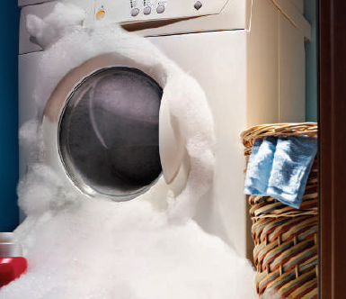
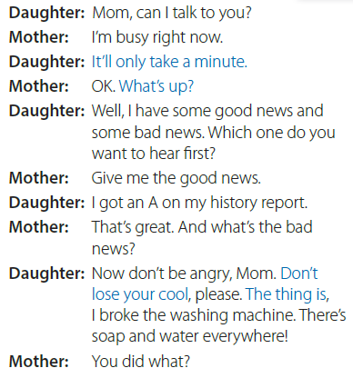
Page 60
☺

Slide 33
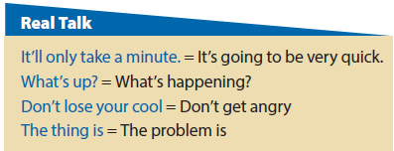
Page 60
☺

Slide 34
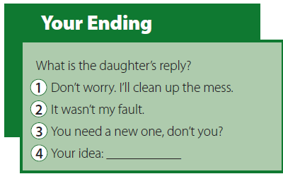
Page 60
☺

Slide 35

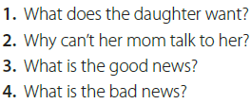
Page 60
☺

Slide 36

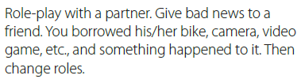
Page 60
☺

Slide 37

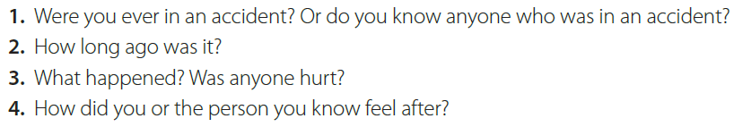
Page 60
☺

Slide 38


Page 61
☺

Slide 39
Page 61
☺

Slide 40
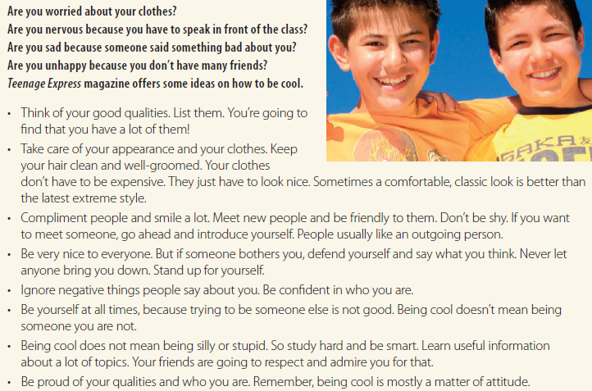
Page 61
☺

Slide 41

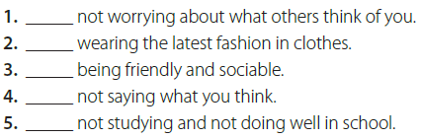
Page 61
☺

Slide 42

Page 61
☺

Slide 43

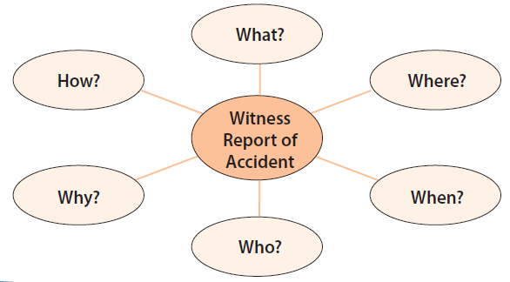
Page 62
☺

Slide 44
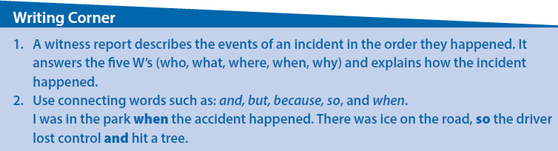
Page 62
☺

Slide 45
Page 62
☺

Slide 46

Page 62
☺

Slide 47
Page 62
☺

Slide 48

☺
Page 62

Slide 49

Page 63
☺

Slide 50

Page 63
☺

Slide 51


Page 63
☺

Slide 52

Page 63
☺

Slide 53


Page 63
☺

Slide 54
The end
Noureyah Alghamdi

Slide 55

Role play is the act of imitating the character and
behaviour of someone who is different from yourself,
Benefits of Role-Play
☺Build confidence:
☺Develop listening skills:
☺Creative problem-solving:
☺Develops communication and language skills:
☺Allows students to act out and make sense of real-life situations:
☺Develops social skills as children, collaborate with others:
☺Encourages children to express their ideas and feelings in a relaxed environment:
☺Sparks creativity and imagination:

Slide 56



Page 83

Slide 57


