Slide 1
U 7
What happened?
Tr. Nora Khalid

Slide 2

Goals:
To know some new words related to traffic accidents, witness reports and emotions.
Listen for specific information about an accident

Slide 3

I’m happy because:
I’m happy because I’m going to a restaurant this evening.
I’m happy because I saw an old friend yesterday.

Slide 4
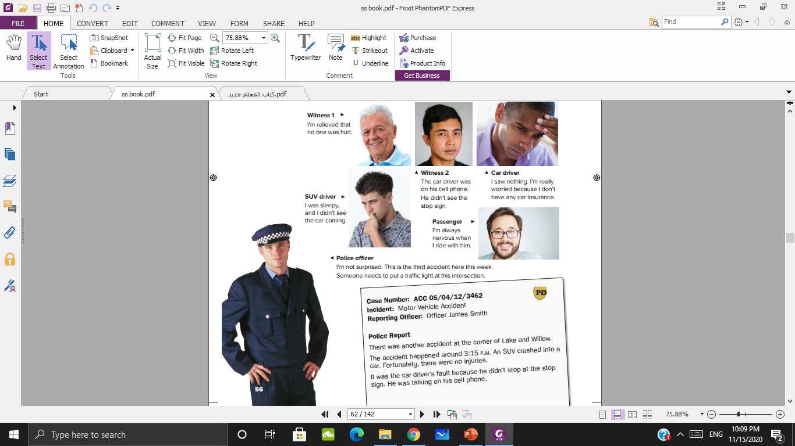
Do you think any of these people are happy? How do they feel.
Sleepy
Nervous
Worried
relieved

Slide 5
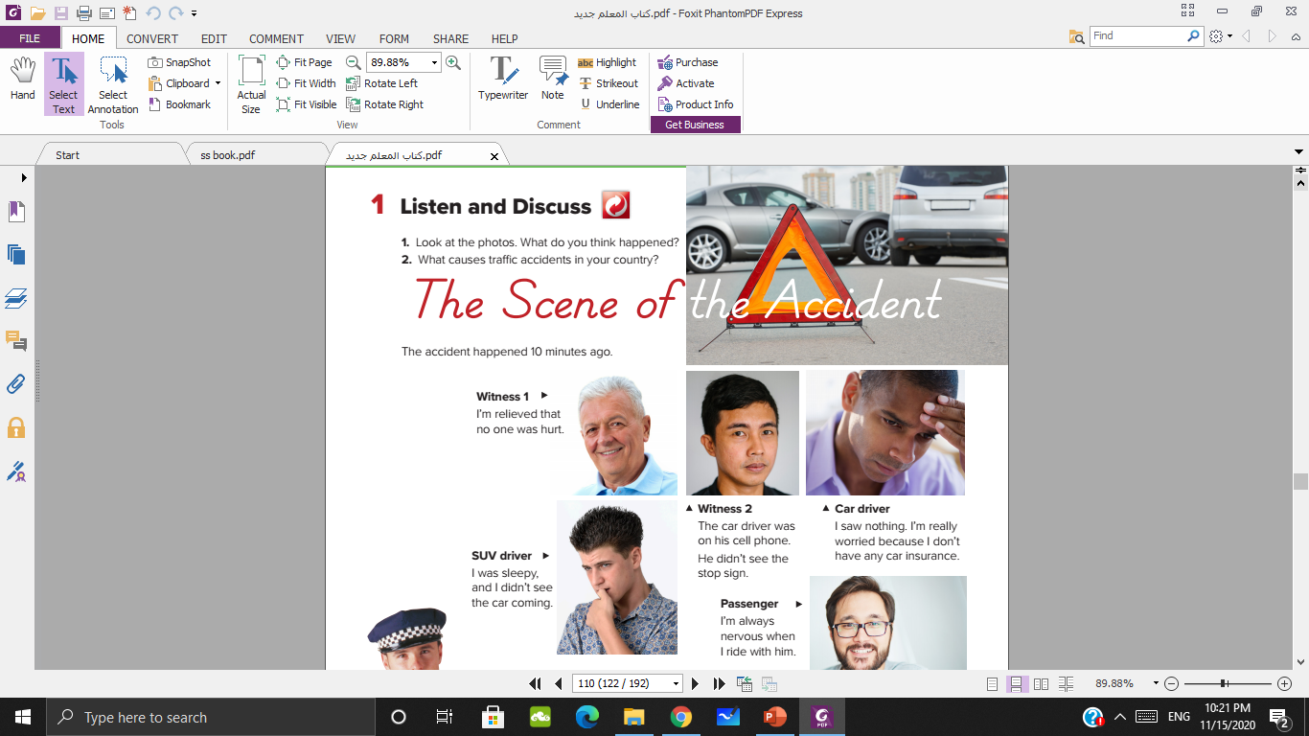
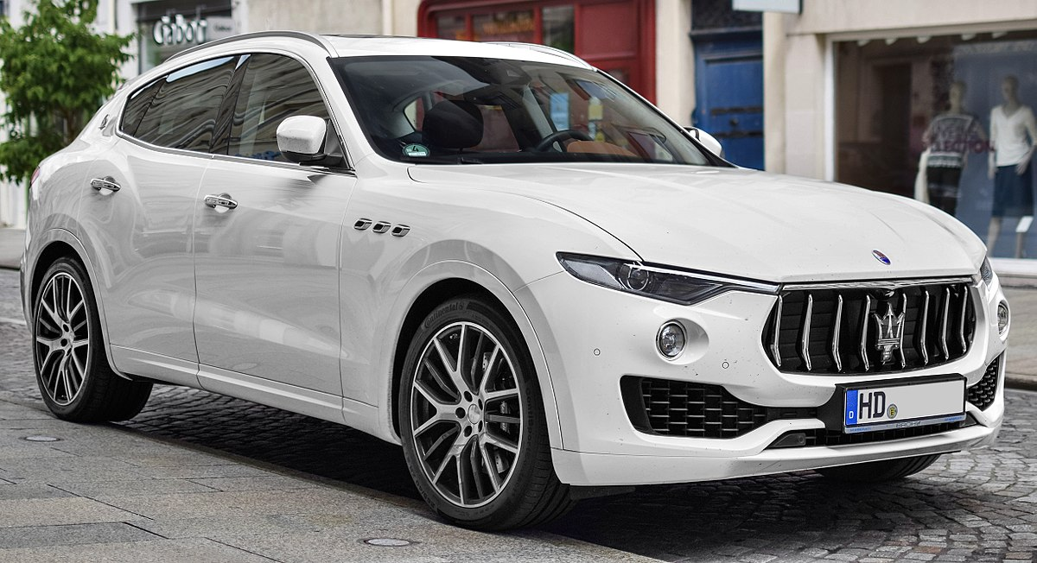
Look at the photos. What do you think happened?
There was an accident. An SUV crashed into a car.

Slide 6
Do you think anyone was hurt?

Slide 7
How do accidents often happen?
Sleeping
Using phone
……………..

Slide 8
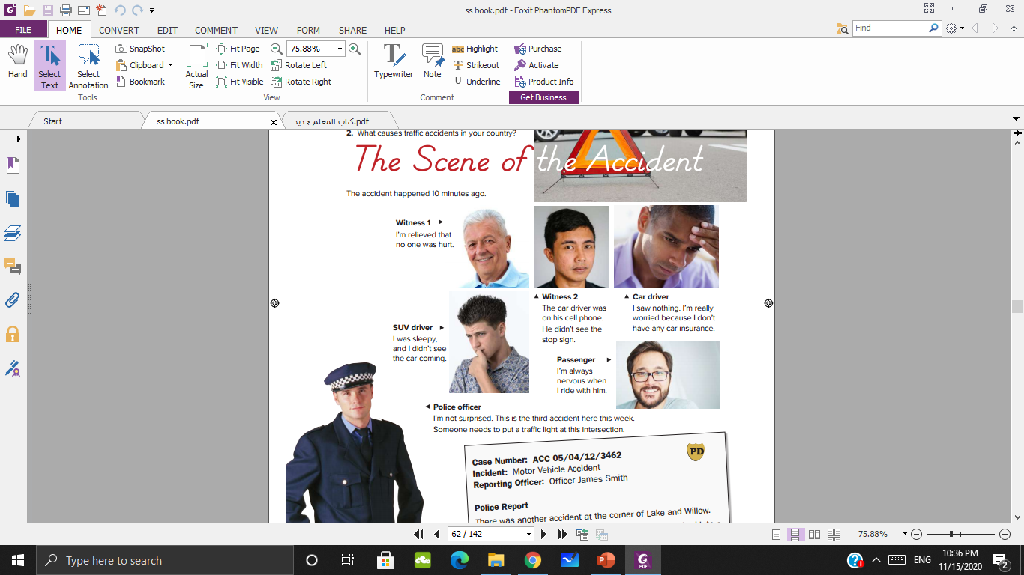


Slide 9
Did the car driver stop at the stop sign?
Did the SUV driver see the car coming?
Was the car driver on his cell phone?

Slide 10

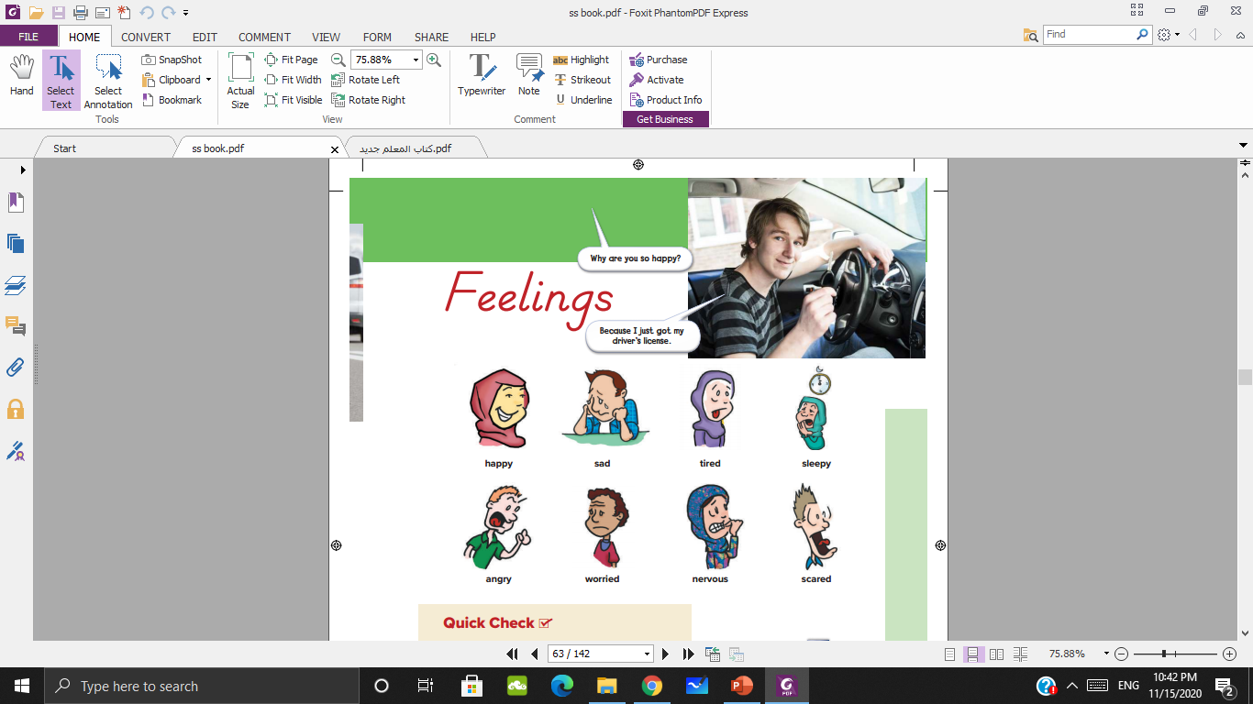
What do the pictures show?
Feeling

Slide 12
Why is …..?
He is a bad a driver.

Slide 13
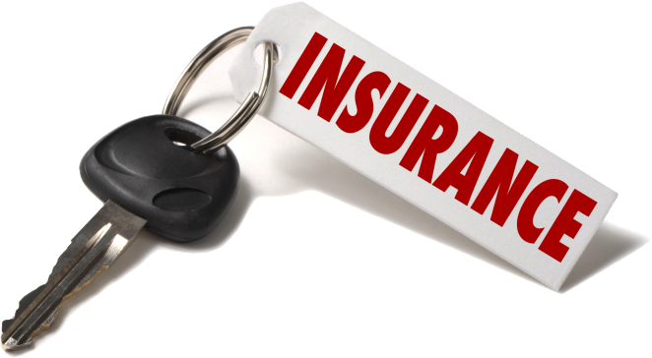
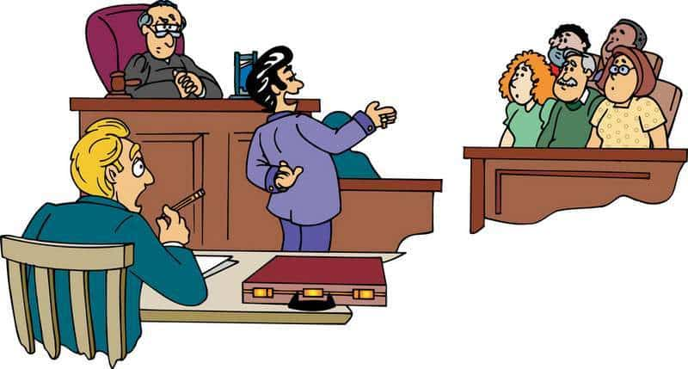
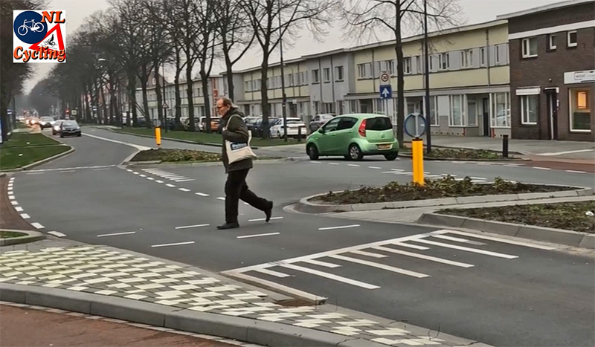
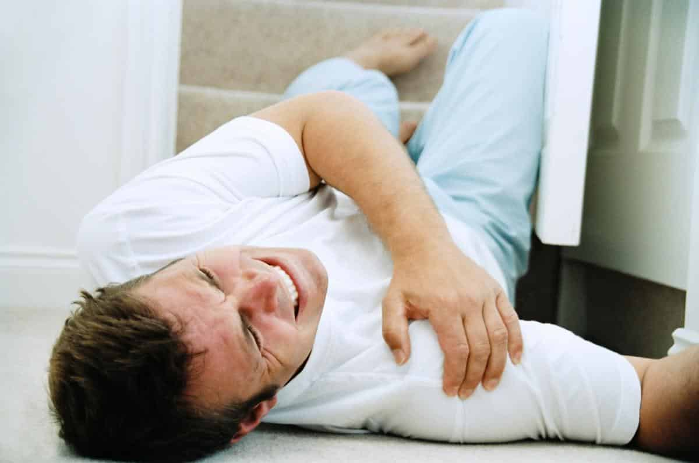
Insurance
Witness
Intersection
Injury

Slide 14
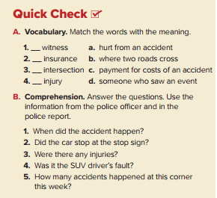
d
c
b
a
Police report

Slide 15
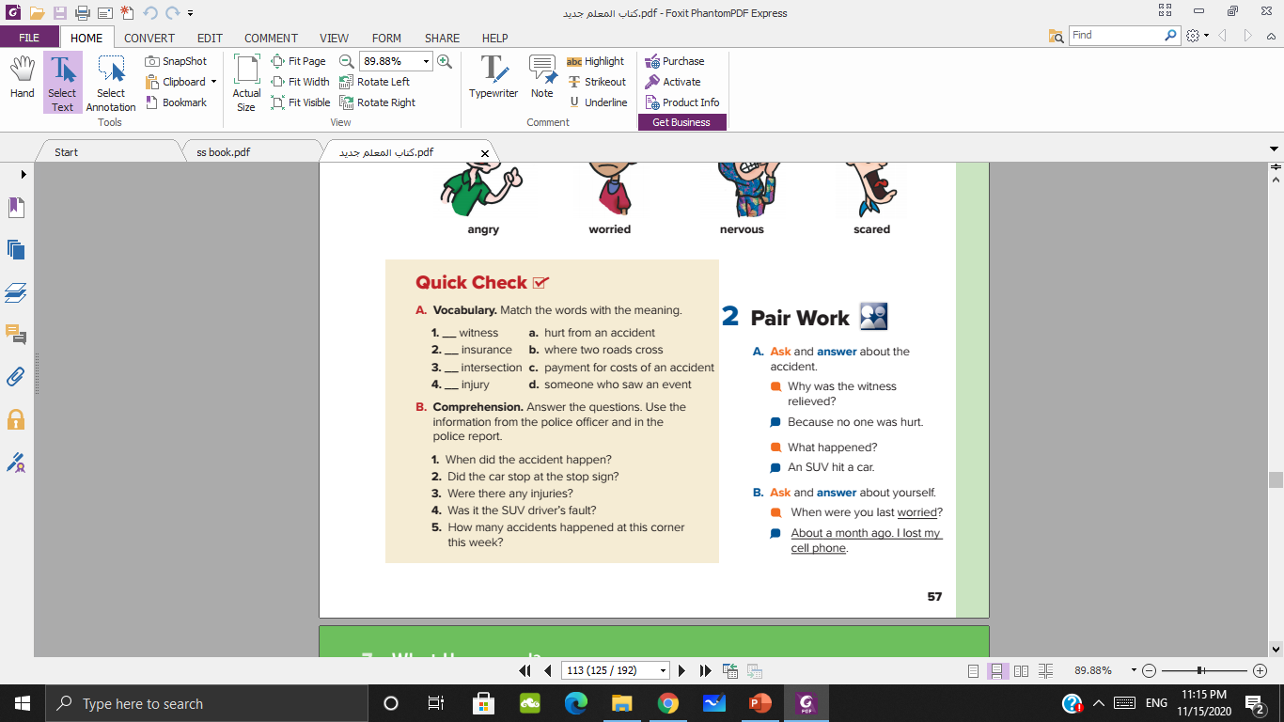
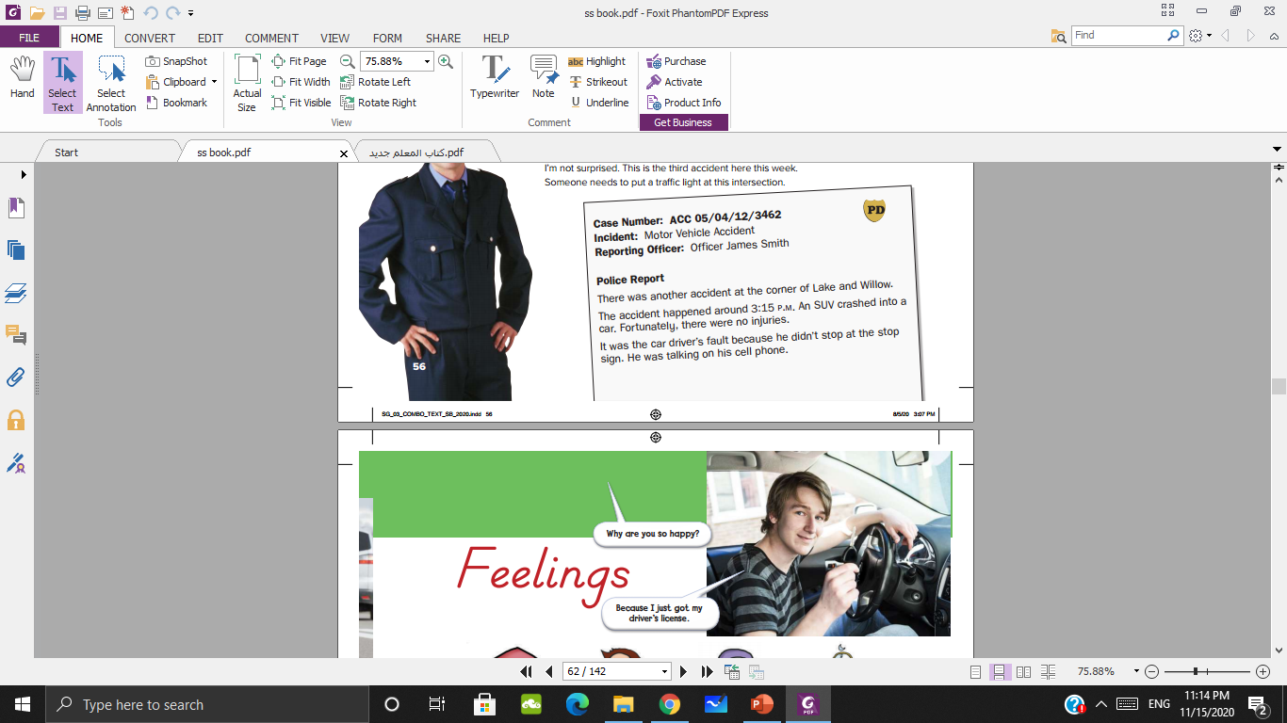
No, it wasn’t.
Three accidents happened this weekend.

Slide 16
Thank you

