Slide 1
U 7 writing
Tr. Nora Khalid

Slide 2
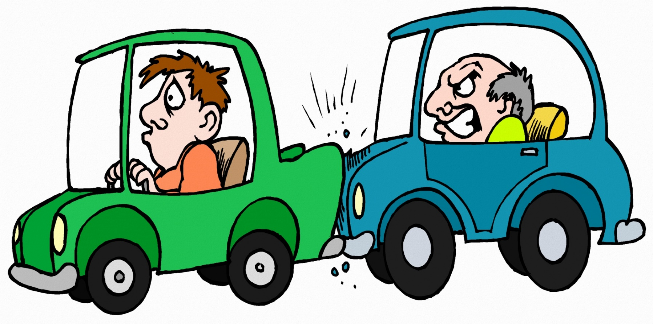
Have you ever seen or heard about an accident?

Slide 3

What are the question words?

Slide 4

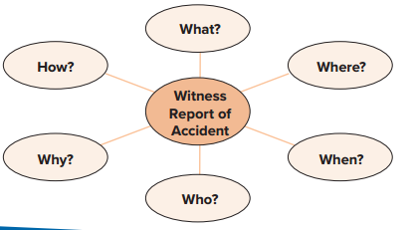





This Photo by Unknown Author is licensed under CC BY-SA

Slide 5
Turn to page 56 and elicit information from the accident report and witness accounts to write notes in the diagram.

Slide 6
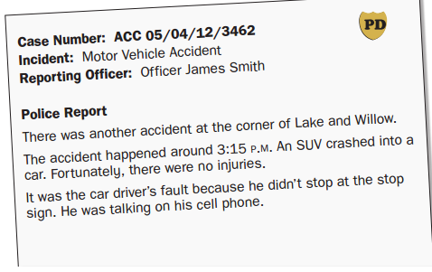

Slide 7
the car didn’t stop at the intersection, so the SUV hit it
SUV crashed into a car
On the corner of Lake and Willow
car driver was talking on his cell phone and didn’t see the stop sign
car driver was talking
on his cell phone and didn’t see the stop sign
3:15 p.m.

Slide 8
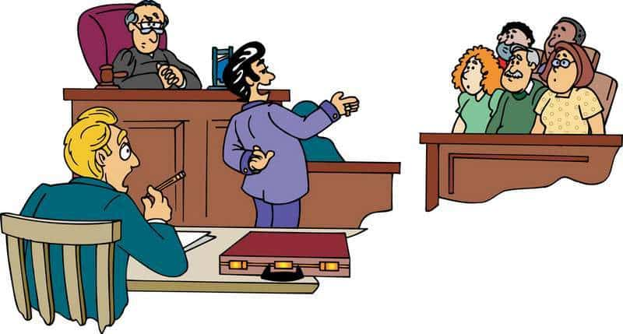
What does “witness” mean?

Slide 9
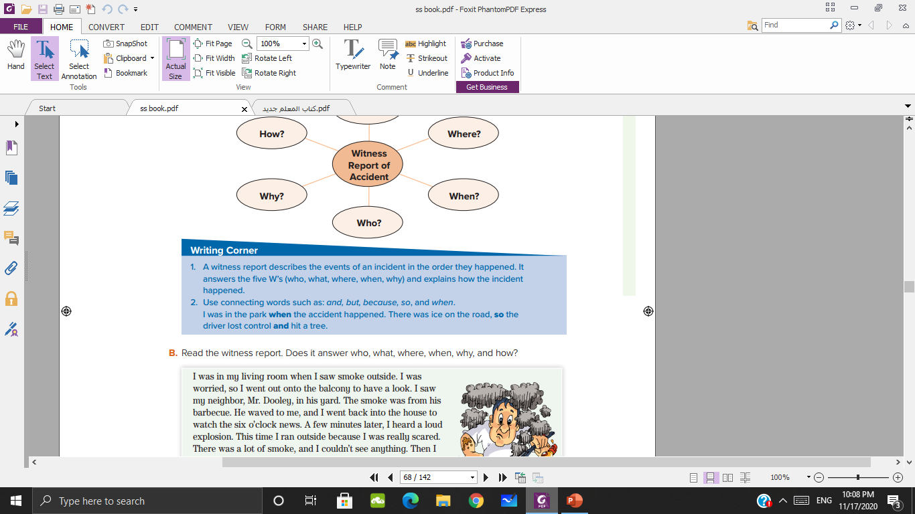

Slide 10
so
The SUV driver was sleepy, _____ he didn’t see the
car coming.
He didn’t see the stop sign _____ he was on his cell phone.
There was a car crash, _____ fortunately no one
was hurt.
There was an accident on the corner of Lake _____
Willow.
There were several witnesses _____ the accident
happened
because
but
and
when

Slide 11
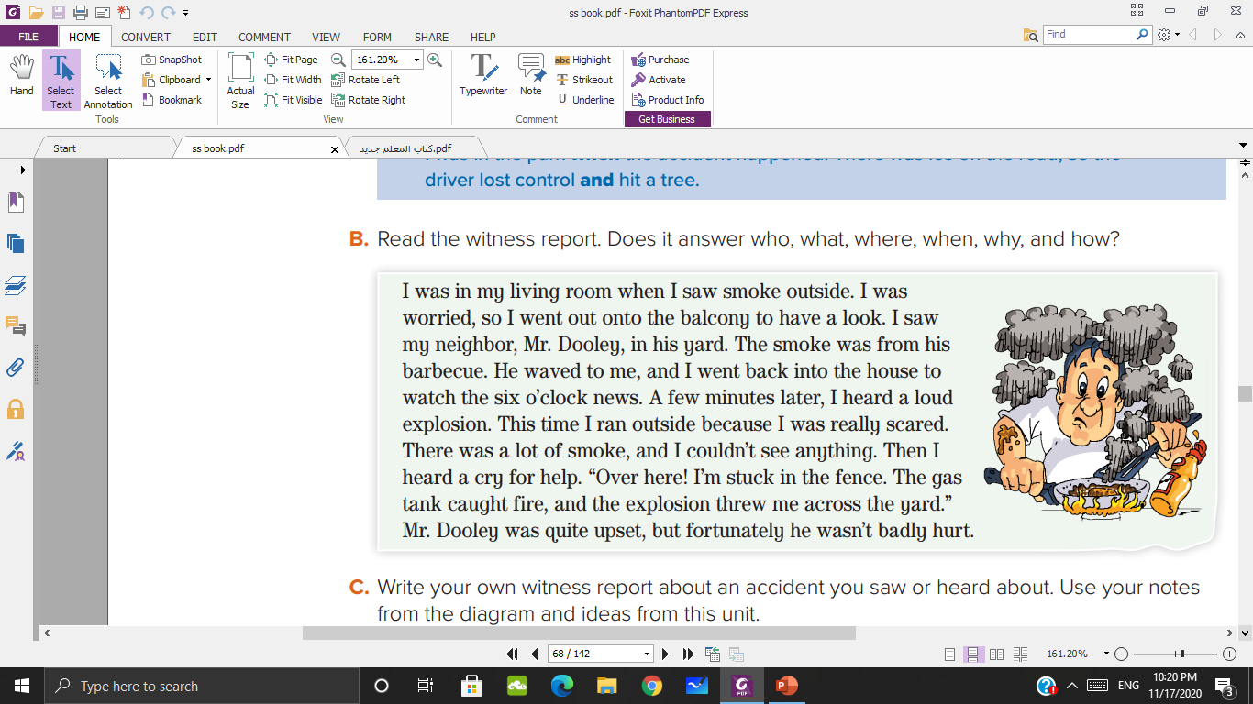

Slide 12
How | Why | When | Where | What | Who
Mr. Dooley
An explosion
In Mr. Dooley yard
Around 6 o’clock
The gas tank caught fire
The explosion threw him across the yard

Slide 13

Write your own witness report about an accident you saw or heard about. Use your notes
from the diagram and
ideas from this unit

Slide 14


