Slide 1

What time do you get up?
Writing

Slide 2
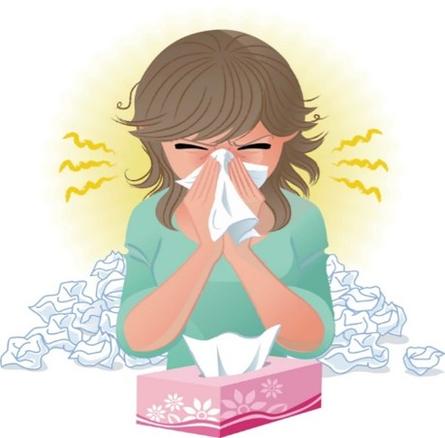
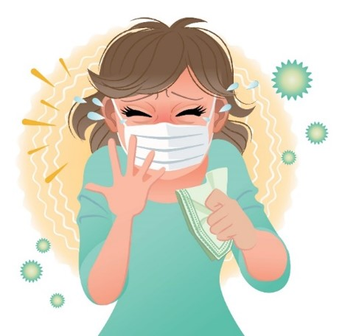
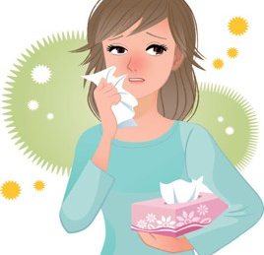
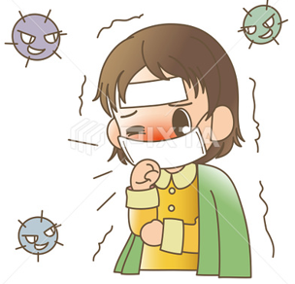

COVID 19
☺ Avoid gathering !
☺ wear a mask before going out
☺ Social distancing is not a choice, it is a must!
☺ Keep a distance of 2 meters to avoid accountability
☺ Wash hands constantly

Slide 3

بسم الله الرحمن الرحيم
Day
Date

Slide 4
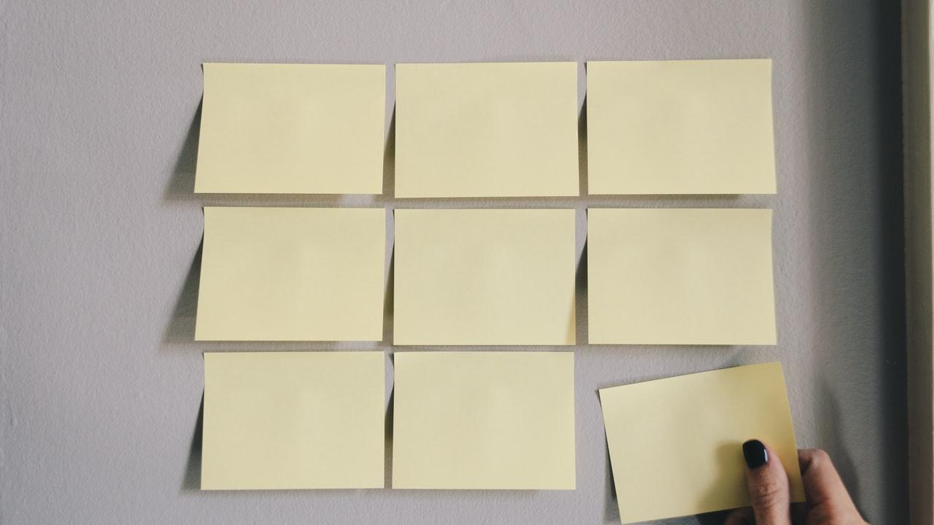
Learning Objectives
Discus information from an email
Arrange a research on school routines
Write email using prepositions " by-to-in-on “

Slide 5
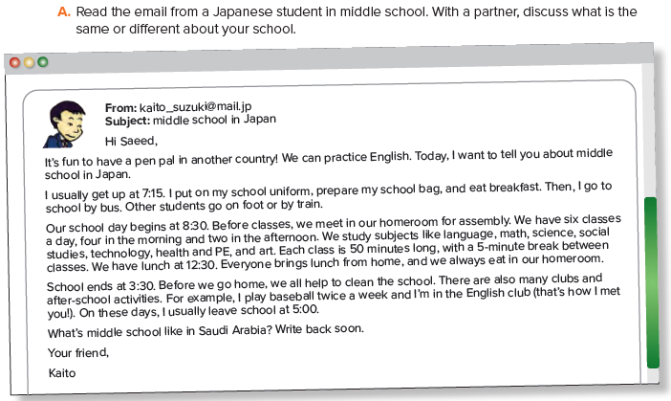

Slide 6
How does Kaito go to school?
(by bus)
What time does school begin?
(at 8:30)
How many classes does he have each day?
(six)
What time does school end?
(3:30)
Does Kaito do any after-school activities?
(baseball, English club)

Slide 7
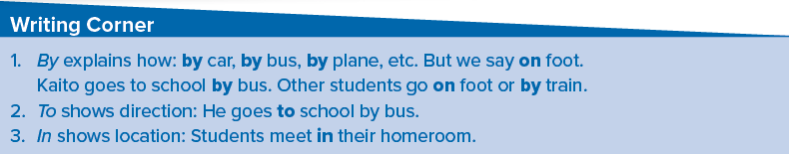
How do you go to school?
Where do you go on the weekend?
Where do you eat lunch?
Where do you study?

Slide 8
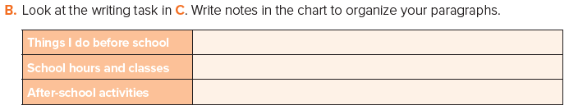
get up at 5:15.& pray Alfajer prayer / put on my school uniform / eat breakfast bus
sing the Saudi national anthem / We have 7 classes a day. Each one lasts 45 minutes. School finishes at 1:30 p.m.,
Go home / have lunch / do homework/ play / sleep early

Slide 9
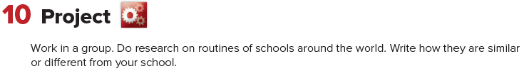
Differences | Similarities

Slide 10

Home work
Page 100 (F)

Slide 11
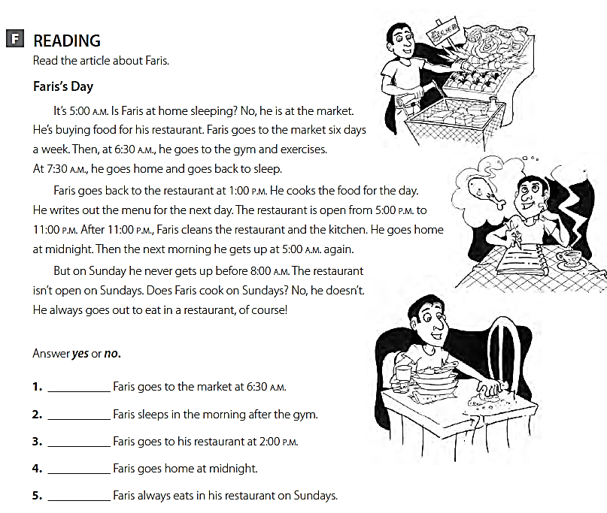
no
yes
no
yes
no

