Slide 1

What time do you get up?
Conversation & Reading

Slide 2
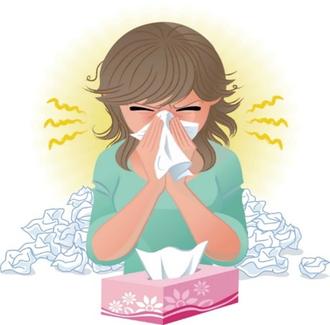
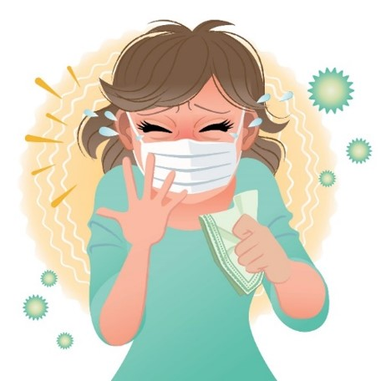
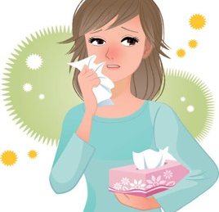
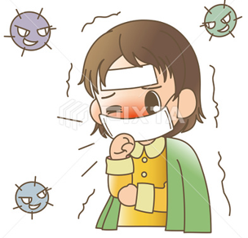

COVID 19
☺ Avoid gathering !
☺ wear a mask before going out
☺ Social distancing is not a choice, it is a must!
☺ Keep a distance of 2 meters to avoid accountability
☺ Wash hands constantly

Slide 3

بسم الله الرحمن الرحيم
Day
Date

Slide 4

Learning Objectives
Read a conversation correctly
Practice making a conversation correctly
Identify the main idea of reading
Answer questions after reading about it
Talk about their daily activities

Slide 5
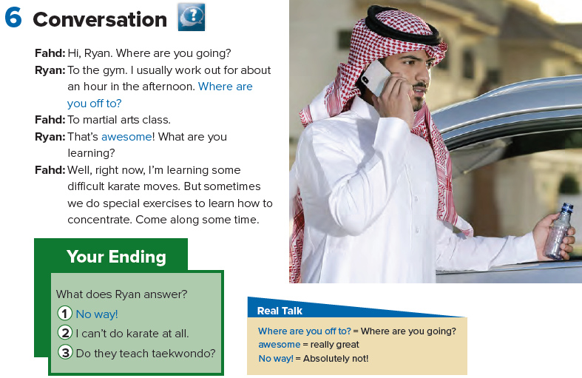


Slide 6
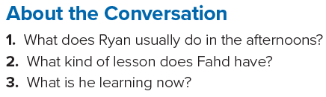
1. He usually works out for about an hour.
2. He has a karate lesson / He has a martial arts class.
3. He’s learning some difficult karate moves.

Slide 7
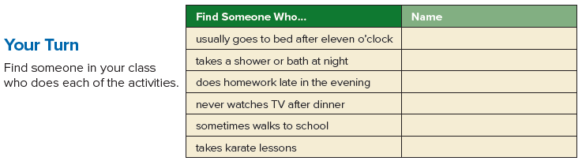

Slide 8
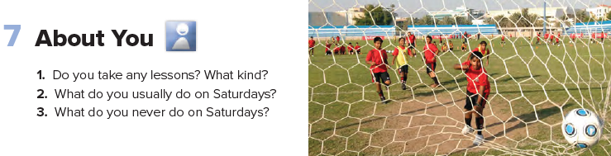

Slide 9



Slide 10
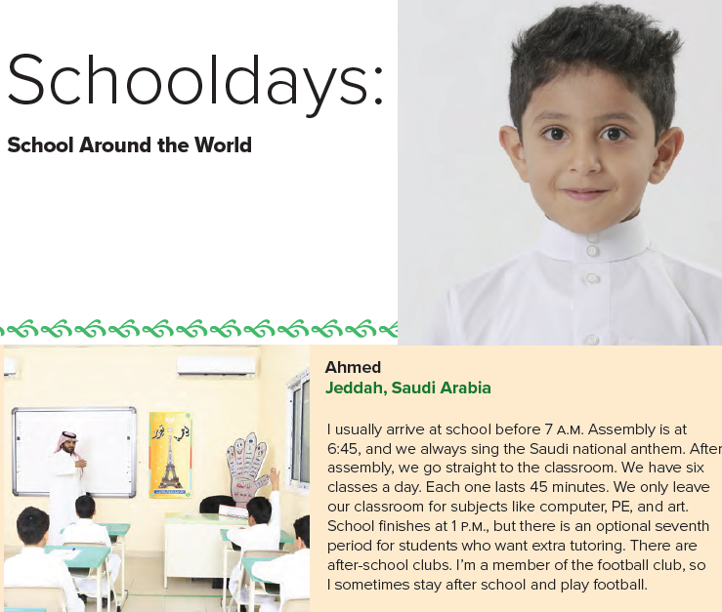

Slide 11
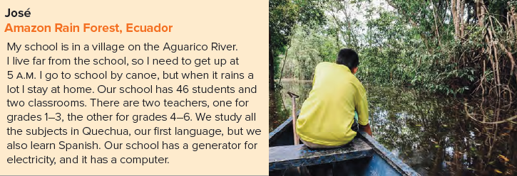

Slide 12

Home work
Page 99

Slide 13
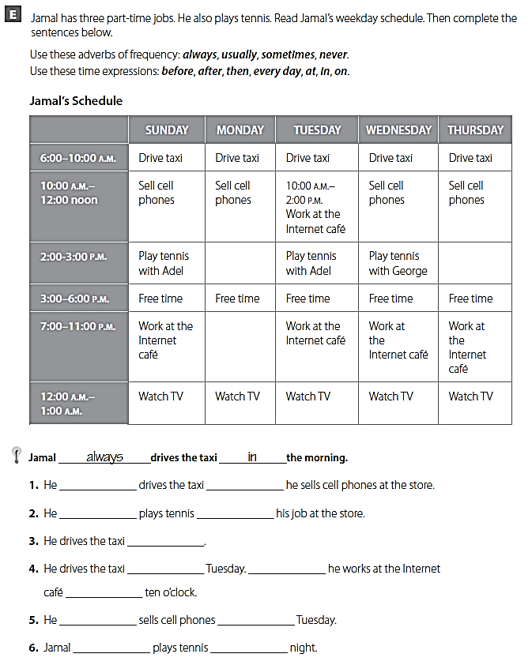
always
before
usually
after
every day
on
Then
at
never
on
never
at

