Slide 1

What’s school like?
Grammar

Slide 2
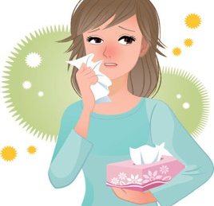
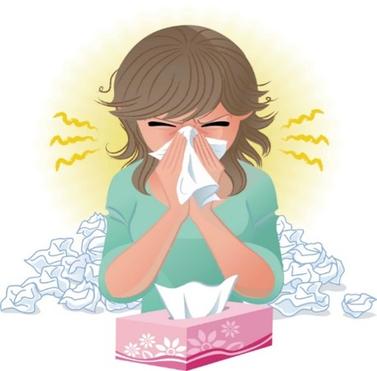
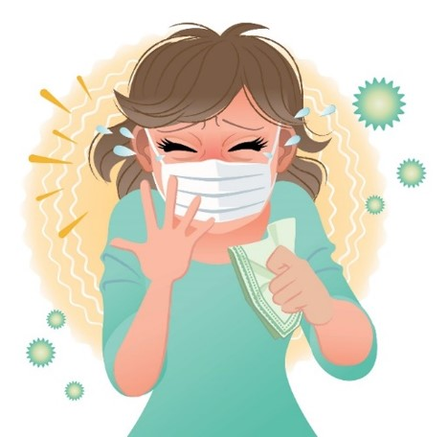
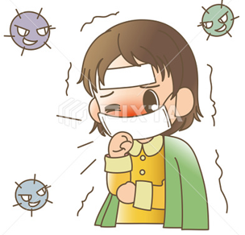

COVID 19
☺ Avoid gathering !
☺ wear a mask before going out
☺ Social distancing is not a choice, it is a must!
☺ Keep a distance of 2 meters to avoid accountability
☺ Wash hands constantly

Slide 3
بسم الله الرحمن الرحيم
Day
Date

Slide 4
Learning Objectives
Use simple present correctly
Form the negative form of verbs in the simple present.
Ask yes/no questions in the simple present
Use adjectives in meaningful sentences
Answer questions after listening
Practice pronunciation correctly

Slide 5
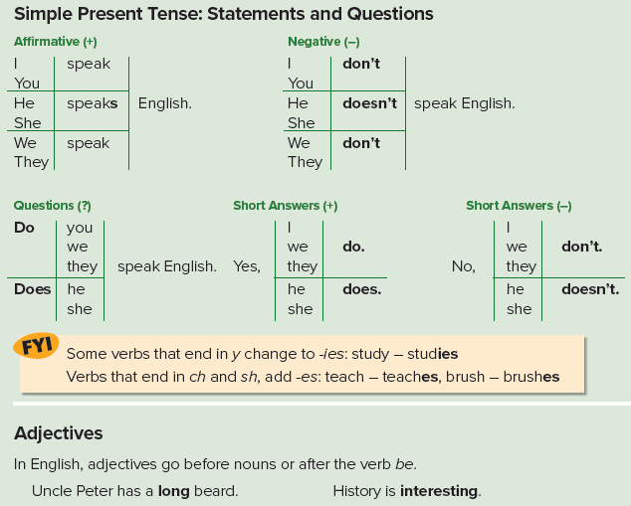

Slide 6
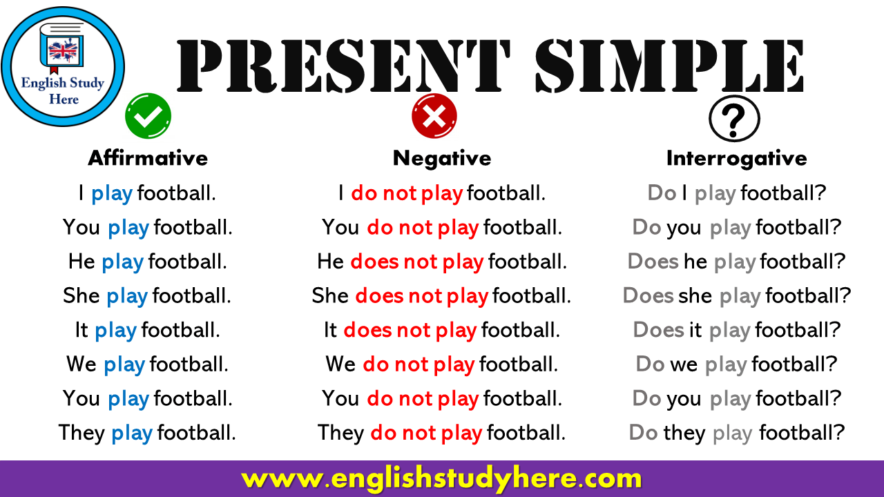

Slide 7

Let’s Practice

Slide 8
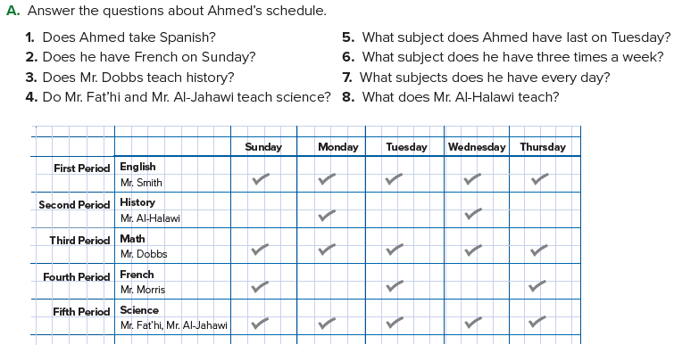

Slide 9
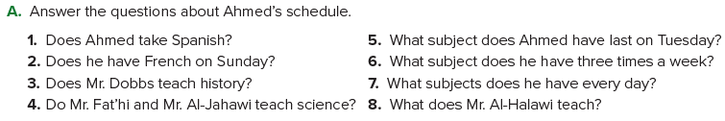
1. No, he doesn’t. He takes French.
2. Yes, he does.
3. No, he doesn’t. He teaches math.
4. Yes, they do.
5. He has science last on Tuesday.
6. He has French three times a week.
7. He has English, math, and science every day.
8. He teaches history.

Slide 10
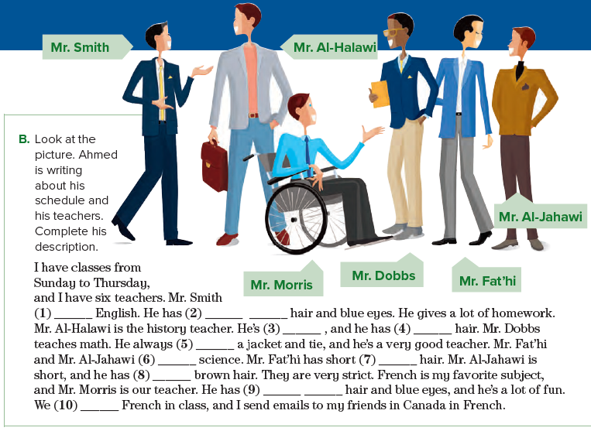
1. teaches
2. short black
3. tall
4. brown
5. wears
6. teaches
7. black
8. short
9. short brown
10. speak

Slide 11
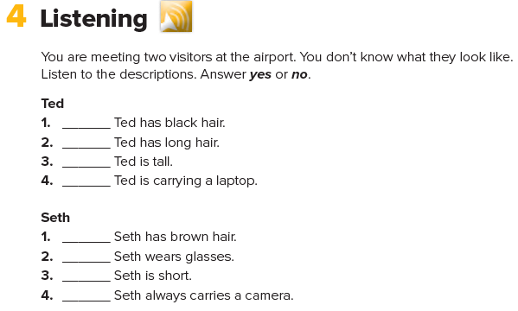

no
no
yes
yes
no
yes
no
yes

Slide 12
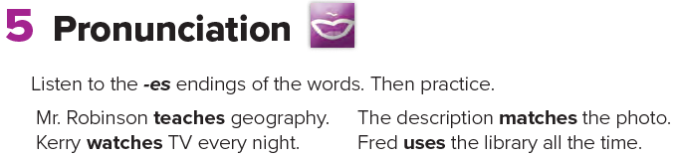

Slide 13
Homework
Page 94

Slide 14
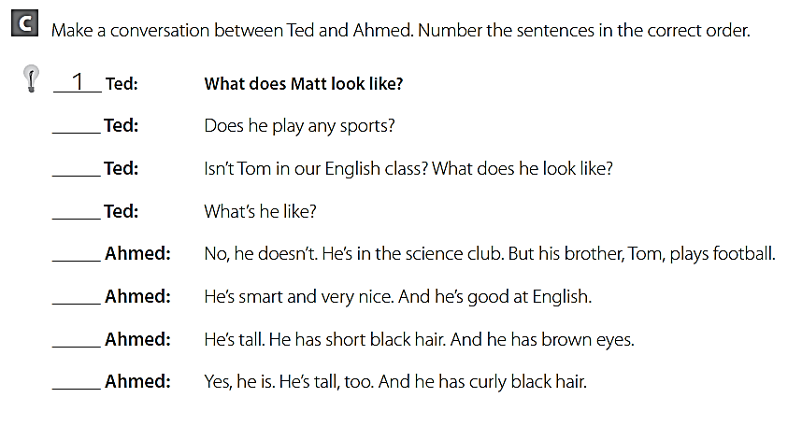
3
5
7
4
8
2
6

Slide 15
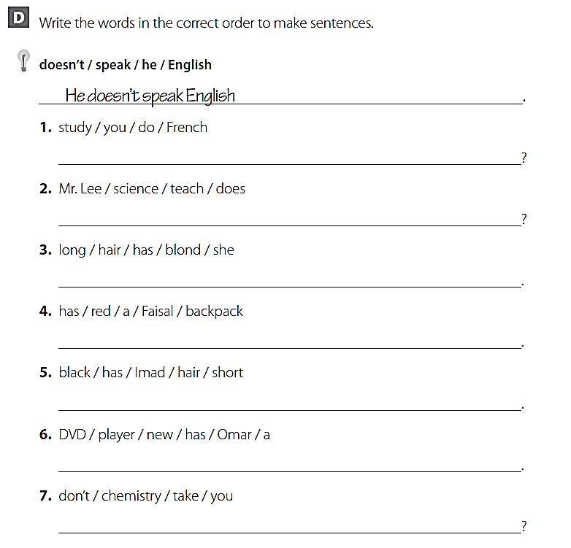
Do you study French ?
Does Mr . Lee teach science ?
She has long blond hair .
Faisal has a red back puck .
Imad has short black hair .
Omar has a new DVD player .
Don΄t you take chemistry ?

Slide 16
THANK YOU

