Slide 1

Unit 10 Writing

Slide 2
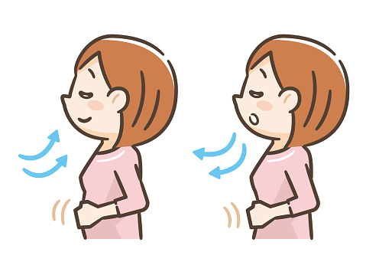
Take a deep breath

Slide 3

1
2
3
Make questions about someone’s appearance, character and interests
Link verbs with “and”
Write a description of someone Ss know

Slide 4
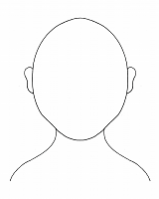

What do you look like?!

Slide 5
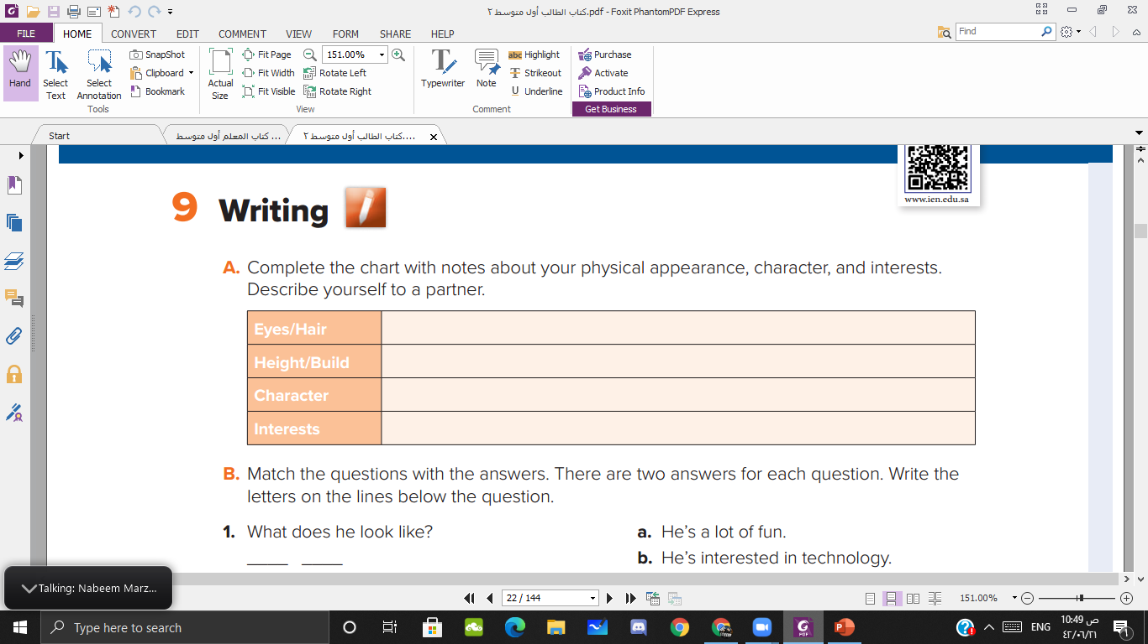

Slide 6
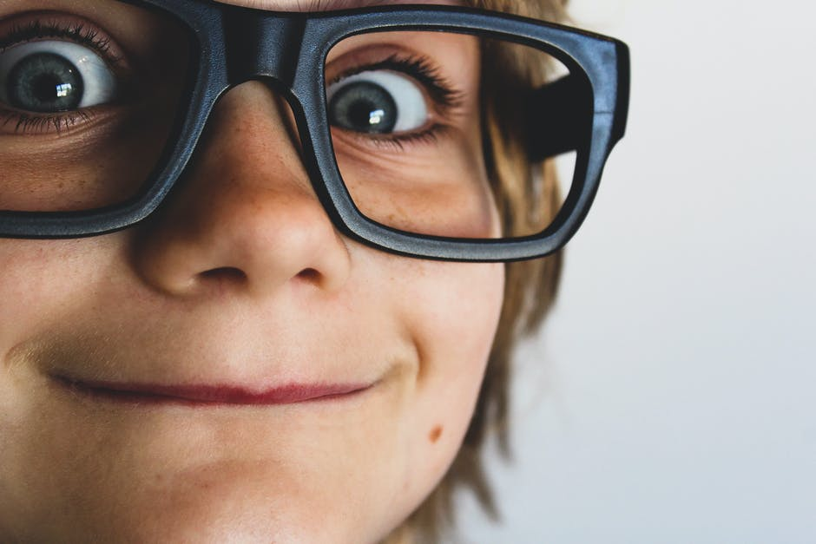

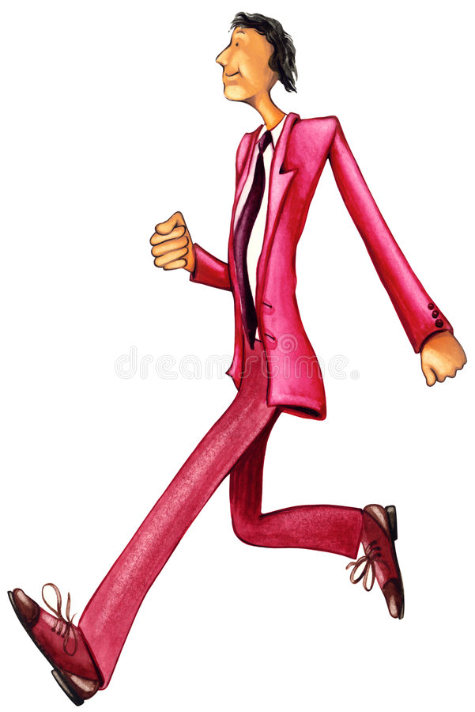
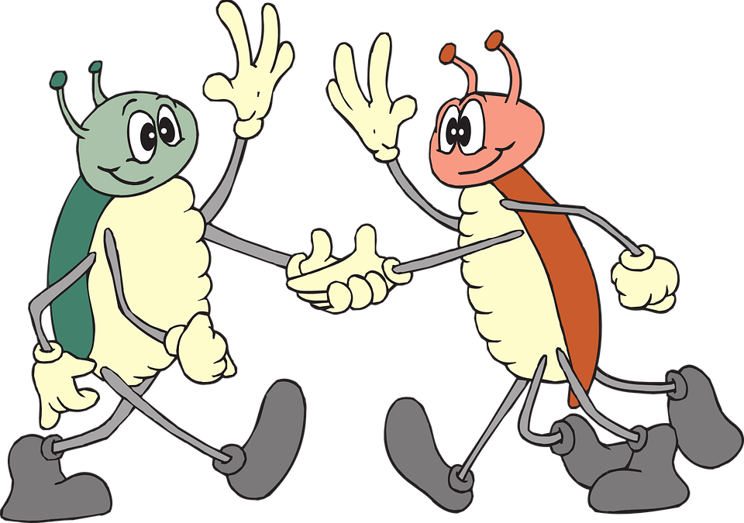
Wears glasses
Tall and thin
Fun
Friendly

Slide 7




Describe the girl:
What does she look like? ( appearance)

Slide 8

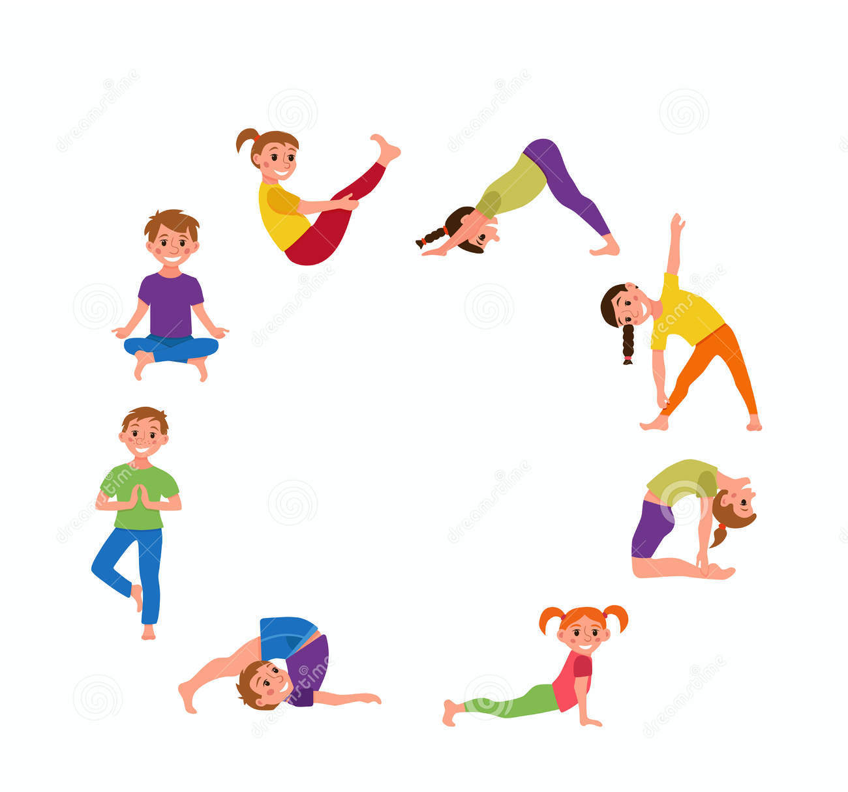
See the picture and tell what is her character :
What is she like? ( characters)

Slide 9


See the picture and tell what is her interests :
What does she like? ( interests)

Slide 10
What does she look like ➡️ appearance
What is she like ➡️ character
What does she like ➡️ interests

Slide 11
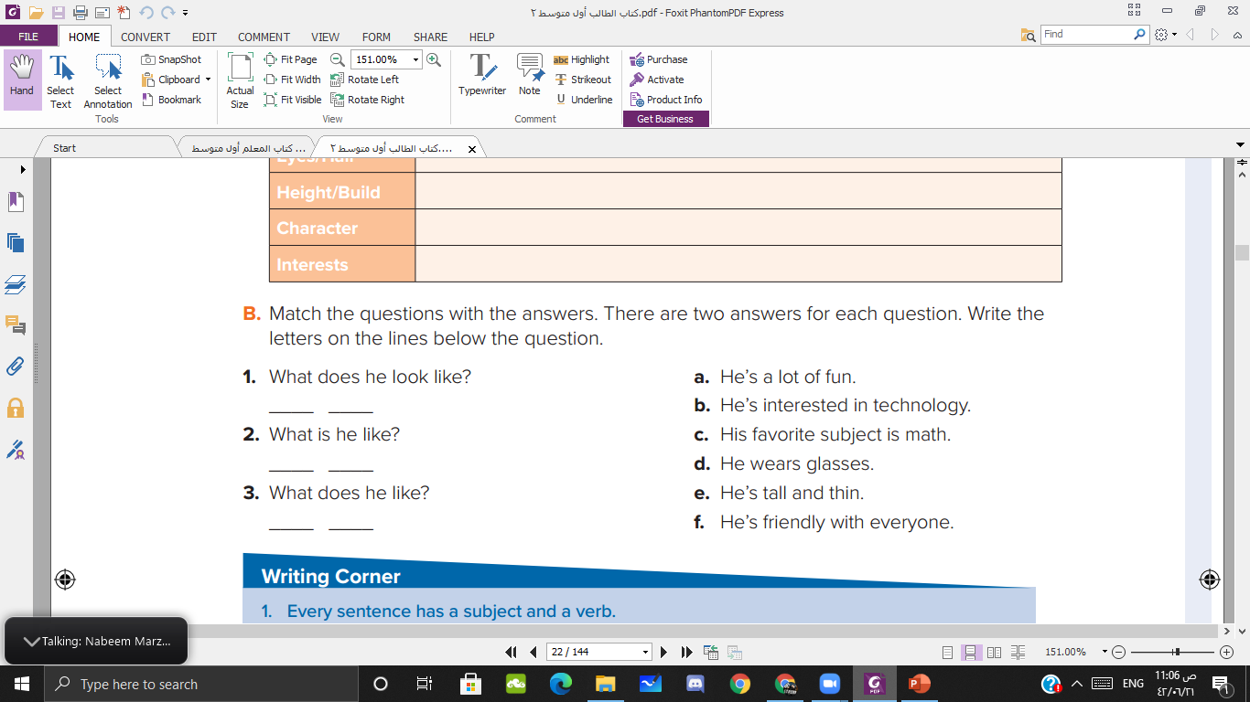
d
e
a
f
b
c

Slide 12
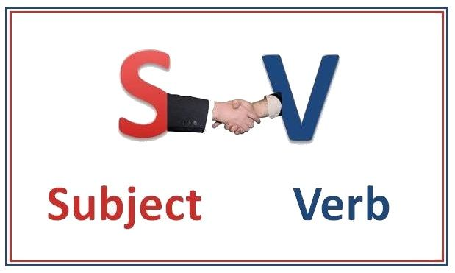
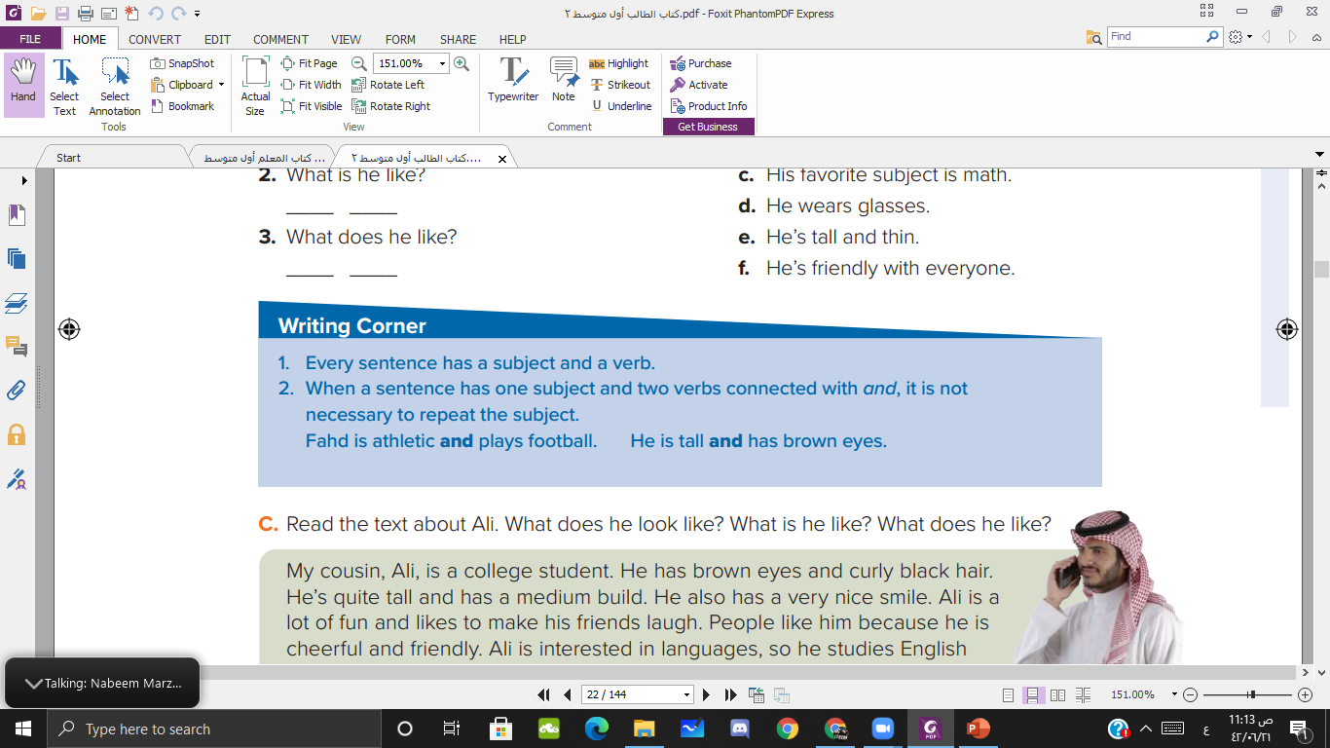

Slide 13
and V
Fahd is athletic and plays football

Slide 14
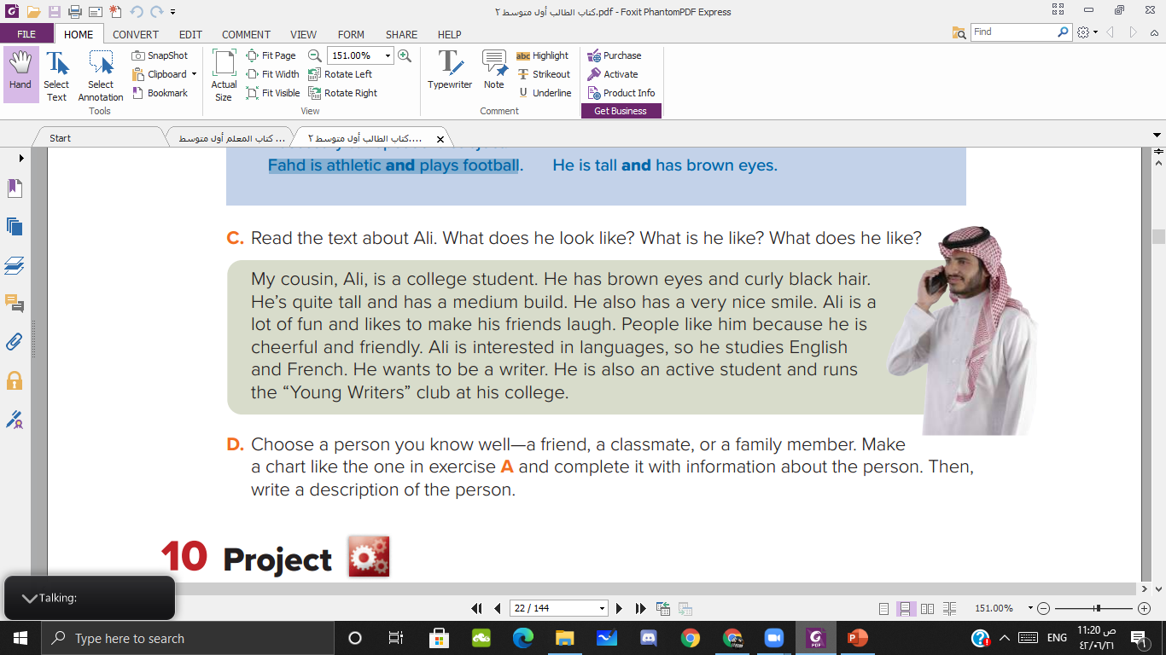

Slide 15

Choose a person you know well—a friend, a classmate, or a family member. Make a chart like the one in exercise A and complete it with information about the person. Then, write a description of the person

Slide 16

Goodbye

