Slide 1


Slide 2
U10: What’s School Like?
Listen & discuss
80

Slide 3
The objectives of the lesson :
At the end of this session, the students will be able to :
Describe subjects
List numbers of school subjects
Describe people

Slide 4

Who’s your Math teacher?

Slide 5

Who teach you science ?

Slide 6

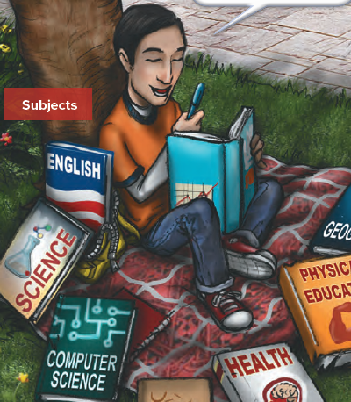
What is Carl doing?

Slide 7

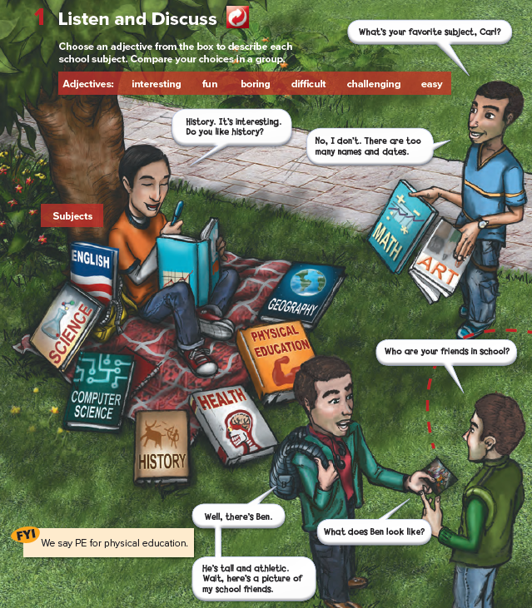

Slide 8









Slide 9
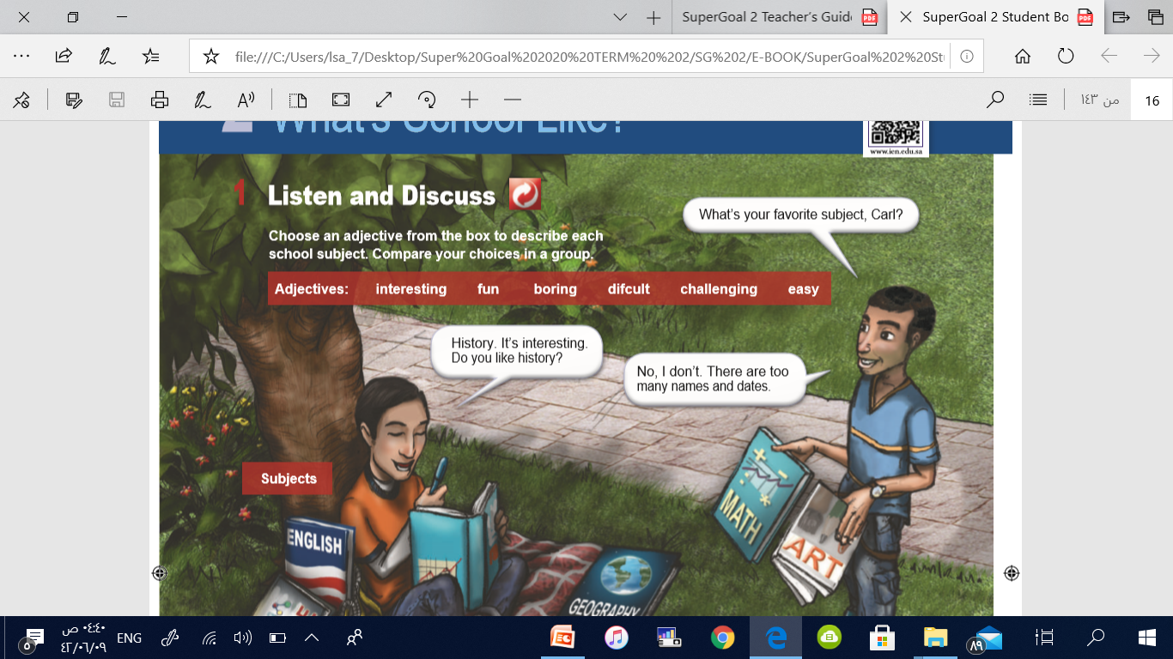
Adjectives

Slide 10


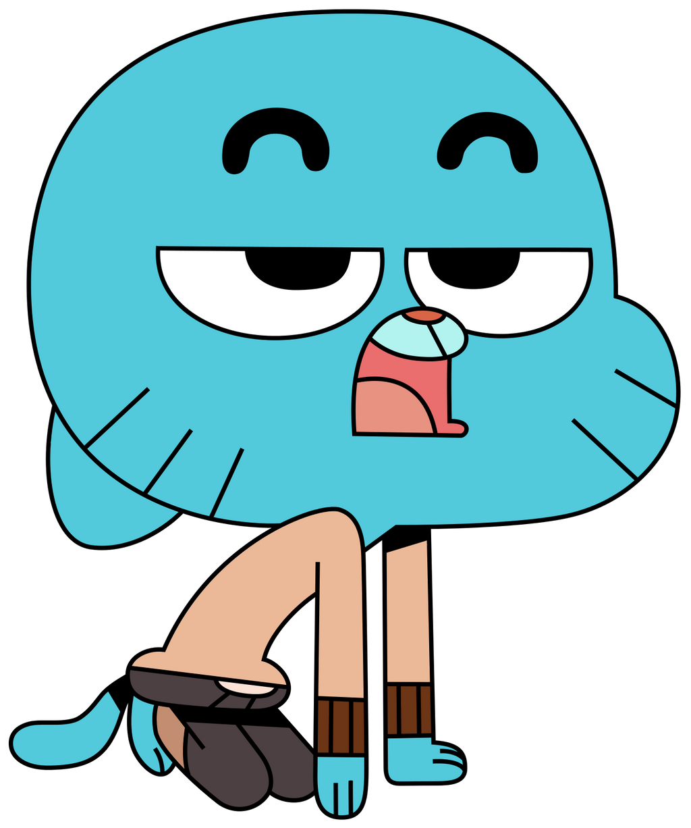
Adjectives
1
Interesting
2
fun
3
boring

Slide 11

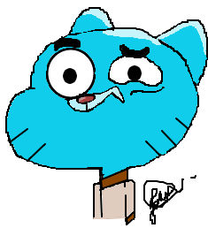

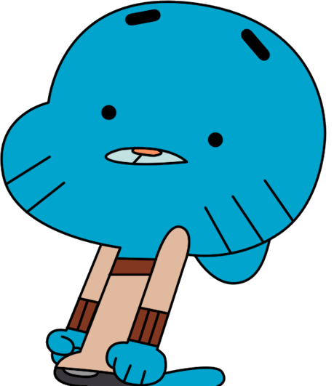
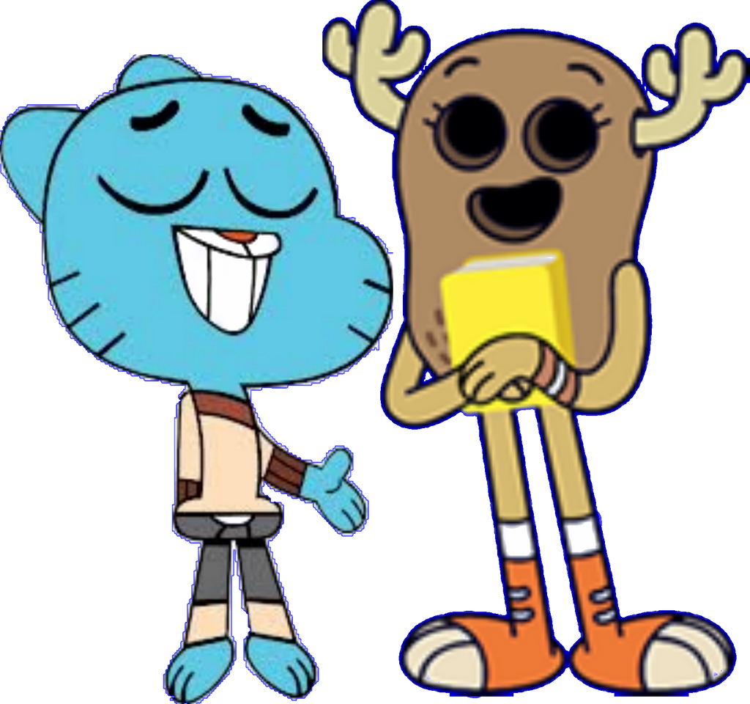
Adjectives
4
difficult
5
challanging
6
easy

Slide 12
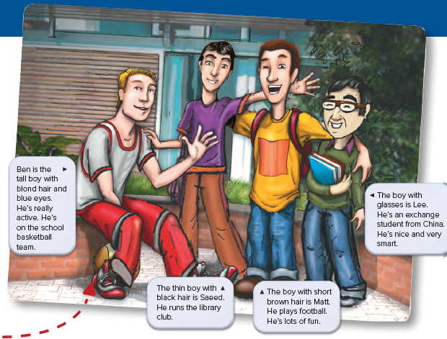

Slide 13
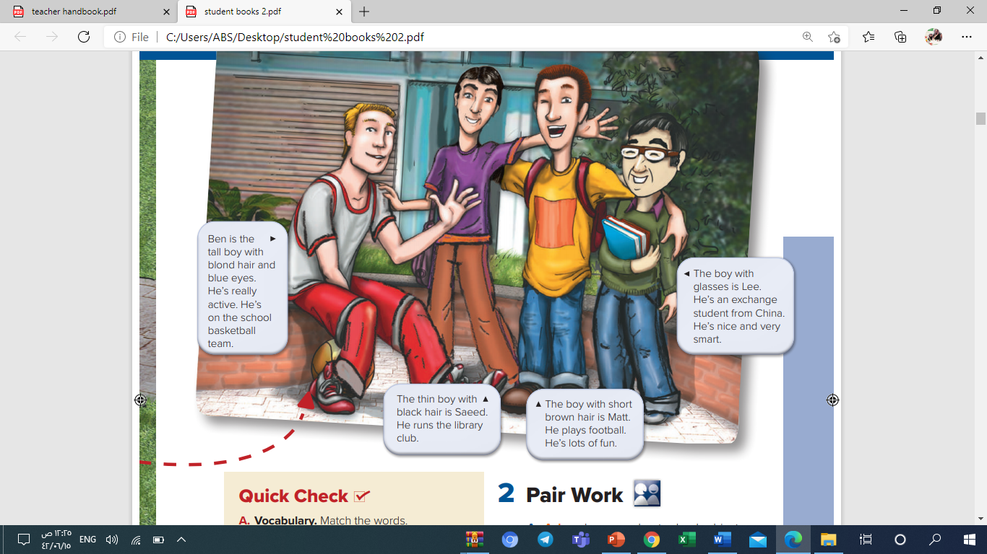
1-Who does Ben play for?
He plays basketball
for his school.
2-What does Saeed look
like?
He’s a thin boy with black
hair.
3-Who wears glasses?
It’s Lee.
4-Who has short brown hair?
It’s Matt.

Slide 14
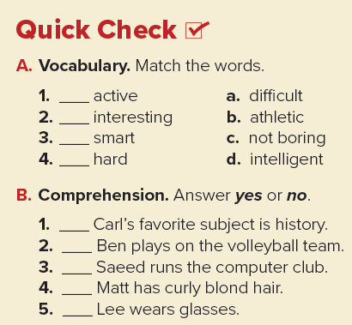
b
c
d
a

Slide 15
yes
no
no
no
yes

