Slide 1

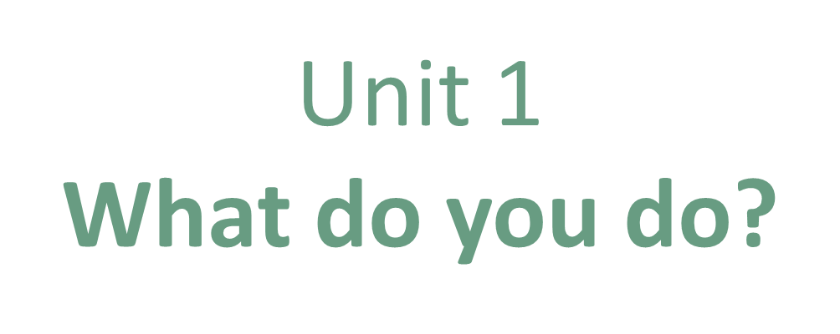
Grammar

Slide 2
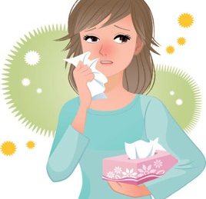
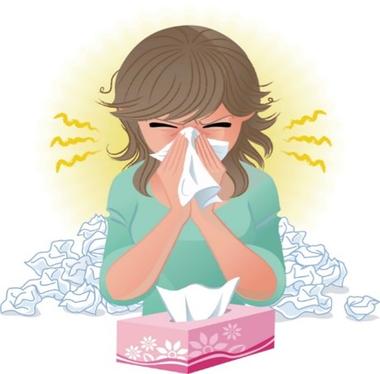
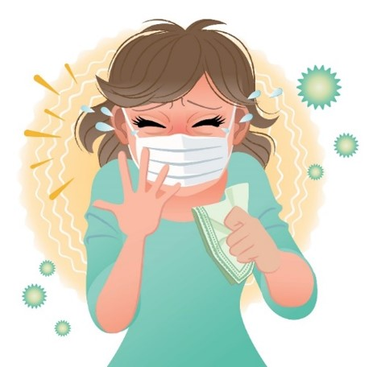
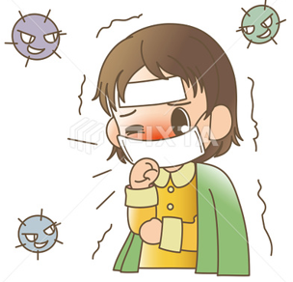

COVID 19
☺ Avoid gathering !
☺ wear a mask before going out
☺ Social distancing is not a choice, it is a must!
☺ Keep a distance of 2 meters to avoid accountability
☺ Wash hands constantly

Slide 3
Day
بسم الله الرحمن الرحيم
Date

Slide 4

LEARNING OBECTIVES
01 Use simple present correctly
02 Form the correct form of verbs in the simple present.
03 Ask questions with " want "
04 Ask questions about jobs correctly
05 Answer questions about jobs correctly

Slide 5
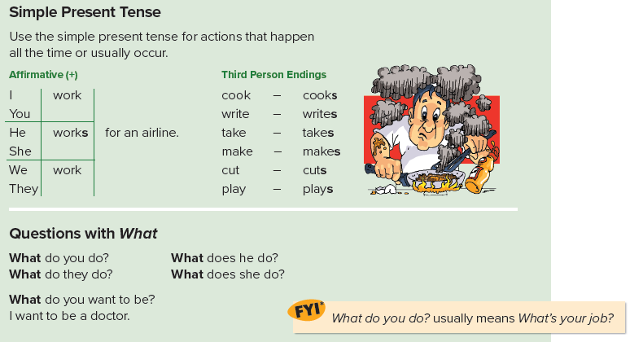

Slide 6
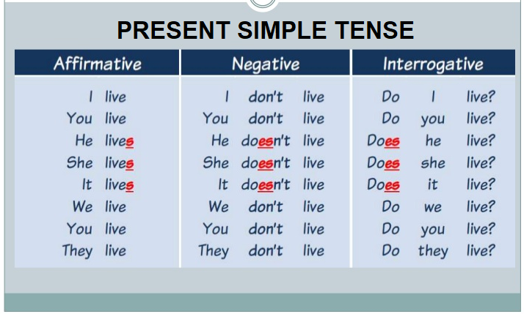

Slide 7
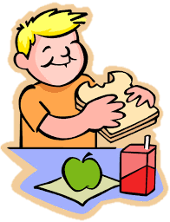
Examples
He eats a sandwich.
What does he eat?

Slide 8

Examples
She reads a book.
What does she read?

Slide 9
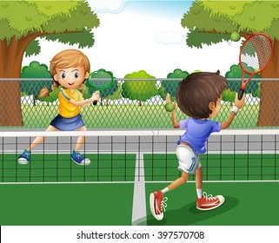
Examples
They play tennis .
What do they play?

Slide 10

Practice

Slide 11
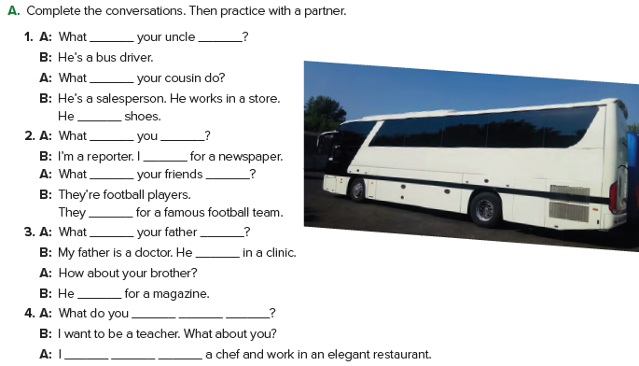
does
do
does
sells
do
do
work
do
do
play
does
do
works
works
want to be
want to be

Slide 12
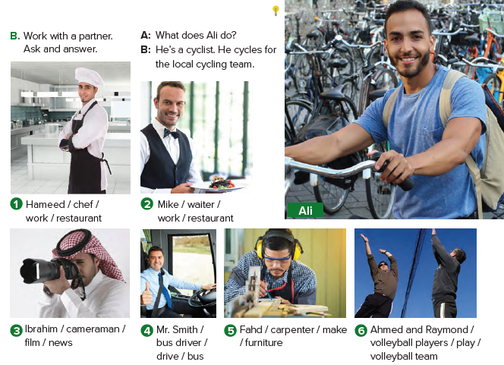
1. A: What does Hameed do?
B: He’s a cook. He works in a restaurant.
2. A: What does Mike do?
B: He’s a waiter. He works in a restaurant.

Slide 13
3. A: What does Ibrahim do?
B: He’s a cameraman. He films the news.
4. A: What does Mr. Smith do?
B: He’s a bus driver. He drives a bus.

Slide 14
5. A: What does Fahd do?
B: He’s a carpenter. He makes furniture.
6. A: What do Ahmed and Raymond do?
B: They’re volleyball players. They play for a volleyball team.

Slide 15

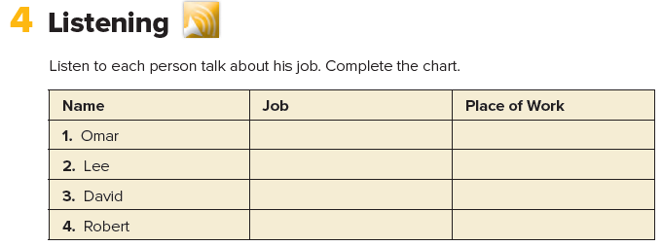
chef restaurant
salesperson store
teacher school
doctor hospital

Slide 16
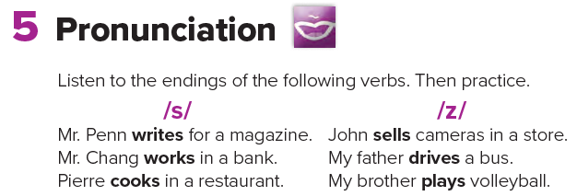

Slide 17
Homework
Page 90

Slide 18
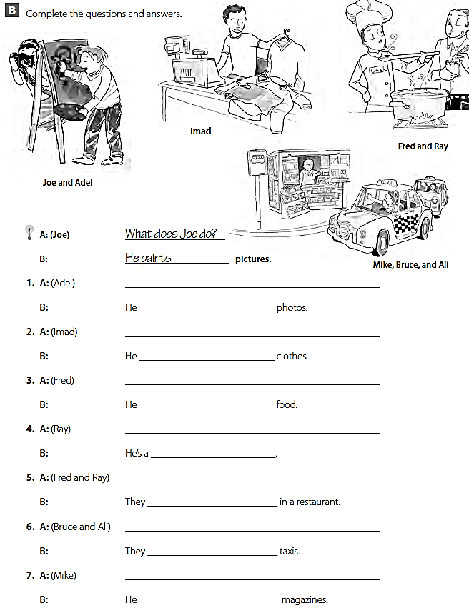
What does Adel do ?
takes
What does Imad do ?
sells
What does Fred do ?
cooks
What does Ray do ?
waiter
What do Fred and Ray do ?
work
What do Bruce and Ali do ?
drive
What does Mike do ?
sells

