Slide 1


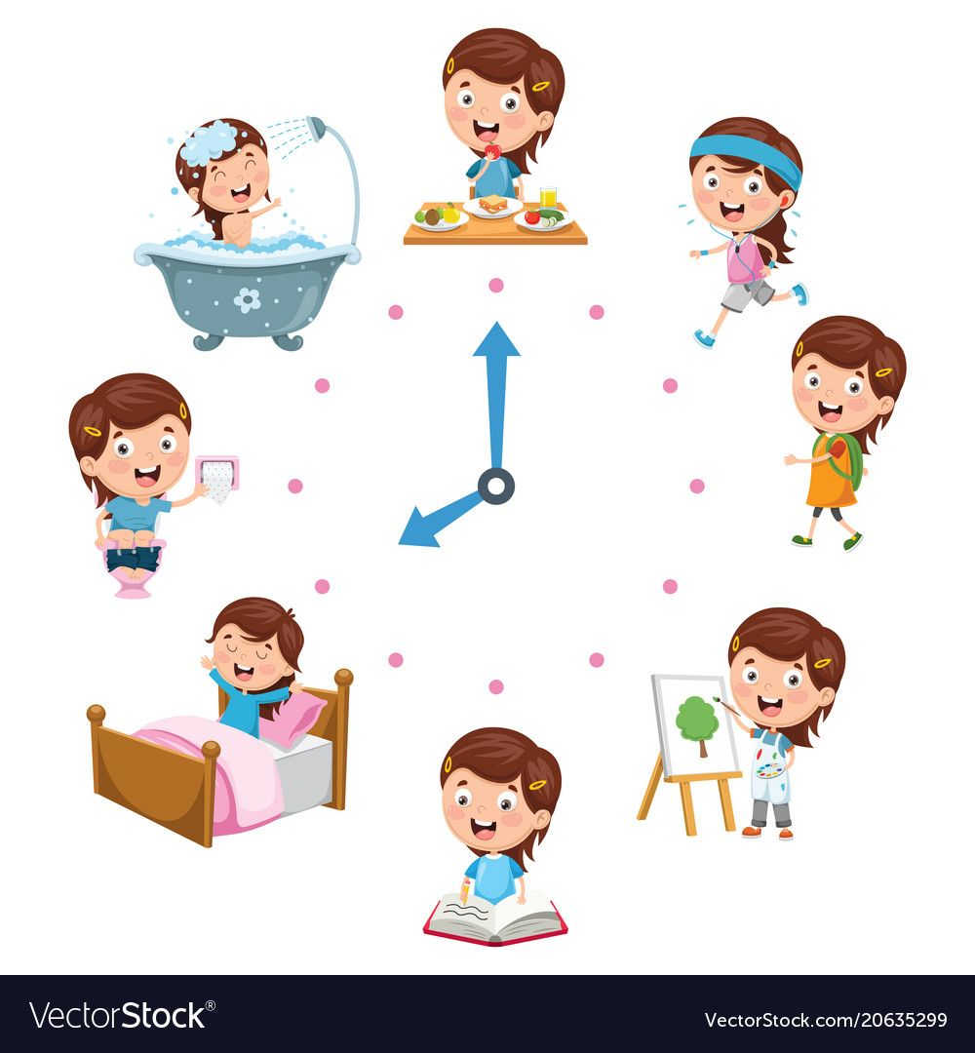
Form meaning and function
70

Slide 2


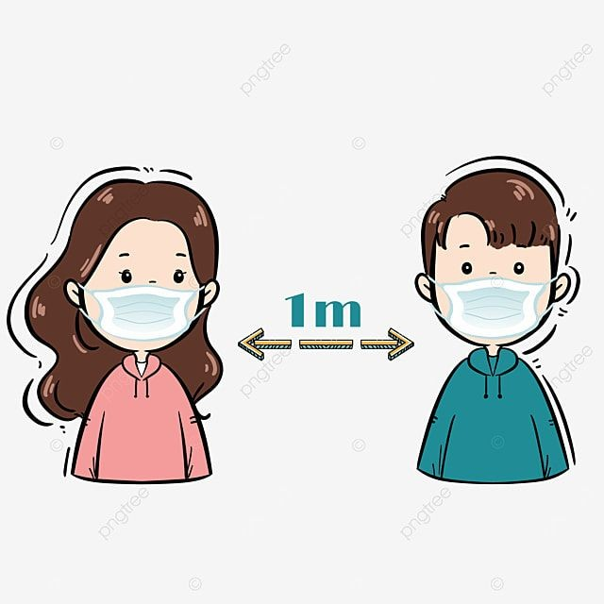

Slide 3

What is he doing ?
Is he watching TV?
Yes, he is watching TV

Slide 4




Video

Slide 5

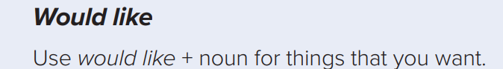
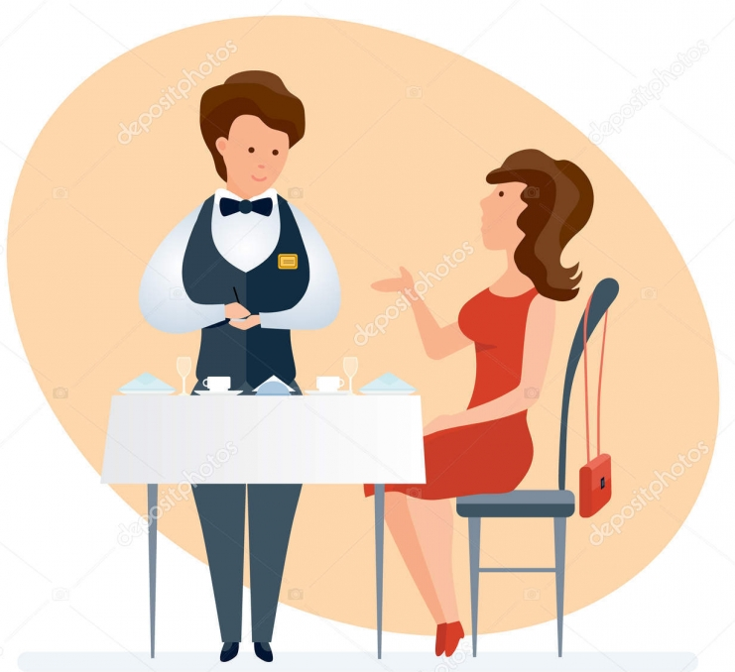
I’d like a sandwich.
No, I’d like a salad.
she’d like
Coffee
What would you like?
would you like fries?
What would she like?
71

Slide 6
I Would like a new cell phone 📱
I Would like a cup of coffee ☕
I Would like a piece of cake 🎂
I Would like the pink shirt 👚

Slide 7
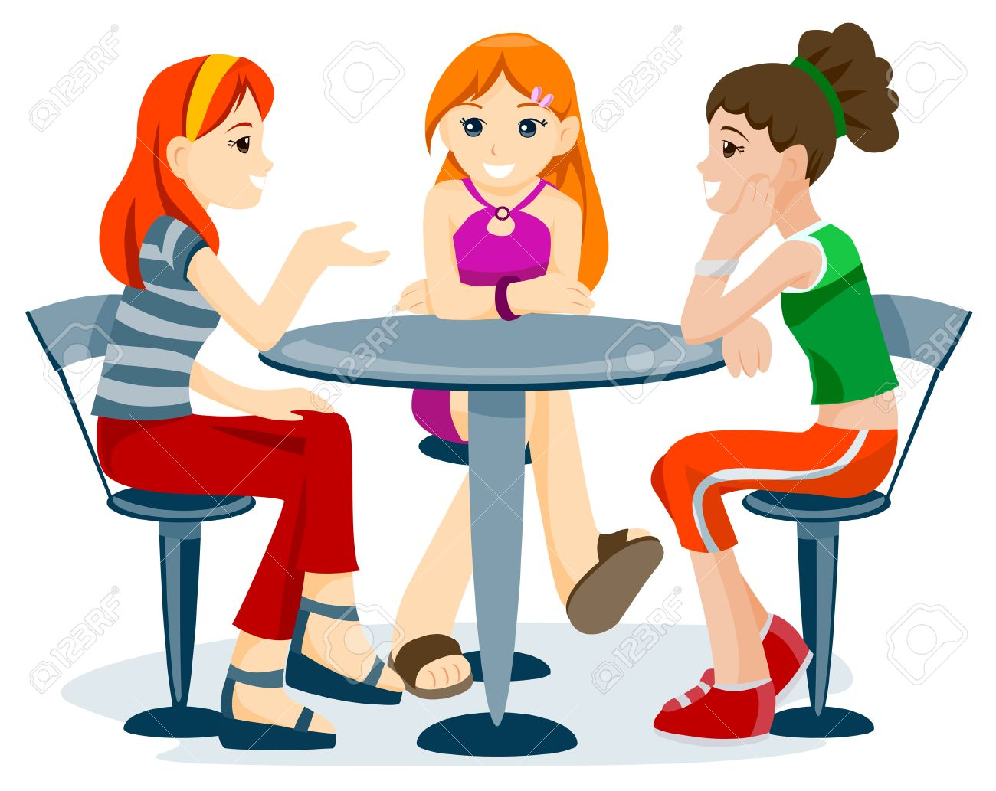
would you Like to watch TV?
No, I’d like to read a magazine
71

Slide 8
I Would like to sleep.
I Would like to have a break.
I Would like to learn English
I Would like to watch TV

Slide 9
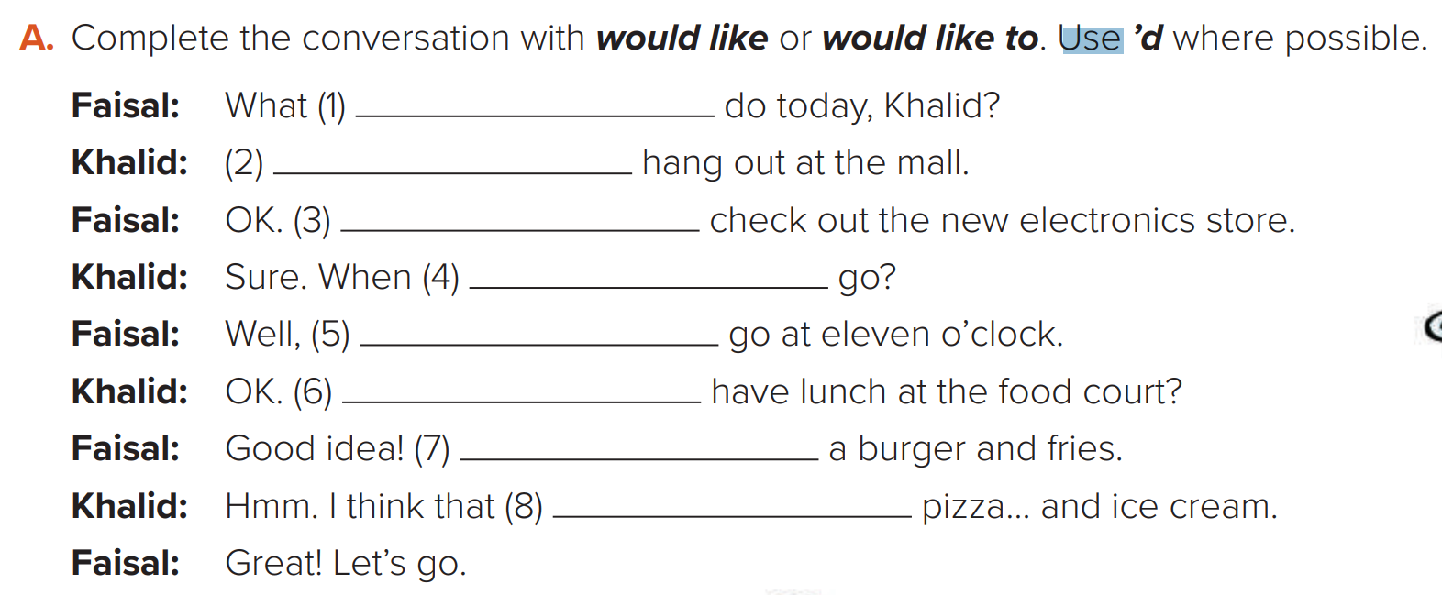
Would you like to
I’d like to
I’d like to
Would you like to
5. I’d like to
6. Would you like to
7. I’d like
8. I’d like a

Slide 10
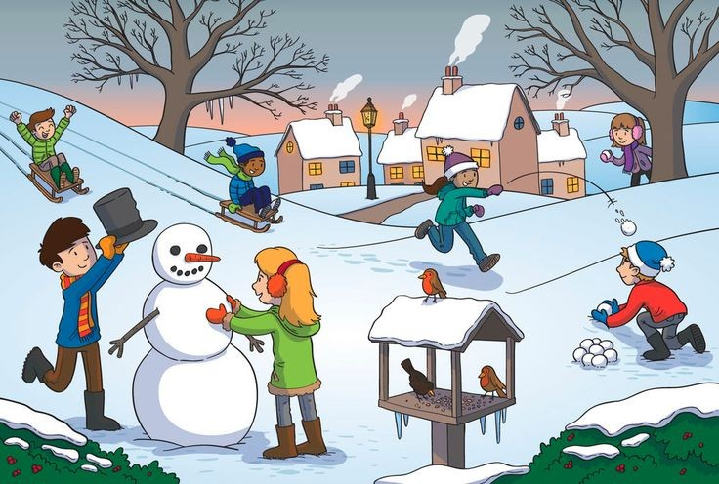
Make a sentence with ( I would like + to )
I’d like to make a distance between us !
I’d like to play outside

Slide 11
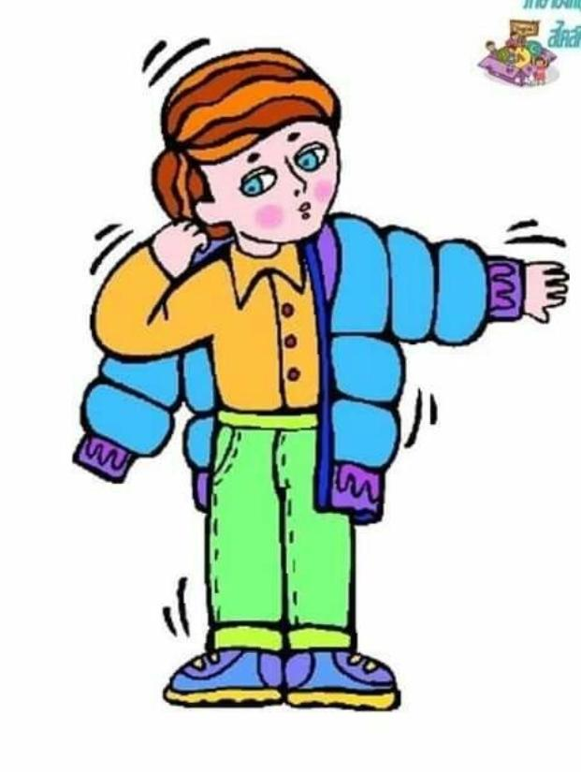

Make a sentence with (I would like (
I’d like a blue jacket
I’d like a Quraan

Slide 12

Thank you for being listening to me
See you soon my lovely girls!
T.Njoud AlFalah

