Slide 1


قال :(نِعمَتانِ مغبونٌ فيهما كثيرٌ من الناسِ: الصَّحَّةُ والفَّراغُ)

Slide 2









Revision
Write a sentence using the present progressive tense:
1 2 3
4 5 6

Slide 3
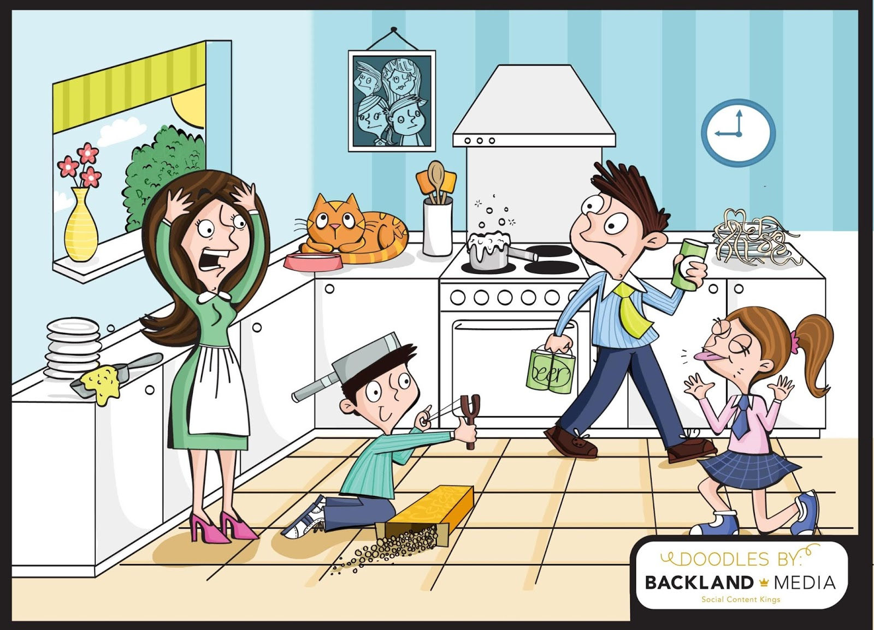

Warm up
Memory game

Slide 4
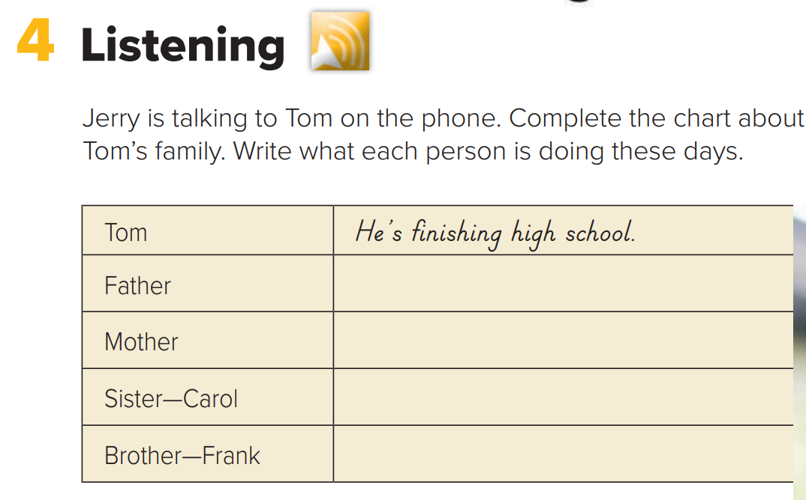
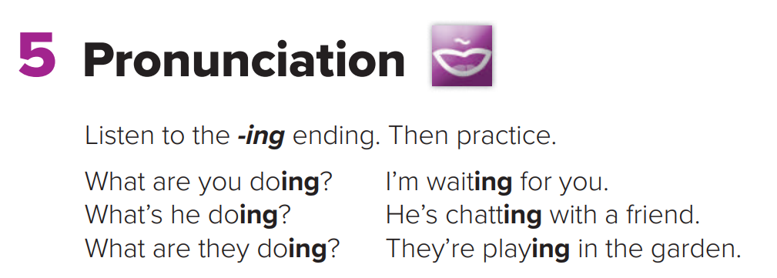

Pages
67-68

Slide 5
Objectives:
Answer questions about the conversation
☞ Answer some personal questions.
☞ Pronounce the- ing ending correctly.
Answer questions after listening.

Slide 6


Page 67
What is he doing?
He’s working in a bank.
She’s watching Carol’s baby.
She’s working at a hospital.
He’s studying computers at college.

Slide 7
Page 67

Slide 8
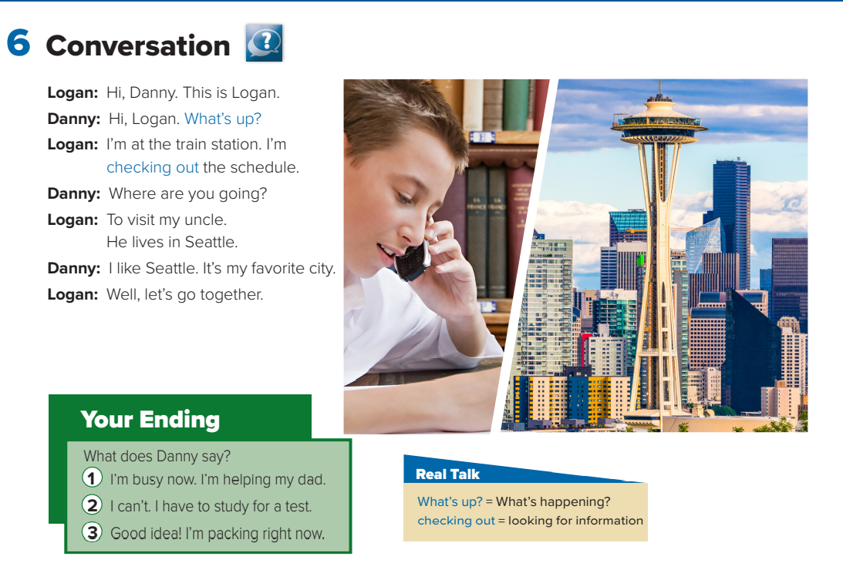
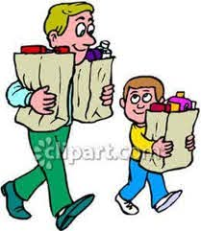
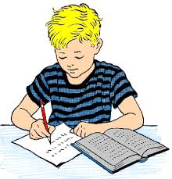
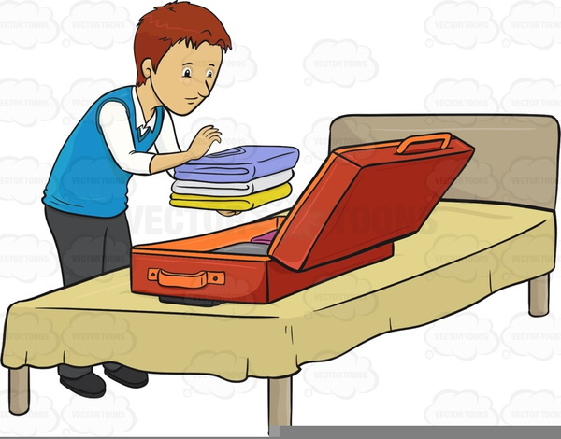
Page 68
What is the boy doing?
(He’s talking on the phone.)
What is the name of the city?
(Seattle)
Where is Logan going?
(Seattle)
Does Danny like Seattle?
(Yes, he does.)

Slide 9
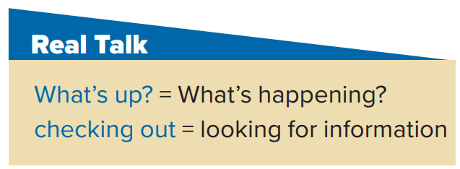

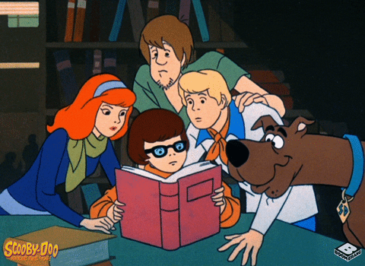
Page 68
Who said
“ what’s up ”?
Who said
“ checking out”?
Danny
Logan

Slide 10
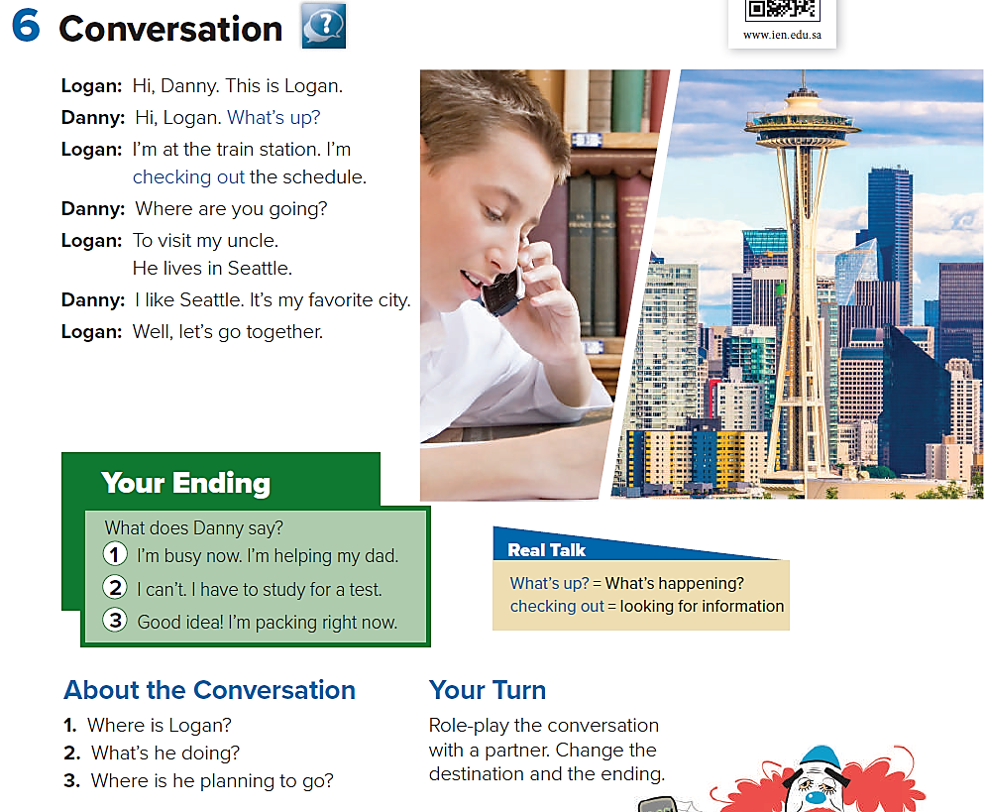
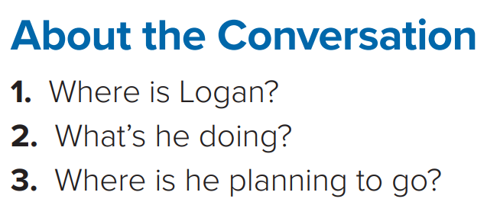

Page 68
He’s at the train station.
He’s checking out the train schedule.
He’s planning to go to Seattle.

Slide 11
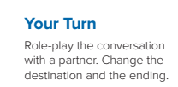


Page 68
Makkah
Abha
Dubai

Slide 12
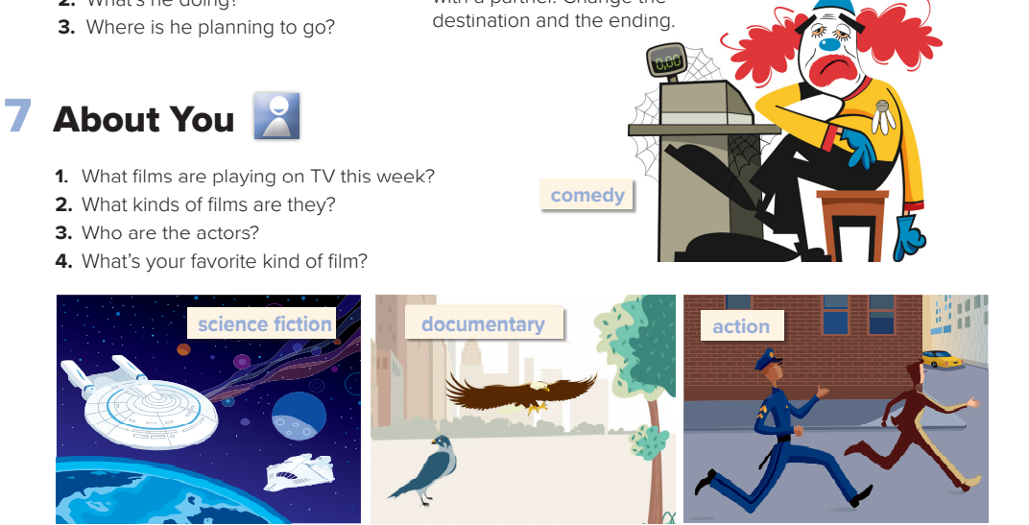

Page 68

Slide 13

Homework

