Slide 1

Unit 8
What are you doing?
Grammar

Slide 2
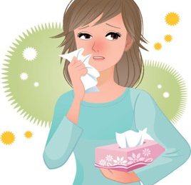
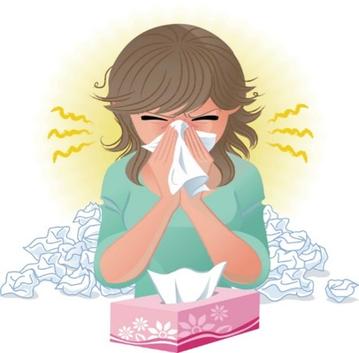
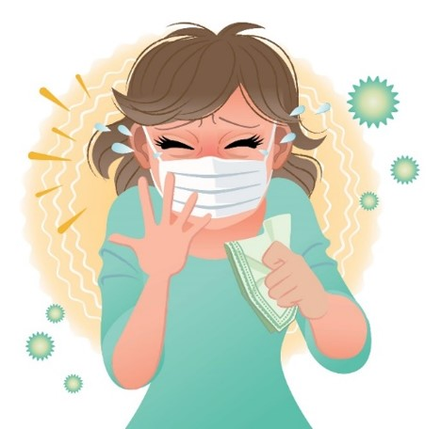
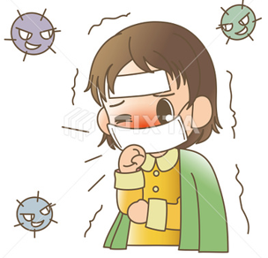

COVID 19
☺ Avoid gathering !
☺ wear a mask before going out
☺ Social distancing is not a choice, it is a must!
☺ Keep a distance of 2 meters to avoid accountability
☺ Wash hands constantly

Slide 3

بسم الله الرحمن الرحيم
Day:
Date:

Slide 4
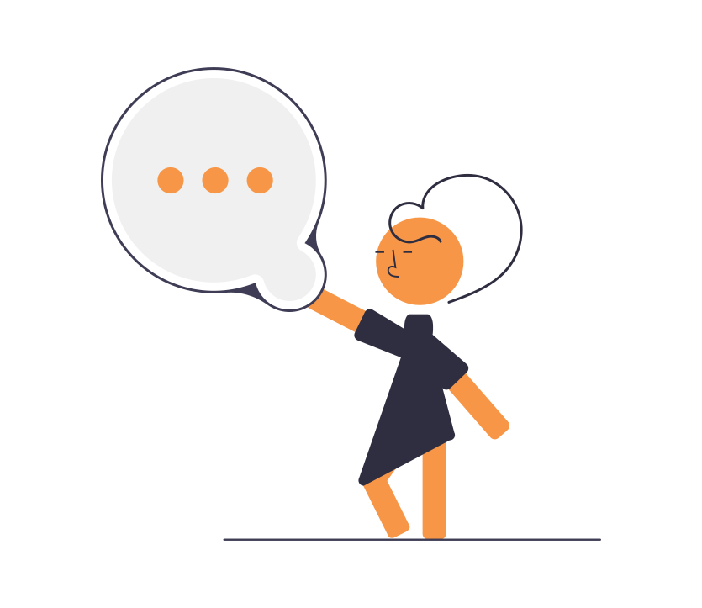
Learning Objectives
1. Use present progressive correctly.
2. Make negative sentences in the present progressive tense.
3. Ask questions in the present progressive correctly.
4. Complete a chart after listening.
5. Practice pronunciation.

Slide 5
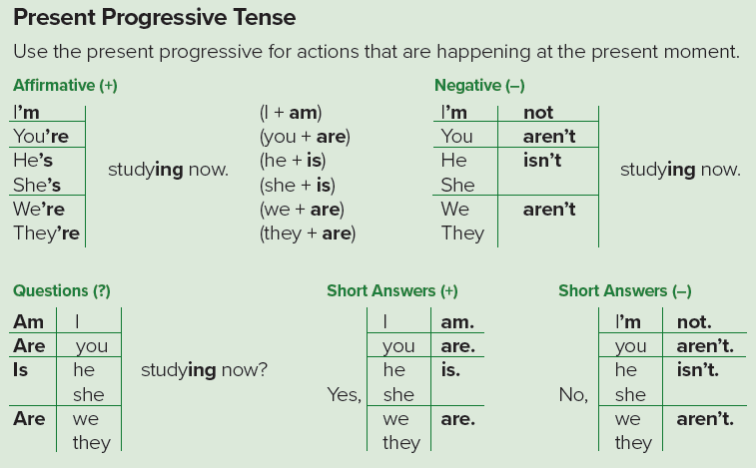
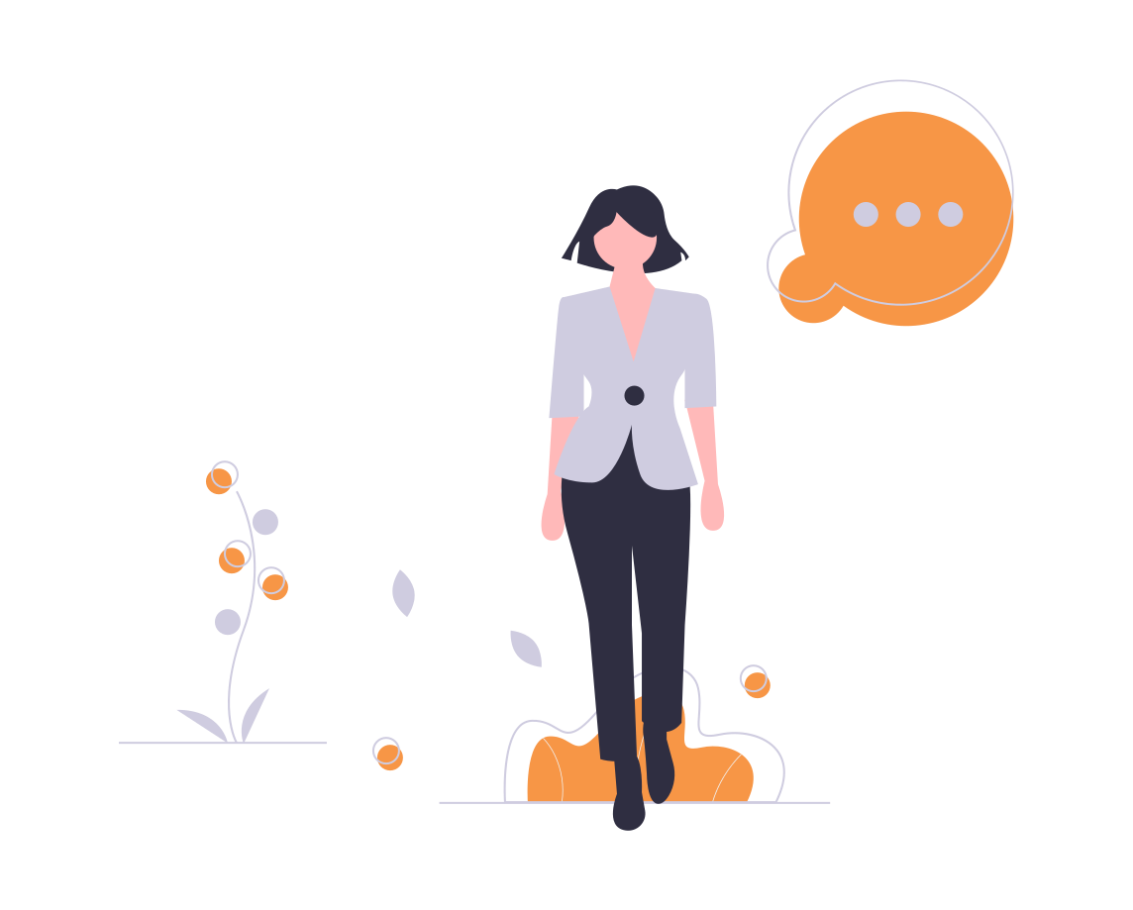

Slide 6
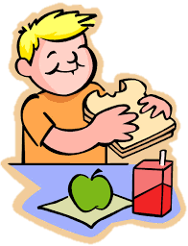
He is eating.
Examples

Slide 7

She is studying.
Examples

Slide 8
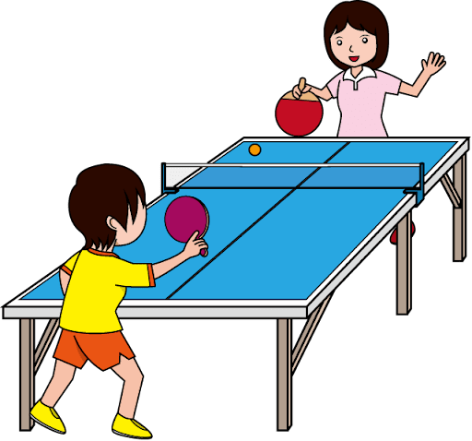
They are playing.
Examples

Slide 9
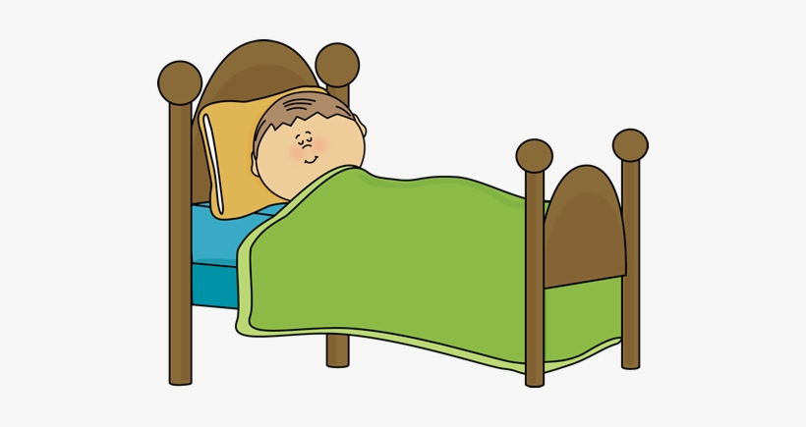
I am sleeping.
Examples

Slide 10

Practice

Slide 11
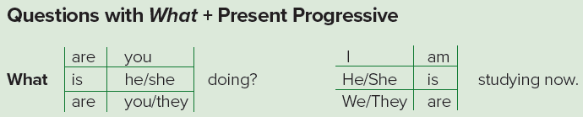

Slide 12
What is he doing?
What is he eating?
Examples

Slide 13
What is she doing?
What is she studying?
Examples

Slide 14
What are they doing?
Examples

Slide 15
What are you doing?
Examples

Slide 16
A. Complete the conversations. You can use contractions.
1. A: ______ you studying now?
B: No, ______. I'm playing video games.
______ you studying?
A: Yes. I’m ______ for the English test.
2. A: ______ the children playing?
B: No, they ______. They ______ TV.
A: Are you watching TV, too?
B: No, I ______. It’s a kids’ film.
3. A: Who ______ Ali calling?
B: He ______ his brother.
A: ______ he coming here?
B: Yes, he ______.
Are
I’m not
Are
studying
Are
aren’t
‘re watching
‘m not
is
‘s calling
Is
is

Slide 17
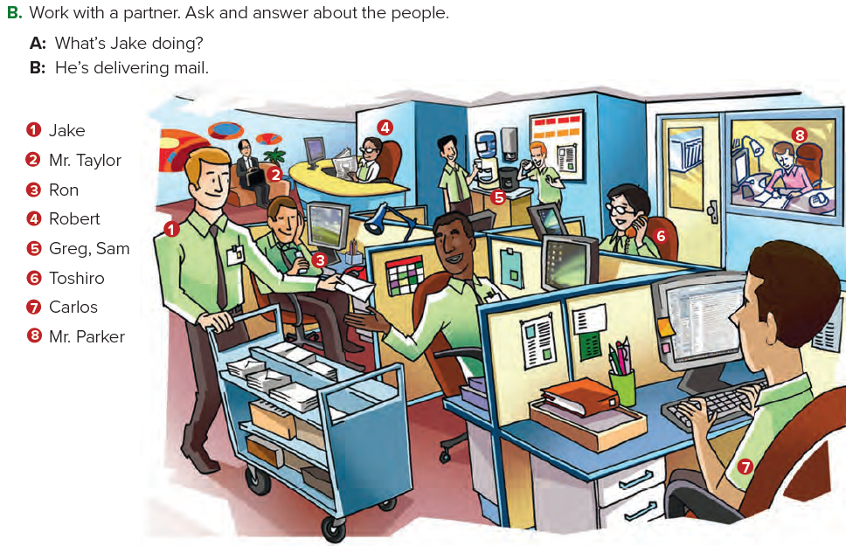
Possible answers:
2. A: What’s Mr. Taylor doing?
B: He’s waiting in the reception area.
3. A: What’s Ron doing?
B: He’s listening to his cell phone.

Slide 18

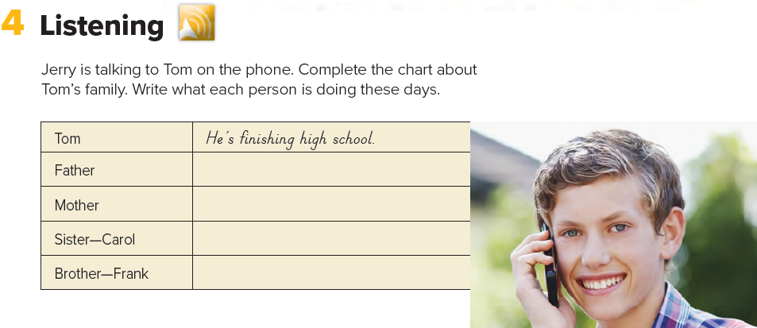
He’s working in a bank.
She’s watching Carol’s baby.
She’s working at a hospital.
He’s studying computers at college.

Slide 19
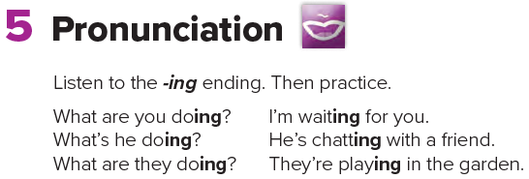

Slide 20

Homework
Page 120

Slide 21
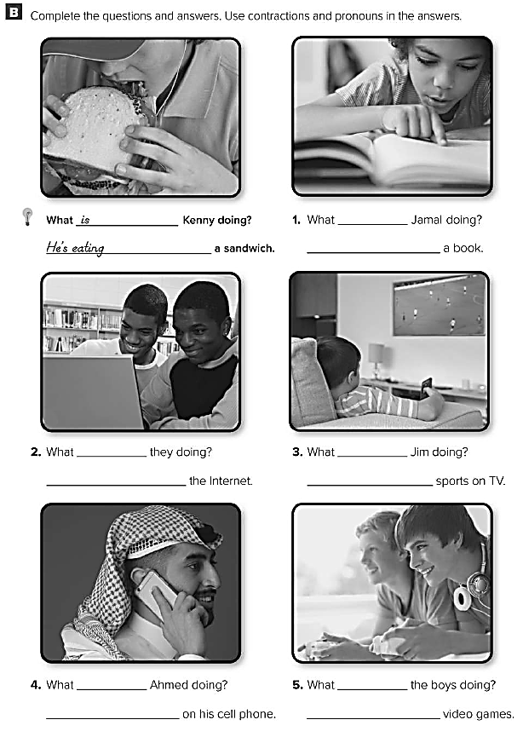
is
He’s reading
are
is
They’re surfing
He’s watching
is
are
He’s talking
They’re playing

