Slide 1

Unit 8
What are you doing?
Listen & Discuss

Slide 2
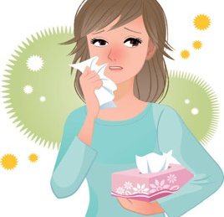
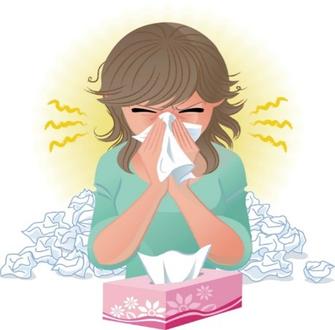
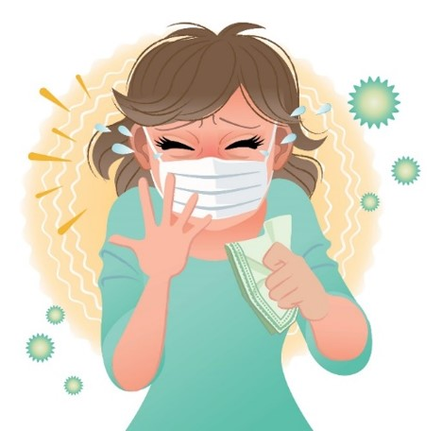
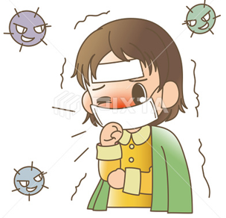

COVID 19
☺ Avoid gathering !
☺ wear a mask before going out
☺ Social distancing is not a choice, it is a must!
☺ Keep a distance of 2 meters to avoid accountability
☺ Wash hands constantly

Slide 3

بسم الله الرحمن الرحيم
Day:
Date:

Slide 4

Learning Objectives
1. Describe activities correctly
2. Name things correctly
3. Ask questions about activities correctly
4. Answer questions about activities correctly

Slide 5
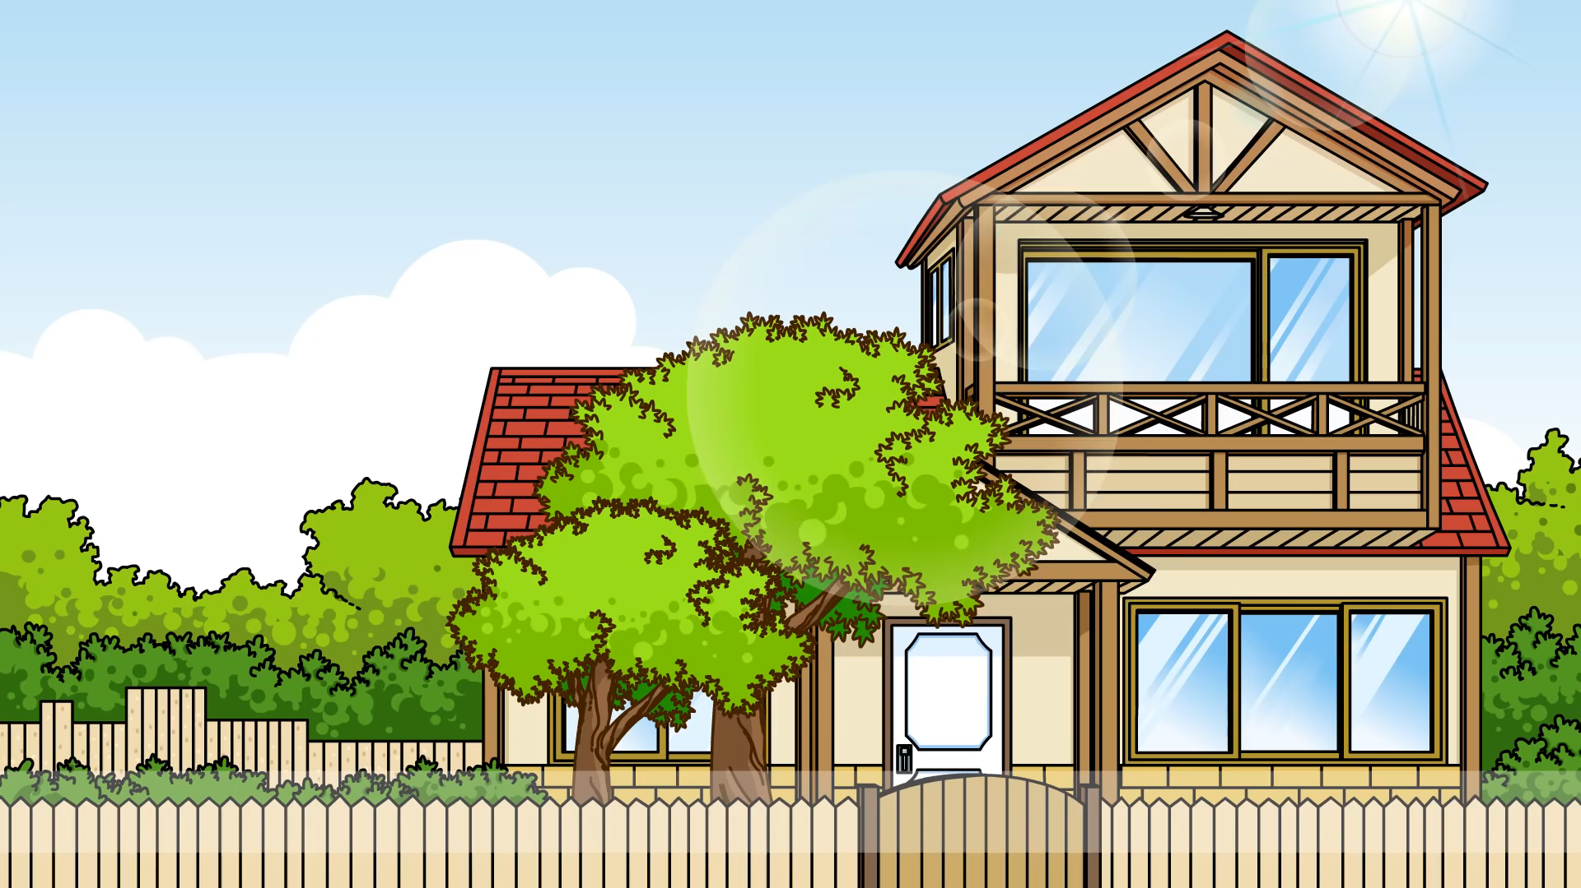


Slide 6
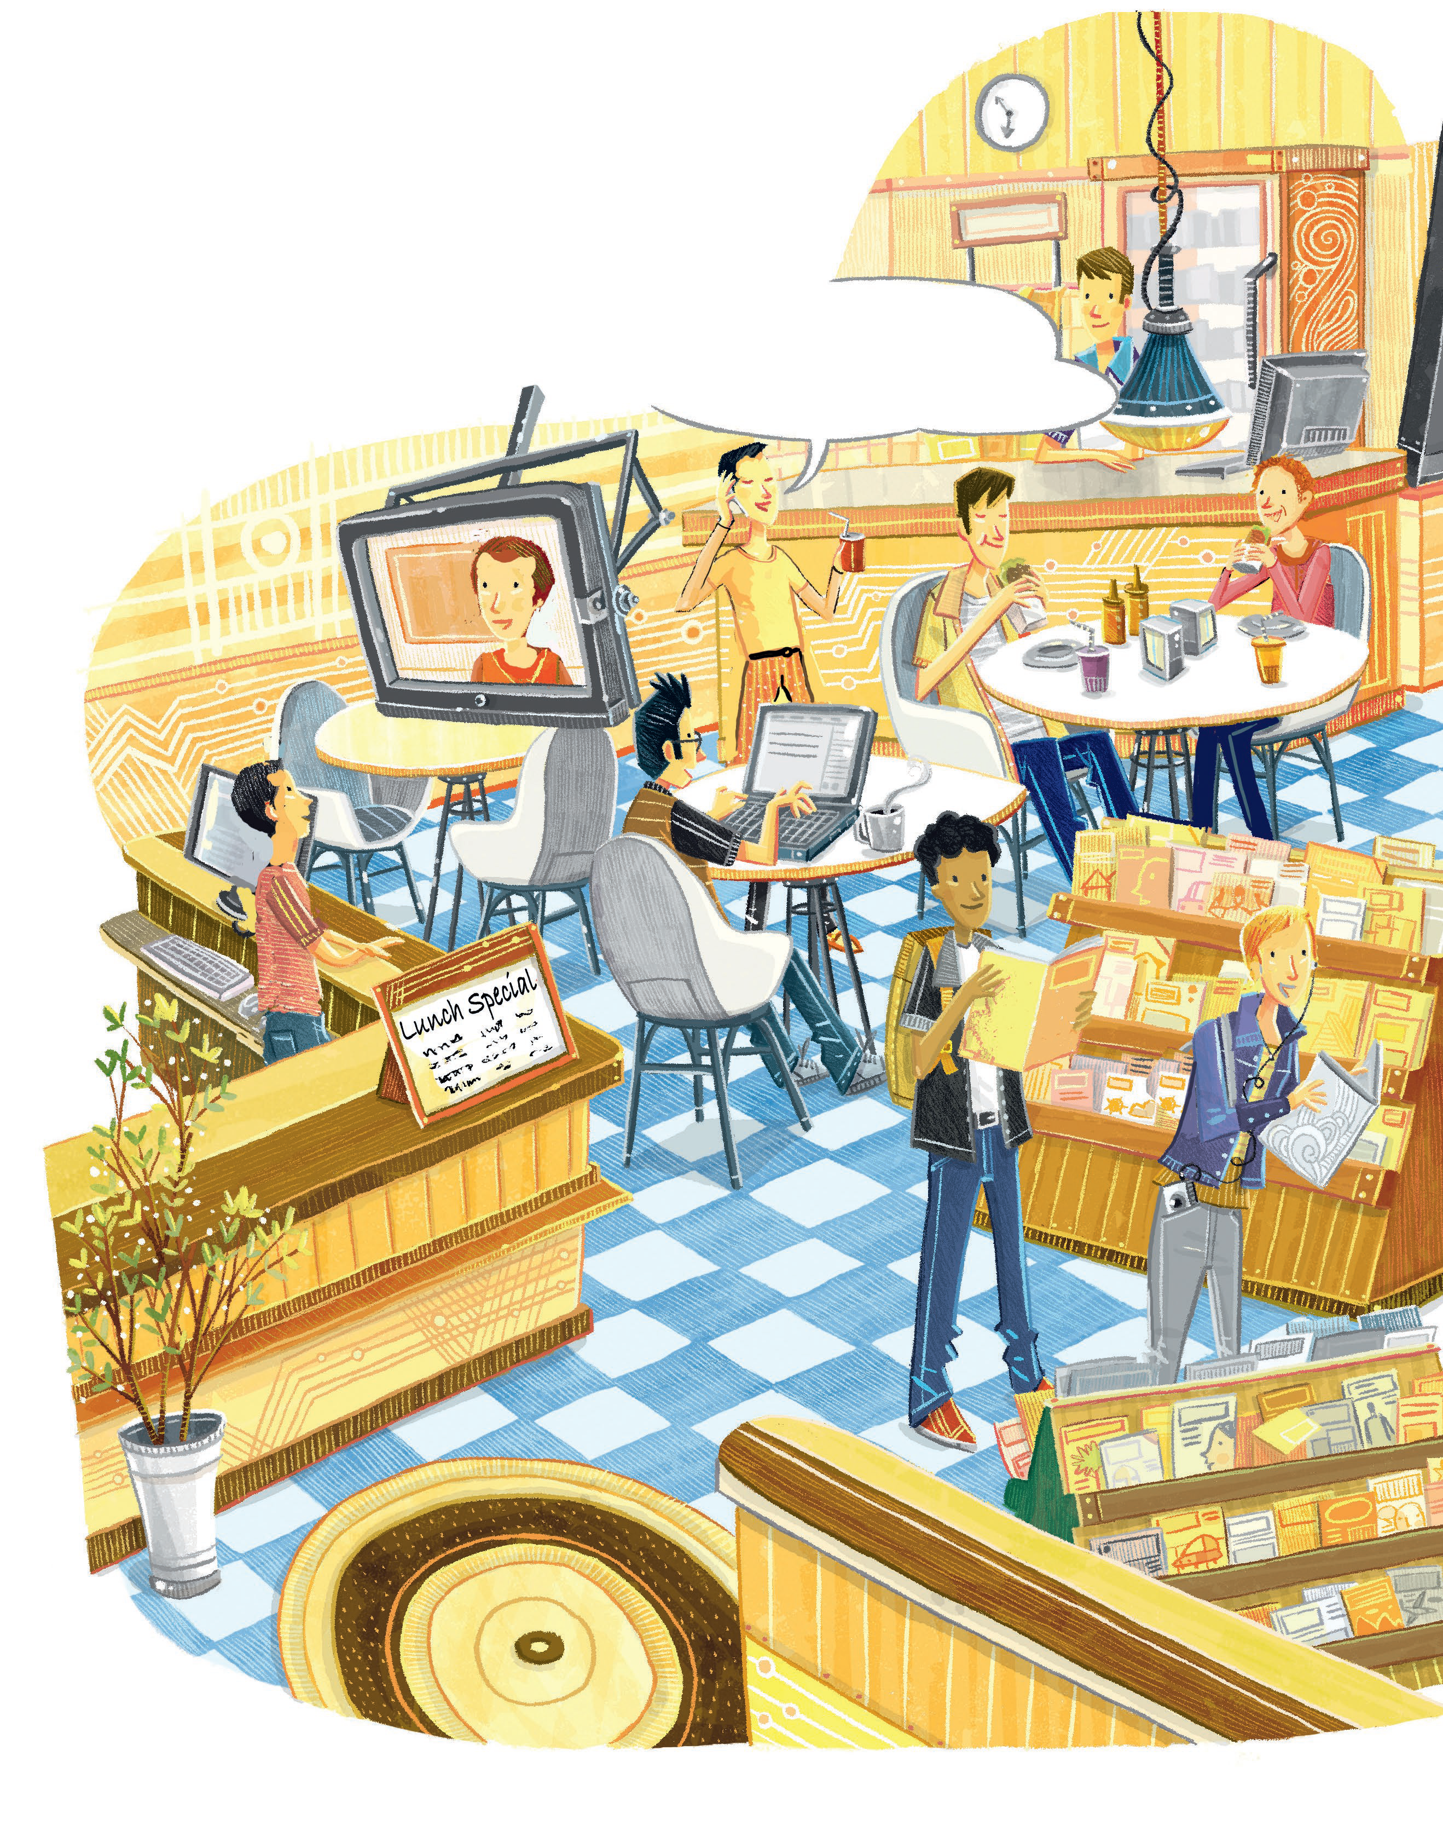
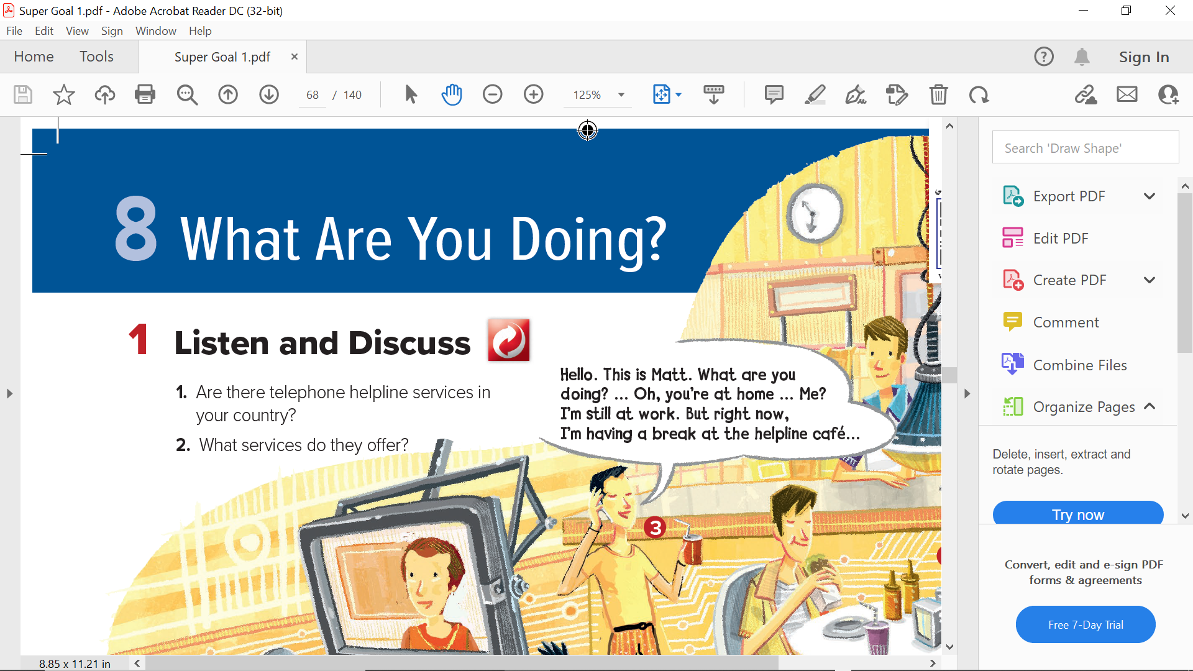
Look at the people in the picture, what are they doing ?

Slide 7
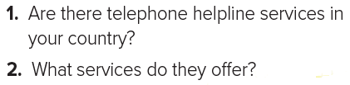
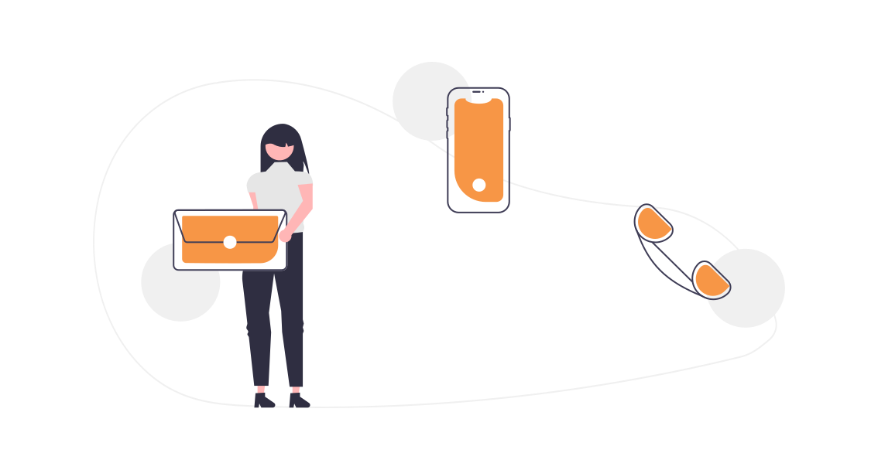

Slide 8
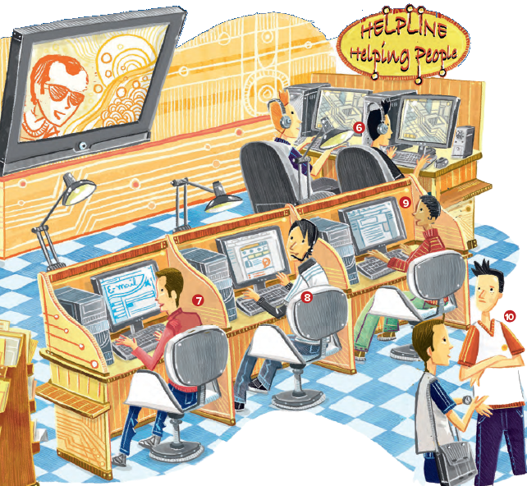

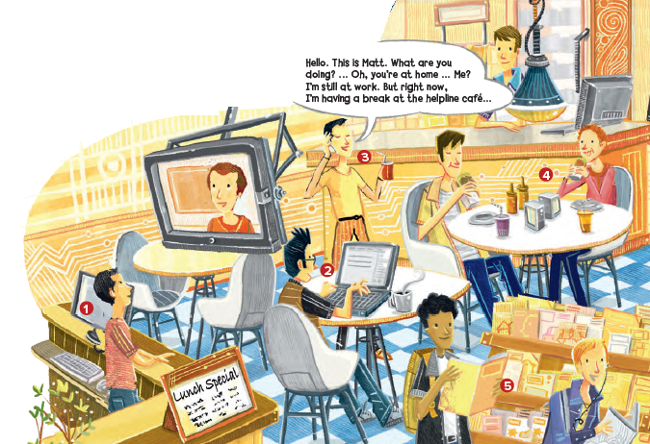
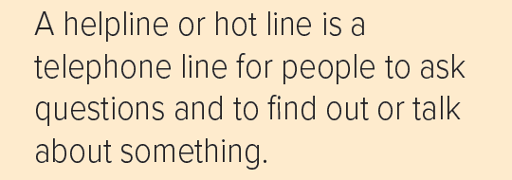
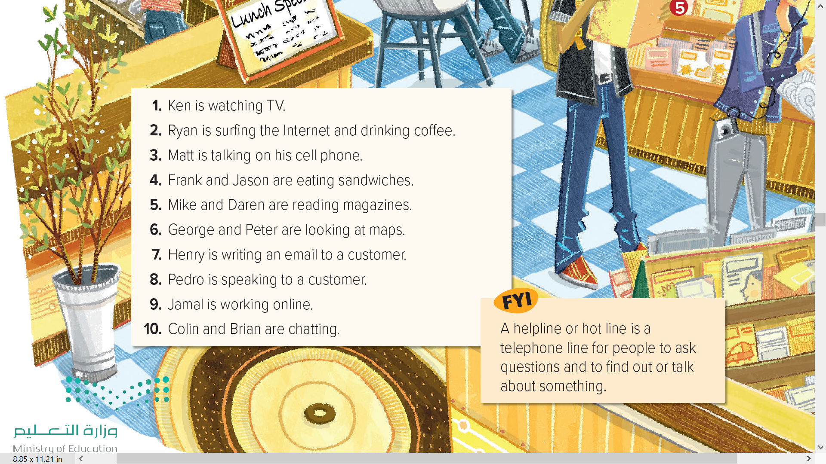


Slide 10
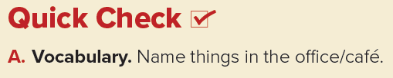

Answers
computers, food, drinks, lights/lamps, headphones, tables, chairs, a TV, magazines, a plant, a headset, cell phone, etc.

Slide 11
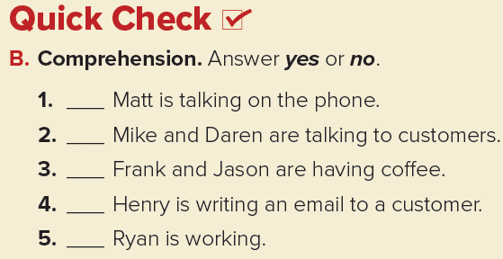
yes
no
no
yes
no

Slide 12
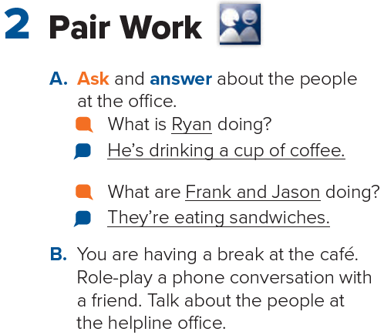


Slide 13

Homework
Page 119

Slide 14
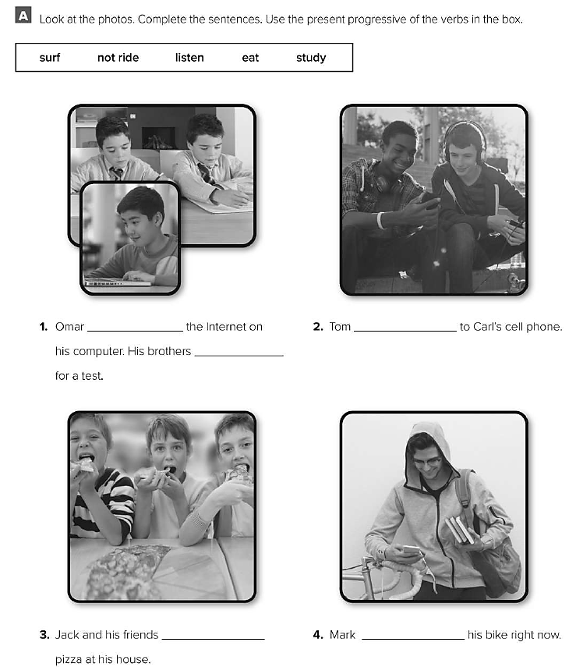
is surfing
is studying
listening
are eating
isn’t riding

